Slide 1



Slide 2
SELECTION OPERATOR
There is three types of selection operator :
if…… else…..
Conditional operator statement/
Short Hand If...Else
Switch

Slide 3
About if
The if statement allows our program to conditionally execute
a statement.
Use the if statement to specify a block of C code to be executed if a
condition is true.
If ( condition )
{
//statement
}

Slide 4
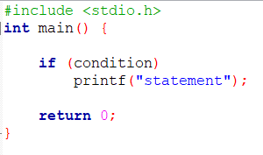
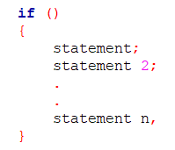
If….
Single line statement :
Condition:
Relational
&
Logical operator.
Multiple line statement :

Slide 5
RELATIONAL & LOGICAL OPERATORS EXAMPLE
Operator | Name | Example | Description
== | Equal Operator | A == B | True If A equal B else False
!= | Not Equal Operator | A != B | True If A does not equal B else False
< | Less Than Operator | A < B | True If A less than B else False
> | Greater Than Operator | A > B | True If A greater than B else False
<= | Less Than or Equal Operator | A <= B | True If A is less than or equal B else False
>= | Greater Than or Equal Operator | A >= B | True If A is greater than or equal B else False

Slide 6
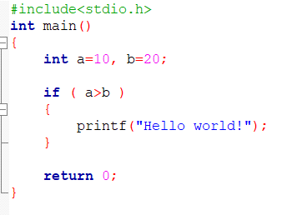


Example – 1 :
Nothing!
a<b

Slide 7
About else
Use the else statement to specify a block of C code to be executed if a
condition is false.
Single line statement :
If ( condition )
{
//statement
}else {
//statement
}
else
statement;
Multiple line statement :
else{
statement;
}

Slide 8
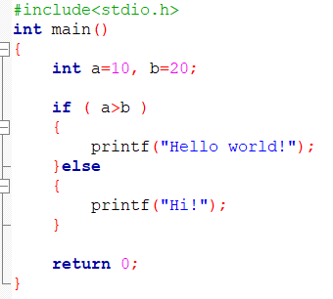

Example – 2 :

Slide 9
About else if..
The else if statement allows our program to use multiple condition.
Use the else if statement to specify a new condition if the first condition
is false.
Single line statement :
else if ( condition )
statement;
If ( condition )
{
//statement
}else if ( condition ) {
//statement
}else{
//statement
}
Multiple line statement :
else if( condition ){
statement;
}

Slide 10
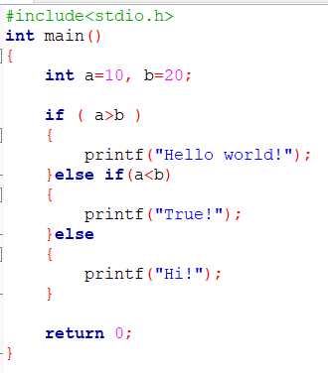

Example – 3 :

Slide 11
Nested if.. else..
If body inside if.
If ( condition )
{
If ( condition )
{
//statement1
} else
{
//statement2
}
} else{
//statement
}

Slide 12
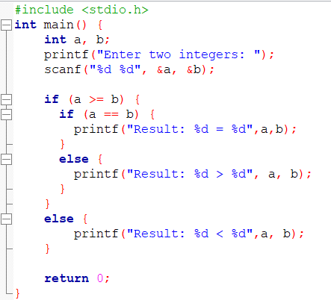
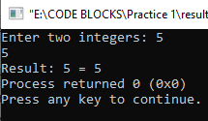
Example 1 :
a=5
b=5

Slide 13
Short Hand If...Else
Expression1 ? Expression2 : Expression3
If else type.
Expression1 = condition
Expression2 = if true then what should print?
Expression3 = else then what should print?
Example :
( i < 0 ) ? printf("True") : printf("False”)
Condition
True Value
False Value

Slide 14
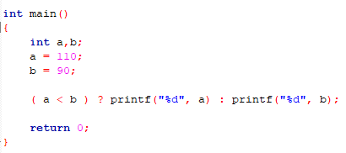

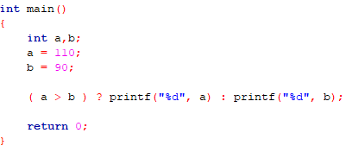
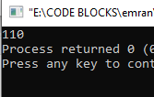

Slide 15
SWITCH
If is good for choosing between two alternatives.
Instead of writing many if..else statements, you can use the switch
statement.
When several alternatives are needed we should use
switch statement.
switch (n){
case1:
//statement
break;
case 2:
//statement
break;
default:
//statement
}
n is taking from the user
Case 1 will be execute.
n = 1
If character case(case ‘a’:) used then input should be character.
If character case capital letter then input should be capital.

Slide 16
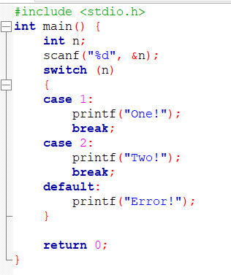
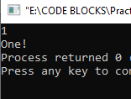
n=1

Slide 17
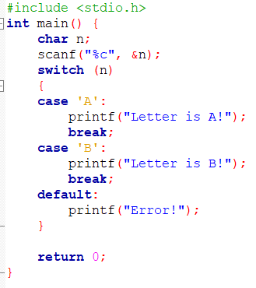
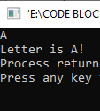
a=A

Slide 18
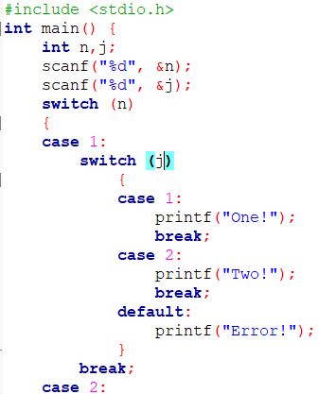
Nested switch
Same to same like nested if…else..

Slide 19




Halimatus Sadia
ID : 221-115-090
STUDY IN C.S.E
MD.Emran Alam
ID : 221-115-110
STUDY IN C.S.E
Anamika Chowdhury
ID : 221-115-100
STUDY IN C.S.E
Mahbuba Akther Liza
ID : 221-115-120
STUDY IN C.S.E

