Slide 1
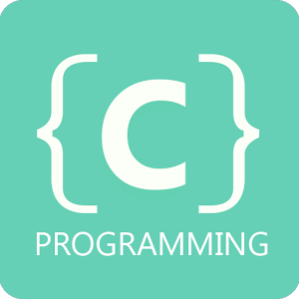

Slide 2
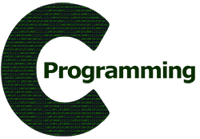
Topics to be covered
Introduction to programming
C as a programming language
Uses/Applications of C language
History of C language
Basic C
Advanced C

Slide 3


What is Programming ?
“ The process of developing and implementing various sets of instructions to enable a computer to do a certain task. ”

Slide 4

Terms related to programming
Programs : They constitute a set of instruction that direct a machine to do a certain task.
Programming : It is a process/skill of making programs.
Debugging : It is the process of identifying and removing errors from a program/software.
program
debugging

Slide 5


Instruction
“ a direction or order”
“detailed information about how something should be done or operated.”

Slide 6
Program = Set of Instructions
Program{
instruction 1;
instruction 2;
instruction 3;
instruction 4;
end of instructions;
}

Slide 7
English Language
Vs
Programming language
Alphabets
Words
Sentences
Paragraphs
Alphabets, digits & special symbols
Constants, variables, keywords
Instructions
Programs

Slide 8
Basic C
Getting started with C
Input/Output

Slide 9
C - character set
A character denotes any alphabet, digit or special symbol used to represent information.
Alphabets: A,B,……..,Y,Z
a,b,……..,y,z
Digits : 0,1,2,3,4,5,6,7,8,9
Special symbols : ~ ! # ^ & * ( ) | + - / ? etc.

Slide 10
Constants & Variables
Constants : These are entities that doesn’t change i.e they remain fixed.
Variables : These are entities that can be changed at any point of time.
Real life examples
Constants -> name, gender etc
Variables -> age

Slide 11
Why Constants & Variables ??
As already said every program constitutes of set of instructions. But these instruction have to be performed on sets of data producing another sets of data.
This data is stored in the memory of computer.
Constants and variables are attributes of this stored information in memory.

Slide 12
Program = Set of Instructions on data
Program{
data element1, data element 2;
instruction 1;
instruction 2;
instruction 3;
instruction 4;
end of instructions;
}

Slide 13
Memory Representation
Computer uses a fixed number of bits to represent a piece of data, which could be a number, a character, or others.
A n-bit storage location can represent up to 2^n distinct entities.
For example, a 3-bit memory location can hold one of these eight binary patterns: 000, 001, 010, 011, 100, 101, 110, or 111.
Hence, it can represent at most 8 distinct entities. You could use them to represent numbers 0 to 7, characters 'A' to 'H', or up to 8 kinds of fruits like apple, orange, banana; or up to 8 kinds of animals like lion, tiger, etc.

Slide 14
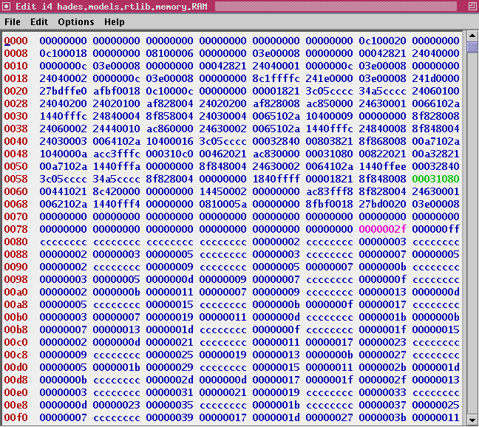
Memory Addressing in RAM

Slide 15
Variable Naming
Remembering or repeated usage of this memory locations will be difficult for user for long run.
Hence Variable names are used to identify the particular memory location.

Slide 16

Rules for constructing Variable Names
A variable name is any combination of 1 to 31 alphabets, digits or underscores.
The first character in the variable name must be an alphabet or underscore.
No commas or blanks are allowed within a variable name.
No special symbols other than underscore can be used in variable name.
Every variable name must have a data type associated with it.
Eg: myvar, age, _name etc

Slide 17
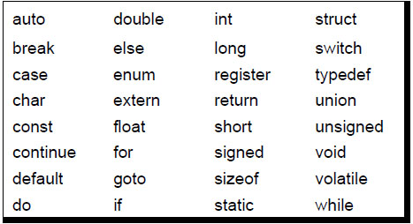
C Keywords
Keywords are the words whose meaning has already been explained to the C compiler(or in a broad sense to the computer).
These keywords cannot be used as variable names as we are trying to assign a new meaning to the keyword.
There are only 32 keywords available in C.

Slide 18
First C Program
#include<first_program.h>
int main(){
do “wake up from sleep”;
do “switch on your laptops”;
do “open a C compiler cum editor”;
do “begin your first program”;
do “enjoy programming”;
return answers;
}

Slide 19
printf() & scanf()

Slide 20
Rules to be followed for writing a C program
Each instruction in a C program is written as a separate statement. Therefore complete program would comprise of a series of statements.
The statements must appear in the same order in which we wish them to be executed.
Blank spaces can be added between two words to improve the readability of the statement.
Remember C language is case-sensitive.
Every C statement must end with a semicolon (;) which acts as a statement terminator

Slide 21
C Instructions
Type declaration instructions : To declare the type of variables used in a C program.
Arithemetic instructions : To perform arithemetic operations between constants and variables.
Control instructions : To control the sequence of execution of various statements in a C program.

Slide 22
Type declaration instructions
These instruction is used to declare the type of variables being used in the program. Any variable used in the program must be declared before using it in any statement. The type declaration statement is written at the beginning of the main() function.
For example:
int age;
float length;

Slide 23
Arithemetic Instructions
A C arithemetic instruction consists of variable name on the left hand side of = and variable names and constants on the right hand side of =.
The variable and constants appearing on the right hand side of = are connected by / = * etc which are called operators.
The variables and constants are called operands.
For example:
int cost_price,selling_price,profit;
Profit = selling_price – cost price;

Slide 24
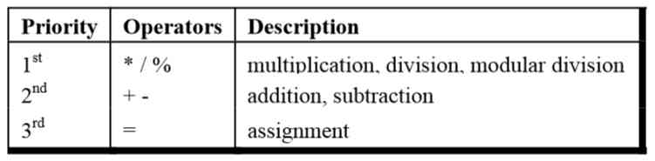
Hierachy of Operators
When there are more than two operators, we have some some problems as to how exactly does it get executed.
For example : A/(B*C) or (A/B)*C

Slide 25
Control Instructions
Sequence Control Instructions
Selection or Decision Control Instructions
Repetition or Loop control instructions
Case Control Instructions.

Slide 26
Decision Control Structure
if statement
if-else statement
Multiple if statements
Nested if else
if(this condition is true){
do this();
}
else{
do this();
}

Slide 27
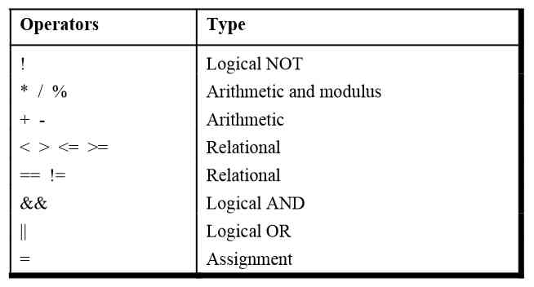
Logical Operators

Slide 28
Thank you

