Slide 1
PERIPHERALS OF MICRO-CONTROLLER

Slide 2
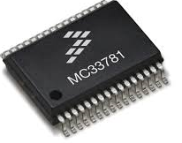
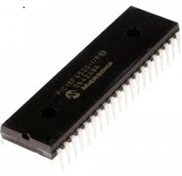
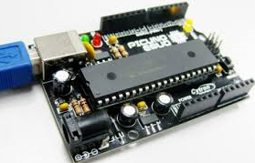

MICRO-CONTROLLER?

Slide 3
MICRO-CONTROLLER:
Its a small computer on a single chip.
Consists of a CPU surrounded by:
Memory
Programmable Input / Output peripherals.

Slide 4

WHAT ARE PERIPHERALS?

Slide 5
PERIPHERALS:
The devices that are connected to the CPU to provide input and output.
2 types of peripherals to a MC:
In-built peripherals
External peripherals

Slide 6
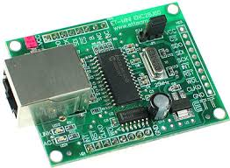
IN-BUILT PERIPHERALS OF A MICRO-CONTROLLER:
GPIO
ADC
TIMER
INTERRUPT
UART
RTC

Slide 7
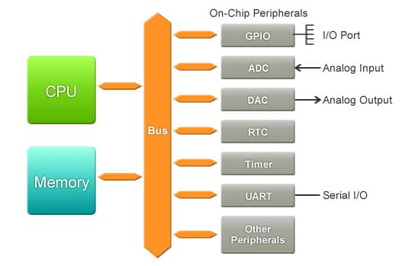

Slide 8
GPIO:
General Purpose Input/Output Port:
Acts both as an input and an output port, whichever way it is configured in.
Each pin of the port can be independently configured to function as an input or output pin.
Continued….

Slide 9
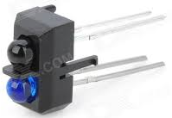
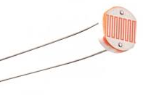
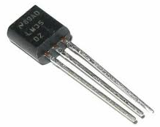
In the input mode:
pins are used to receive inputs from switches and sensors.

Slide 10
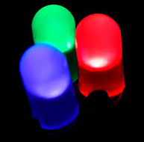
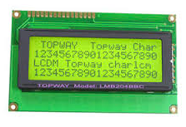
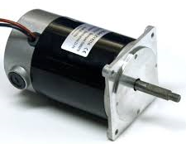
In the output mode:
Pins are used to drive other externally connected components.

Slide 11
ADC:
Analog to digital converter:
Used to convert the analog inputs from the sensors to equivalent digital value.
A/D conversion is essential because MC works on digital logic.
Continued……

Slide 12
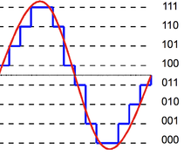
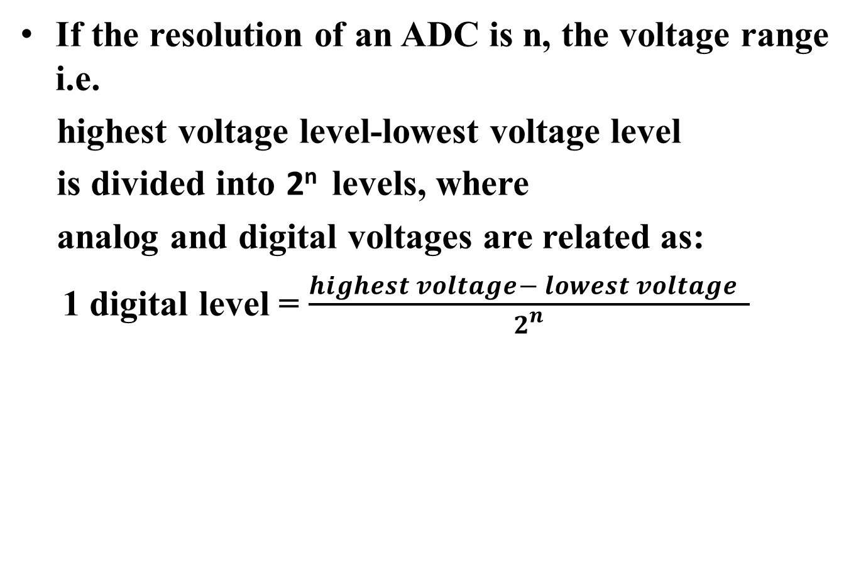
RESOLUTION OF AN ADC:
If the resolution of an ADC is n, the voltage range i.e.
highest voltage level-lowest voltage level
is divided into 2^{n} levels, where
analog and digital voltages are related as:
1 digital level = $\frac{highest voltage− lowest voltage }{2^{n}}$

Slide 13
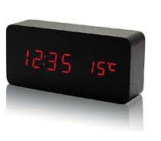
TIMERS:
Basically used to measure the time elapsed by counting the clock pulses.
Applications:
To measure the time taken by a particular task.
To issue a particular signal after some fixed time period.
To make the MC wait for some pre-specified time.

Slide 14
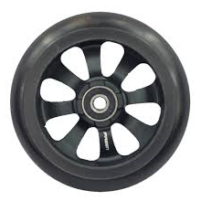
INTERRUPTS:
Used to interrupt the current process of the MC to handle some other process.
The MC processes the interrupt request and resumes its current processing.

Slide 15
SENSORS:
Used to convert physical change into electrical change i.e voltage or current.

Slide 16
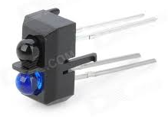
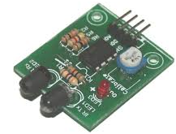
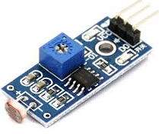
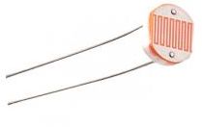
EXAMPLES OF SENSORS:
Infrared (IR) sensor
Light dependent resistor(LDR)

Slide 17
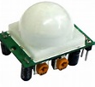
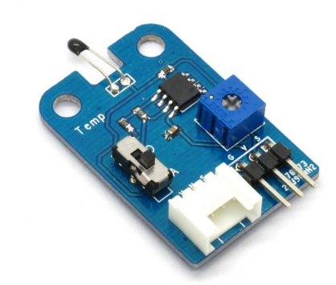
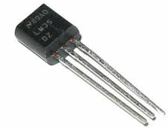
EXAMPLES OF SENSORS:
Passive infrared (PIR) sensor
Temperature sensor

Slide 18
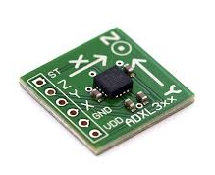
EXAMPLES OF SENSORS:
Accelerometer: used to measure the acceleration in a particular direction i.e. x,y or z.

