Slide 1
ATMEGA8
RISC vs CISC

Slide 2
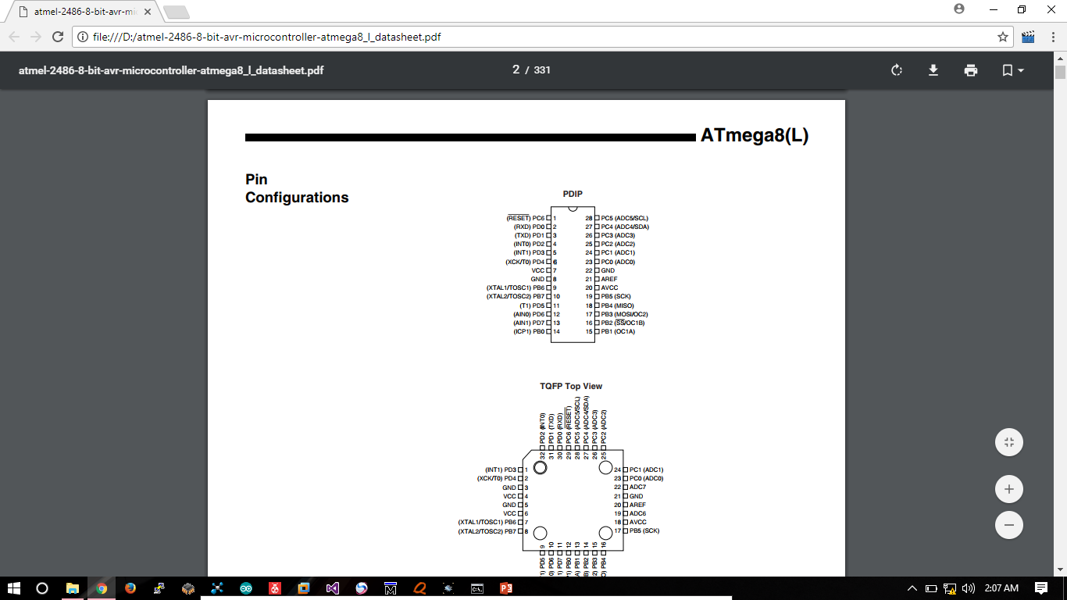
ATmega8 is Harvard Architecture based AVR’s 8 bit RISC microcontroller.

Slide 3
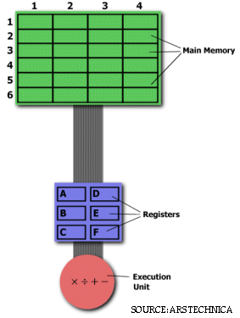
CISC vs RISC
Execution unit is responsible for carrying out all the computations.
However the execution unit can only operate on data that has been loaded into one of the six registers (A to F).
Task:
Find the product of two numbers stored in
location 2:3 and 5:2 and store the result in
location 2:3.

Slide 4
CISC Approach:
MULT 2:3, 5:2 ; //MULT is known as complex instruction
When executed, the above instruction loads two values into separate registers, multiplies the operands in execution unit, then stores the product in appropriate registers.
Thus the entire task of multiplying two numbers can be completed in single instruction.
ADVANTAGES:
The compiler’s job is reduced.
Since the length of code is short, very less RAM is required to store the
instructions.
The entire emphasis is put on hardware that operates on this complex instructions.

Slide 5
RISC APPROACH:
LOAD A, 2:3
LOAD B, 5:2
PROD A, B
STORE 2:3, A
More lines of code -> more RAM is needed to store instructions.
The compiler must also perform more work.
Since the instructions are less complex -> hardware can be simpler.

