Slide 1
VERILOG
- Sidharth Magoon
Placed @ Synopsys ;Internship @ Mentor :P

Slide 2
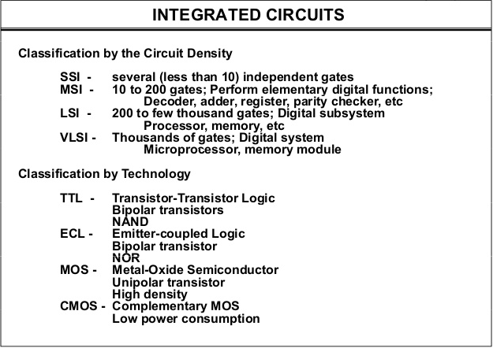

Slide 3
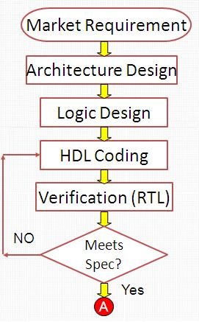

Slide 4
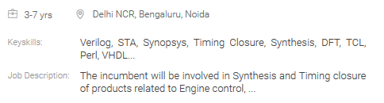
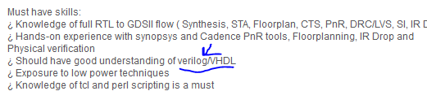

Need

Slide 5
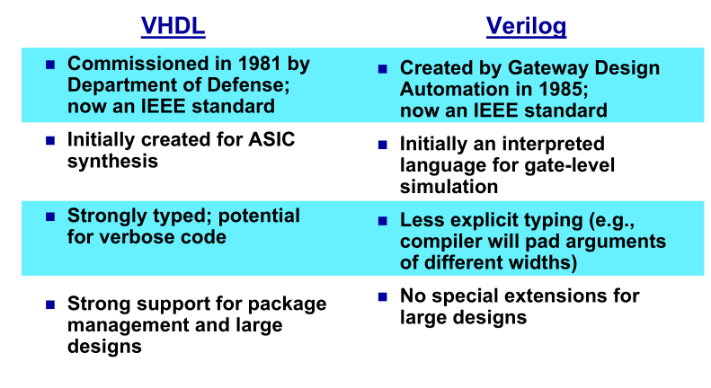
VHDL and Verilog

Slide 6
Simulation and Synthesis
Simulation- to verify functional correctness of design
Synthesis- design modelled into implementation consisting of gates
Non synthesizable constructs like tasks,delay, event , fork-join etc

Slide 7
HDL Simulators
ModelSim- Mentor
VCS- Synopsys
NC Sim/ Incisive- Cadence
Vivado- Xilinx

Slide 8
Resources
Verilog HDL- Samir Palnitkar
Verilog LRM
Morris Mano

Slide 9
Let’s Begin !
Design Methodologies top –down & bottom –up
Modelling Styles-
Gate Level
Data Flow
Behavioral
Switch Level

Slide 10
Gate level Modelling
And(f,a,b..)
Nand(f,a,b..)
Similarly or,nor,xor,xnor,not
Buf(f,a)
notif0(f,a,e)
notif1(f,a,e)
Bufif0(f,a,e)
Bufif1(f,a,e)

Slide 11
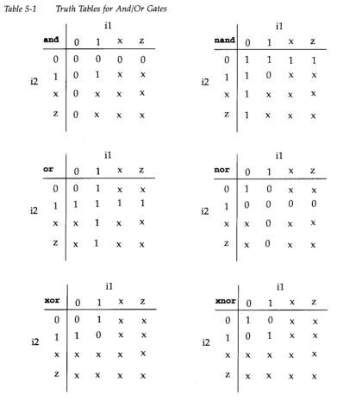
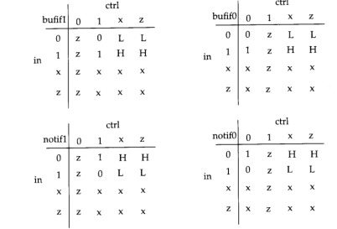
More about Gates

Slide 12
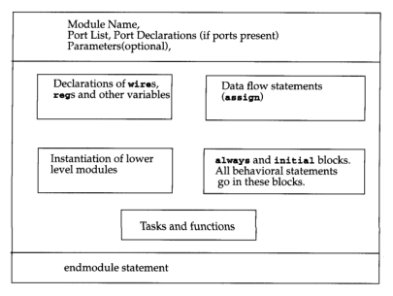

Slide 13
Gate level- Code
module my_and_gate(o,a,b);
output o;
input a,b;
and and1(o,a,b);
endmodule

Slide 14
Ports
4 types of signal values 0,1,X,Z
Net/wire is just a connection
Reg –holds a value
All port declarations are wire by default
When modules instantiated in another
input must be wire
Output can be wire/reg , usualy reg
Inout must be net

Slide 15
Testbench
module tb_my_and;
wire o;
reg a,b;
my_and_gate ma1(o,a,b);
initial begin
$monitor(“time =%d, o=%b,a=%b,b=%b”,$time,o,a,b);
end
initial begin
#10 a=1’b0; b=1’b1;
#10 a=1’b1; b=1’b0;
#10 a=1’b1; b=1’b1;
end
endmodule

Slide 16
Testbench
$monitor is one of many system tasks
$time represents current simulation time
Initial block executed once at t=0
Always block
Bit format eg 5’b11100, 6’o57,3’d6,8’h2D etc

Slide 17
Exercise 1
Create half adder design
Create it’s testbench and simulate
Create full adder module by using half adder module
Again create testbench and simulate

Slide 18
Data Flow Modelling
Keyword assign results in continuous assignment
Bitwise operators
a=3’b001,b=3’b110
~a inverts each bit- 3’b110
a&b -and
a|b -or
a^b -xor
a~^b -xnor

Slide 19
Half adder example
module half_adder(s,c,a,b);
output s,c;
input a,b;
assign s=a^b;
assign c=a&b;
endmodule

Slide 20
Decoder example
module decoder_1 (f,x,y);
output [0:3] f;
input x,y;
assign f[0]=~x&~y;
......complete.....

Slide 21
Vectors and arrays
Vectors- wire [0:2] wire1;
reg [3:0] reg1; etc
Arrays- allowed only for reg, integer ,time
reg mem[31:0] etc
What does reg [3:0] mem [31:0] mean?

Slide 22
Wire types
wor, wand etc
Example
module test_wor();
wor a;
reg b,c;
assign a=b;
assign a=c;
initial begin
$monitor(“time=%d,a=%b,b=%b,c=%b”,$time,a,b,c)
end
Initial begin
#10 b=1’b0;
#10 c=1’b0;
#10 b=1’b1;
.......check...

Slide 23
Arithemetic and logical operators
Arithmetic- +, -, *, / ,% ,** if any operand contains x or z , result is unknown
Logical operators
a=4, b=0
&& logical and a&&b=0
|| logical or a||b=1
!a =0

Slide 24
Shift, relational and equality operators
Logical shifts
a=4’b0010
a>>1, a<<2
Arithmetic shifts
a=4’b1010
a<<<3, a>>>2

Slide 25
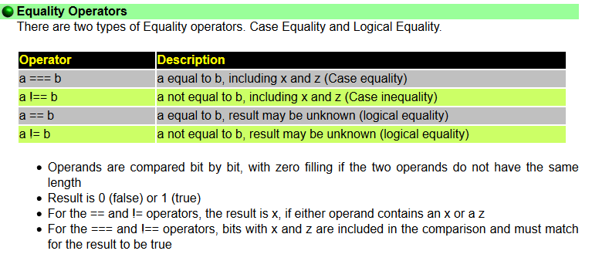
Shift, relational and equality operators
Relational operators- result in x if any operand x or z, else they evaluate to 1 or 0
(a>b), (a>=b) etc

Slide 26
Operators continued
Concatenation-
wire [3:0] a1;
wire abit;
wire [6:0] a2;
assign c= {a1,abit,a2};
Replication
assign c={4{abit},4’b0000};
Conditional *
assign y= (sel? A:B)//mux
assign y= (s1? (s0?i1:i2) : (s0? I3:i4)); //nesting

Slide 27
Comparator
module comparator(comp,a,b);
output comp;
input [7:0] a,b;
assign comp = ((a>=b) ? 1’b1:1’b0);
endmodule

Slide 28
Exercises
1. Design a four bit ripple carry adder (gate level modelliing)

Slide 29
Exercises
2. Design a BCD adder, assume 4 bit inputs a &b , input carry c0 , and output sum and carry.
(using data flow modelling)

Slide 30
Exercises
2.Design an ALU which implements the following
S0 S1 Output
0 0 a+b
0 1 a^b
1 0 a-b
1 1 a>>b
Assume a & b are of 2 bits each

Slide 31
Delays
Regular delays
assign #d1 y= a&b;
Intra assignment delays
assign y= #d1 a&b;
Assign #d1 y= #d2 a&b;
Gate and net delays
wire #5 y1;
and #3 and1(y,x1,x2);

Slide 32
Delays
Rise delay – transition from 0,x,z to 1
Fall delay – transition from 1,x,z to 0
Turn off delay?
and #(1,2,3) a1(....);
and #(2,5) a2(...);
Minimum, typical and maximum delays
and #(1:2:3,4:5:7) a3 (...)

Slide 33
Timing Checks
Setup time , hold time ?
Violations?

Slide 34
Behavioral Modelling
Always and initial block
--contain blocking and non blocking assignments(note not concurrent)
--may have sensitivity list
--contain all if-else statements and case statements(they cant exist without always/initial block)

Slide 35
Day-2

Slide 36
FINITE STATE MACHINES

Slide 37
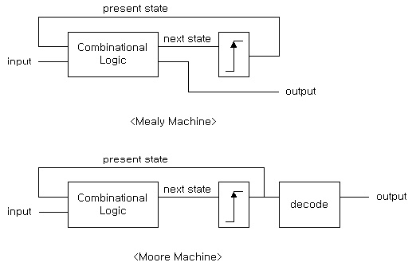

Slide 38
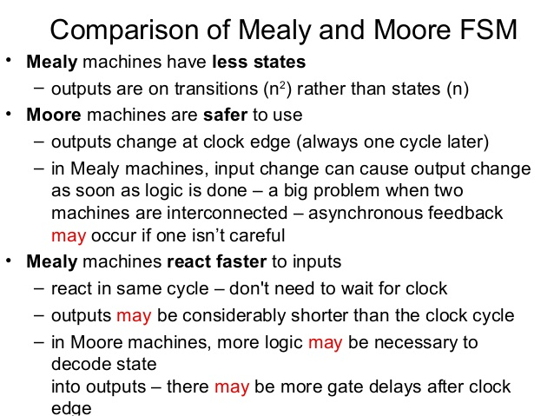

Slide 39
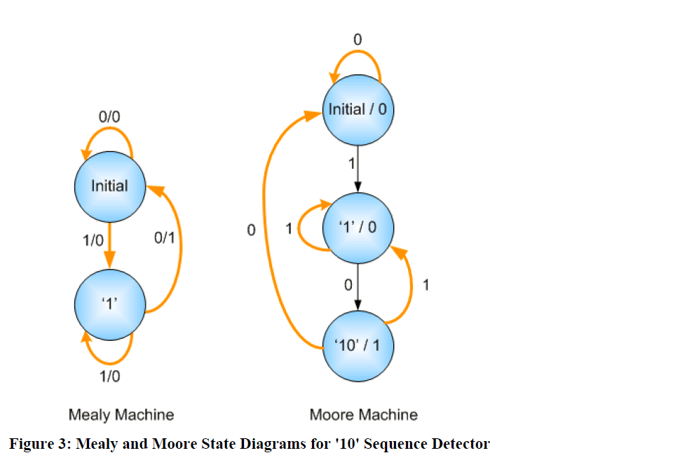
‘10’ sequence detector

Slide 40
Designing FSM Using Verilog “sequence-1101”

Slide 41
STEPS
Assignment of states
Defining CLOCK
Next state function
Assignment of next state to current state
Output function

Slide 42
Assignment of States
-Defining states by using PARAMETER
parameter s1=2’b00,s2=2’b01,s3=2’b11,s4=2’b10;
reg[1:0] Q,D; //present and next state

Slide 43
CLOCK
reg clk;
initial clk<=0;
always
#20 clk<=~clk;

Slide 44
State function
always@(x or Q)
begin
y<=0;
case(Q)
s1:D<=x?s2:s1;
s2:D<=x?s3:s1;
s3:D<=x?s3:s4;
s4:
if(x) begin
D<=s2;
y<=1;
end
else begin
D<=s1;
end
default:D<=2’bxx;
endcase
end

Slide 45
Next state function
Assign next state to present state at clock edge (if reset then system goes to default => Q=0;)
?
?
?
?

Slide 46
Output for Moore FSM
parameter s1=3’b000,s2=3’b001,s3=3’b011,s4=3’b110;
always@(Q)
y=Q[2];

Slide 47
Generate statement
Work as parrallel block, allows instance creation
module Rcadder (a,b,ci,s);
parameter n=64;
input [n-1:0] a,b;
input ci;
output [n-1:0] s;
wire [n-1:0] pc;
genvar i;
generate for (i=0;i<n;i++) begin :u1
fulladder inst[i] (a[i],b[i],pc[i],s[i],pc[i+1]);
end
endmodule

Slide 48
Tasks
Variables declared are local
Can include timing delays like @, # wait etc
Output assigned only at end of execution of task
A task must be clled within a statement
task task_name ;
input output variable declartions
local variables
procedural statements
endtask

Slide 49
Functions
Behaves same as tasks but a difference
Cannot include timing delays like @, #,wait; hence used only for modelling of combinational ckts
Functions can call other functions but not other tasks
Can have any number of inputs but only 1 output
Unlike tasks they need to be called as part of expression

Slide 50
Function example
function my_function;
input a,b,c,d;
begin
myfunction=((a+b)+(c-d));
end
endfunction
module function_calling(a,b,c,d,e,f);
output f;
input a,b,c,d;
`include “myfunction.v”
assign f= (myfunction(a,b,c,d))? e:0;
endmodule

