Slide 1
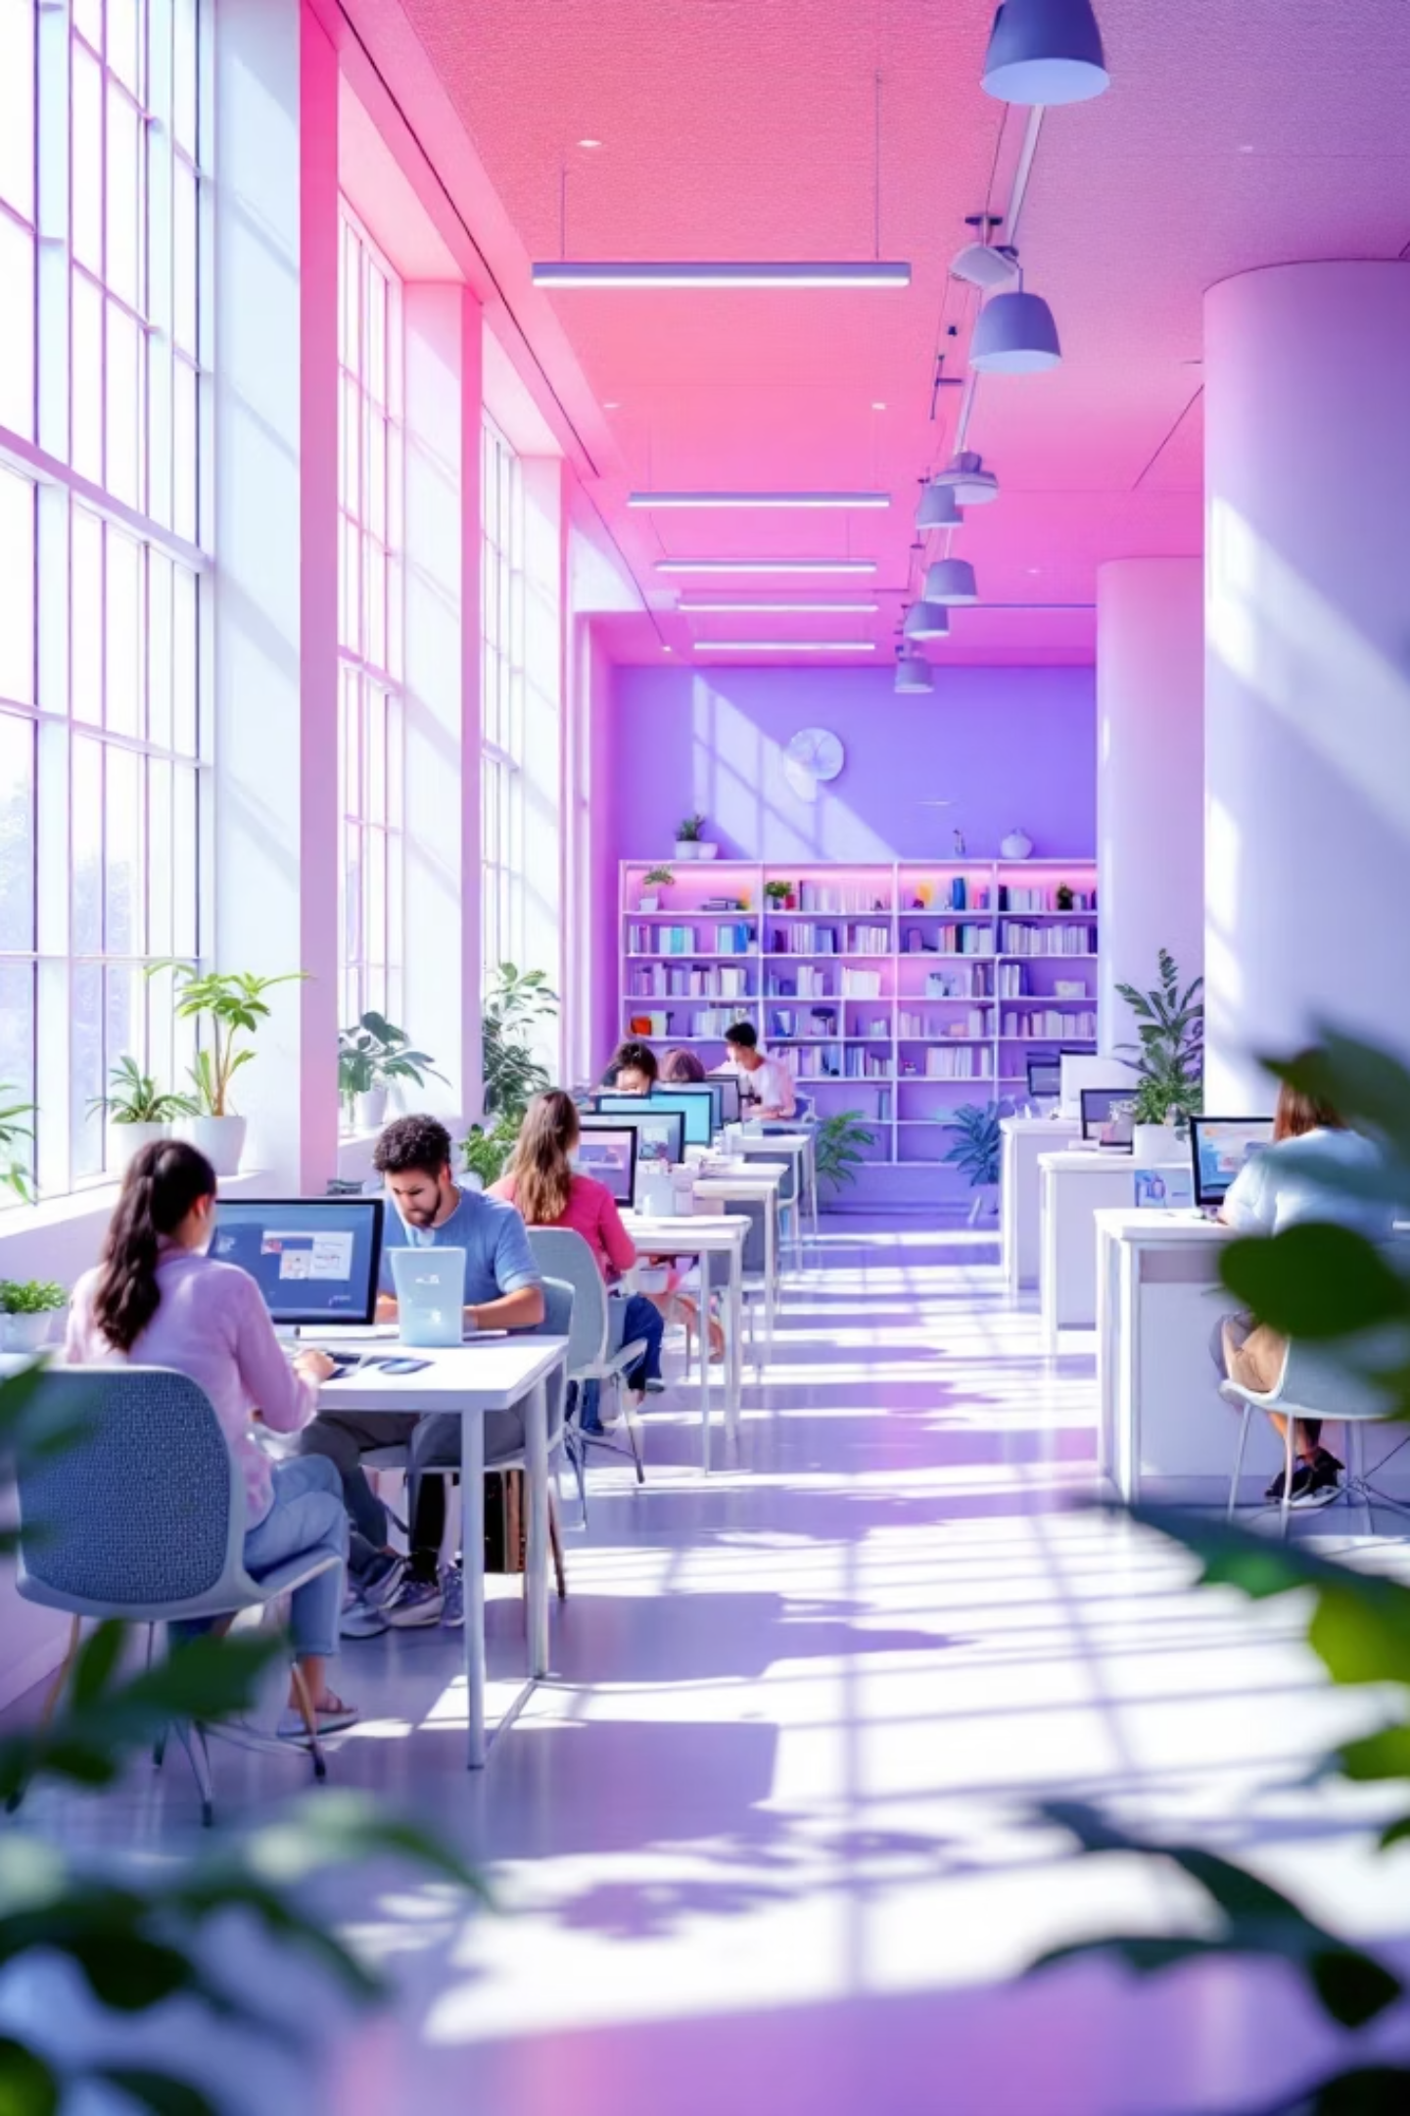
📊 LibTracker - Midterm Presentation

Slide 2
Project Introduction
Project Name
Team
Members
LibTracker
Rebs Dev
Sirac Ketenoğlu, Emre Turan, Barış Küçükkaya, Reis Yıldız
Goal
To monitor, manage, and display the live occupancy levels of university libraries and study spaces.

Slide 3
Project Charter & Vision
Problem
Unpredictable busyness and wasting time to find available spots in university libraries.
Vision
For university students who struggle to find available study spaces, LibTracker is an occupancy tracking application that displays the real time busyness of libraries. Our product saves students' time by providing reliable data.
Key Stakeholders
University Students
Library Management
University Administration

Slide 4
Personas
Damla (22)
Barış (23)
Senior law student and commuter. Time management is crucial; she plans to use LibTracker to check occupancy before leaving home.
Computer engineering student. Cannot focus in loud places and values data integrity.
Can (20)
Zeynep (45)
Business student. Prefers group study and dislikes walking aimlessly to find a large table.
Head librarian. Wants to view occupancy trends to manage resources and schedule cleaning staff effectively.

Slide 5
User Stories & Key Features
Top User Story
"As a student living far from campus, I want to check real time occupancy before leaving home so that I don't waste hours commuting to a full library."
Prioritised Features
01
02
Real Time Occupancy Dashboard
User Feedback System
Displays current busyness.
Allows verified students to update active occupancy.
03
04
Study Area Reservation System
Backend Statistics Dashboard
Book seats in advance during peak periods.
Visual charts on daily peak hours for administrative use.

Slide 6
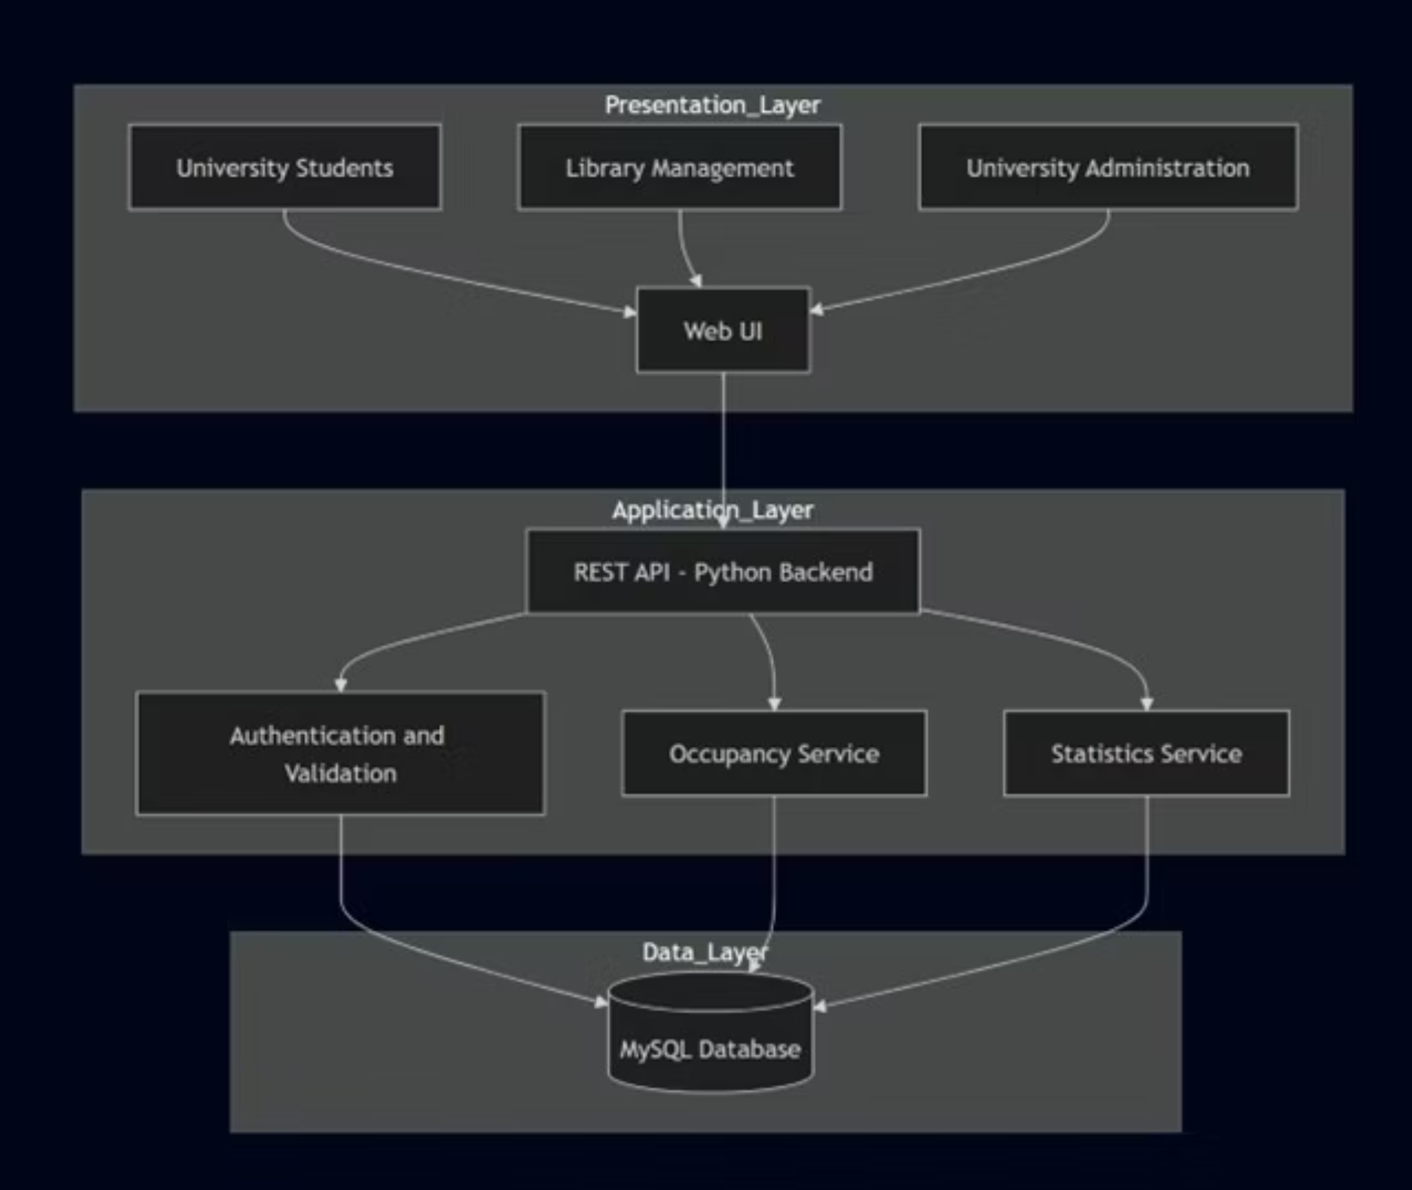
Architecture Style
Layered Architecture
Why Chosen
Provides strict separation of services for Simplicity, Accuracy, and Scalability

Slide 7
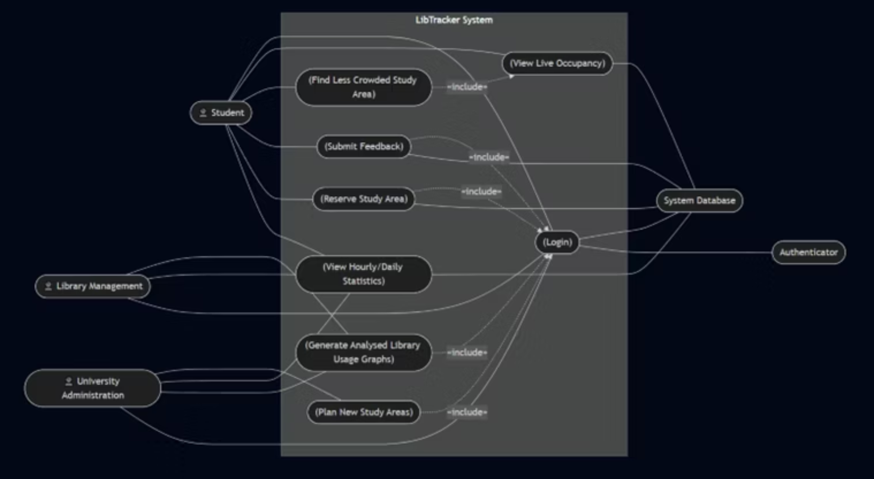
UML Diagrams - Use Case Diagram
Actors
Three primary human actors (Student, Library Management, University Administration) and two system actors.
Key Highlight
The <<include>> relationship with the "Login" use case guarantees that actions like submitting feedback or reserving an area are secure and restricted to verified users.

Slide 8
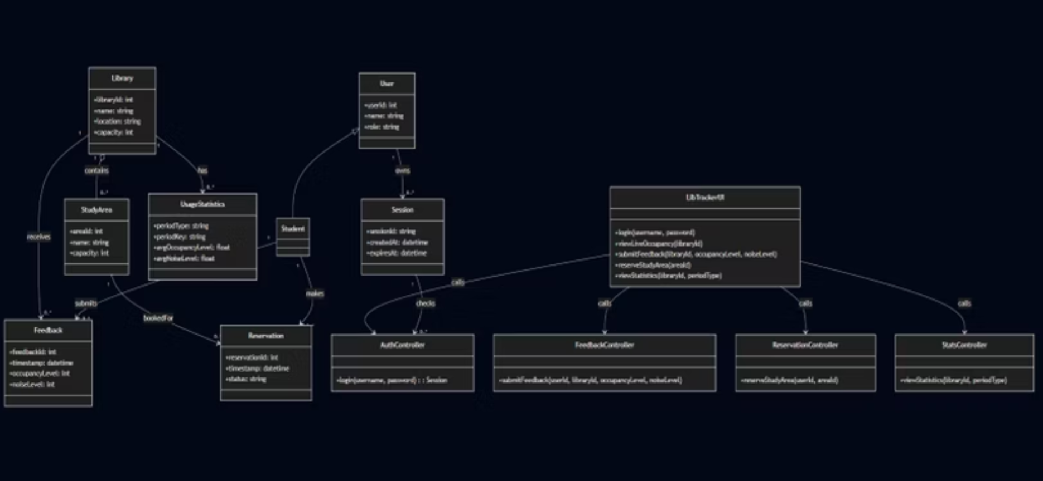
UML Diagrams - Class Diagram
Key Entities
Library, StudyArea, User, Feedback, Reservation, and UsageStatistics.
Key Highlight
Controller classes (e.g., AuthController, ReservationController) act as bridges between the user interface and the database to maintain a clean architecture.

Slide 9
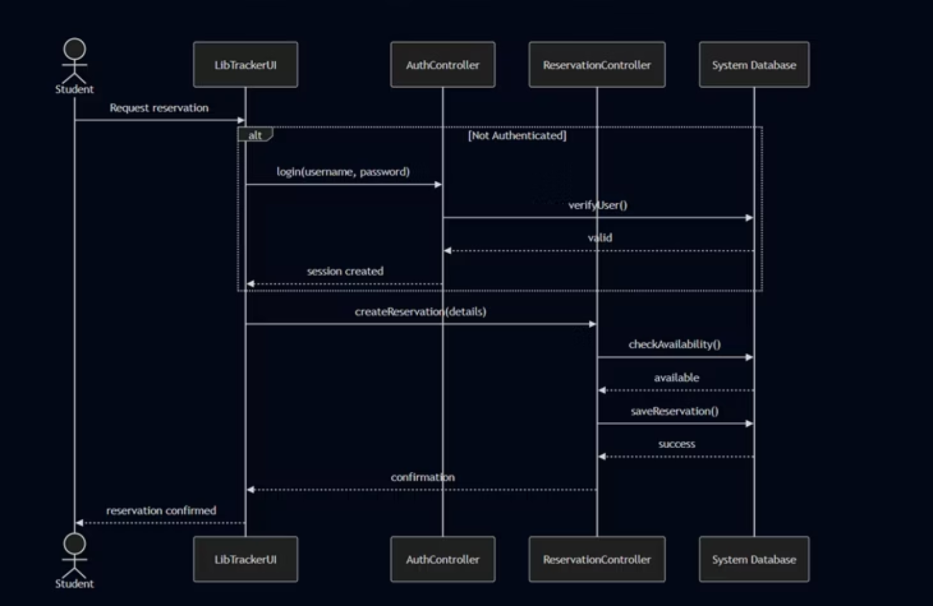
UML Diagrams - Sequence Diagram
Workflow
Displays the complex workflow for reserving a study area.
Key Highlight
Ensures the student is logged in, then the ReservationController calls checkAvailability() to ensure the seat is free before continuing to saveReservation().

Slide 10
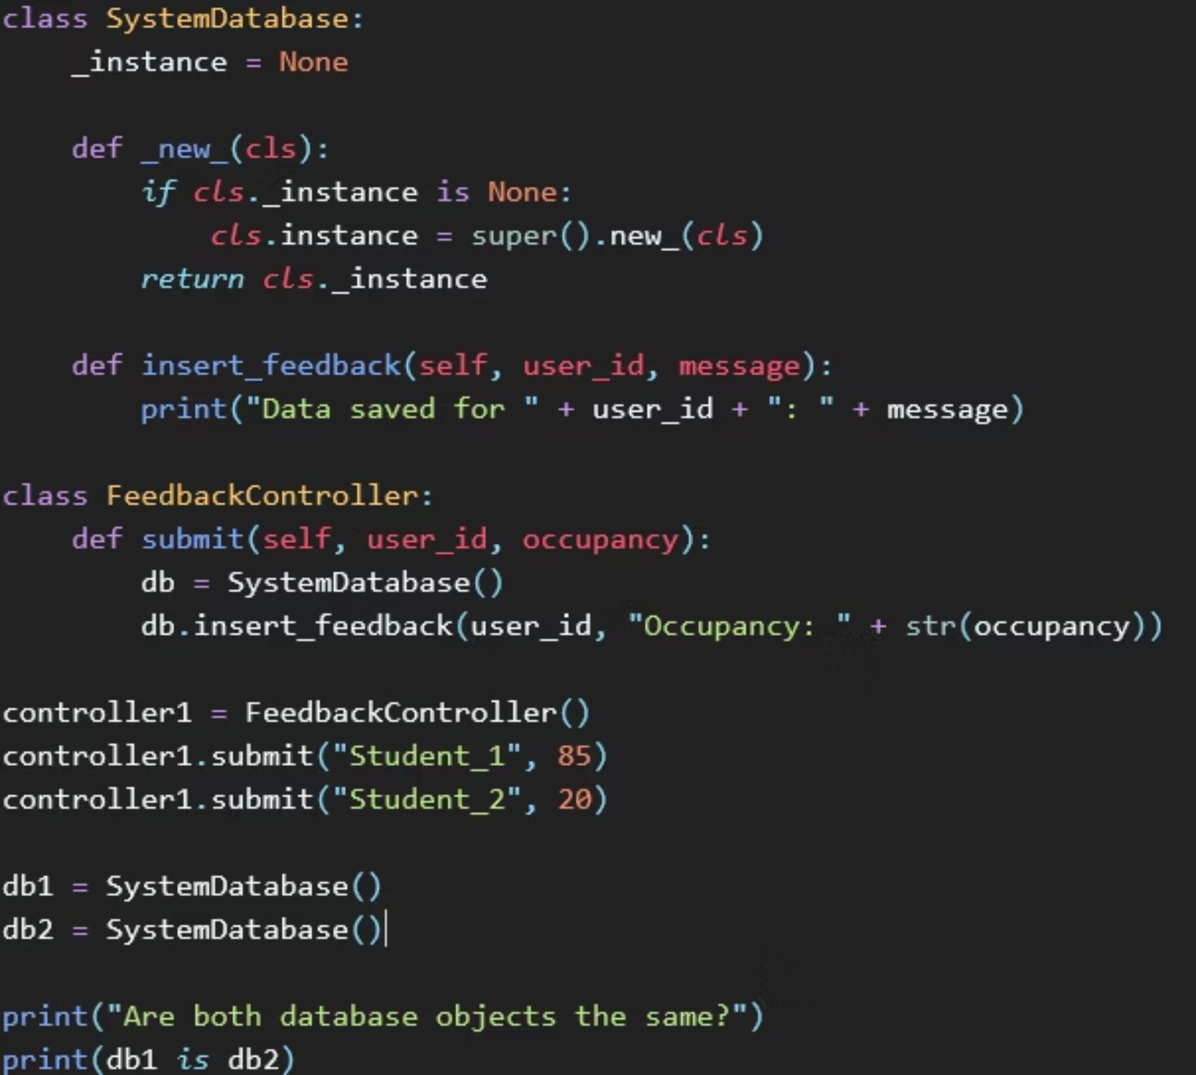
Selected Design Pattern
Pattern
Singleton Design Pattern
Context
Used to manage the SystemDatabase connection.
Why Chosen
Opening a new connection for every request would waste memory and cause data synchronization problems. Singleton ensures only one shared instance exists during the application lifecycle.

Slide 11
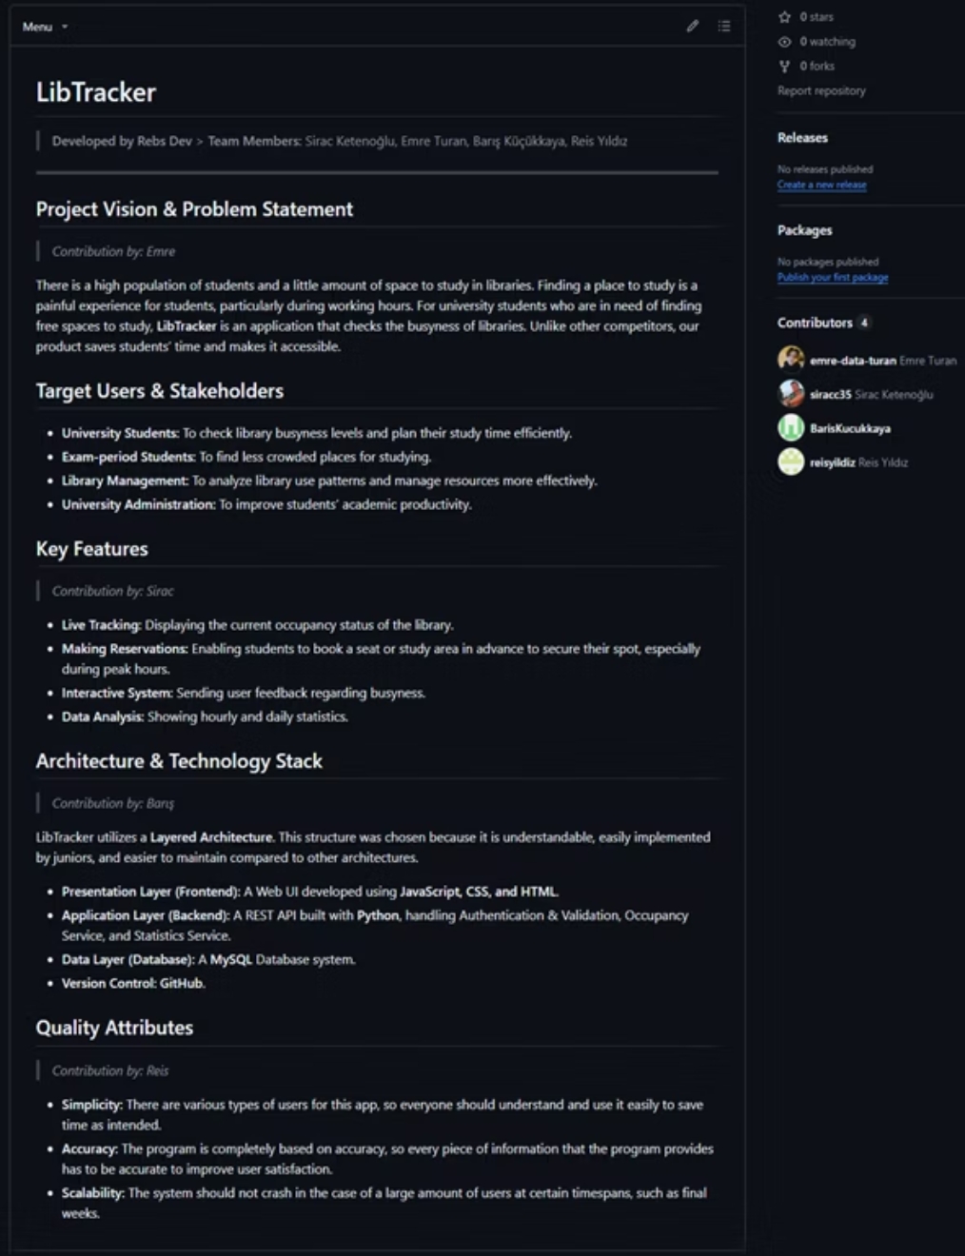
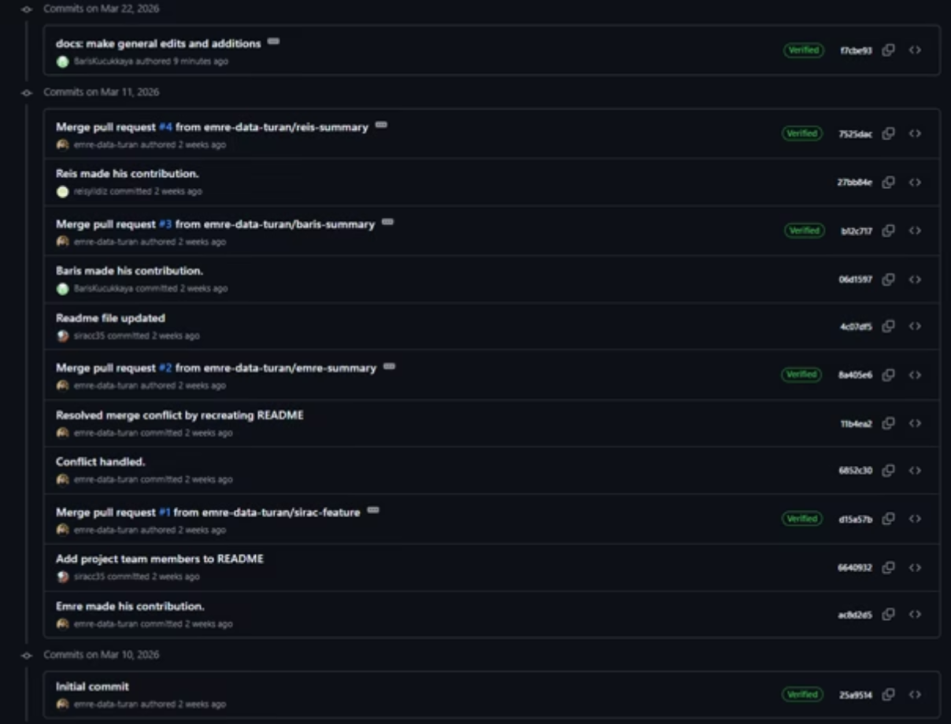
GITHUB
Project Management (GitHub)
Our project is meticulously managed within a well-structured GitHub repository. This platform transparently tracks our evolving tech stack, comprehensive commit history, and a robust branching strategy, ensuring efficient collaboration and clear development progress.

Slide 12
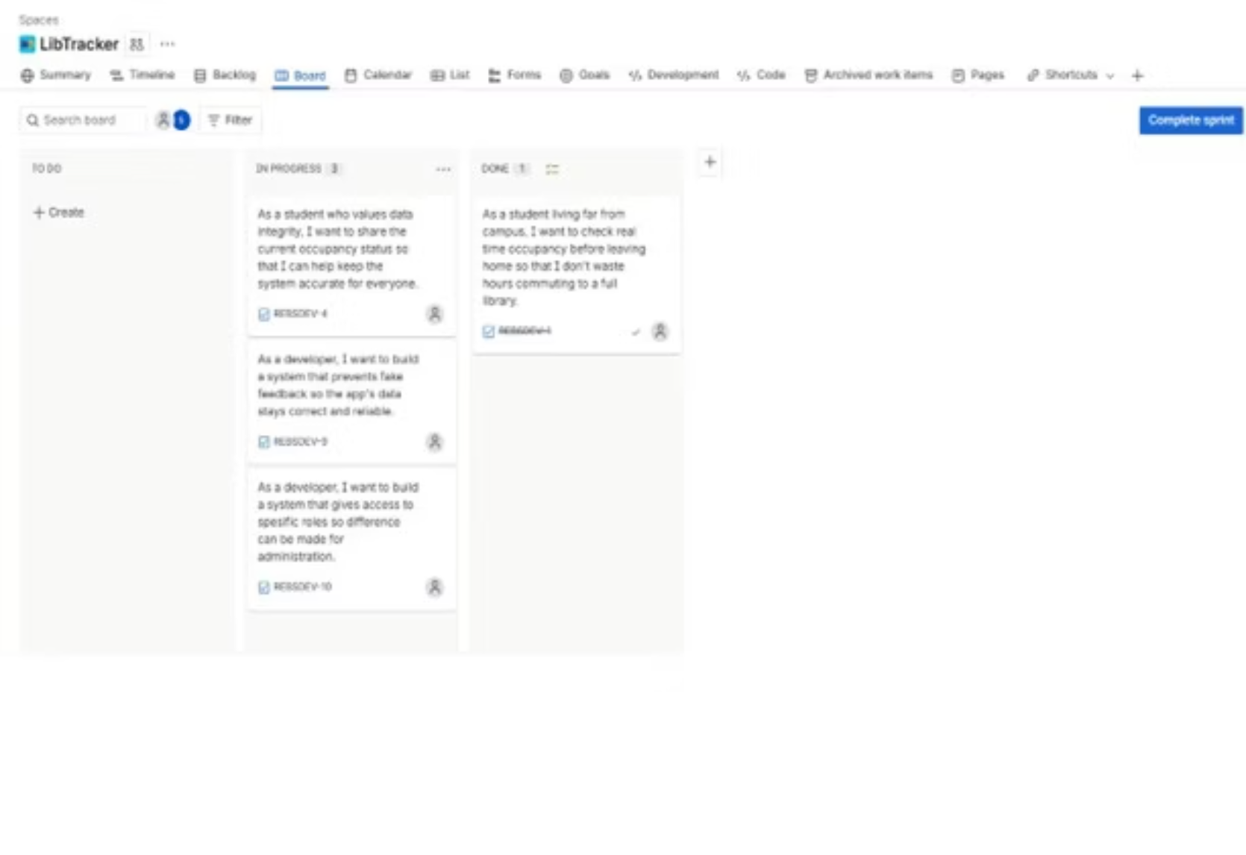
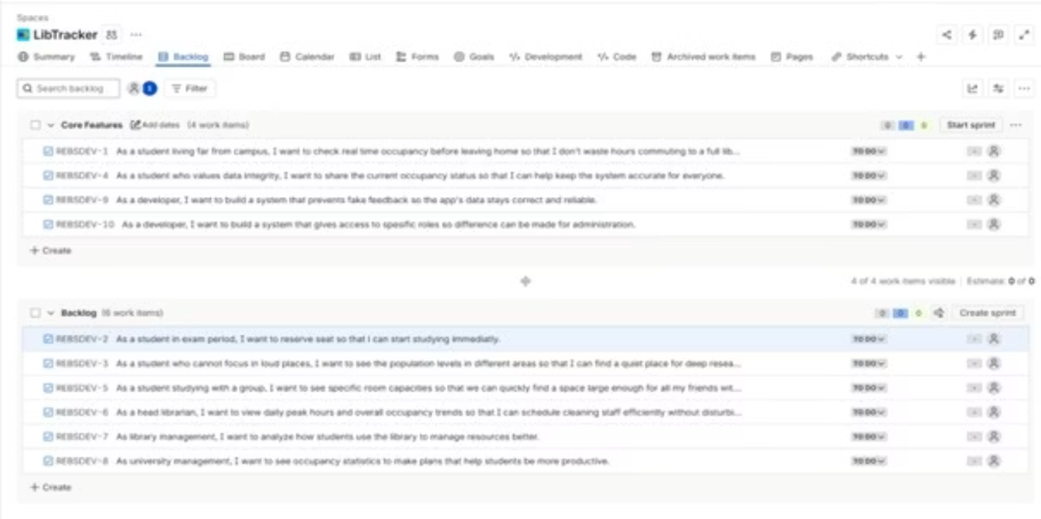
Project Management (Jira)
Core features like authentication and occupancy tracking are prioritised in the backlog and actively tracked in Sprint 1 using To Do, In Progress, and Done statuses.

Slide 13
Conclusion & Next Steps
Project Roadmap
01
02
Weeks 10-12: System Validation
Weeks 13-14: Final Deliverables
Focused efforts on thorough system testing, debugging, and implementing stringent quality controls to ensure robust performance and user satisfaction.
Completion of final project documentation, comprehensive report preparation, and a compelling presentation showcasing our solution and its impact.
Our End Goal
To deliver a reliable, scalable system that revolutionizes how students access university study spaces, thereby saving valuable time and enhancing academic productivity.

