Slide 1
CSE454 Project
Emre Yılmaz - 1901042606

Slide 2
1. Data Overview
2. Data Preprocessing
3. Correlation Analysis
4. Classification
5. Clustering

Slide 3
Data Overview
Data is about accident statistics
70 columns
Approximately 300k rows
There are generally categoric attributes
There are too many missing values
Example of attributes: Accident severity, sex of driver, purpose of driver, weather/road conditions, longtitude, latitude, day of week

Slide 4
Data Preprocessing
Some rows have too many missing values. Remove them.
Correlation Analysis: Cramer’s V method: Cramer’s V normalizes the chi-square statistic based on the number of variables and sample size.
1. Indicate all attributes that have at least one missing value.
2. Generate correlation tables of those attributes.
3. Search all data, if a value is missing, check its most correlated top 5 attributes.
4. Take the rows that has the same value with top 5 correlated attributes.
5. Take mode and fill the missing value

Slide 5
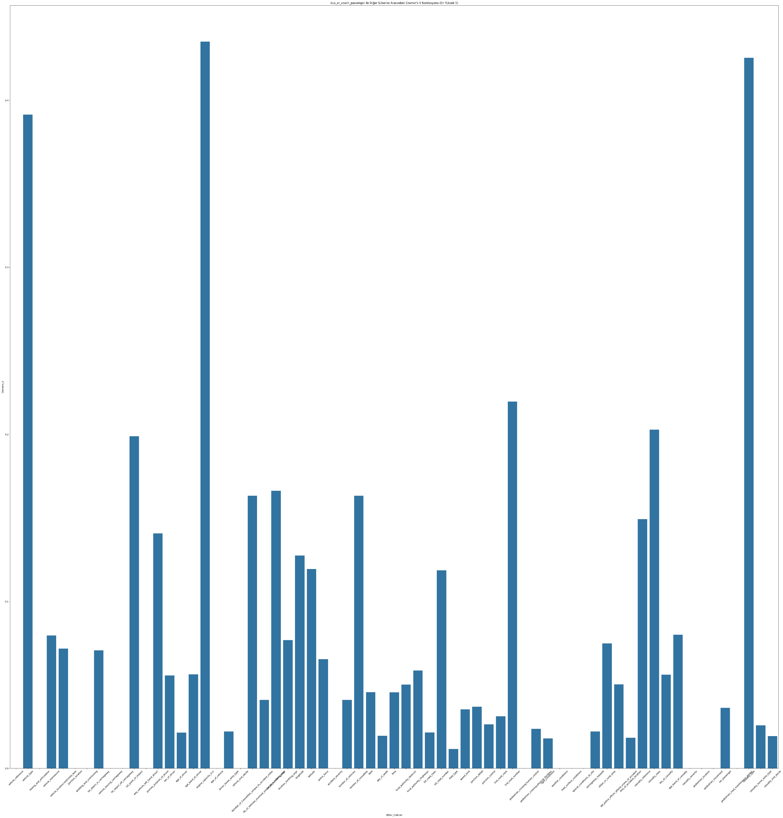
Correlation Analysis
Bus or Coach Passenger:
1. Engine Capacity
2. Vehicle Type
3. Casualty Type

Slide 6
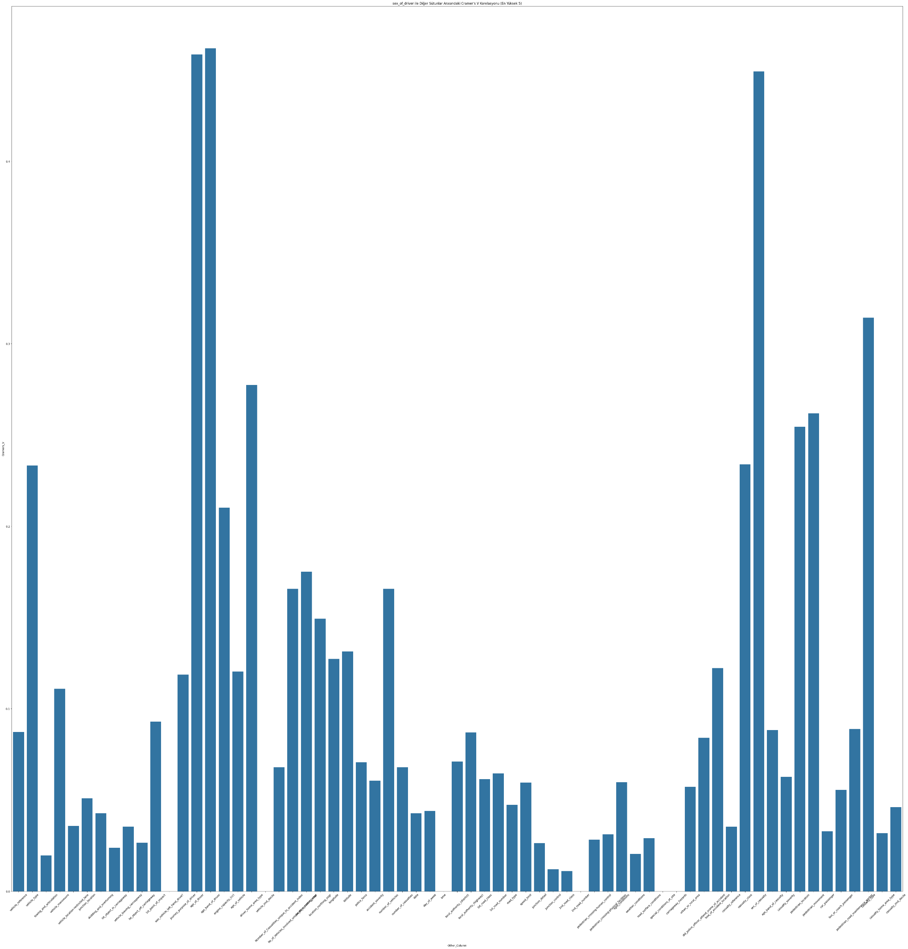
Correlation Analysis
Sex of Driver:
1. Age of Driver
2. Age Band of Driver

Slide 7
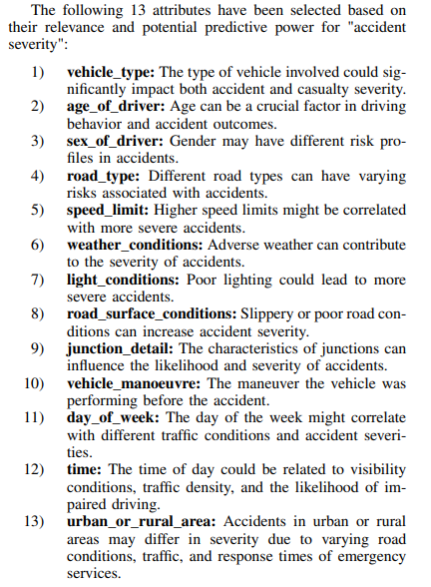
Classification
These attributes are chosen based on common factors that are often considered in traffic safety analyses. They encompass a range of factors including driver demographics, vehicle characteristics, environmental conditions, and road infrastructure. The use of these attributes in a decision tree model aims to provide insights into the factors that significantly influence accident severity, thereby aiding in effective traffic safety management

Slide 8
Classification
GINI Index and Entropy has been applied seperately
Oversampling and undersampling is applied

Slide 9
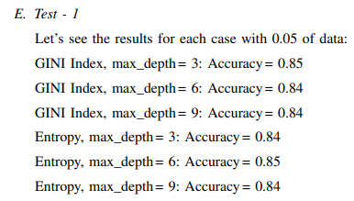
Classification
Maximum Depth and Overfitting?
Comparison of GINI Index and Entropy
Also, Logistic Regression is applied using sklearn library: 0.89 accuracy

Slide 10
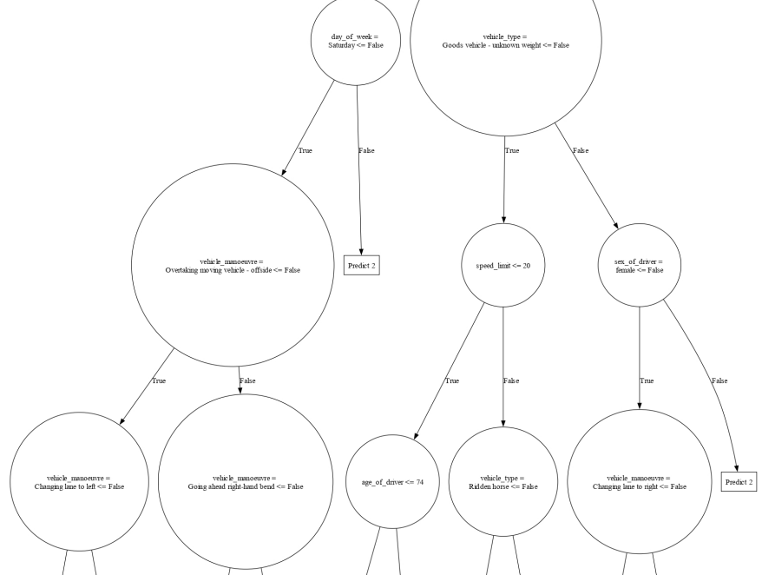
Classification
Why is the decision model is very successful?

Slide 11
Classification
Important Features:
Age of Driver
Day of Week
Manouver Type
Sex of Driver
Weather Conditions

Slide 12
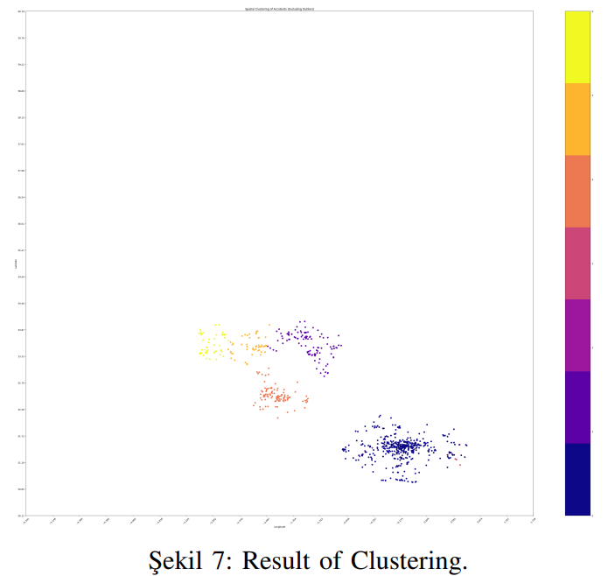
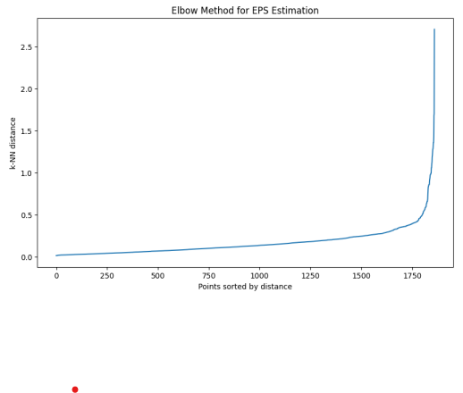
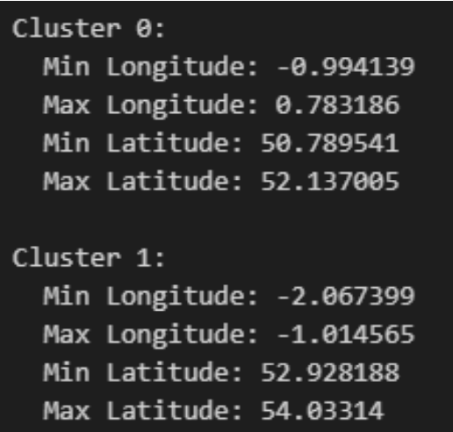

Clustering - 1
DBSCAN algorithm is implemented and used.
Cluster the data points based on their geographical locations
Elbow Method is used to find optimal EPS parameter

Slide 13
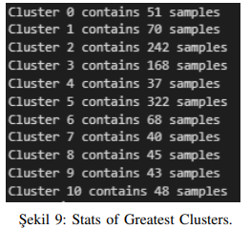
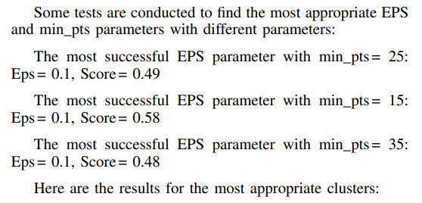
Clustering - 2
In the second test, I attempted clustering using multiple categorical features. Clustering using ’vehicle_manoeuvre’, ’pedestrian_movement’, ’vehicle_location-restricted_lane’, ’junction_location’ allows for a detailed analysis of the interaction between driver behavior, pedestrian movement, and road infrastructure in causing accidents. It can provide actionable insights for improving road safety and reducing accident rates.
Based on Silhouette score method, eps parameter is indicated as 0.1 and min_pts parameter is indicated as 15

Slide 14
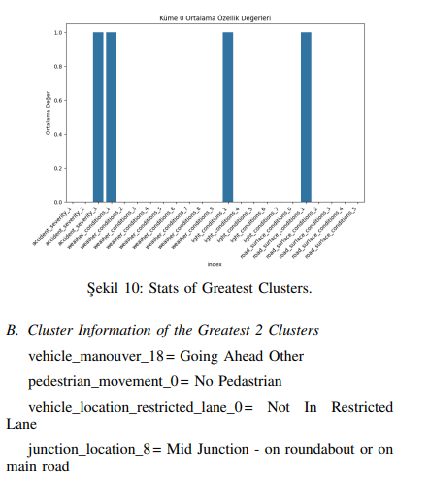
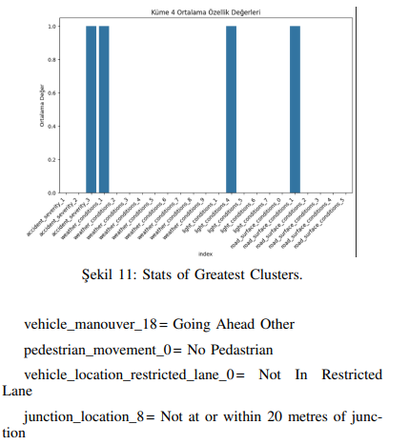
Clustering - 2

Slide 15
Clustering - 3
In particular, examining the effects of weather and light conditions on accidents provides important information about the environmental conditions in which the accidents occur. Understanding the role of road surface conditions on the severity of accidents can guide the development of road safety measures. This analysis could provide actionable insights for reducing traffic accidents and enhancing road safety

Slide 16
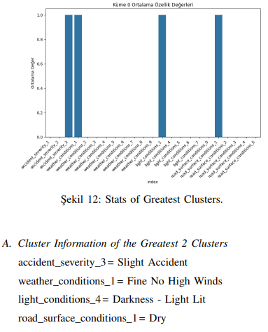
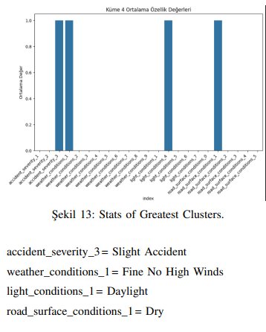
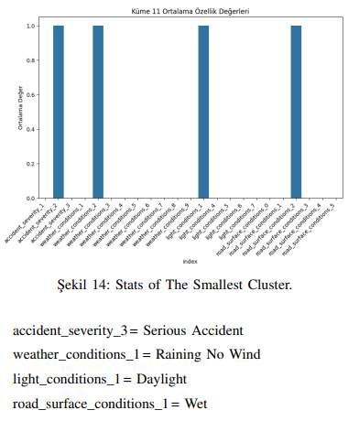
Clustering - 3

