Slide 1
Toxicity/Hate Speech Detection System
Using Few-Shot Learning with Large Language Models
Emre Yılmaz
S028845 AI525 Project

Slide 2
Project Overview
• Objective: Build a binary text classifier to detect toxic content using LLMs
• Approach: Few-shot learning (no fine-tuning required)
• Model: llama3.2:3b (3 billion parameters) via Ollama
• Dataset: Surge AI Toxicity Dataset (1,000 samples)
• Evaluation: Comprehensive metrics, visualizations, error analysis

Slide 3
What is Toxicity Detection?
Toxic Content Includes:
• Hate speech & discrimination
• Insults & profanity
• Threats & harassment
• Offensive content

Slide 4
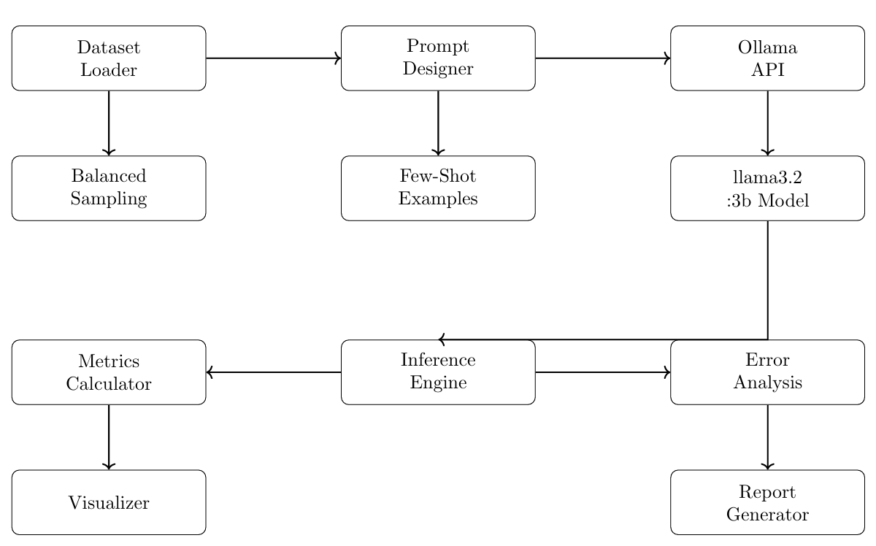
System Architecture

Slide 5
Dataset
• Source: Surge AI Toxicity Dataset (1,000 English samples)
• Labels: Binary (Toxic / Not Toxic) - 50% each class
• Preprocessing: Remove nulls, duplicates, standardize labels
• Balanced Sample: 100 toxic + 100 non-toxic = 200 samples
• Split: 40 for few-shot examples, 160 for evaluation

Slide 6
Few-Shot Prompt Design
You are a toxicity classifier. Classify text as "toxic" or "non-toxic". Toxic: hate speech, insults, threats, harassment Non-toxic: respectful, constructive, neutral Example 1: "Great product!" → non-toxic Example 2: "You're an idiot!" → toxic Example 3: "The weather is nice" → non-toxic Example 4: "I hate all [group]!" → toxic Example 5: "This is garbage" → toxic Now classify: [INPUT TEXT] Respond with ONLY "toxic" or "non-toxic"

Slide 7
Zero-Shot vs Few-Shot
Zero-Shot Prompting:
Few-Shot Prompting:
• No examples provided
• Relies on pre-trained knowledge
• Simpler, shorter prompts
• Faster inference
• 5 examples in prompt
• Guides model behavior
• More context provided
• May improve edge cases

Slide 8
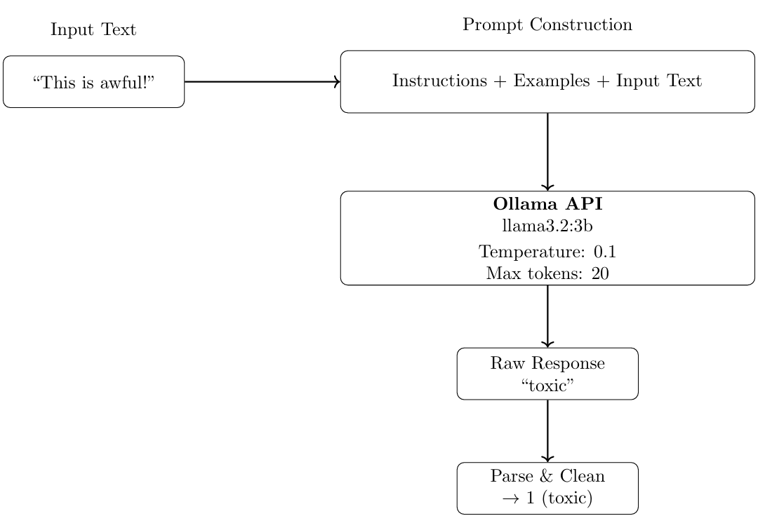
Inference Flow

Slide 9
Inference Engine - How It Works
Input Text
Build Prompt
Ollama API
Parse
Ollama API Configuration
Response Parsing
• Model: llama3.2:3b
• Temperature: 0.1 (low for consistency)
• Max tokens: 20 (short response) (we only need toxic or non-toxic output)
• Retries: 3 attempts on failure
• Timeout: 60 seconds
• Clean response (lowercase, strip)
• Check for 'non-toxic’ or 'toxic'
• Handle invalid responses (-1)
• Return: 0, 1, or -1
response = ollama.generate(model='llama3.2:3b', prompt=prompt, options={'temperature': 0.1, 'num_predict': 20}) result = parse_response(response['response']) # Returns 0, 1, or -1

Slide 10
Performance Results
Metric | Zero-Shot | Few-Shot (5 examples)
Accuracy | 95.60% | 94.23%
Precision | 95.65% | 94.22%
Recall | 95.61% | 94.24%
F1-Score | 95.60% | 94.23%
Valid Responses | 99.4% | 97.5%
False Positives | 5 | 5
False Negatives | 2 | 4

Slide 11
Confusion Matrix (Zero-Shot)
 | Pred: Non-toxic | Pred: Toxic
Actual: Non-toxic | 75 (TN) | 5 (FP)
Actual: Toxic | 2 (FN) | 78 (TP)

Slide 12
Error Analysis
False Positives (5 cases):
False Negatives (2 cases):
• Strong opinions misclassified
• Sarcasm or emphatic language
• Discussing sensitive topics in a neutral/academic way
• Subtle or coded toxicity
• Context dependent harm

Slide 13
Conclusion
• Built complete toxicity detection pipeline using LLMs
• Achieved 95.6% accuracy with zero-shot prompting
• Compared few-shot vs zero-shot approaches
• Pre-trained LLMs are practical for content moderation
• Edge cases (sarcasm, context-dependent different meaning) remain challenging
• No fine-tuning needed for strong baseline performance

Slide 14
Thank You!
Questions & Discussion AI525 - Toxicity Detection System

