Slide 1
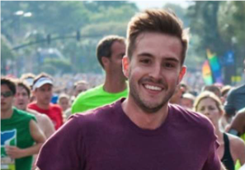
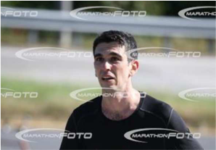
Emotion Detection for Marathon Runners
Notes:
Running long distance clears your mind from everyday hustles.
In todays fast paced world, there are lots of stressors around us and we are interrupted every few minutes with emails and notifications.
So, I see it like a meditation where you can spend time with yourself without any disturbances for more than half an hour.
Well when you think it like this, you should express a happy face while you’re running right?
But there is a more fundamental trade-off that while you’re running you physiological stress to your body.
A more personalized way of looking this trade-off is actually when my pictures are taken in a marathon I always look like this.
But there is this infamous meme in the internet shows the most photogenic guy ever and it’s taken in a marathon.
So I was wondering which side of this trade-off most of the people running marathons and what are the features affecting feeling positive or negative.

Slide 2

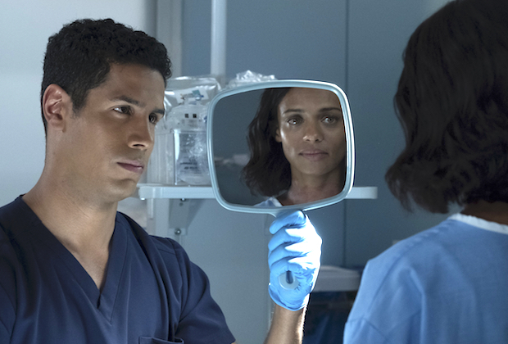
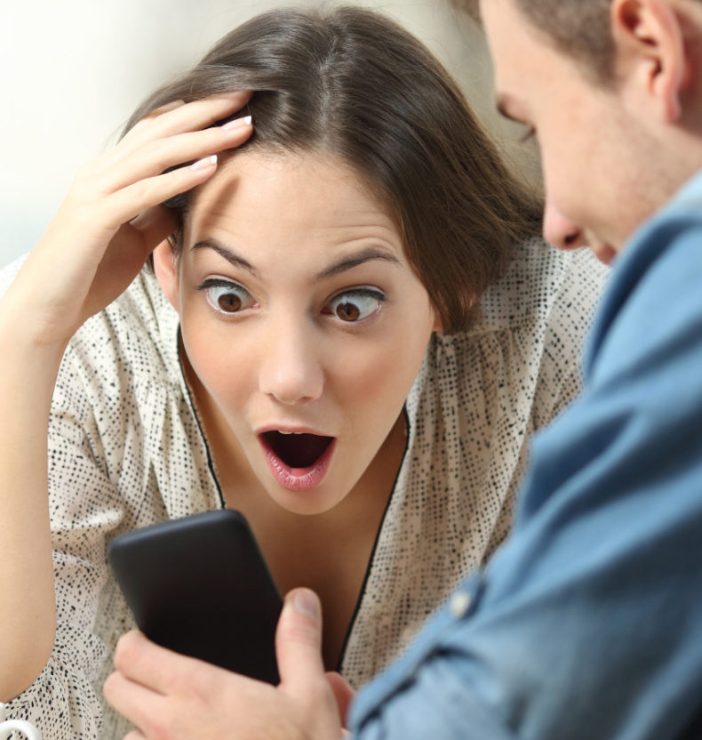
Business Value
The global facial recognition market size was $4 billion in 2018 and is estimated to grow to $10 billion in 2025.*
Industries using emotion detection:
Human-Machine Interaction
Security Systems
Healthcare
Market Research
*Reuters September 2018, BussinesWire October 2018

Slide 3
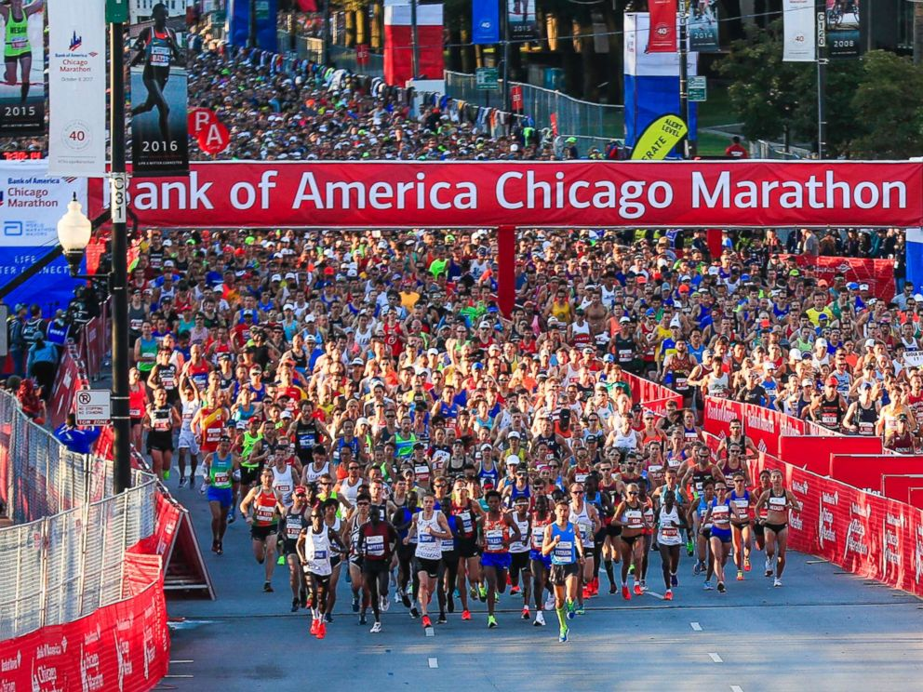
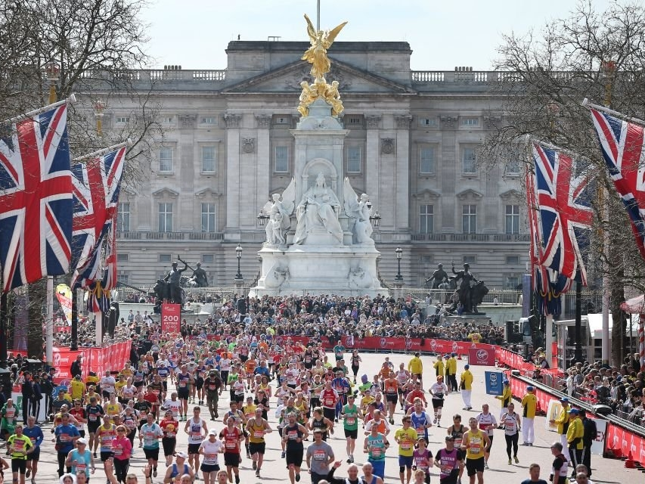
Implementation
Chicago Marathon
London Marathon
Notes:
More than 40 000 london marathon finishers and 44500 Chicago marathon finishers in 2018

Slide 4
Implementation

Slide 5
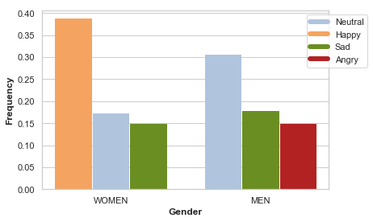
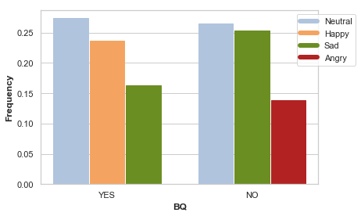
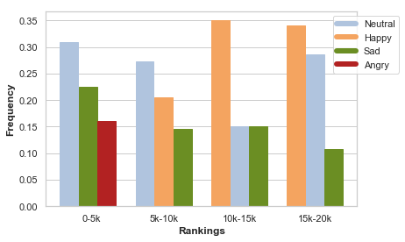
Demographics

Slide 6
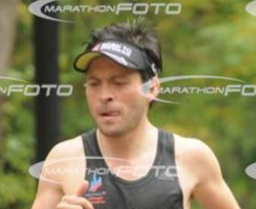

Emotions

Slide 7
Emotions

