Slide 1
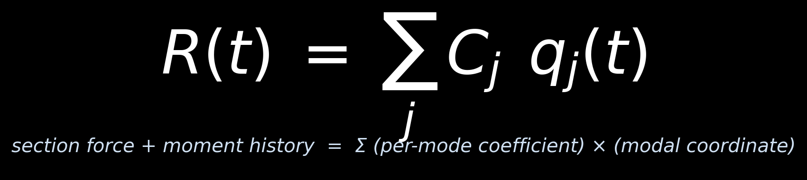
Transient Section Resultants from MSUP Modal Coordinates
Methodology & Theory — section forces and moments reconstructed from a modal file.rst and an MSUP file.mcf, without a transient result file
examples/ansys_transient_extraction/mcf_dpf_section_resultants_gui.py · method walkthrough

Slide 2
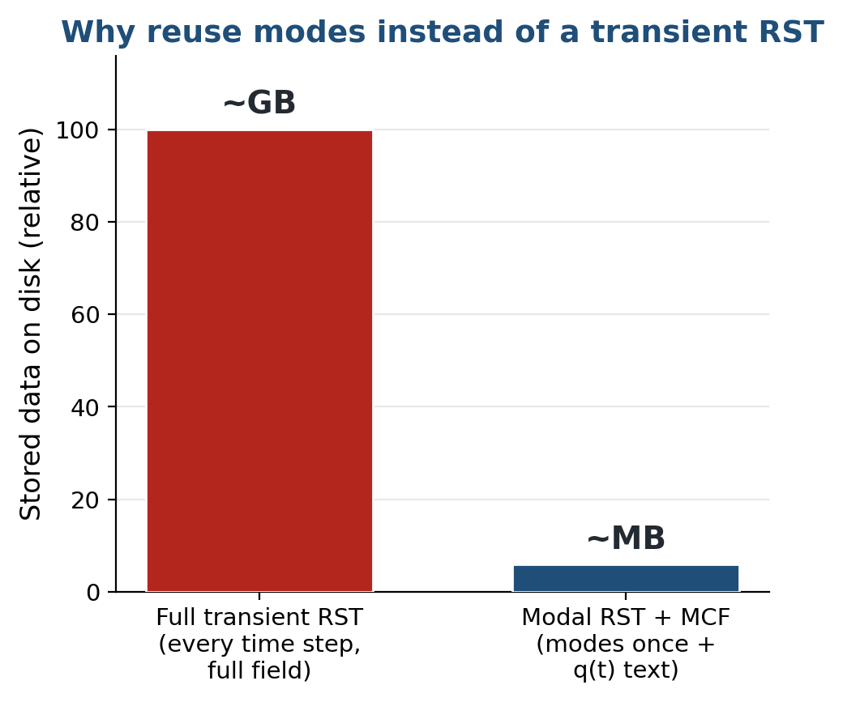
Motivation — skip the transient result file
▸ A full transient RST stores every field at every time step — gigabytes, slow to write and to read.
▸ The deliverable is usually a handful of section resultants, not the whole field.
▸ An MSUP solve already stores the modes and the modal coordinates — reuse them.
▸ Output is one compact CSV of F(t), M(t) across the cut.
MSUP MCF + DPF Section Resultants — Methodology & Theory
2

Slide 3
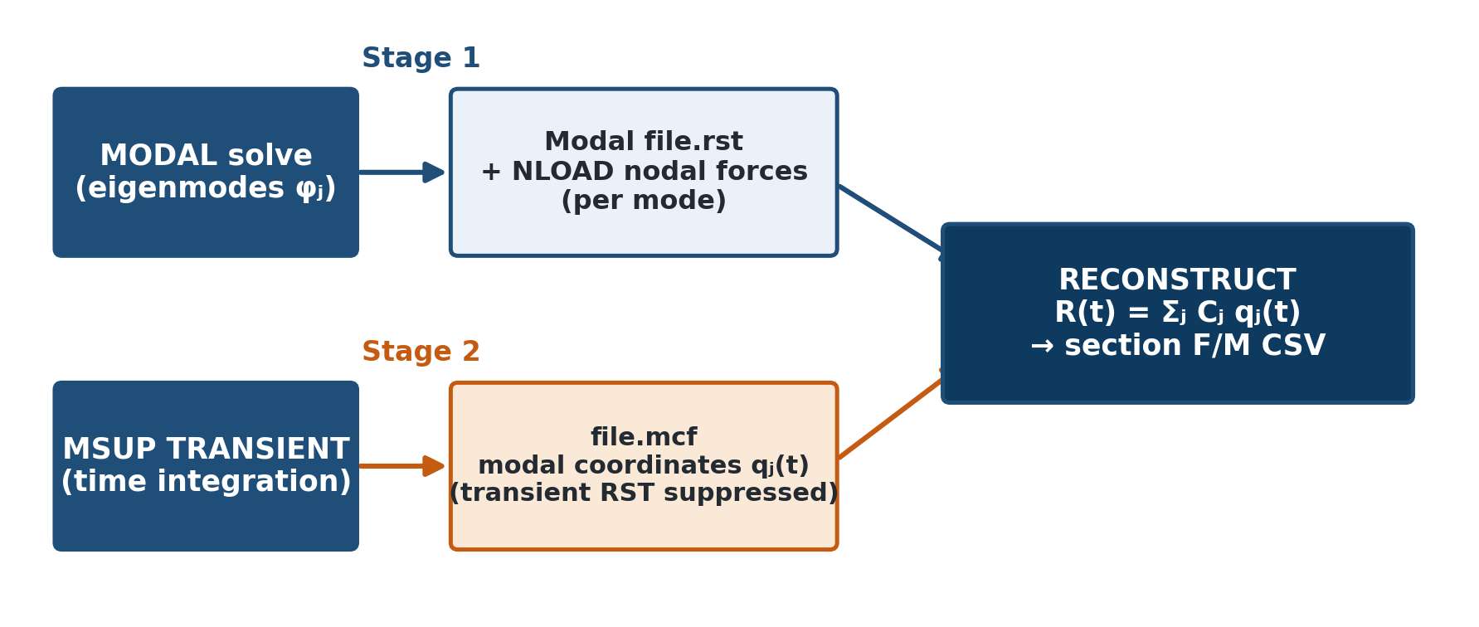
Theory — mode-superposition background
▸ Modal solve — eigenmodes φⱼ and modal-set IDs, stored in the modal file.rst.
▸ MSUP transient — modal coordinates qⱼ(t) written to Jobname.mcf; u(t) = Σⱼ φⱼ qⱼ(t).
▸ Two committed command snippets wire the stages; the transient RST is suppressed.
MSUP MCF + DPF Section Resultants — Methodology & Theory
3

Slide 4
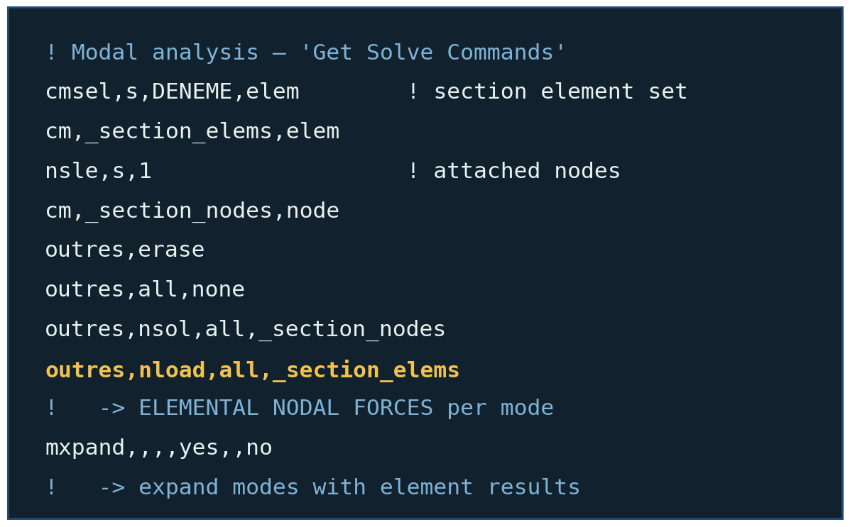
Theory — modal nodal forces (ENF / NLOAD)
▸ OUTRES,NLOAD — writes the elemental nodal forces that force_summation sums.
▸ OUTRES,NSOL — keeps the nodal solution for the section node set.
▸ MXPAND … ELCALC=YES — expands the modes WITH element results, so the forces exist per mode.
MSUP MCF + DPF Section Resultants — Methodology & Theory
4

Slide 5
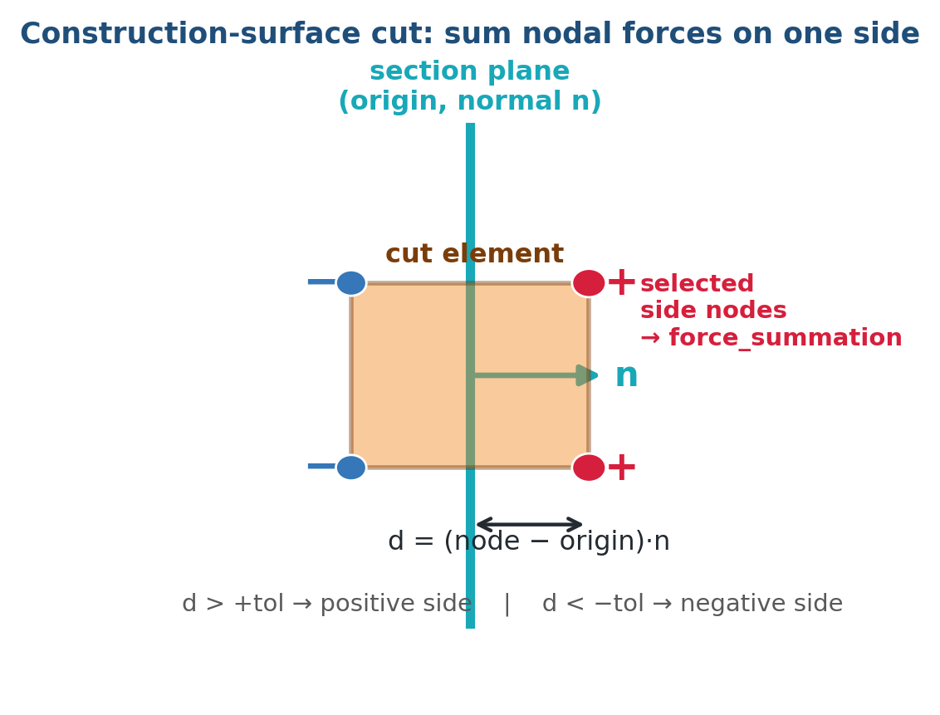
Theory — the free-body section cut (NFORCE)
▸ Pick an element named selection; cut it with a plane (origin + a local-axis normal).
▸ Signed distance d = (node − origin)·n classifies each element as cut or not-cut.
▸ Sum the cut elements' nodal forces over the nodes on the requested side = the section resultant.
MSUP MCF + DPF Section Resultants — Methodology & Theory
5

Slide 6
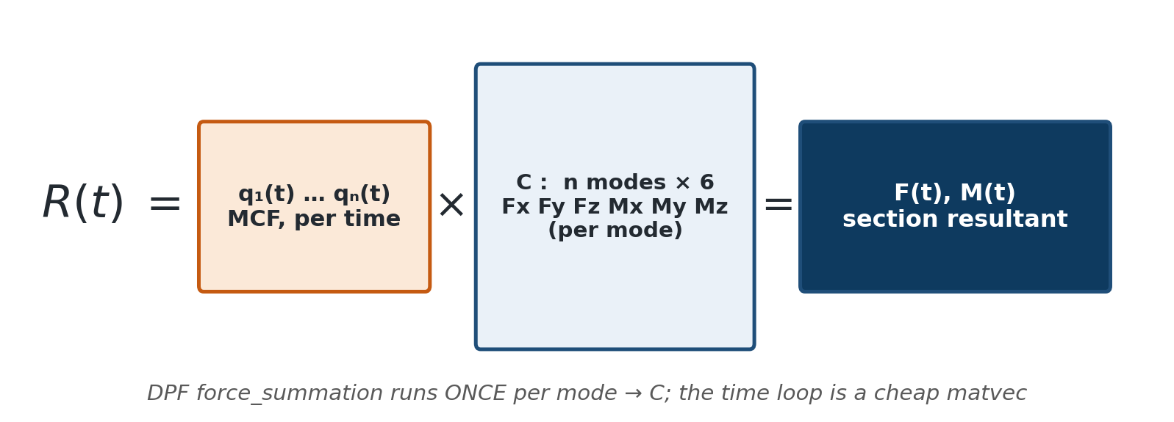
Theory — the superposition coefficient idea
▸ Section nodal forces are linear in displacement, so R(t) = Σⱼ Cⱼ qⱼ(t).
▸ Cⱼ — the six-component section resultant that mode j alone produces.
▸ force_summation runs once per mode to build C; the time history is a cheap matrix–vector product.
MSUP MCF + DPF Section Resultants — Methodology & Theory
6

Slide 7
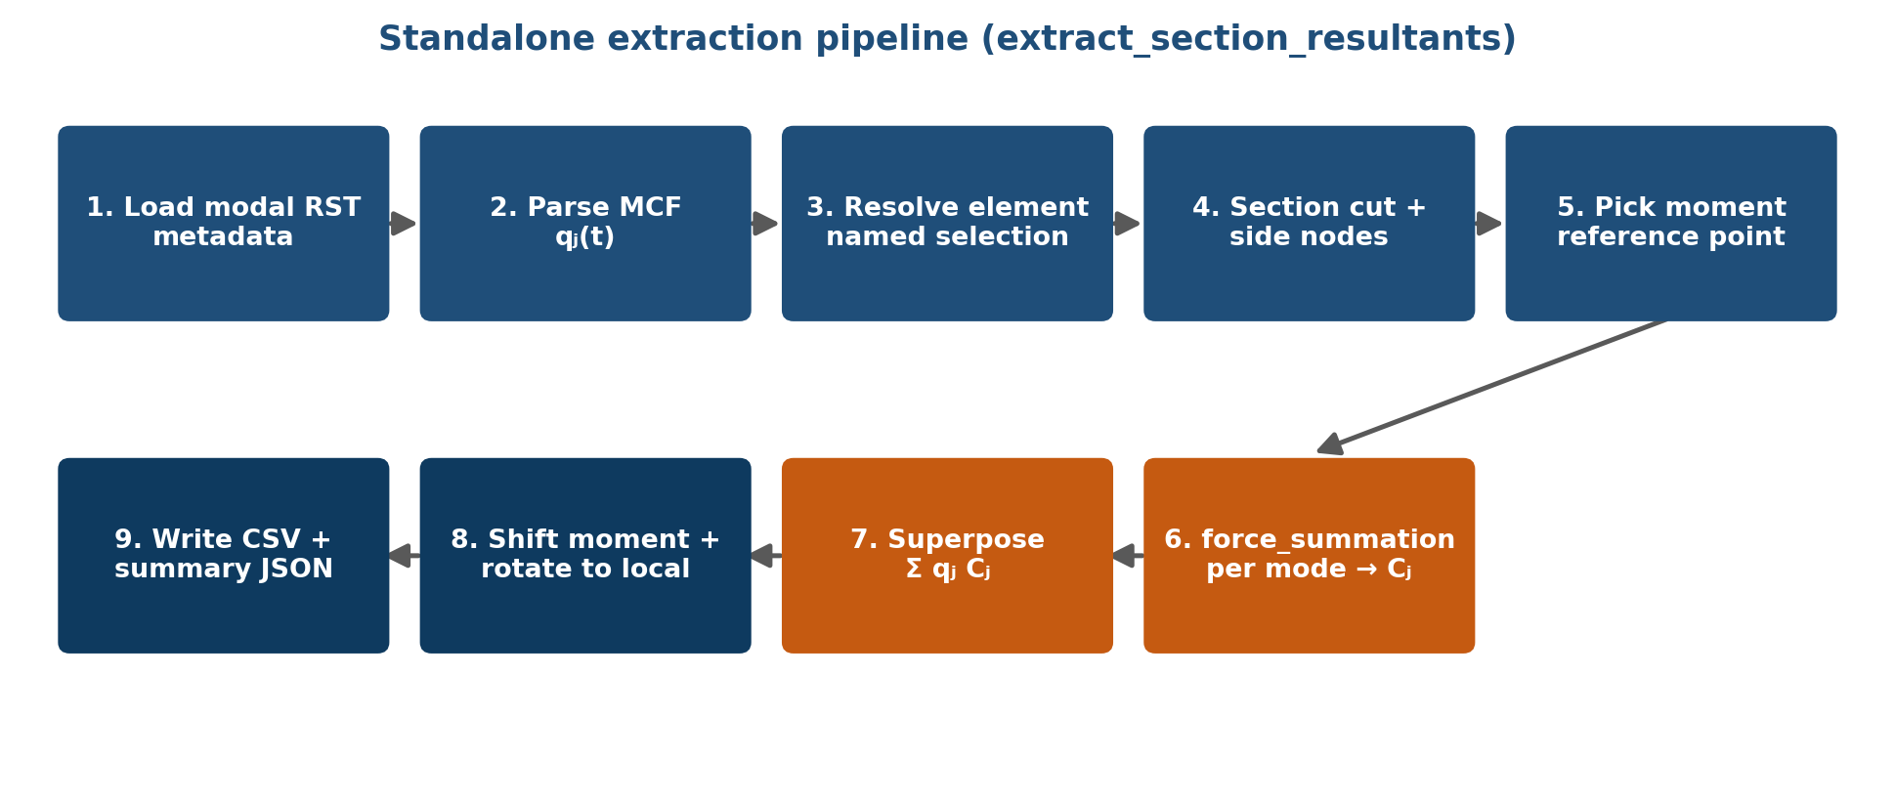
Feature — the extraction pipeline
▸ extract_section_resultants() chains nine stages — the expensive DPF work happens once per mode, the per-time-step work is arithmetic.
MSUP MCF + DPF Section Resultants — Methodology & Theory
7

Slide 8
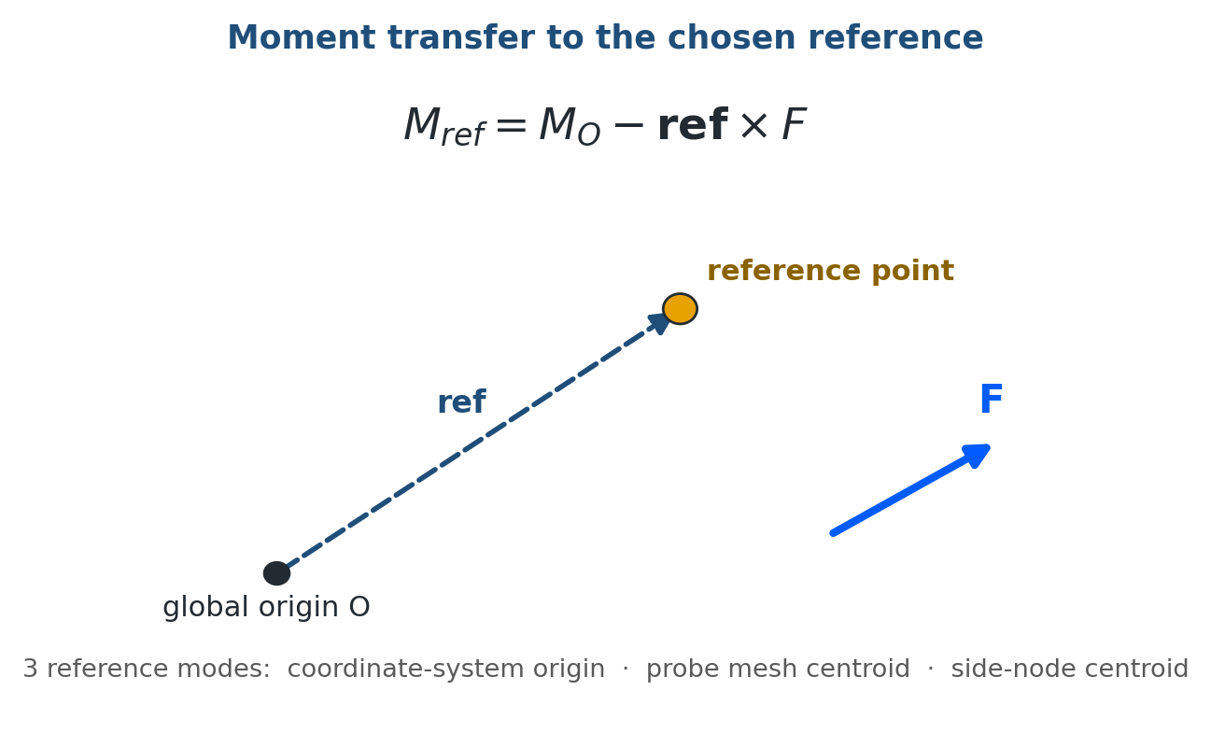
Theory — moment transfer
▸ force_summation returns the moment about the global origin.
▸ Transfer to any reference point: M_ref = M_O − ref × F (the force is unchanged).
▸ Three reference modes — coordinate-system origin · Mechanical-probe mesh centroid · selected-side node centroid.
MSUP MCF + DPF Section Resultants — Methodology & Theory
8

Slide 9
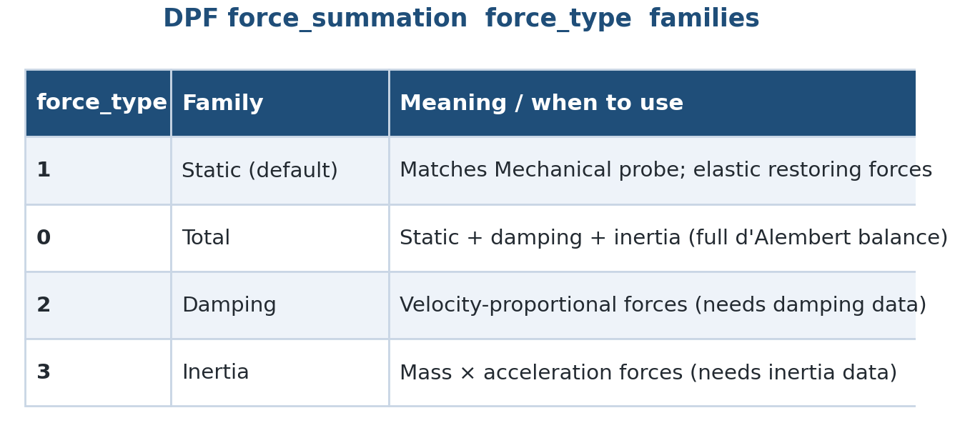
Feature — force-type families
▸ force_type selects which force family is summed.
▸ Static (1) matches the Mechanical probe; Total (0) adds damping + inertia.
▸ Damping (2) and Inertia (3) require those contributions to be stored in the RST.
MSUP MCF + DPF Section Resultants — Methodology & Theory
9

Slide 10
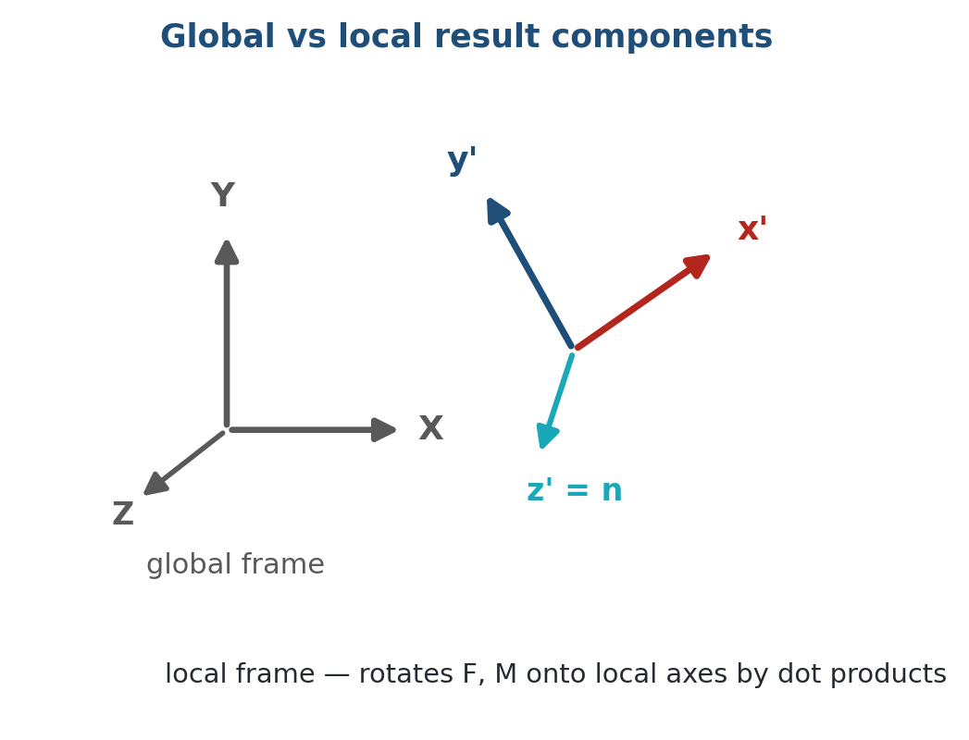
Theory — global vs local result frames
▸ Results are reported in both the global XYZ frame and the local coordinate-system frame.
▸ rotate_to_local projects F and M onto the local axes by dot products.
▸ Axes are validated orthonormal (det ≈ +1) before use.
MSUP MCF + DPF Section Resultants — Methodology & Theory
10

Slide 11
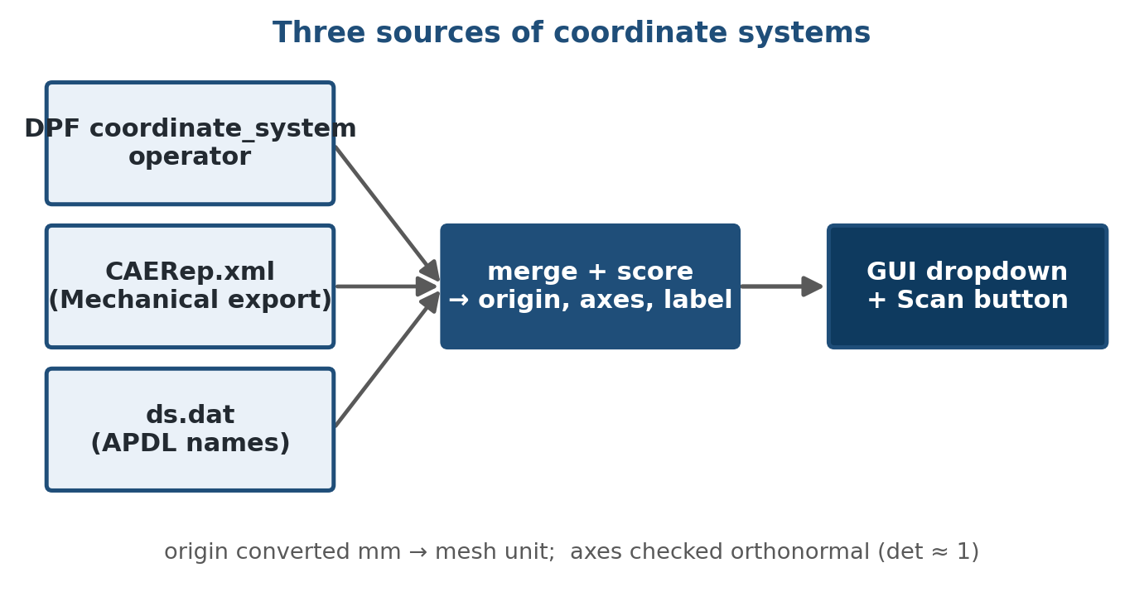
Feature — coordinate-system discovery
▸ Coordinate systems are discovered from three sources — the DPF operator, CAERep.xml, and ds.dat APDL names.
▸ Merged, scored, and labelled into a searchable dropdown with a Scan button.
▸ Origin entered in millimetres is converted to the mesh solver unit.
MSUP MCF + DPF Section Resultants — Methodology & Theory
11

Slide 12
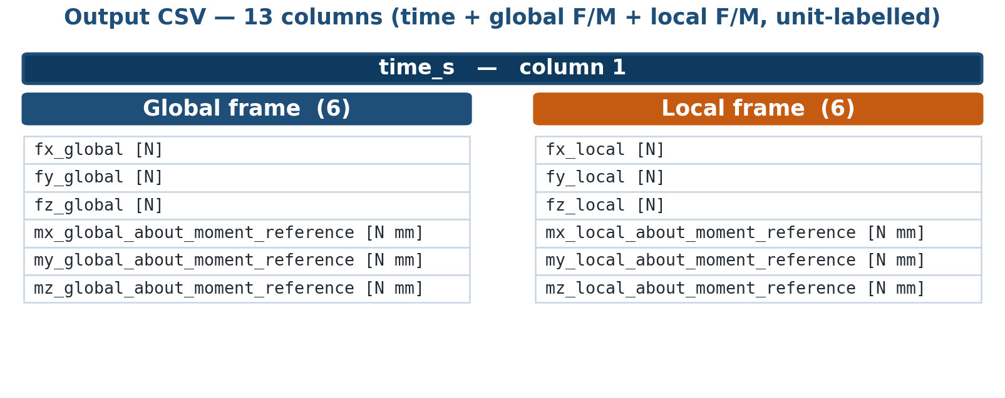
Feature — units and the output CSV
▸ Force unit comes from the DPF field; moment unit = force × mesh length (e.g. N mm).
▸ The 13-column CSV carries the resolved unit in every header.
▸ A moment-unit selector converts the plotted history (N mm, N m, kN m, lbf in, …).
MSUP MCF + DPF Section Resultants — Methodology & Theory
12

Slide 13
Feature — the upstream Mechanical snippets
▸ Modal 'Get Solve Commands' — write NLOAD / NSOL for the section set and expand with ELCALC.
▸ Transient 'Get Solve Commands' — mcfopt,1 writes the MCF; outres,all,none suppresses the transient RST.
▸ 'On After Solve' — an embedded IronPython twin reconstructs the same CSV inside Mechanical.
▸ All are standard Mechanical callbacks — no external file is imported into the tree.
MSUP MCF + DPF Section Resultants — Methodology & Theory
13

Slide 14
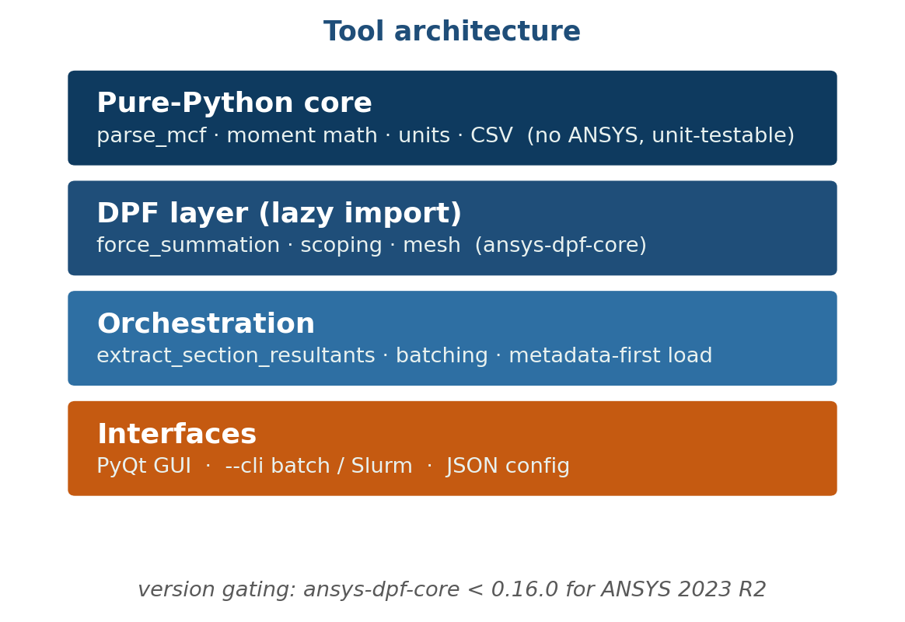
Feature — standalone tool architecture
▸ Pure-Python core (parsing, moment math, units, CSV) runs with no ANSYS and is unit-testable.
▸ Heavy deps (DPF, PyQt, PyVista) import lazily inside functions — importing the module is cheap.
▸ Metadata-first RST load, modal-set batching, and DPF version gating handle large models.
MSUP MCF + DPF Section Resultants — Methodology & Theory
14

Slide 15
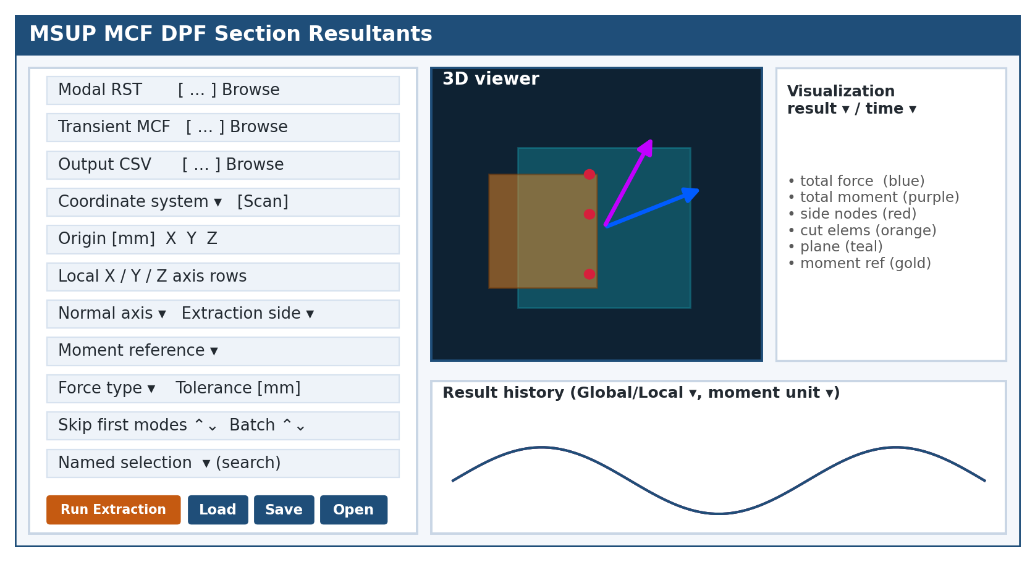
Feature — the PyQt GUI
▸ A PyQt desktop GUI: file pickers, coordinate-system dropdown + Scan, origin and local-axis rows, section combos, batch/skip spins, and a searchable named-selection box. Extraction and visualization run off the UI thread.
MSUP MCF + DPF Section Resultants — Methodology & Theory
15

Slide 16
Feature — 3D viewer and result-history plot
▸ PyVistaQt viewer — cut elements (orange), section plane (teal), side nodes (red), per-node force glyphs, total force (blue) and moment (purple) vectors, moment-reference point (gold).
▸ Matplotlib history dock — Global/Local toggle, moment-unit selector, hover read-out, and double-click a curve to jump the 3D view to that time.
▸ Right-click — export per-node forces to a styled CSV or Excel workbook.
MSUP MCF + DPF Section Resultants — Methodology & Theory
16

Slide 17
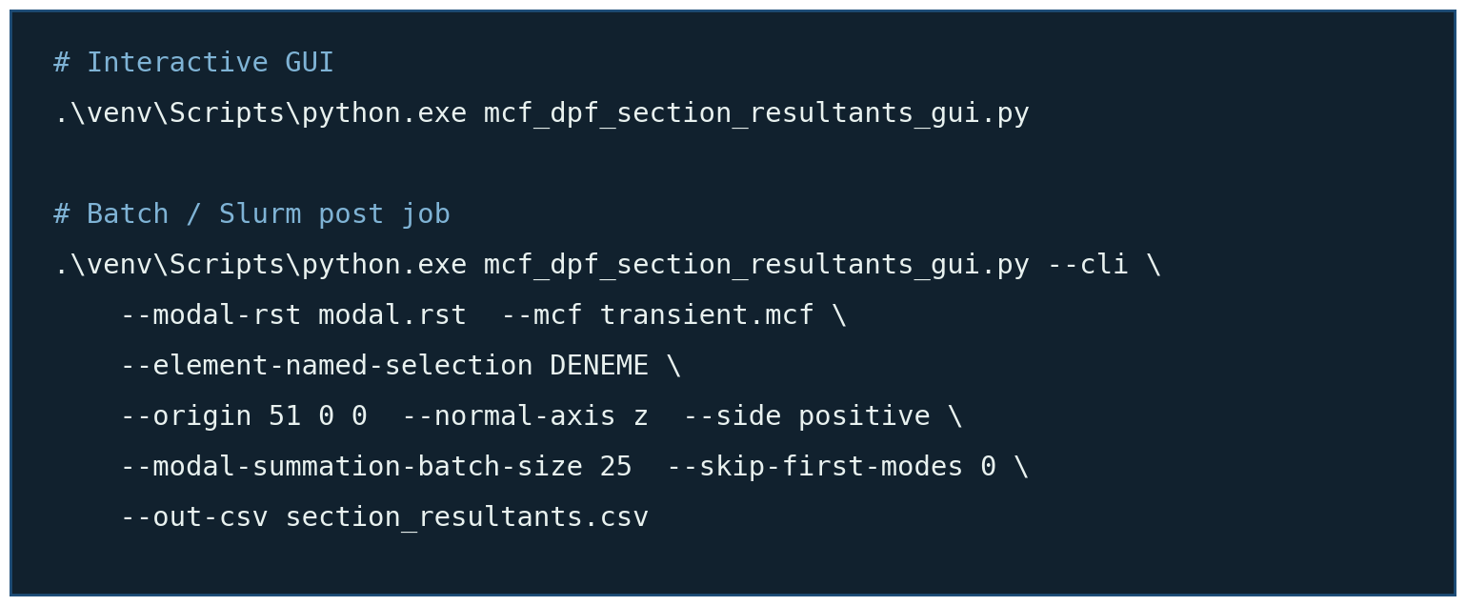
Feature — CLI / batch usage
▸ The same engine runs headless for Slurm / batch post-processing via --cli, overriding a saved JSON config.
MSUP MCF + DPF Section Resultants — Methodology & Theory
17

Slide 18
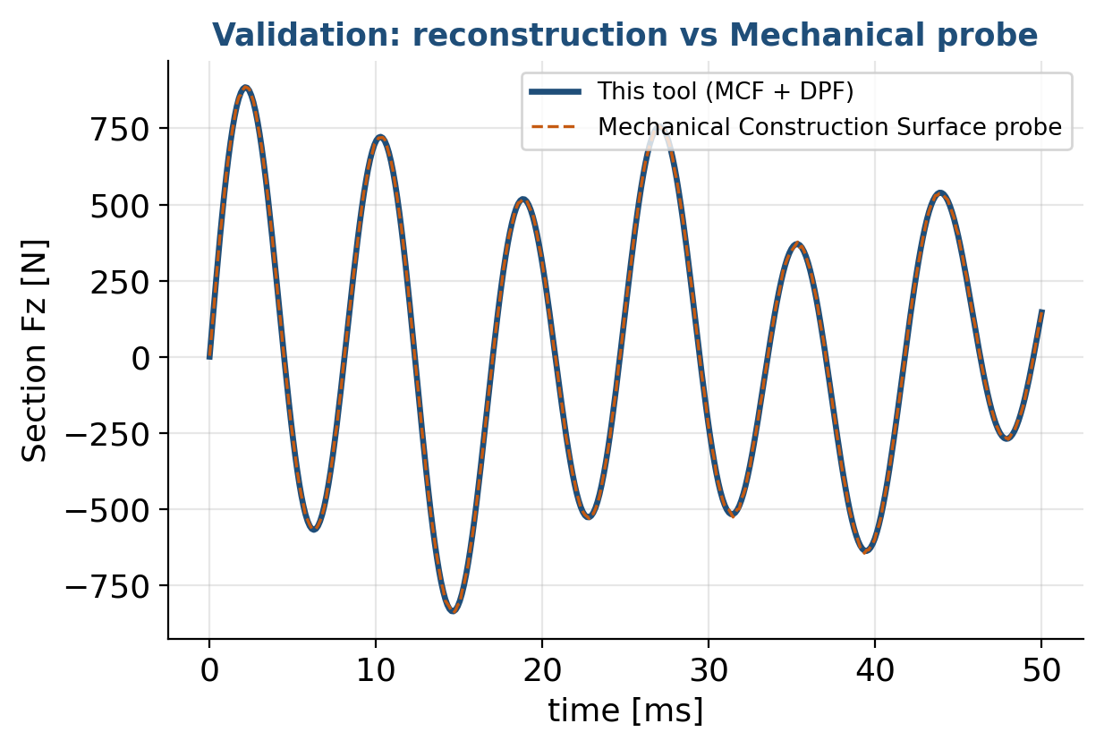
Validation — against the Mechanical probe
▸ Compare the CSV against a Mechanical Construction Surface / Surface probe with Local Coord Summation.
▸ Match the probe's centroid summation point with moment_reference_mode = mechanical_probe_mesh_centroid.
▸ Agreement is to numerical precision — same physics, a different execution path.
MSUP MCF + DPF Section Resultants — Methodology & Theory
18

Slide 19
Limitations & assumptions
▸ Linear MSUP recombination only — contact / large-deflection nonlinearity in the recombination breaks superposition.
▸ Requires OUTRES,NLOAD / NSOL and MXPAND ELCALC=YES; the damping / inertia families need that data stored.
▸ skip_first_modes must remove the same leading modes from the MCF columns and the RST modal sets.
▸ Coordinate-system axes must be orthonormal; the origin is taken in mm and converted to the mesh unit.
MSUP MCF + DPF Section Resultants — Methodology & Theory
19

Slide 20
Summary — key takeaways
▸ One compact CSV instead of a multi-gigabyte transient result file.
▸ Physically exact for a linear MSUP recombination — R(t) = Σⱼ Cⱼ qⱼ(t).
▸ force_summation runs once per mode; the transient is a cheap matrix–vector product.
▸ Standalone library + PyQt GUI + --cli batch, validated against the Mechanical Construction Surface probe.
Companion notebook: mcf_dpf_section_resultants_methodology_walkthrough.ipynb

