Slide 1
Rotor LLP Airworthiness FEA Review Showcase
Project review deck
Workspaces: 2
Generated from the open COREX project.

Slide 2
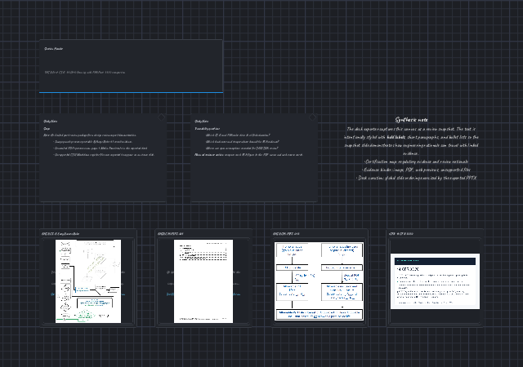
Certification Review Map - Snapshot
Workspace canvas snapshot

Slide 3
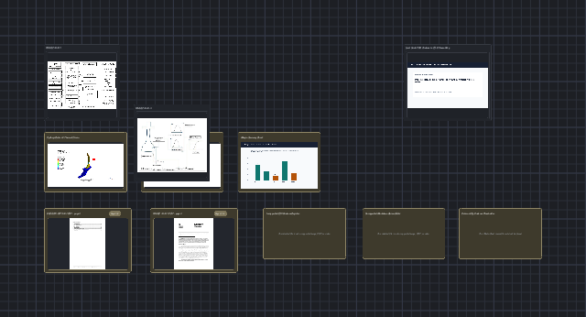
Evidence Binder - Snapshot
Workspace canvas snapshot

Slide 4
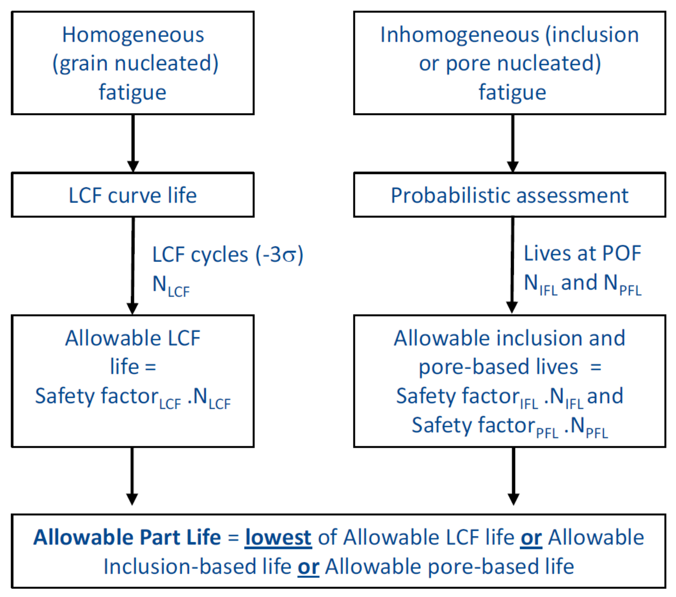
Certification Review Map / EASA CM-PIFS-013 / 03-easa-cm-pifs-013.png
Image evidence

Slide 5
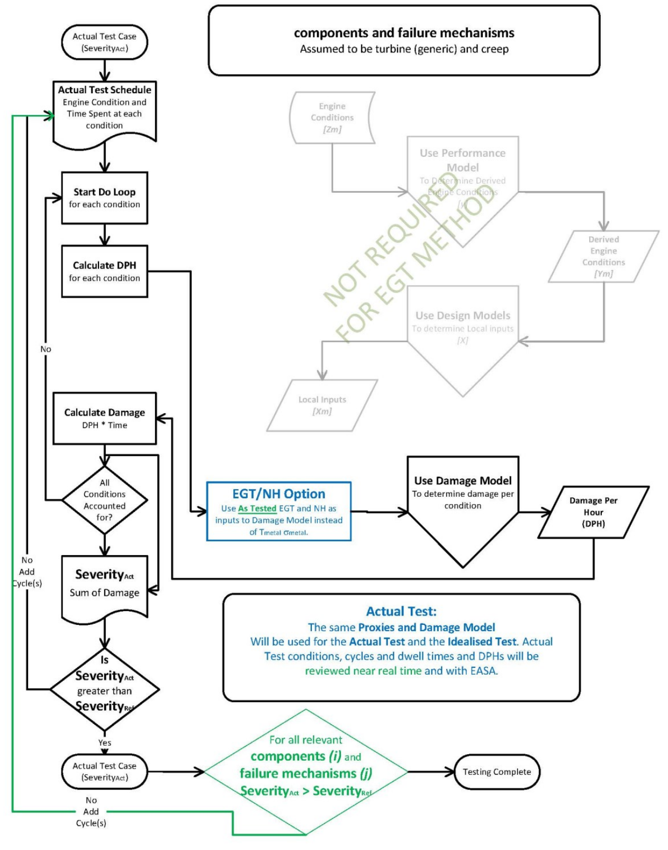
Certification Review Map / EASA CS-E Easy Access Rules / 01-easa-cs-e-easy-access-rules.png
Image evidence

Slide 6
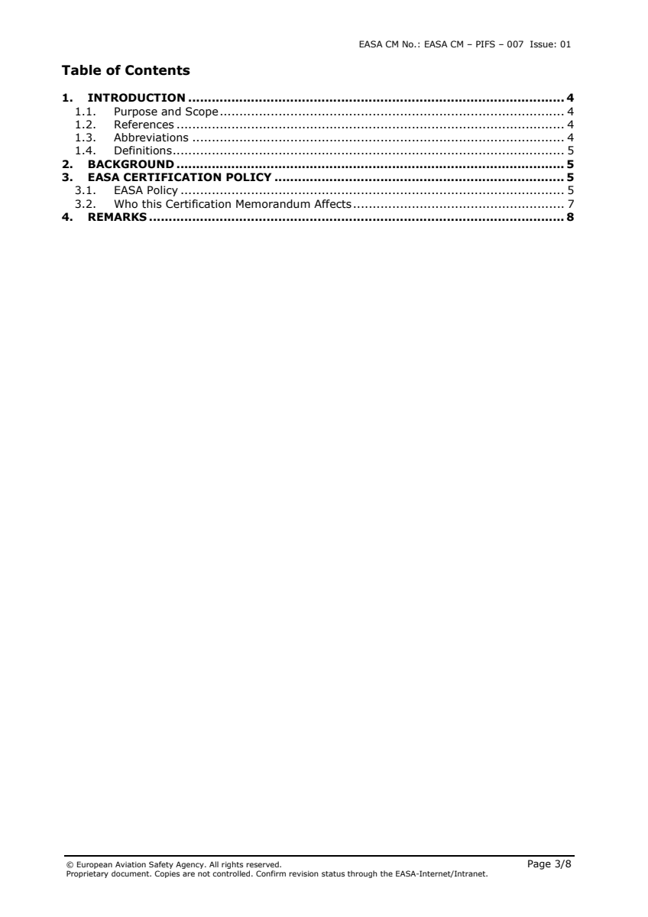
Certification Review Map / EASA CM-PIFS-007 / 02-easa-cm-pifs-007.png
Image evidence

Slide 7
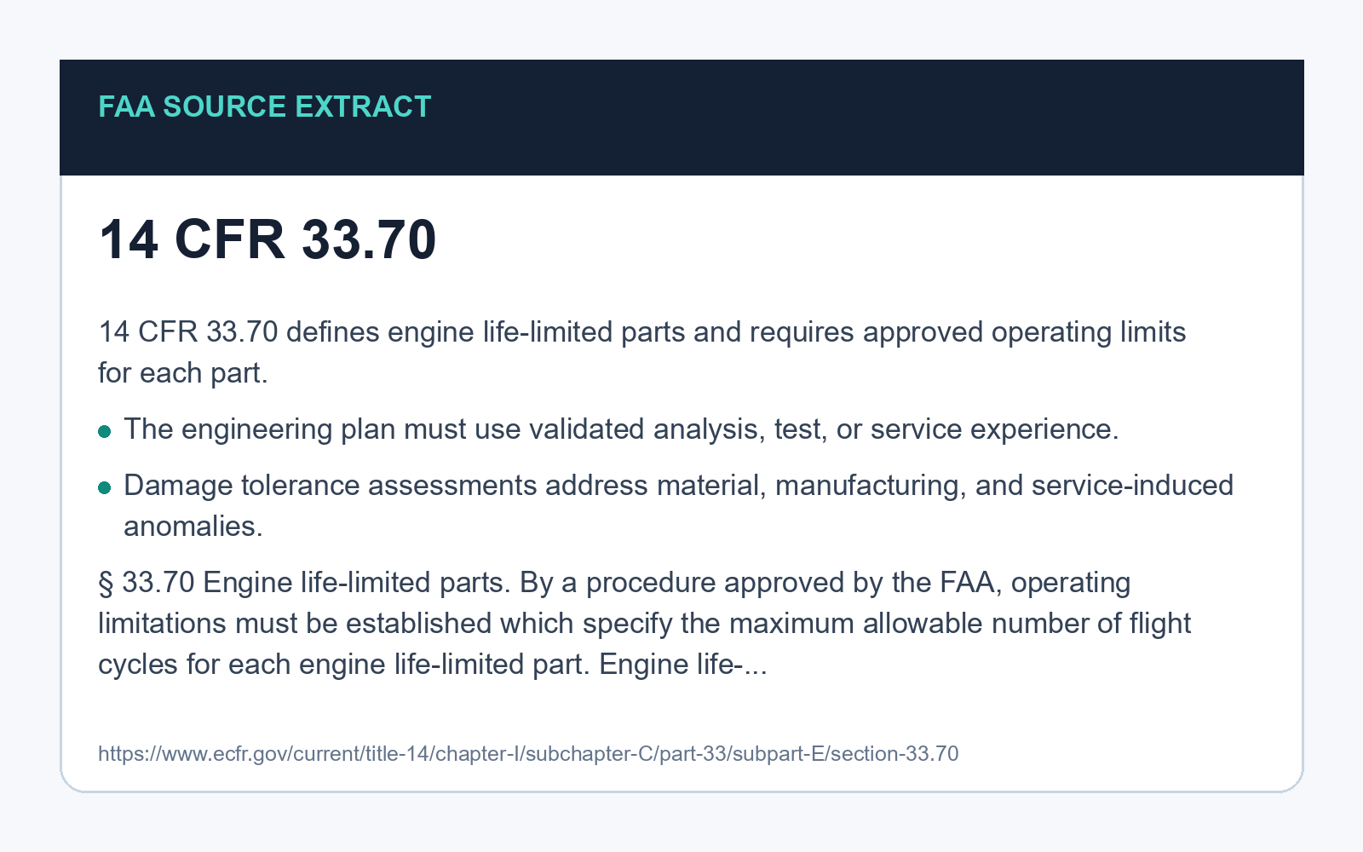
Certification Review Map / eCFR 14 CFR 33.70 / 04-ecfr-14-cfr-3370.png
Image evidence

Slide 8

Evidence Binder / EASA CM-PIFS-007 PDF - page 3 / cm-pifs-007-page-pdf-1.pdf
PDF evidence
PDF page 3 of 8

Slide 9
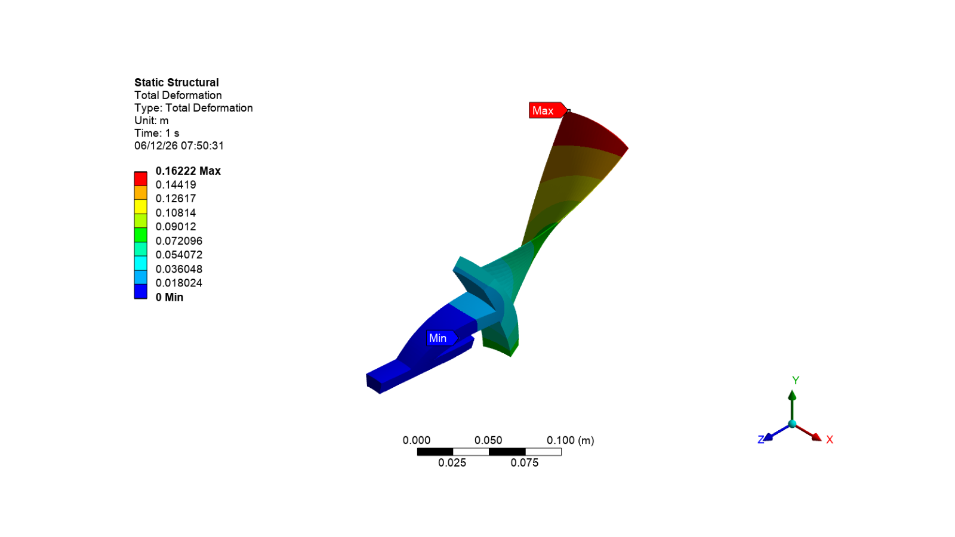
Evidence Binder / PyAnsys Rotor 67 Total Deformation / displacement-envelope.png
Image evidence

Slide 10
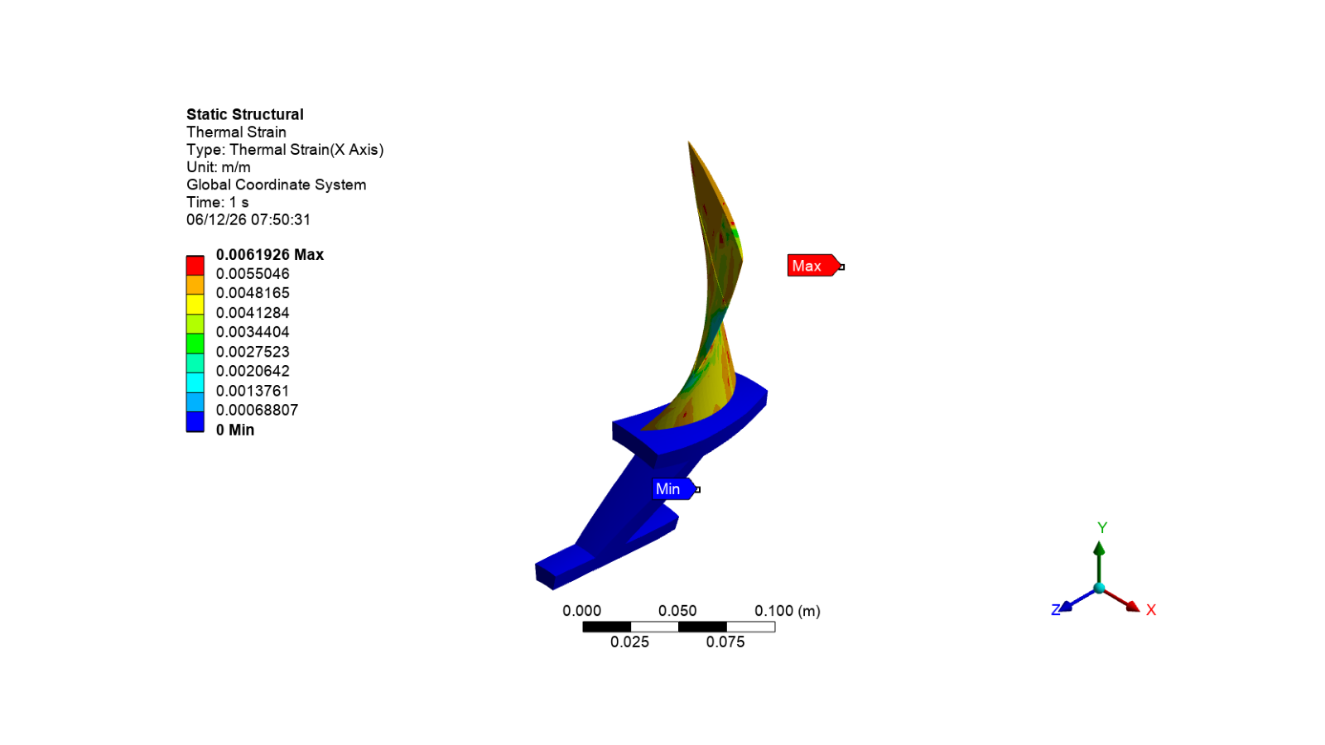
Evidence Binder / PyAnsys Rotor 67 Thermal Strain / stress-hotspot-map.png
Image evidence

Slide 11
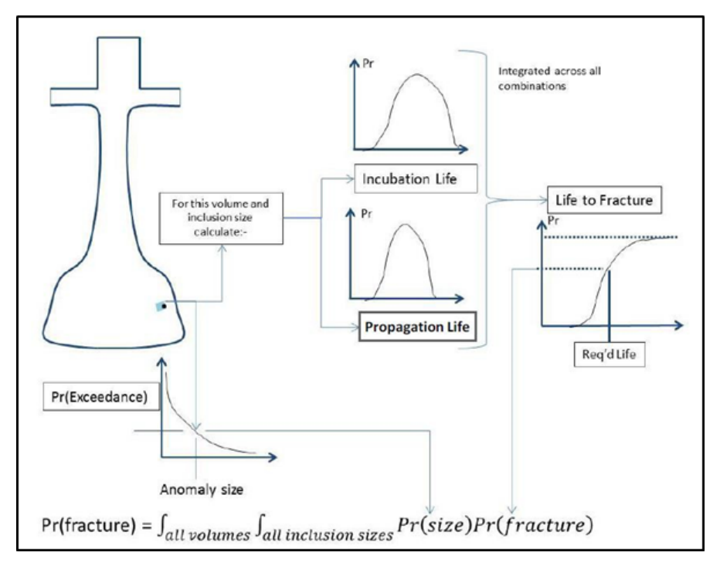
Evidence Binder / FAA AC 33.70-4 / 06-faa-ac-3370-4.png
Image evidence

Slide 12
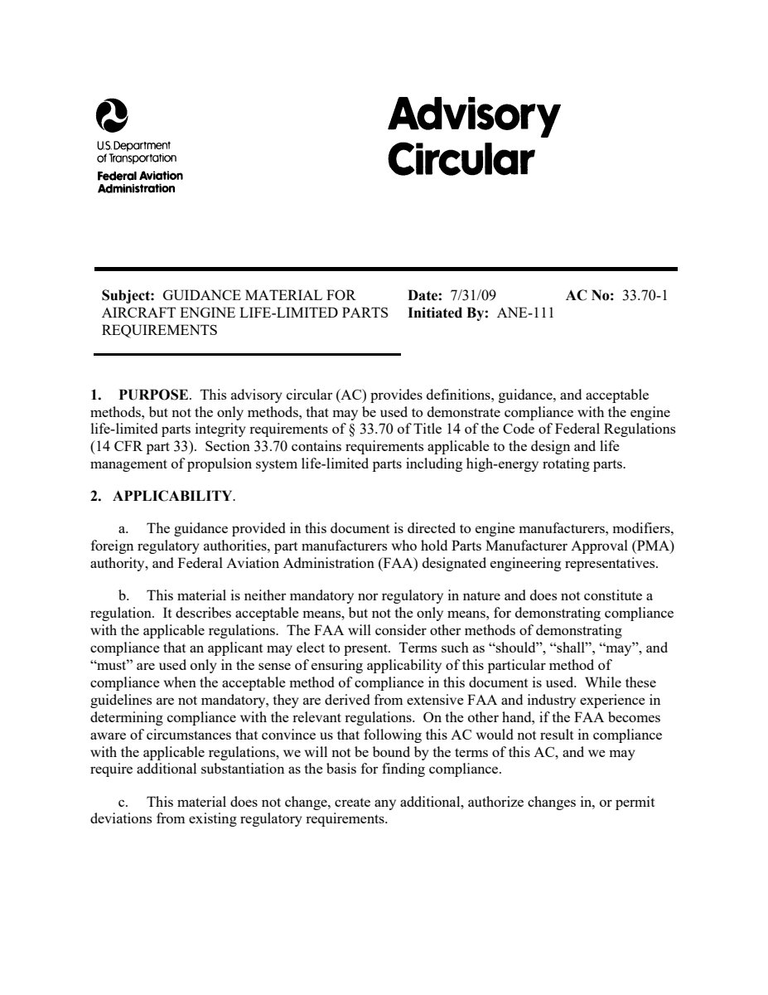
Evidence Binder / FAA AC 33.70-1 PDF - page 2 / ac-33-70-1-life-limited-parts-chg-1.pdf
PDF evidence
PDF page 2 of 25

Slide 13

Evidence Binder / Local Guide: FEA Evidence to CS-E Traceability / local-fea-traceability-guide-preview.png
Image evidence

Slide 14
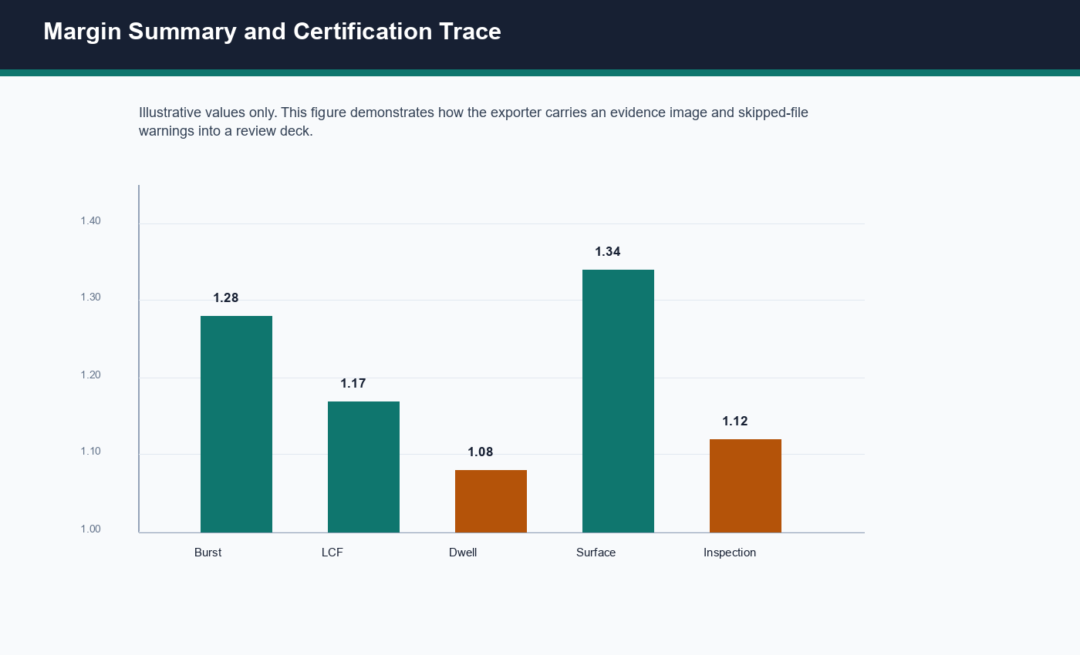
Evidence Binder / Margin Summary Chart / margin-summary-chart.png
Image evidence

Slide 15
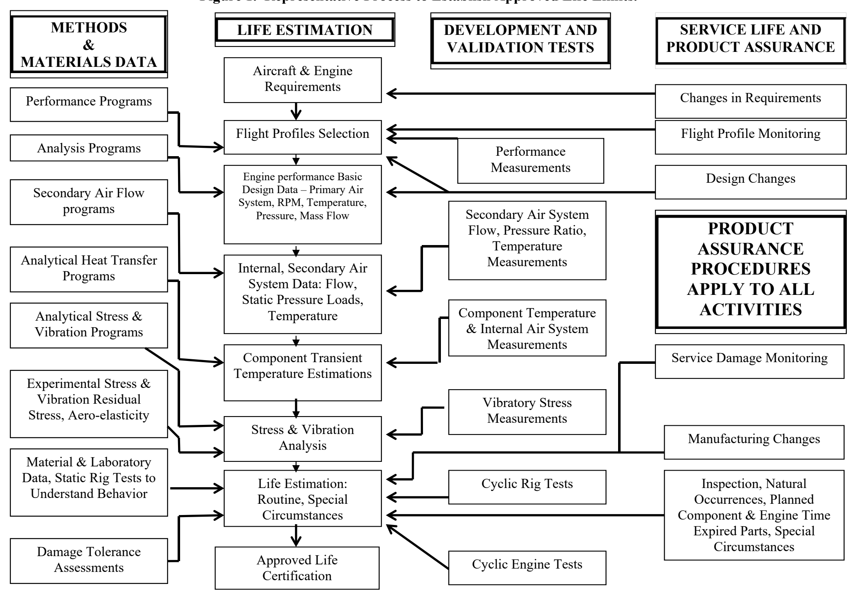
Evidence Binder / FAA AC 33.70-1 / 05-faa-ac-3370-1.png
Image evidence

Slide 16
Project Files To Review
Missing, temporary, or unsupported evidence
Evidence Binder / Unsupported CSV Evidence Register / artifact: Media Panel source is invalid. The selected file is not a supported image, PDF, or video.
Evidence Binder / Unsupported Markdown Review Notes / artifact: Media Panel source is invalid. The selected file is not a supported image, PDF, or video.
Evidence Binder / Local Guide: FEA Evidence to CS-E Traceability / fea-evidence-to-cs-e-traceability.html: unsupported evidence file type '.html'.
Evidence Binder / External Rig Evidence Placeholder / artifact: Media Panel source is stale. The Media Panel source file could not be found.

