Slide 1
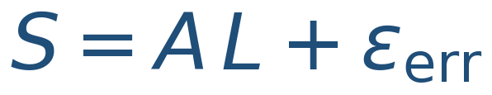
ANSYS Load Reconstruction Toolchain
Methodology & Theory — recovering applied loads from strain-gauge data
scripts/ansys_load_reconstruction · strain-gauge force identification by FE unit-load superposition

Slide 2
The problem: from strains to loads
▸ Goal: estimate the applied loads L that a part experienced, from strains S measured by a gauge network
– Forward map L → S is a cheap FE calculation
– Inverse map S → L is the hard, error-sensitive direction (force identification / inverse problem)
▸ Why it matters for turbine structures:
– recover in-service / test mission loads from instrumented hardware
– cross-check applied test loads; monitor load paths
– feed measured loads into downstream stress & life assessment
▸ The toolchain builds the forward model once, then inverts it per measured strain record
ANSYS Load Reconstruction Toolchain — Methodology & Theory
1

Slide 3
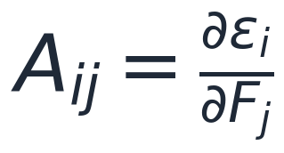
Forward model & assumptions
▸ Linear elastic superposition is the foundation:
– strain at channel i is a linear combination of the applied loads
εᵢ = Σⱼ Aᵢⱼ Lⱼ ⇔ S = A·L
▸ Valid when:
– material behaviour is linear elastic
– deformations small (linear strain–displacement)
– contacts, supports, preload, load paths are load-independent
– the real loading lies in the span of the unit-load basis
▸ If violated, least squares still returns numbers — but not physically meaningful loads
ANSYS Load Reconstruction Toolchain — Methodology & Theory
2

Slide 4
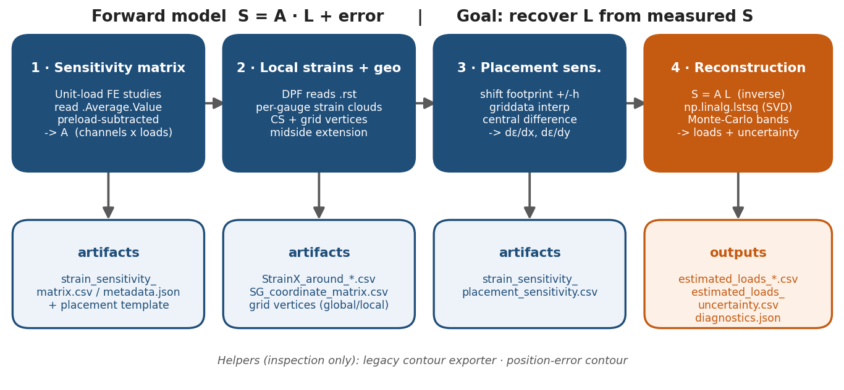
Workflow at a glance
Four production scripts (build A → export local strains → placement gradients → invert) plus two inspection helpers.
Execution pattern: Mechanical runs each button in IronPython (no NumPy), which writes a CPython worker and launches external python.exe for the array math.
ANSYS Load Reconstruction Toolchain — Methodology & Theory
3

Slide 5
Mechanical model contract
▸ Naming conventions the scripts rely on:
– Unit_Load_Study_LC_* — one analysis per unit load case (tree order = column order of A)
– StrainX_SG* — Normal Elastic Strain results, one per channel
– SG_Grid_Body_* — finite shell body modelling each gauge footprint
– CS_SG_Ch_* — per-gauge local coordinate system (measurement axis)
– NS_of_faces_of_SG_test_parts — instrumented surface
▸ Scoping & averaging:
– each StrainX_SG* scoped to its SG_Grid_Body* → .Average.Value is the finite-grid mean
– channel order identical across all analyses and the measured-strain file
do NOT double-average; do NOT use equivalent stress/strain for placement
ANSYS Load Reconstruction Toolchain — Methodology & Theory
4

Slide 6
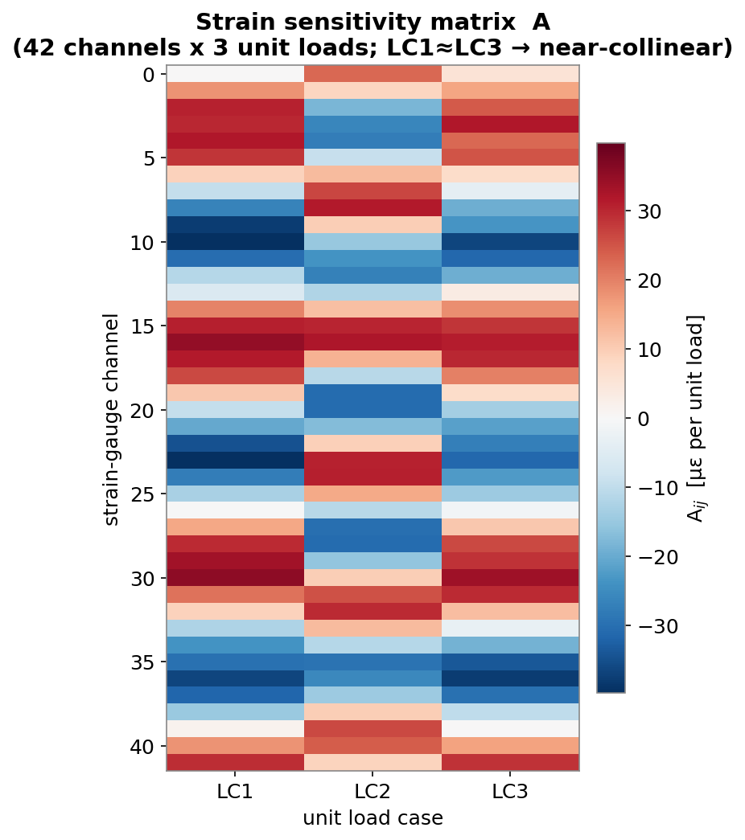
Theory — the strain sensitivity matrix A
▸ Aᵢⱼ = ∂εᵢ/∂Fⱼ : strain at channel i per unit of load j
– column j = the gauge response to unit load case j
– rows = channels, columns = load components
– benchmark shape: 42 × 3
▸ Built from unit-load FE studies, preload-subtracted
– isolates the incremental response to each unit load
▸ Near-collinear columns (similar gauge response) →
– small singular value → high condition number
ANSYS Load Reconstruction Toolchain — Methodology & Theory
5

Slide 7
Tool 1 — sensitivity matrix generator
get_strain_sensitivity_matrix_from_unit_load_cases_in_mechanical_v0.py
▸ Runs in Mechanical (IronPython) + spawned CPython
– Scans Unit_Load_Study_LC_* analyses in tree order
– Reads each StrainX_SG* .Average.Value at the unit-load step minus the preload step
– Preload subtraction → each column is the pure incremental unit-load response
▸ Outputs:
– strain_sensitivity_matrix.csv (the matrix A)
– strain_sensitivity_metadata.json (rank, singular values, condition number, scope evidence)
– strain_sensitivity_placement_sensitivity.csv (template, filled by Tool 3)
CPython worker adds the SVD diagnostics
ANSYS Load Reconstruction Toolchain — Methodology & Theory
6

Slide 8


Theory — least squares via SVD (not normal equations)
▸ Per time point, solve the overdetermined system:
– implemented as np.linalg.lstsq(A, S.T, rcond=None) — a direct SVD
▸ Why not the normal equations?
– forming AᵀA squares the condition number
– inv() is unstable for ill-conditioned / rank-deficient A
– SVD truncates negligible singular values → graceful rank handling
▸ Error inputs never change the point estimate — only the uncertainty bands
ANSYS Load Reconstruction Toolchain — Methodology & Theory
7

Slide 9
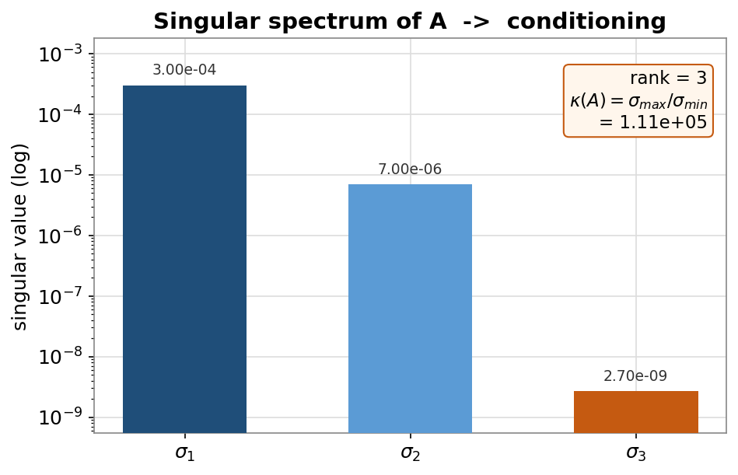
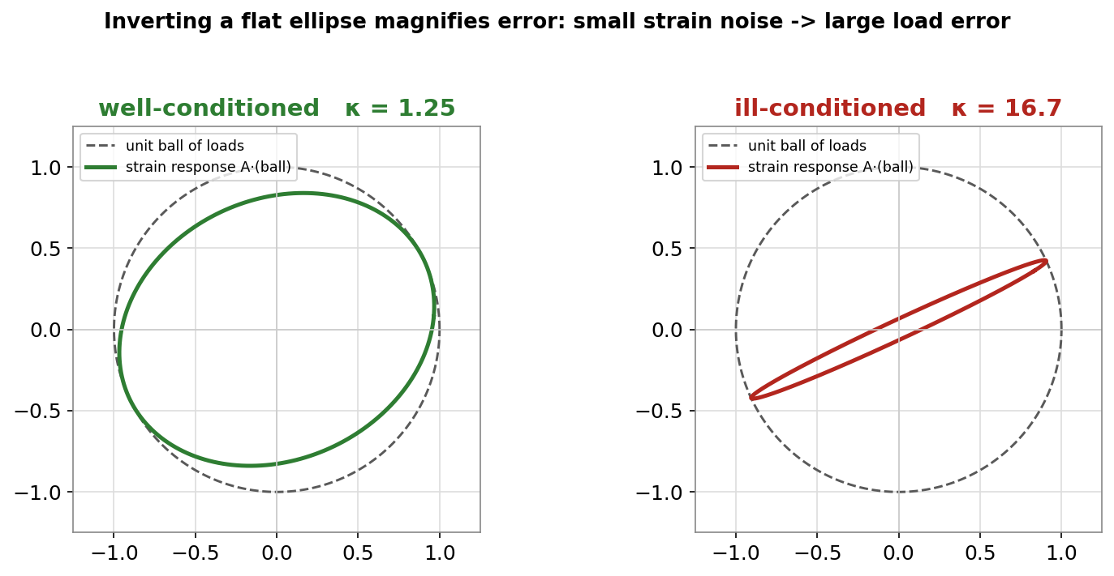
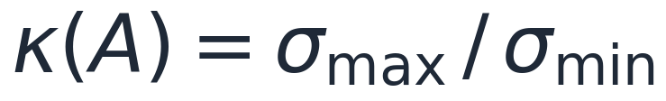
Theory — conditioning & error amplification
▸ Condition number from the singular spectrum:
– benchmark A: κ ≈ 1.11 × 10⁵
▸ Large κ ⇒ small strain error → large load error
– the load component aligned with σ_min is weakly observed
– inverting a 'flat' response ellipse magnifies noise
▸ Baseline stays plain least squares; add regularization only if validation demands it
ANSYS Load Reconstruction Toolchain — Methodology & Theory
8

Slide 10
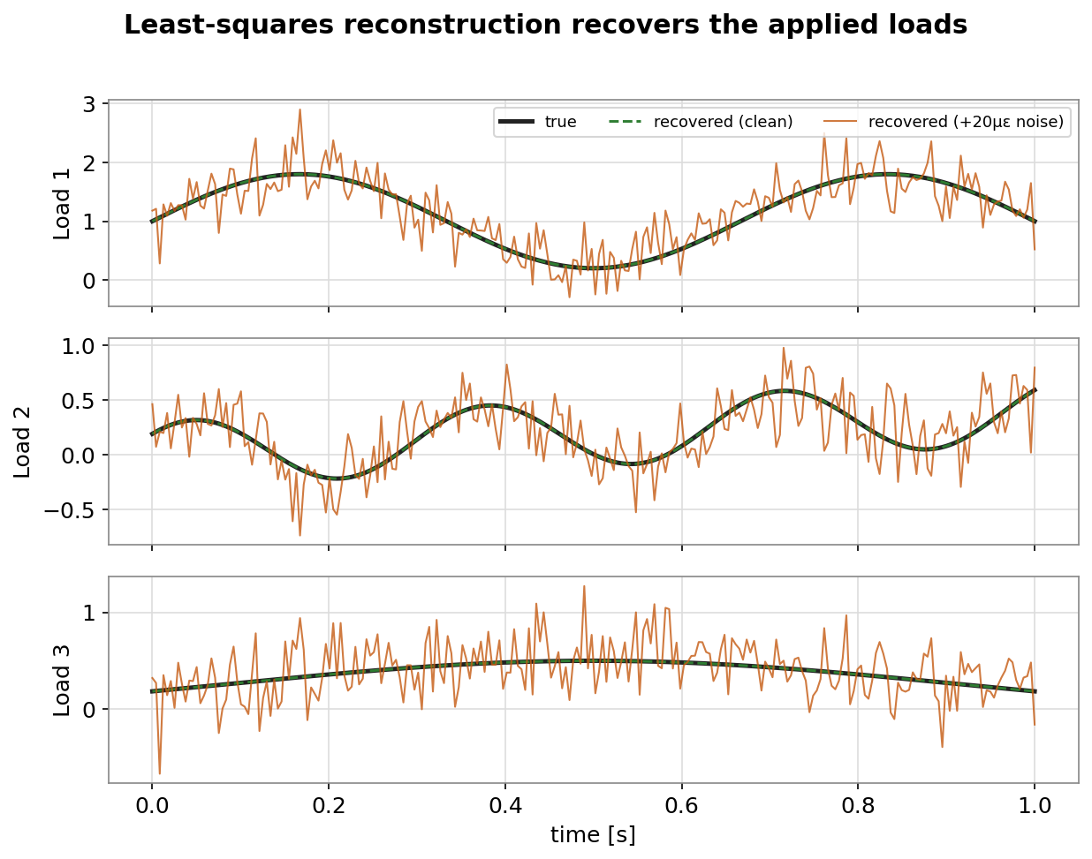
Tool 4 — load reconstruction solver
load_reconstruction_function_with_errors_weighting_function_v1.py
▸ Inputs: SG_FEA_strain_data.csv (measured) + strain_sensitivity_matrix.csv (A)
– SVD least-squares point estimate per time point
– residual RMS, rank, singular values, κ recorded
▸ Outputs:
– estimated_loads_with_errors_per_gauge_RMS.csv (point estimate)
– estimated_loads_uncertainty.csv (Mean / Std / P2.5 / P97.5)
– load_reconstruction_diagnostics.json (check this first)
– load_reconstruction_validation.csv (if known_loads.csv supplied)
ANSYS Load Reconstruction Toolchain — Methodology & Theory
9

Slide 11
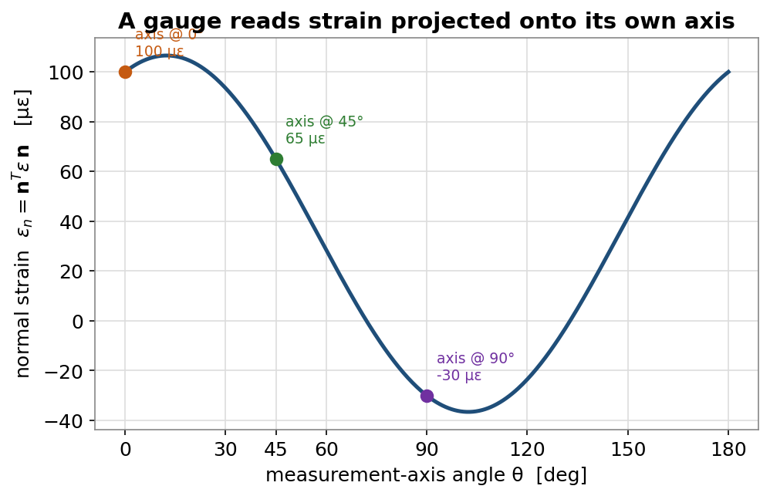
Theory — local strain measurement
▸ A gauge reads the normal strain along its own axis n:
– εₙ = nᵀ ε n (tensor contraction)
– per-channel local CS defines the measurement direction
▸ Same strain state reads differently per orientation
– 0° / 45° / 90° → 100 / 65 / −30 µε (example)
▸ This projection is local_x_normal_strain() in the exporter
ANSYS Load Reconstruction Toolchain — Methodology & Theory
10

Slide 12
Tool 2 — DPF local strain + geometry exporter
get_local_strains_and_SG_geo_data_around_each_SG_grid_dpf.py (preferred)
▸ Exports, per gauge channel:
– local strain cloud within a radius (StrainX_around_*.csv)
– local coordinate systems (SG_coordinate_matrix.csv)
– SG_Grid_Body_* vertices, global and in local frame
▸ DPF reads the .rst directly — no temporary tree objects
– midside (parabolic) nodes filled via extend_to_mid_nodes_fc
– batch via SG_LOCAL_DPF_* env vars; writes diagnostics JSON
Legacy contour exporter (...grid.py) kept for Mechanical-native inspection
ANSYS Load Reconstruction Toolchain — Methodology & Theory
11

Slide 13
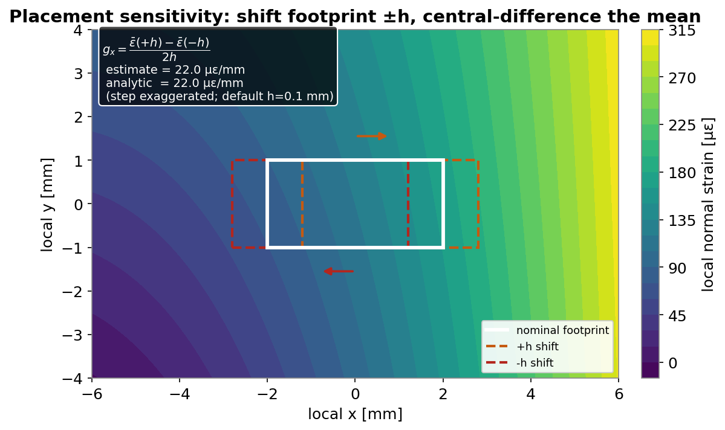
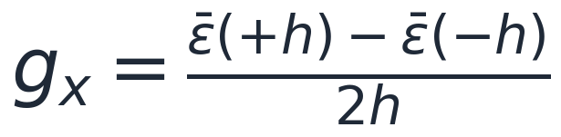
Theory — placement sensitivity
▸ A finite-size gauge can only be bonded to finite accuracy
– shifting the footprint changes the averaged strain
– Δε ≈ (∂ε/∂x)·dx + (∂ε/∂y)·dy
▸ Compute the spatial gradient of the footprint-averaged strain:
– interpolate the cloud (scipy.griddata, linear + nearest fill)
– rigidly shift the footprint ±h and central-difference the mean
h = 0.1 mm is a derivative step, not the placement uncertainty
ANSYS Load Reconstruction Toolchain — Methodology & Theory
12

Slide 14
Tool 3 — placement sensitivity calculator
calculate_placement_sensitivity_from_local_strains.py
▸ IronPython button + spawned CPython worker (NumPy/SciPy)
– Rotates each exported cloud into its CS_SG_Ch_* frame
– Interpolates strain onto the footprint grid; shifts ±h in local x, y
– Central-differences the footprint-averaged strain
▸ Output: strain_sensitivity_placement_sensitivity.csv
– d_epsilon_d_x_per_mm, d_epsilon_d_y_per_mm, gradient_norm_per_mm
– per (channel, load case); feeds the positioning term of Tool 4
Least-squares-plane fallback if SciPy interpolation is unavailable
ANSYS Load Reconstruction Toolchain — Methodology & Theory
13

Slide 15
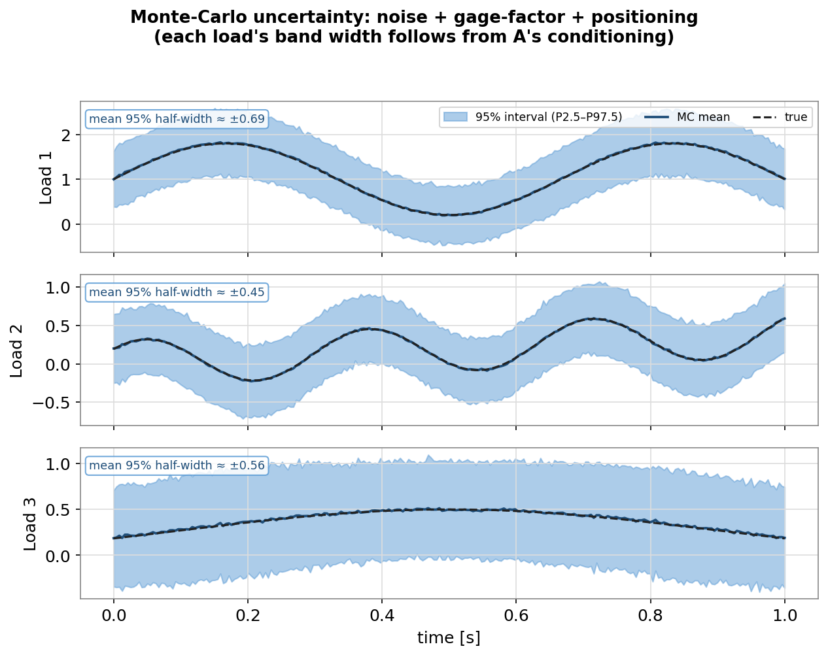
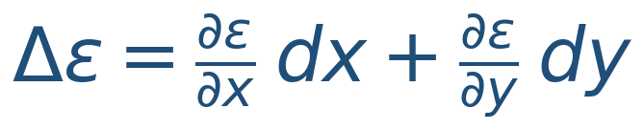
Theory — uncertainty propagation (Monte Carlo)
▸ Point estimate is pure least squares; errors drive the bands only
▸ Three error sources, perturb measured strain & re-solve (1000×):
– additive signal noise: ε* = ε + N(0, σ²) per (time, channel)
– gage factor: ε* = ε·(1+N(0,σ²)) systematic per channel, held over time
– positioning: Δε = ∂ε/∂x·dx + ∂ε/∂y·dy, gradient-driven
▸ Positioning gradient is load-weighted: dstrain_dx = L_hat @ gx.T
– → position error scales with how hard the part is driven
▸ Reported per load: Mean, Std, P2.5, P97.5
ANSYS Load Reconstruction Toolchain — Methodology & Theory
14

Slide 16
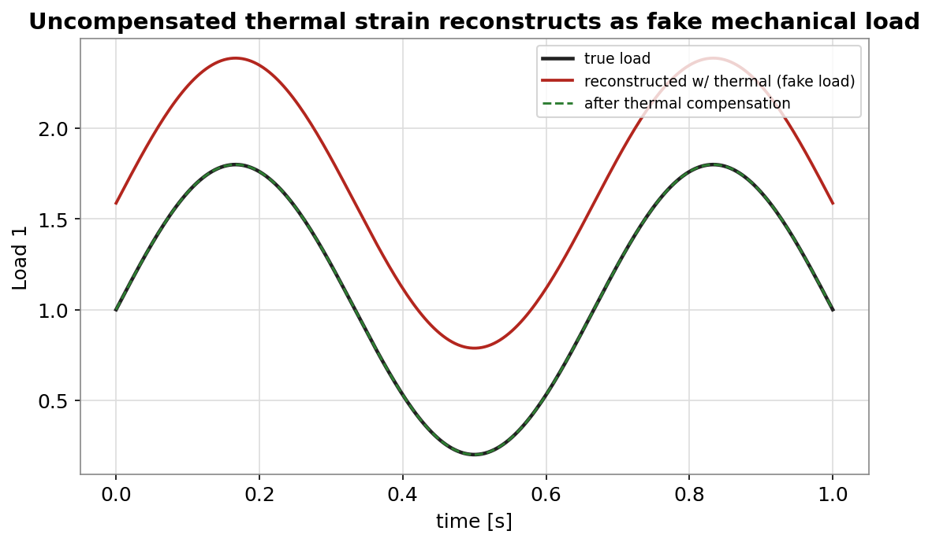
Theory — thermal / apparent strain (the silent trap)
▸ The solver only knows S = A·L
– a load-independent thermal/apparent strain present in S …
– … is projected onto the load basis and reported as FAKE load
▸ Mitigation:
– supply SG_thermal_apparent_strain_data.csv (subtracted before solving)
– diagnostics warn if Isothermal Heating exists and no file is given
Always relevant for thermally-loaded turbine hardware
ANSYS Load Reconstruction Toolchain — Methodology & Theory
15

Slide 17
Helper — position error contour (inspection only)
get_position_error_contour_v0.3.py
▸ For each reference gauge (CS_SG_Ch_*_2):
– find the nearest mesh node to the reference position
– map the field difference to neighbours within a user radius
▸ Outputs SG_positioning_errors.csv + an in-Mechanical CSV-Plot contour
– Use it to visualise where placement error hurts most
▸ NOT the source of reconstruction placement sensitivity
– it does not shift each finite footprint in the channel's local frame — that is Tool 3
ANSYS Load Reconstruction Toolchain — Methodology & Theory
16

Slide 18
Benchmark evidence
Benchmark project: load_reconstruction_v0.wbpj, system 'Arbitrary Loads with Isothermal Heating'
▸ Model:
– 42 SG_Grid_Body_* shell/sheet bodies (CAERep: GeometryType=Sheet, ModelType=Shell)
– gauge grid bounding-box diagonal ≈ 4.7 mm
▸ Sensitivity matrix:
– A is 42 × 3, full rank 3
– condition number κ ≈ 1.11 × 10⁵
▸ Solver:
– upgraded SVD OLS point estimate matches the legacy output to roundoff
ANSYS Load Reconstruction Toolchain — Methodology & Theory
17

Slide 19
Diagnostics & trust checklist
▸ Check load_reconstruction_diagnostics.json first. Before trusting loads:
– diagnostics JSON exists; normal_equations_used = false
– rank equals the number of load columns
– condition_number is acceptable for the application
– metadata_confirms_shell_channel_average = true (when metadata present)
– no channel-order warning
– thermal compensation supplied if thermal loading exists
– placement derivatives are numeric (not 'not_computed') if positioning matters
– known_loads.csv validation error acceptable, where available
ANSYS Load Reconstruction Toolchain — Methodology & Theory
18

Slide 20
Limitations
▸ The method does NOT automatically handle:
– nonlinear material, geometry, or contact behaviour (breaks S = A·L)
– loading outside the span of the unit-load basis
– FE model error baked into A
– transverse-sensitivity correction of the gauges
– physical calibration against known loads
– regularization-parameter selection
– missing or incorrect gauge scoping
▸ Treat reconstructed loads as engineering estimates — validate whenever possible
ANSYS Load Reconstruction Toolchain — Methodology & Theory
19

Slide 21
Summary — key takeaways
S = A·L solved by SVD least squares is a clean, defensible baseline estimator.
Build A once from preload-subtracted unit-load FE studies; .Average.Value gives finite-grid strain.
Accuracy is governed by basis span, conditioning of A (benchmark κ ≈ 1.1×10⁵), and honest error accounting.
Uncertainty = Monte Carlo over signal noise, gage factor, and gradient-driven positioning — never the point estimate.
Thermal/apparent strain must be compensated or it reconstructs as fake load.
DPF extraction is the preferred (fast, batch) path; the IronPython→CPython pattern runs the heavy math.
Always check load_reconstruction_diagnostics.json and validate against known loads when you can.
Companion notebook: load_reconstruction_methodology_walkthrough.ipynb · Guide: LOAD_RECONSTRUCTION_USER_GUIDE.md

