Slide 1
Thermal Correction of Strain-Gauge Test Data
Recovering mechanical strain for FE validation — BAB350 (STC 16, copper) on a titanium part
Goal: validate engine-test strain gauges against an FE model's elastic strain.
Problem: a heated gauge reads thermal output (apparent strain) even with no load.
Method: subtract apparent(T), rescale for gauge-factor drift, then overlay vs FE.
Key risk resolved: the manufacturer curve is the copper STC reference → mismatch term ON.
COREX · Strain-Gauge Thermal Correction · BAB350 (STC 16, copper) on titanium

Slide 2
The problem — raw strain ≠ mechanical strain
Measured = mechanical strain (what FE predicts) + thermal output (apparent strain).
Apparent strain comes from grid resistance drift + differential grid/substrate expansion.
On titanium it can reach ~1000 µε — larger than the strains being validated.
FE gives elastic (mechanical) strain only, so the apparent part must be removed first.
COREX · Strain-Gauge Thermal Correction · BAB350 (STC 16, copper) on titanium

Slide 3
Governing equation
COREX · Strain-Gauge Thermal Correction · BAB350 (STC 16, copper) on titanium

Slide 4
Self-temperature compensation (the “(16)”)
STC number = substrate α the gauge is tuned to null thermal output on.
“(16)” → self-compensated for α ≈ 16 ppm/°C (copper); near-flat curve on copper.
A curve from the gauge maker is that copper-reference curve — NOT your titanium part.
So on titanium the gauge is uncompensated and a large mismatch term appears.
COREX · Strain-Gauge Thermal Correction · BAB350 (STC 16, copper) on titanium

Slide 5
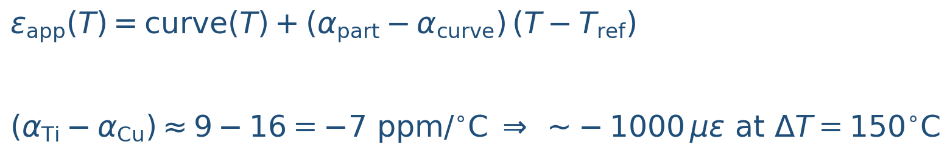
Substrate α-mismatch term
COREX · Strain-Gauge Thermal Correction · BAB350 (STC 16, copper) on titanium

Slide 6
Gauge-factor variation with temperature
COREX · Strain-Gauge Thermal Correction · BAB350 (STC 16, copper) on titanium

Slide 7
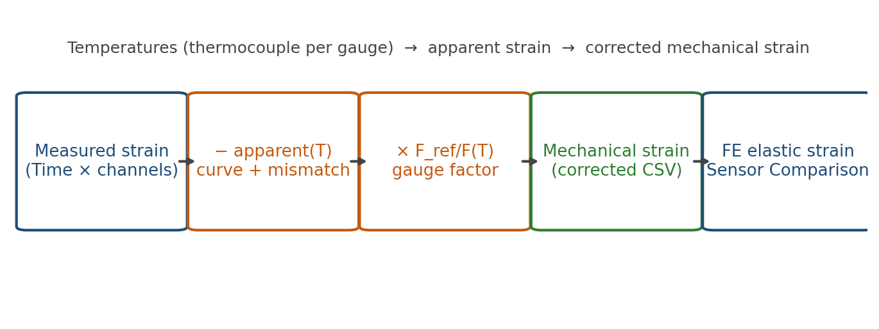
Workflow — from measured strain to FE overlay
COREX · Strain-Gauge Thermal Correction · BAB350 (STC 16, copper) on titanium

Slide 8
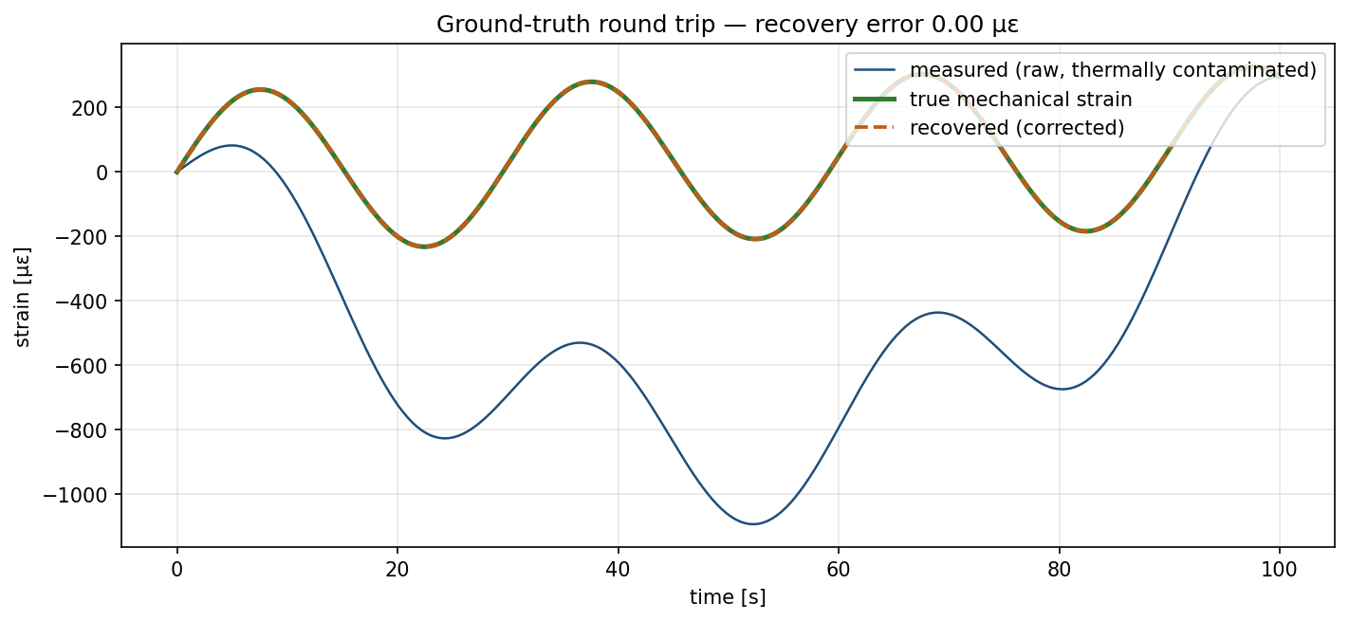
Worked example — recovered ≈ ground truth
COREX · Strain-Gauge Thermal Correction · BAB350 (STC 16, copper) on titanium

Slide 9
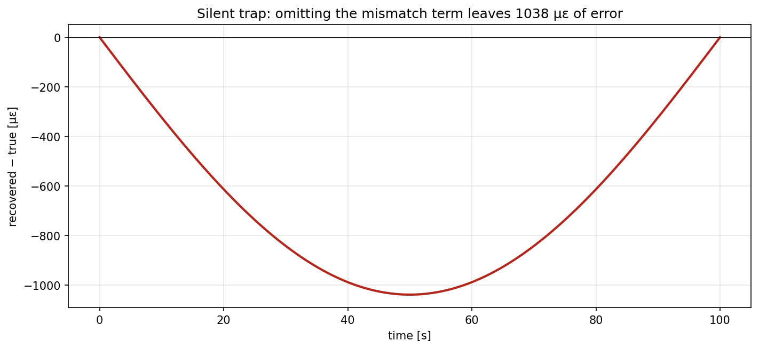
The silent trap — omitting the mismatch term
COREX · Strain-Gauge Thermal Correction · BAB350 (STC 16, copper) on titanium

Slide 10
Diagnostics, assumptions & what to confirm
Every run emits diagnostics JSON: fit R²/coeffs, α's, units, per-channel max |apparent|.
Confirm with the gauge maker: curve substrate, exact α_curve, and curve reference temperature.
Use α(T) for the specific Ti alloy; set output units to match SG_FEA_strain_data.csv.
Compare against FE elastic strain projected onto the gauge axis, not total strain.
COREX · Strain-Gauge Thermal Correction · BAB350 (STC 16, copper) on titanium

