Slide 1
Rotor LLP Airworthiness FEA Review Showcase
Project review deck
Workspaces: 3
Generated from the open COREX project.

Slide 2
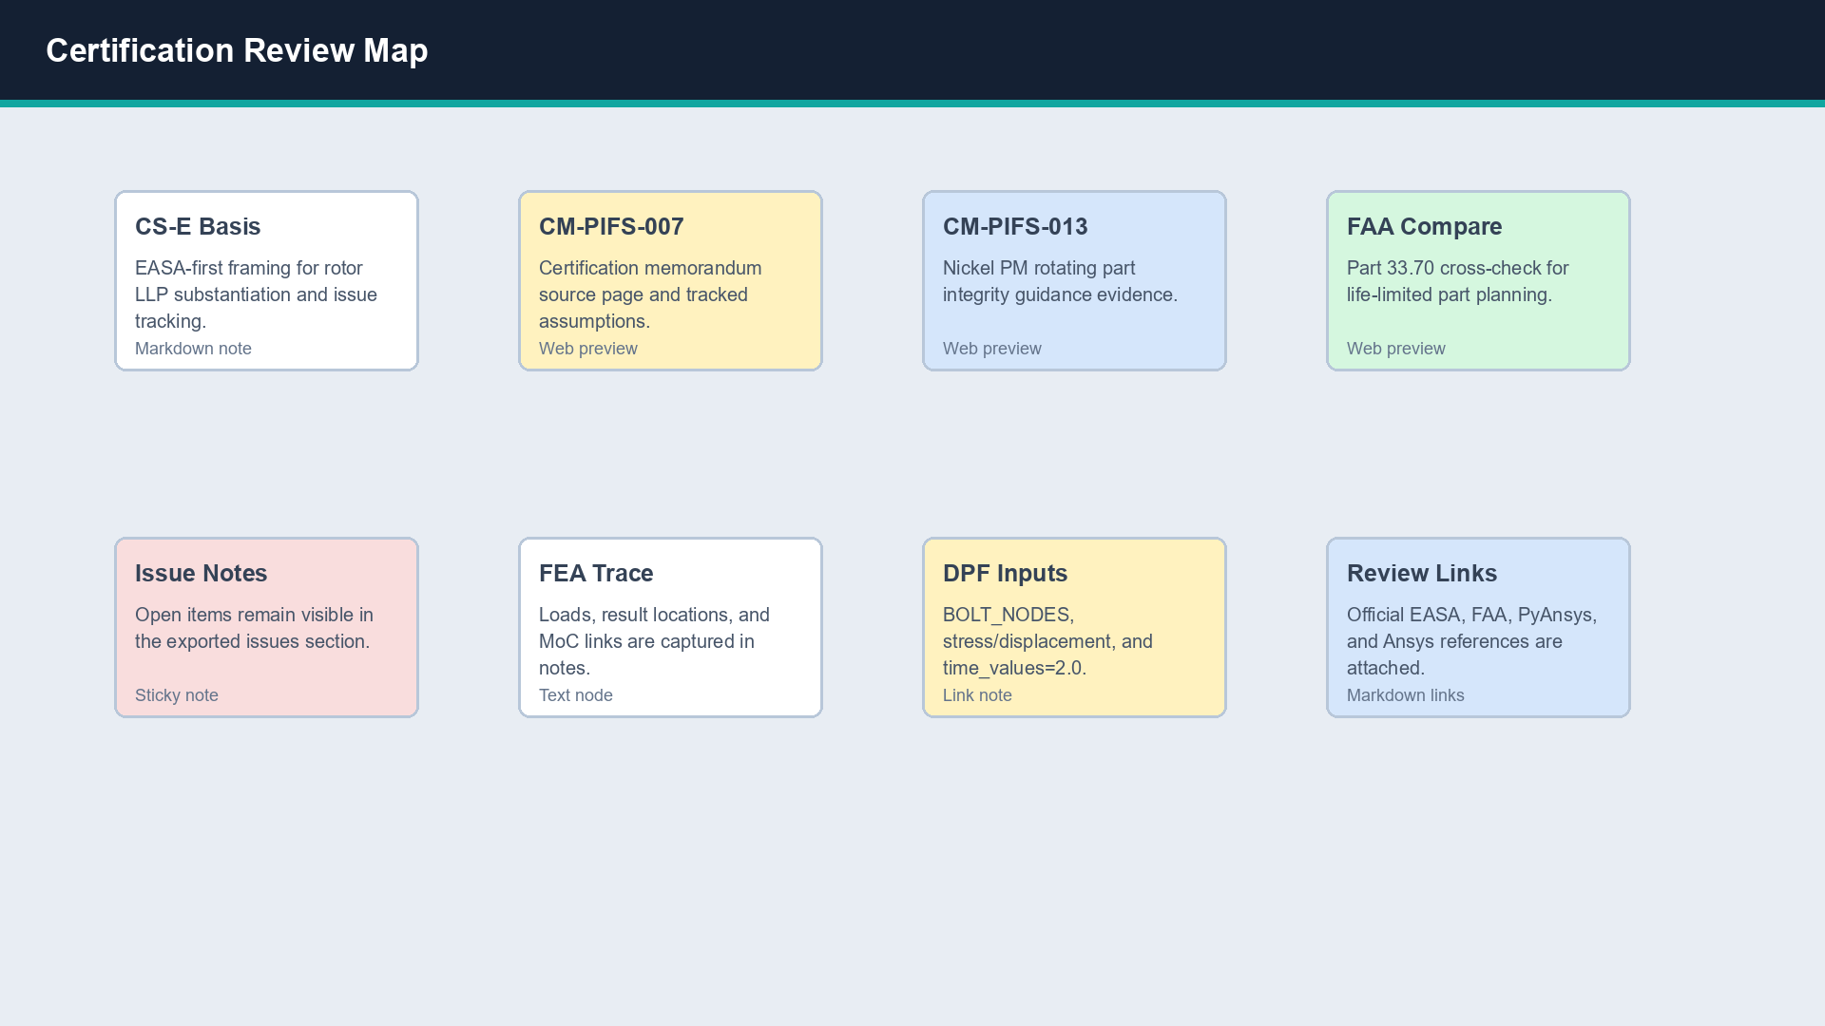
Certification Review Map - Certification Review Map
Workspace canvas snapshot

Slide 3
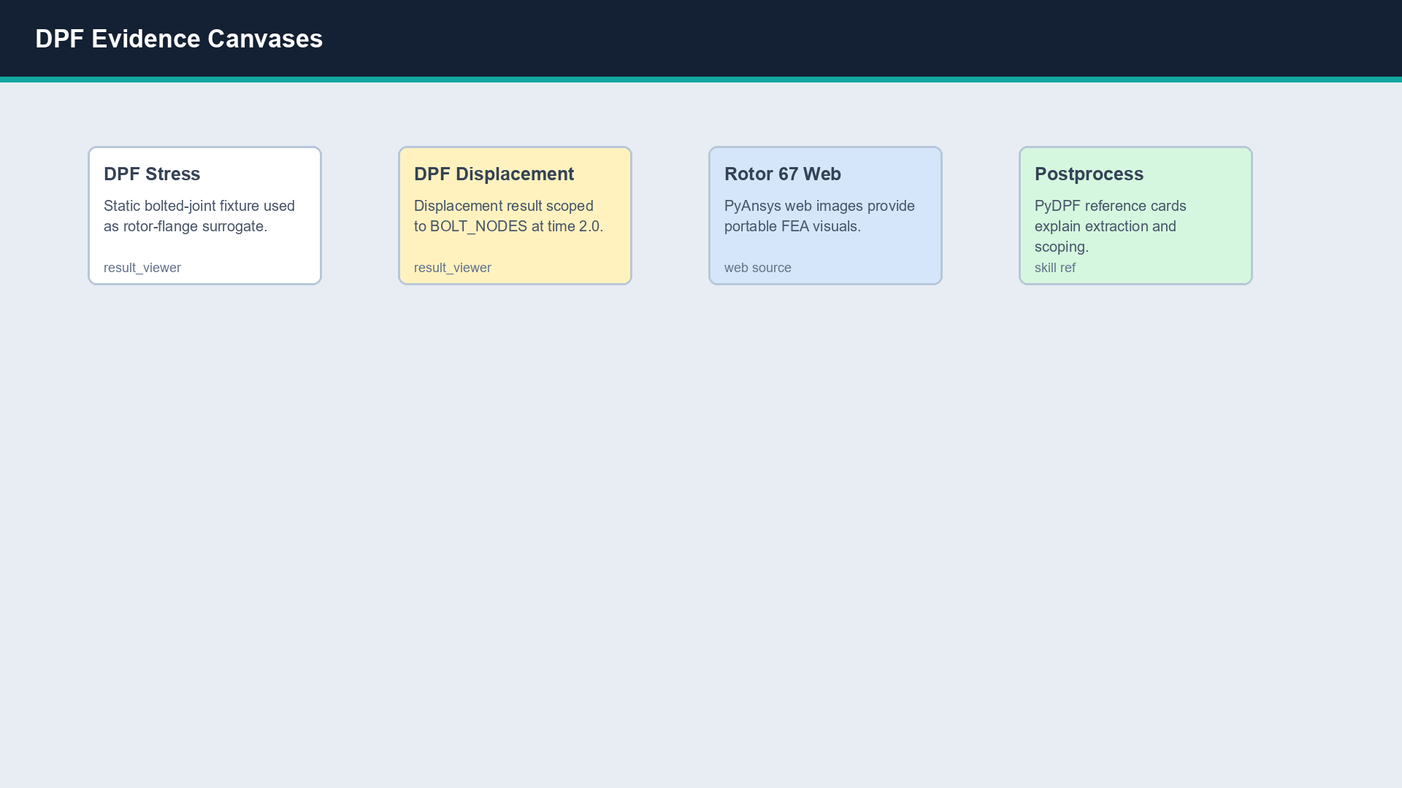
DPF Evidence Canvases - DPF Evidence Canvases
Workspace canvas snapshot

Slide 4
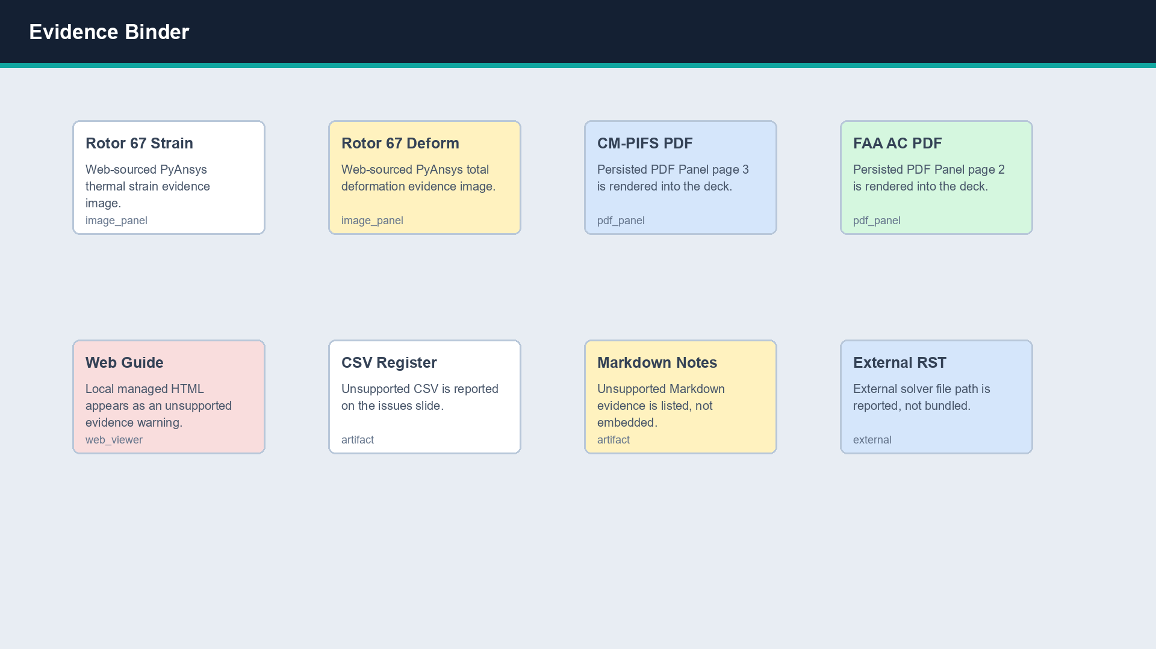
Evidence Binder - Evidence Binder
Workspace canvas snapshot

Slide 5
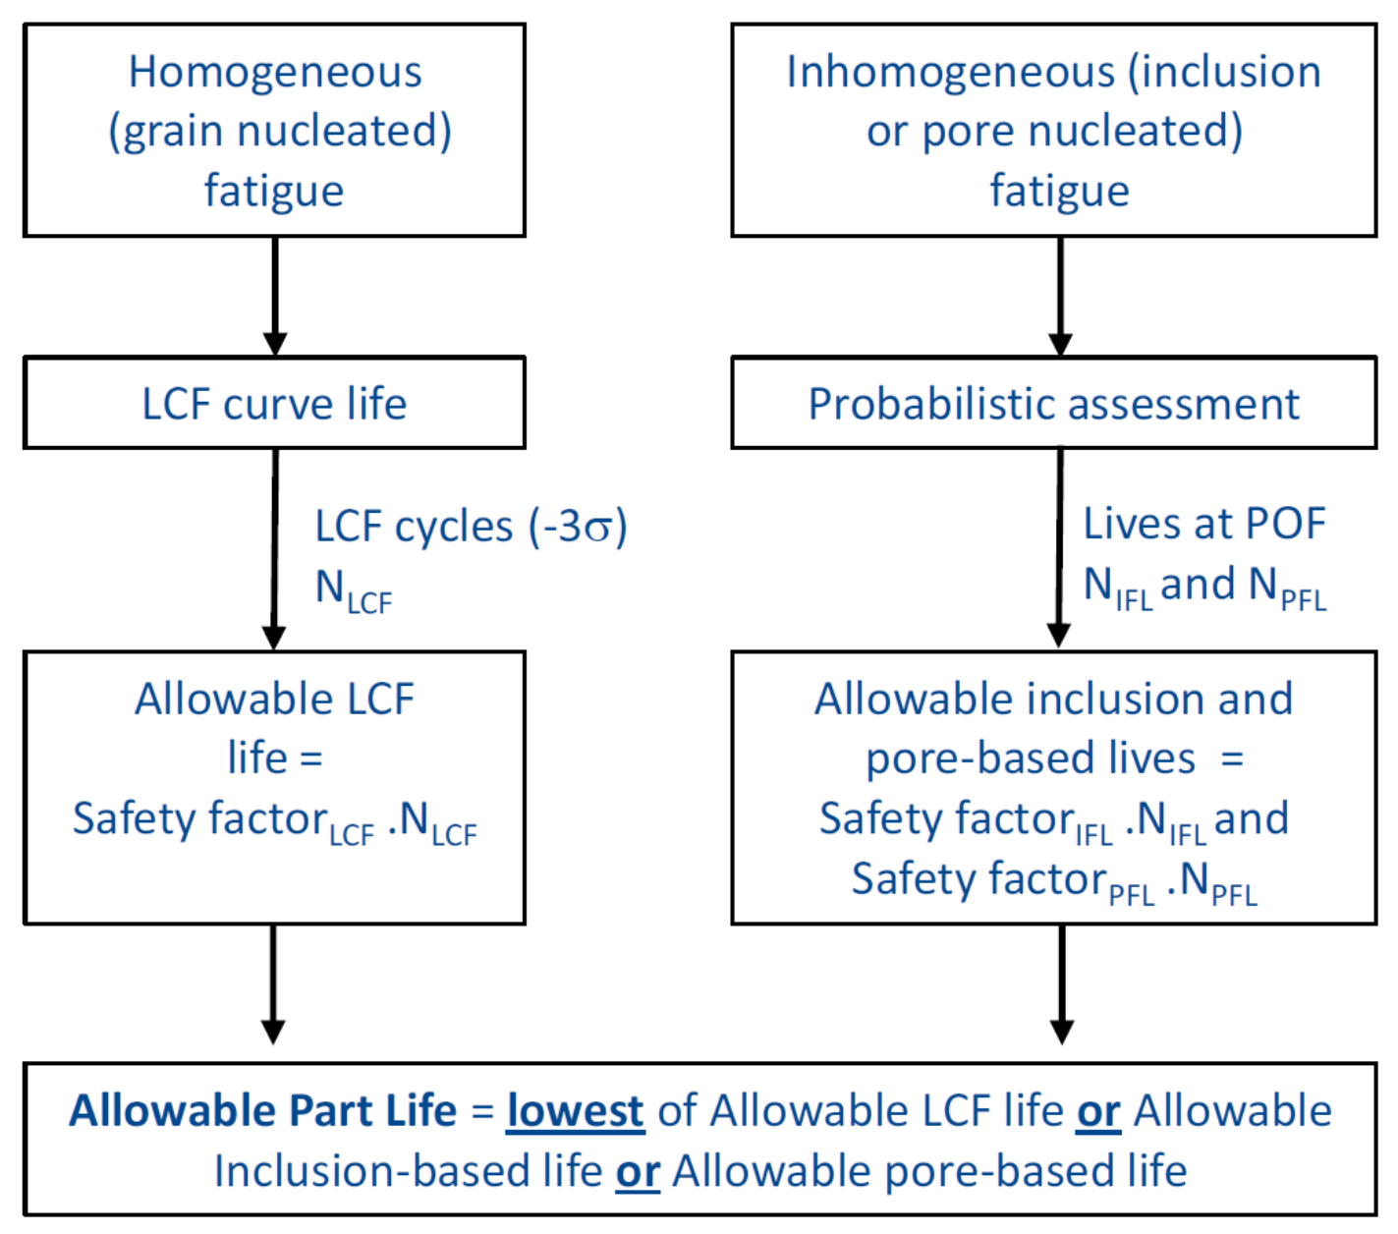
Certification Review Map / EASA CM-PIFS-013 / 03-easa-cm-pifs-013.png
Image evidence

Slide 6
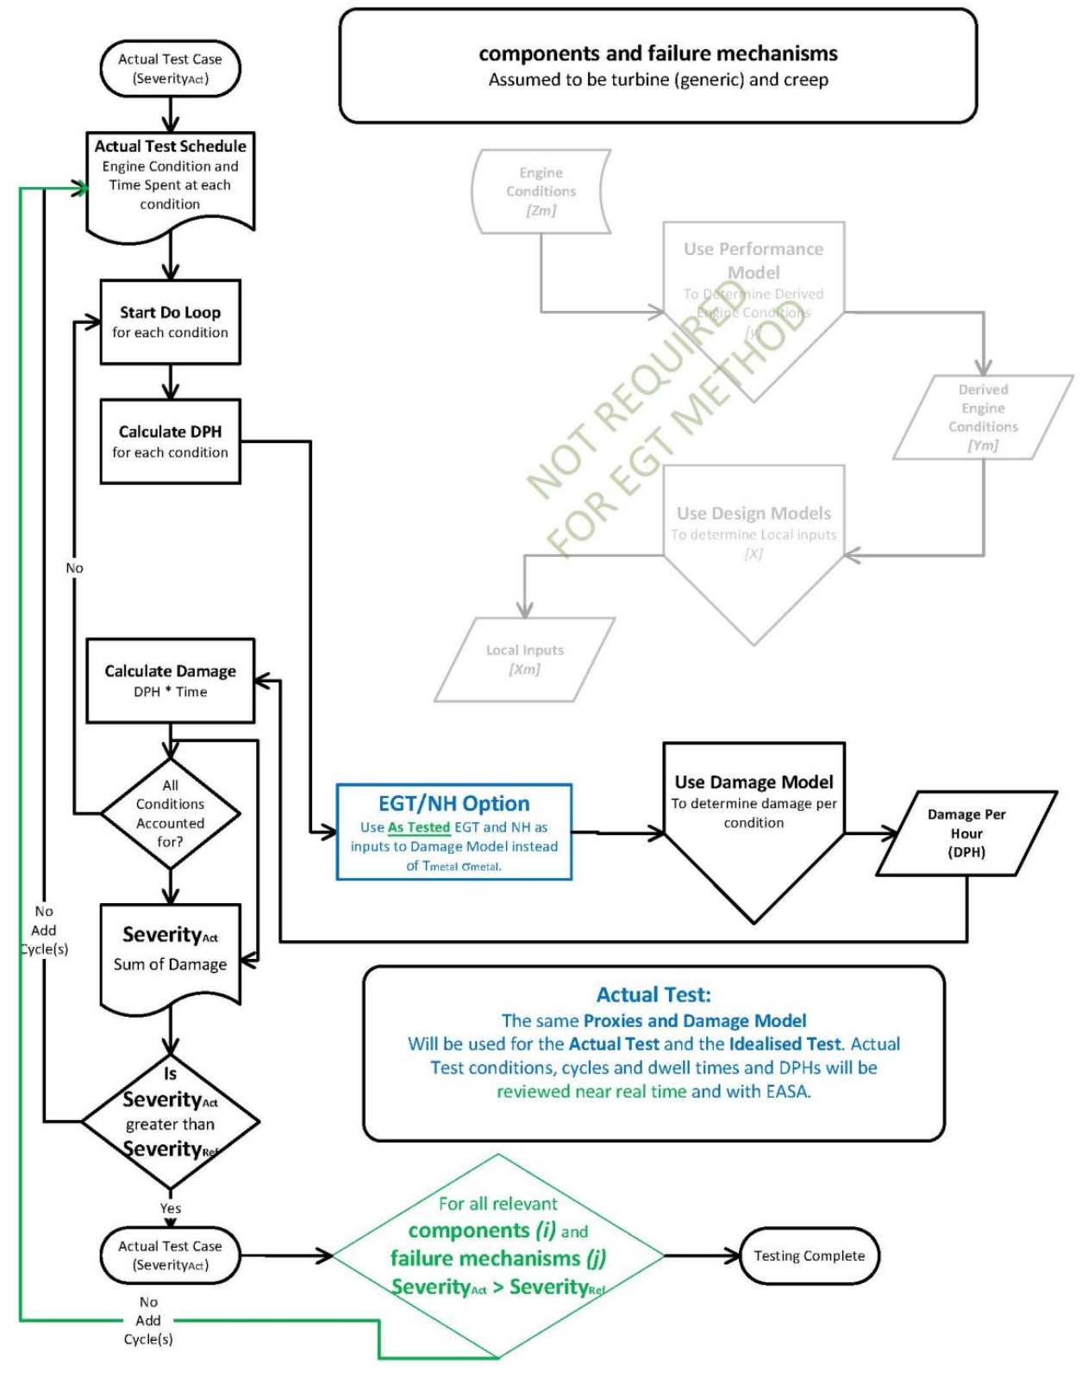
Certification Review Map / EASA CS-E Easy Access Rules / 01-easa-cs-e-easy-access-rules.png
Image evidence

Slide 7
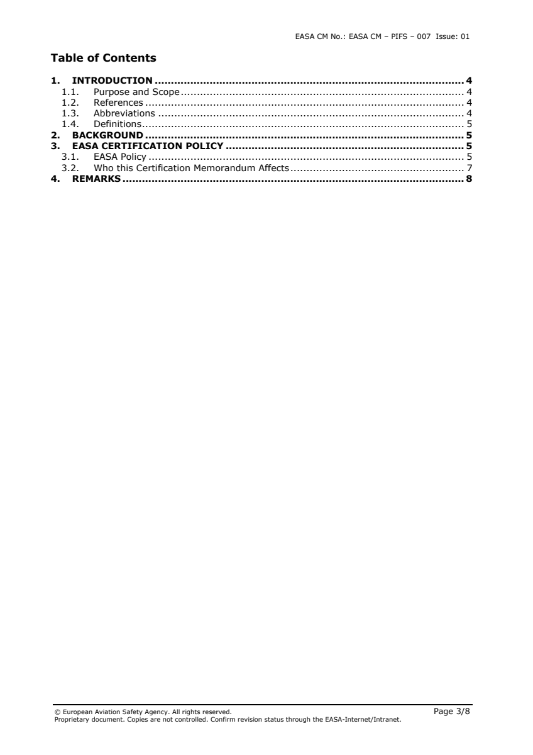
Certification Review Map / EASA CM-PIFS-007 / 02-easa-cm-pifs-007.png
Image evidence

Slide 8
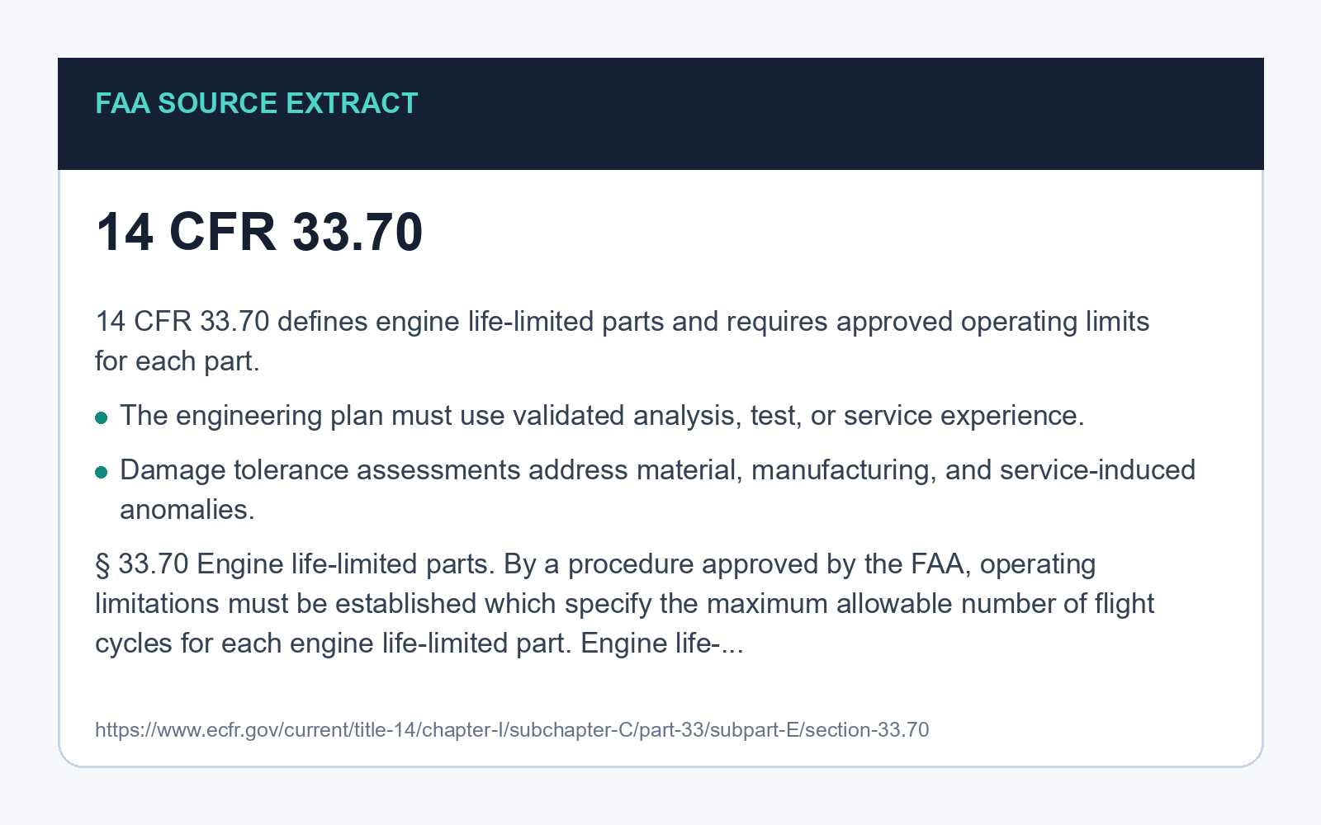
Certification Review Map / eCFR 14 CFR 33.70 / 04-ecfr-14-cfr-3370.png
Image evidence

Slide 9
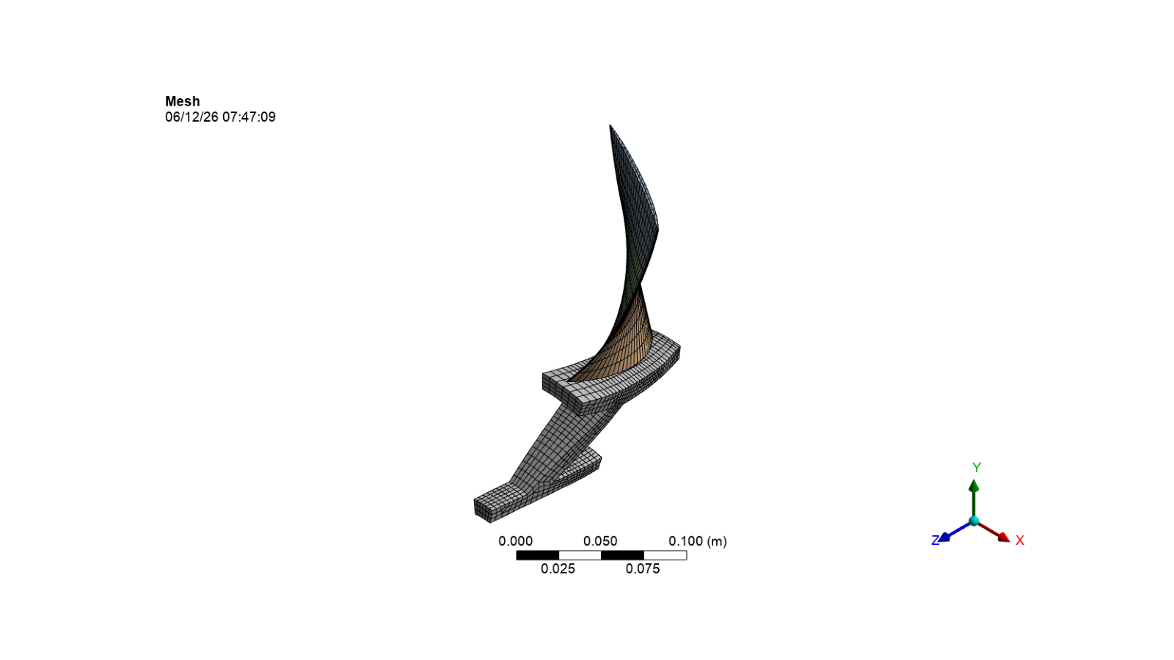
Evidence Binder / PyDPF-Core User Guide / 07-pydpf-core-user-guide.png
Image evidence

Slide 10
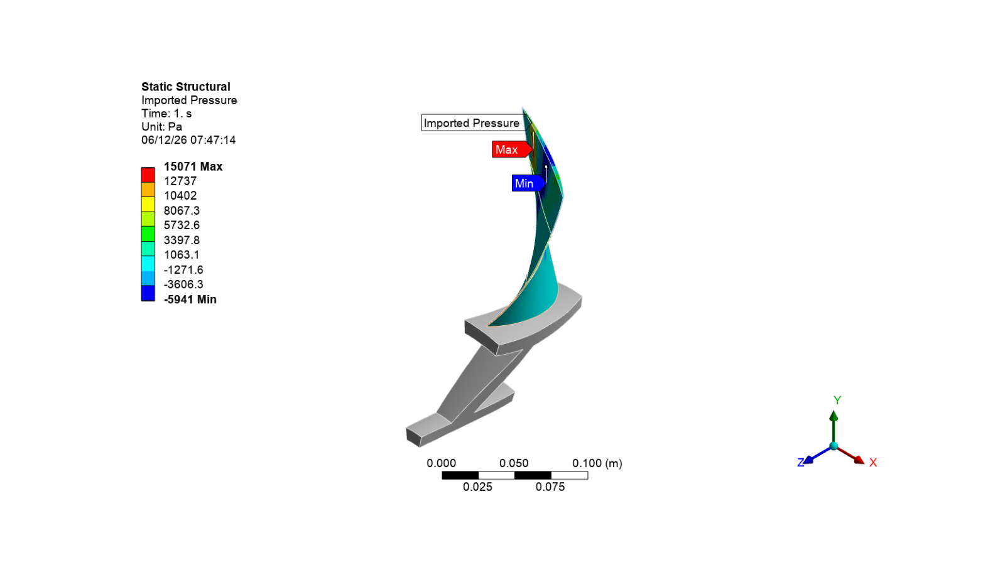
Evidence Binder / Ansys DPF Developer Docs / 08-ansys-dpf-developer-docs.png
Image evidence

Slide 11
Evidence Binder / EASA CM-PIFS-007 PDF - page 3 / cm-pifs-007-page-pdf-1.pdf
PDF evidence
PDF page 3 of 8

Slide 12
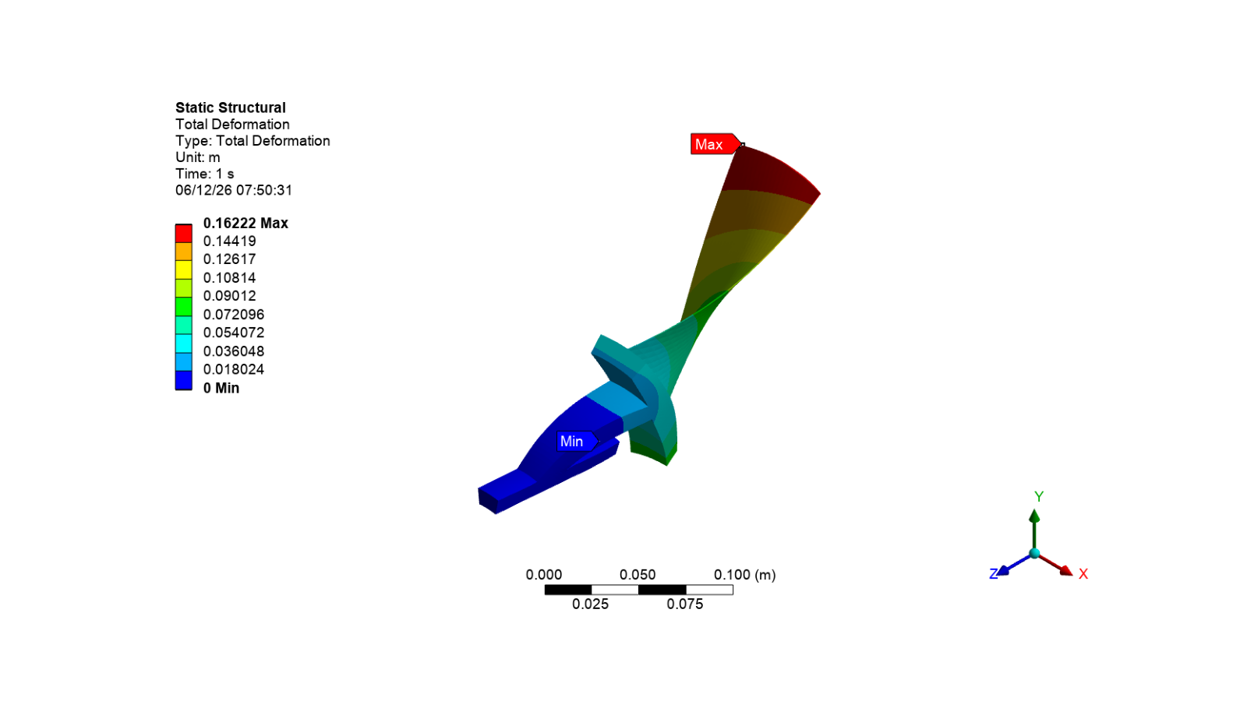
Evidence Binder / PyAnsys Rotor 67 Total Deformation / displacement-envelope.png
Image evidence

Slide 13
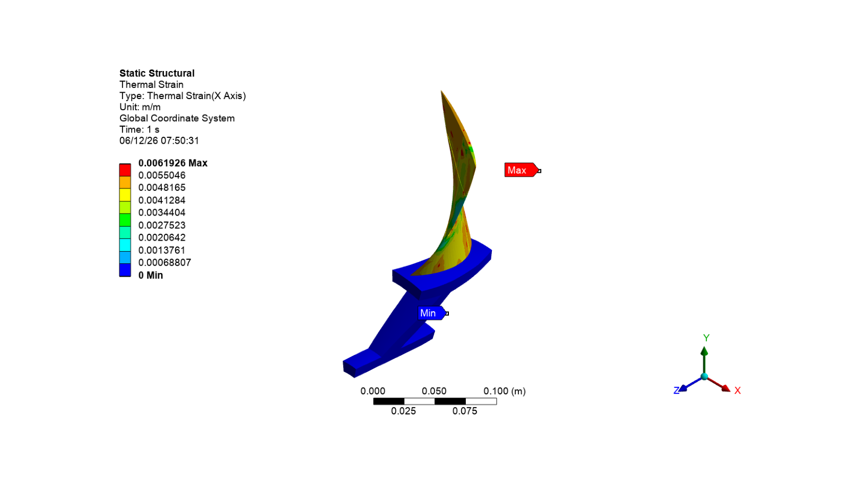
Evidence Binder / PyAnsys Rotor 67 Thermal Strain / stress-hotspot-map.png
Image evidence

Slide 14
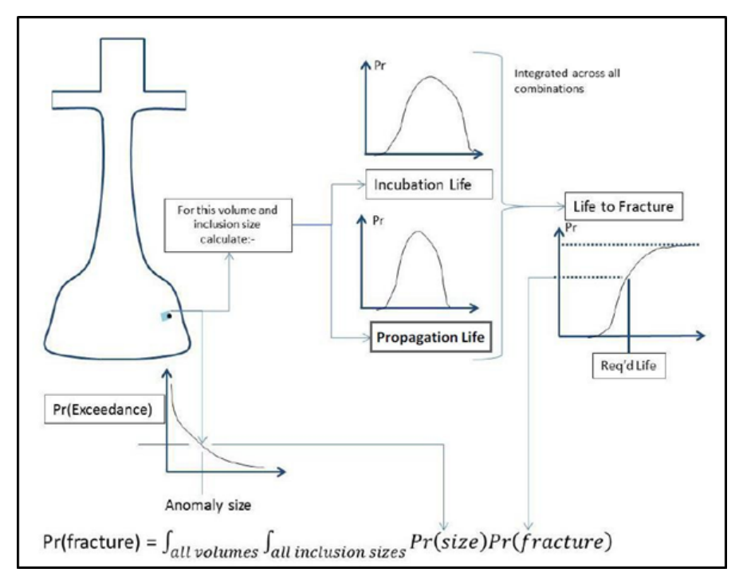
Evidence Binder / FAA AC 33.70-4 / 06-faa-ac-3370-4.png
Image evidence

Slide 15
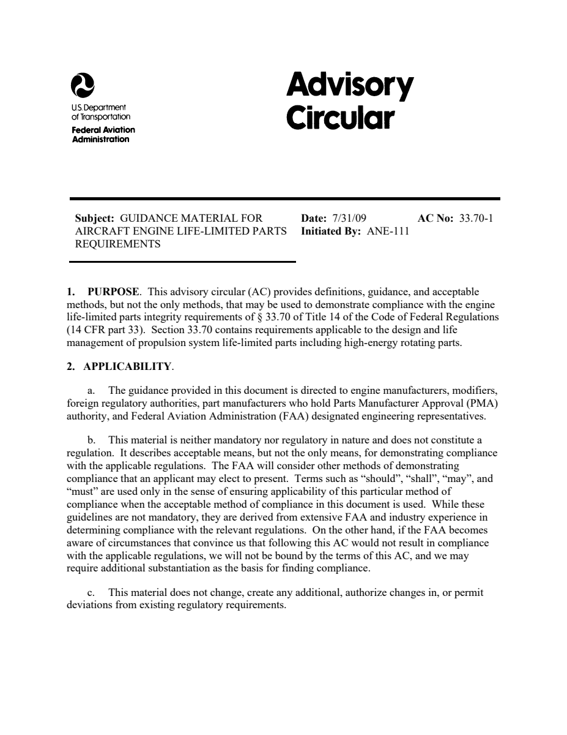
Evidence Binder / FAA AC 33.70-1 PDF - page 2 / ac-33-70-1-life-limited-parts-chg-1.pdf
PDF evidence
PDF page 2 of 25

Slide 16
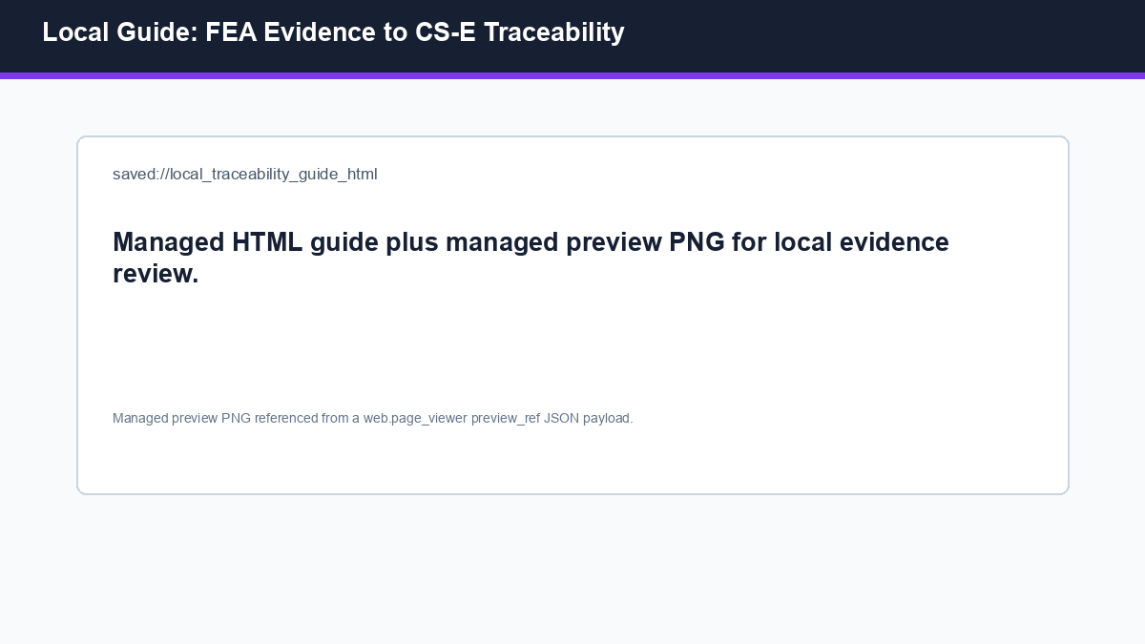
Evidence Binder / Local Guide: FEA Evidence to CS-E Traceability / local-fea-traceability-guide-preview.png
Image evidence

Slide 17
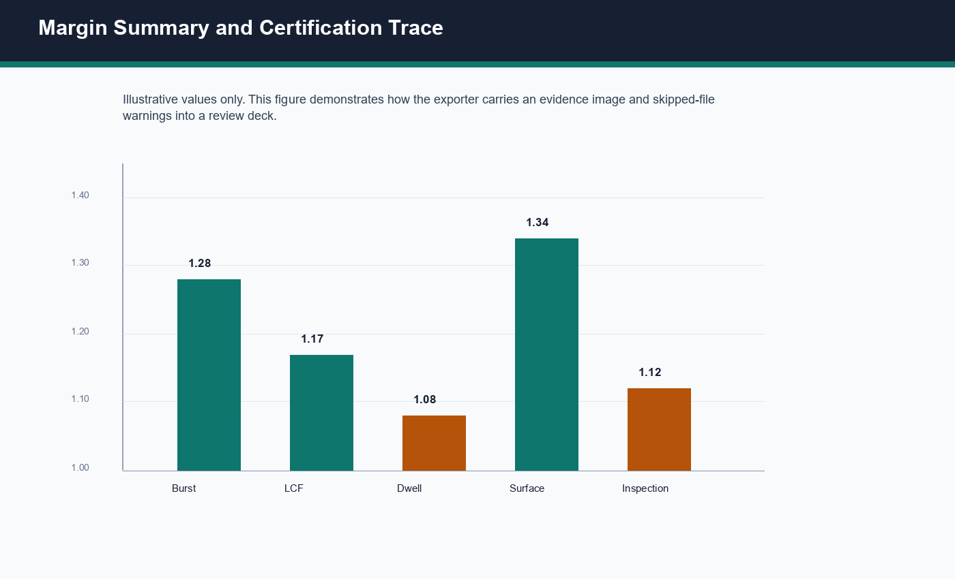
Evidence Binder / Margin Summary Chart / margin-summary-chart.png
Image evidence

Slide 18
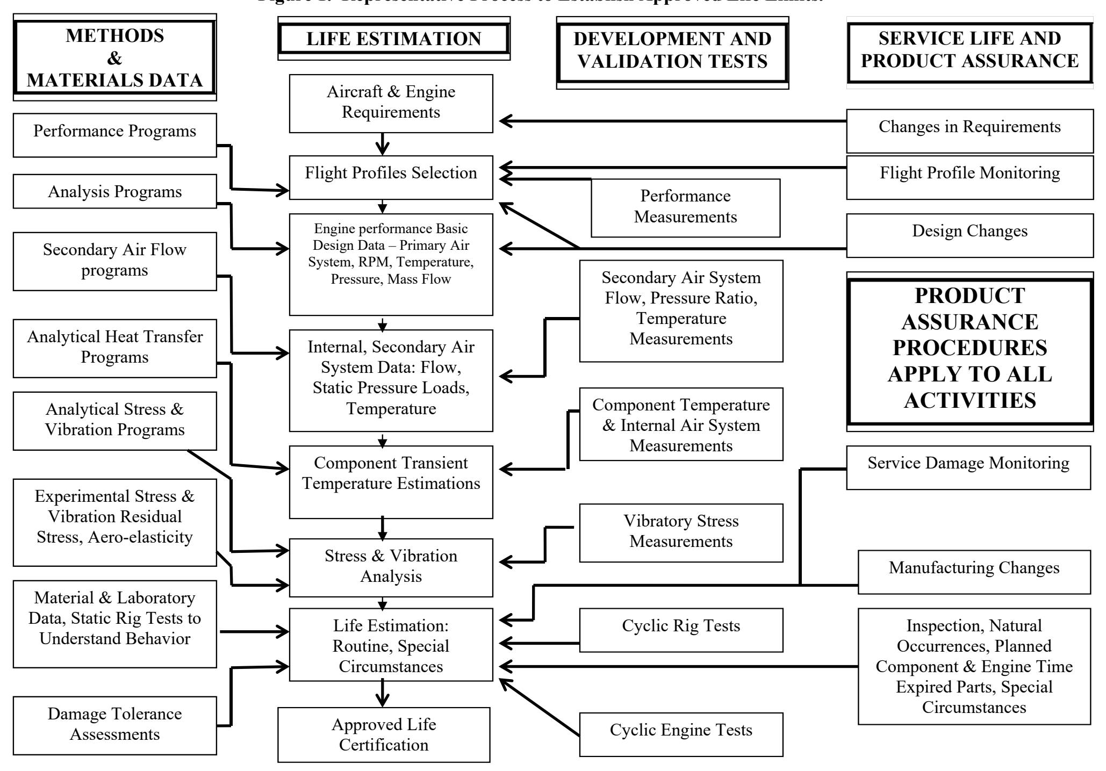
Evidence Binder / FAA AC 33.70-1 / 05-faa-ac-3370-1.png
Image evidence

Slide 19
Project Files To Review
Missing, temporary, or unsupported evidence
DPF Evidence Canvases / DPF Stress Evidence - BOLT_NODES / file.rst: external file paths are listed but not embedded in Project Review Deck v1.
DPF Evidence Canvases / DPF Displacement Evidence - BOLT_NODES / file.rst: external file paths are listed but not embedded in Project Review Deck v1.
Evidence Binder / Unsupported CSV Evidence Register / evidence-register.csv: unsupported evidence file type '.csv'.
Evidence Binder / Unsupported Markdown Review Notes / review-notes.md: unsupported evidence file type '.md'.
Evidence Binder / Local Guide: FEA Evidence to CS-E Traceability / fea-evidence-to-cs-e-traceability.html: unsupported evidence file type '.html'.
Evidence Binder / External Rig Evidence Placeholder / rotor_rig_strain.raw: external file paths are listed but not embedded in Project Review Deck v1.

