Slide 1
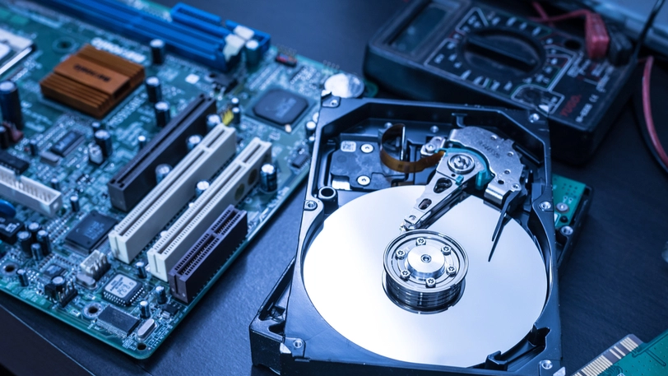

Slide 2

Disk Space Rental System
Emrecan üzüm - 1900005485
Şükrü Erim Sinal - 1900003587

Slide 3
HOW THE SYSTEM WORKS
USER WITH DISK SPACE
SHARES THE INFORMATION ABOUT
DURATION, PRICE,SIZE
USER RENT THE DISK SPACE

Slide 4
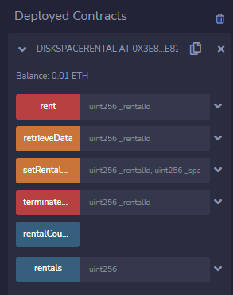
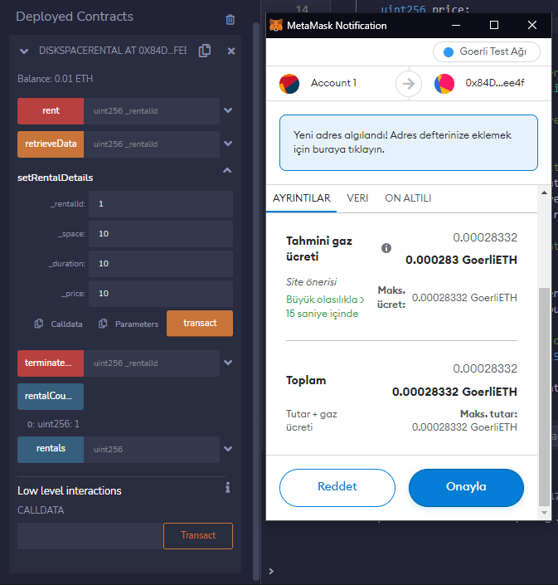
Firstly, we deployed our contract with 10 Finney. Here
we see some functions here. Firstly we need to use
‘’setRentalDetails’’ function to set our details as an
owner.
We set our data with our ID, space, duration and price that we want from user.

Slide 5
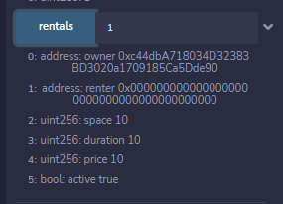
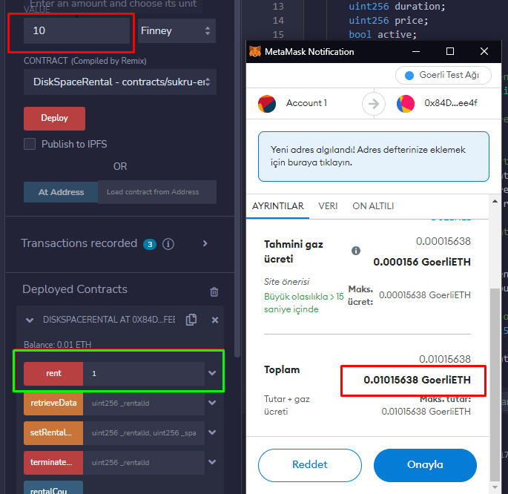
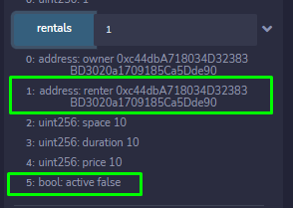
After setting our rental, we successfully
Shared our rent with blockchain
Now, as a user, we rent the disk
space with Id 1. In this process
we need to pay enough money
for rent. After this part you can
see how the data change.

Slide 6
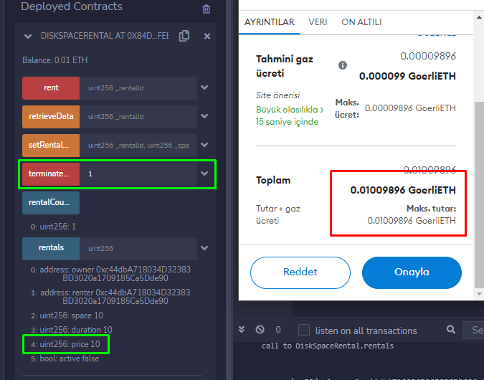
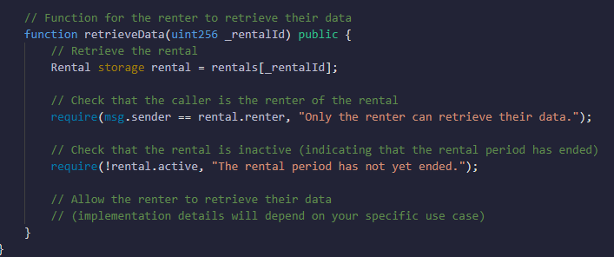
If the owner terminates the rental before
the duration, he/she need to pay the
price to the contract.
Thus the renter does not suffer.
But if the person wants to cancel the
rent before the deadline, then no payment
will be made to renter.

Slide 7
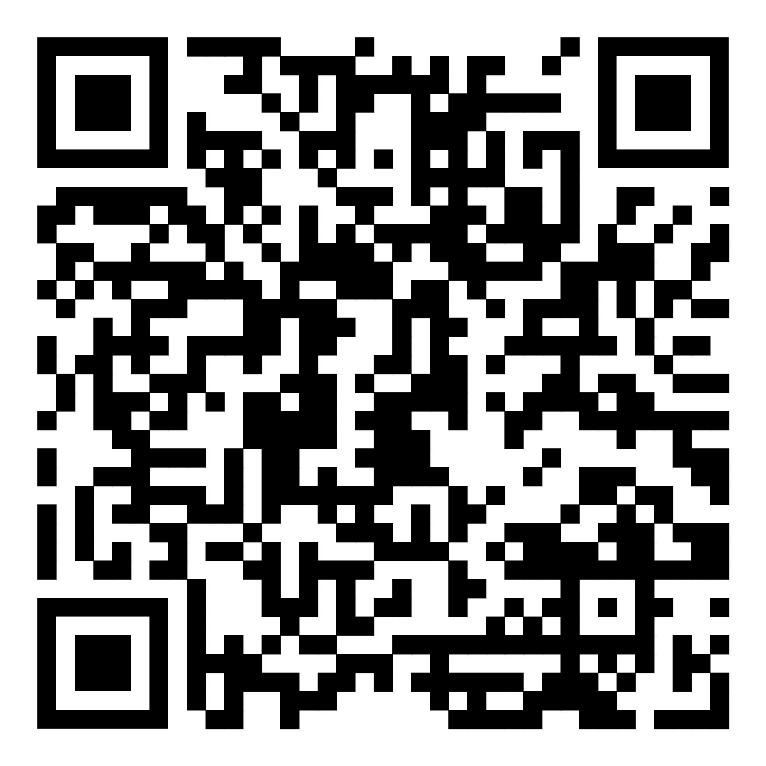
https://github.com/emrecanuzum/DiskSpaceRentalSolidity
1900003587 – Şükrü Erim SİNAL
1900005485 – Emrecan ÜZÜM

