Slide 1

THE IDENTIFIDACION OF SATIRICAL FAKE NEWS IN TURKEY
1900005528- Ahmet Kaan Memioğlu
1900003587- Şükrü Erim Sinal
1900005485- Emrecan Üzüm

Slide 2

List of contents
List of Contents
Introduction
Problem Statement
Problem Purpose
Source Gathering
Tools and Technology
Approach
Advantages and Disadvantages
Results
Comparisons
Future Works
Conclusions
References

Slide 3


Problem Statement

Slide 4


Project Purpose

Slide 5

Source Gatherıng
Turkish news articles, both real and fake.
-Real News Resources:
AykiriComTr, BBCTürkçe, BPTHaber, PushHolder, HaberTürk, TrtHaber, etc.
-Fake News Resources:
Zaytung, Kaparoz, Kramponnet, ResmiGaste, Volsitrit, DeminHaber, etc.

Slide 6






Tools and Technology
Snscrape (Tweet retrieval)
Graphviz (Graphics of Random Forest Tree)
Zemberek (NLP library designed for Turkish Language)
Stopwords List (Turkish stopwords list)
Machine learning models used: Logistic Regression, XGBoost, Random Forest, CNN, and LSTM.

Slide 7
Dataset
Label | Tweet Profile | Date-Time | Text
Real | bpthaber | 2021-05-15 | Süper Lig'de şampiyonu belirleyecek olan maçlar başladı!,
Real | Haber | 2021-12-20 | Rusya, geçtiğimiz hafta 2 Rus diplomatı istenmeyen kişi ilan eden Almanya’nın 2 diplomatını "istenmeyen kişi" ilan etti.
Fake | Kaparoz | 2020-02-14 | Meteorolojiden 14 Şubat uyarısı: “Hissedilen sıcaklıklar artacak, nazlanma ve don beklenmiyor
Fake | Zaytung | 2016-03-22 | Türkiye'nin 3. havaalanını çekemeyenler hırslarını Brüksel'dekinden aldı…
-Preprocessing steps:
Hyperlink & emoji removal
Removing punctuations
Tokenization
Lemmatization
Concatenation
-Qualifications:
31275# of real tweet posts
28711# of fake tweet posts
18 total number of news resources
(9 real + 9 fake resources)

Slide 8
Approach
Hyperparameter Optimization => RandomSearchCv
Performance Evaluation => F1 score, ROC curve, Confusion Matrix, Accuracy, Loss etc.
Model Used => XGBoost, Random Forest, Logistic Regression, CNN, LSTM
Fine-Tuning => Early Stopping, Attention Layers, Dropout Rate, Activation Function(Sigmoid, LeakyRelu) etc.

Slide 9
Advantages and Disadvantages
Advantages:
High Accuracy
Multiple Models (CNN, XGBoost, Random Forest, Logistic Regression)
Hyperparameter Optimization (RandomSearchCV)
Rightly Balanced Dataset (30k F.N / 30k R.N)
Disadvantages:
Potential Bias: Potential Political Bias
Potential Improvements for Hyperparameters: (GridSearchCV)
Language and Cultural Context: (Turkish l. only)
News Source Limitations

Slide 10
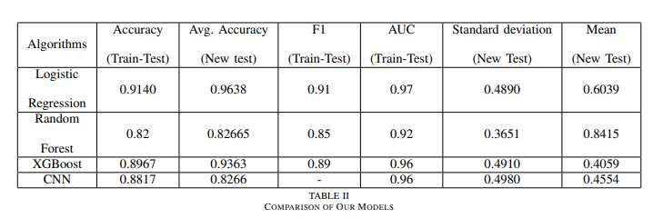
Results

Slide 11
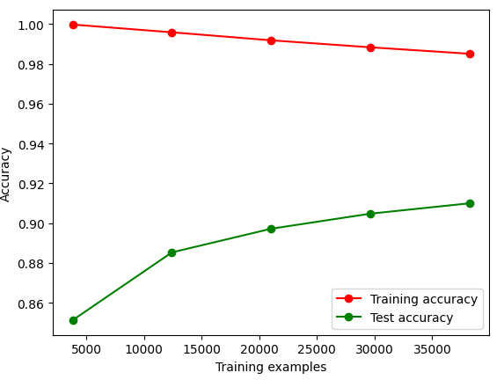
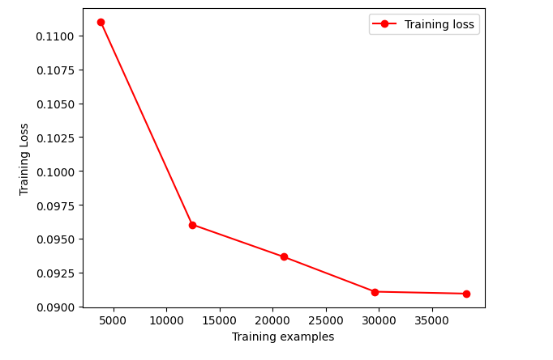
Results (Logistıc Regressıon)
Most Solid Algorithm
Most Cost Effective Solution
High Acc. At 91%
Std dv, Mean value (0.48, 0.60)

Slide 12
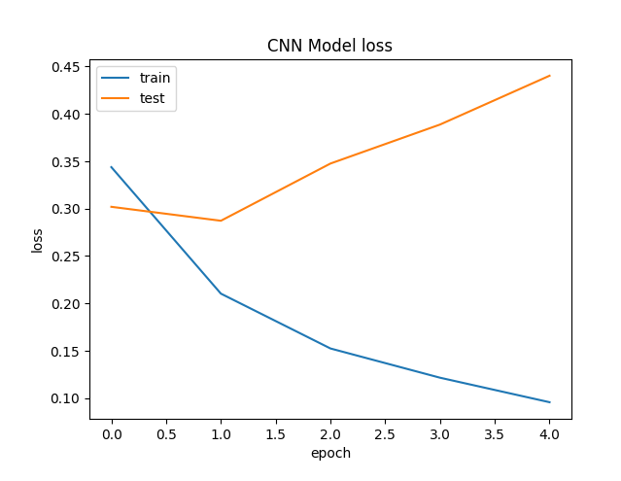
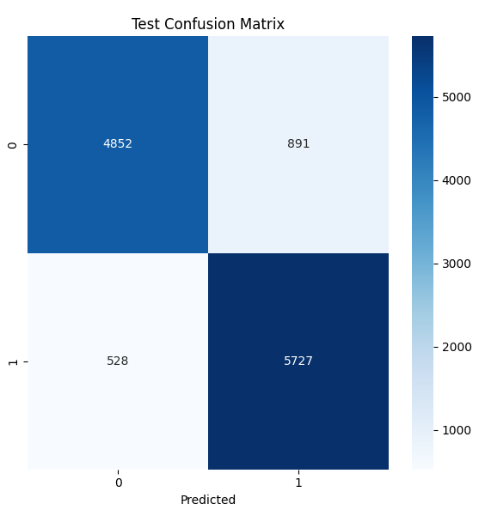
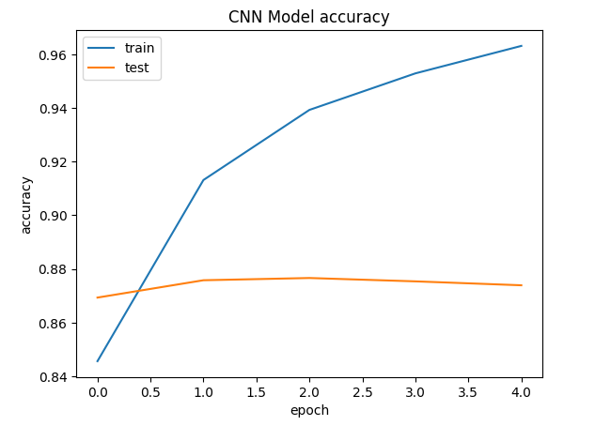
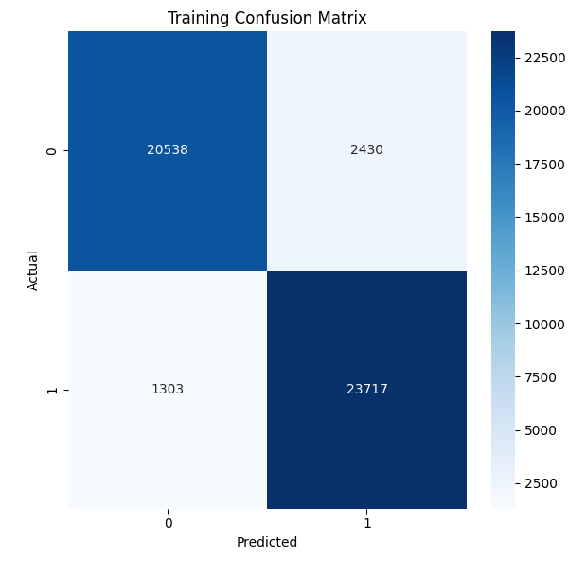
Results (CNN Model)
Deep Learning Approach Acc. 88.71%
Std dv, Mean: 0.49, 0.45
Consistent compared to other alg.

Slide 13
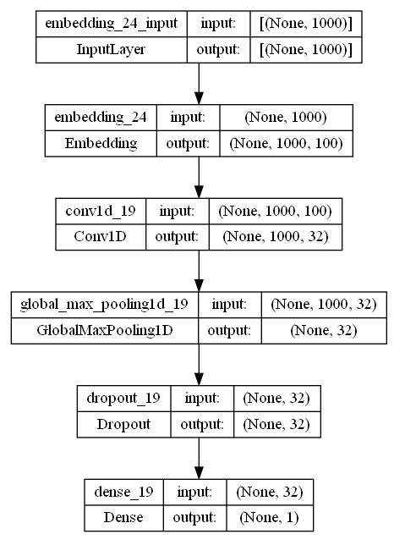
results (Cnn archıtecture)
1 Embedding layer with 1000 input length and 100 output dimension
3 Conv1D layer
1 GlobalMaxPooling Layer
1 dropout with 0.5 ratio
1 Output layer with 1 node for binary classification

Slide 14
Results (Random Forest)
Solid choice of algorithm
Respectable Acc. Of 82.5
Std deviation, Mean value (0.84, 0.36)

Slide 15
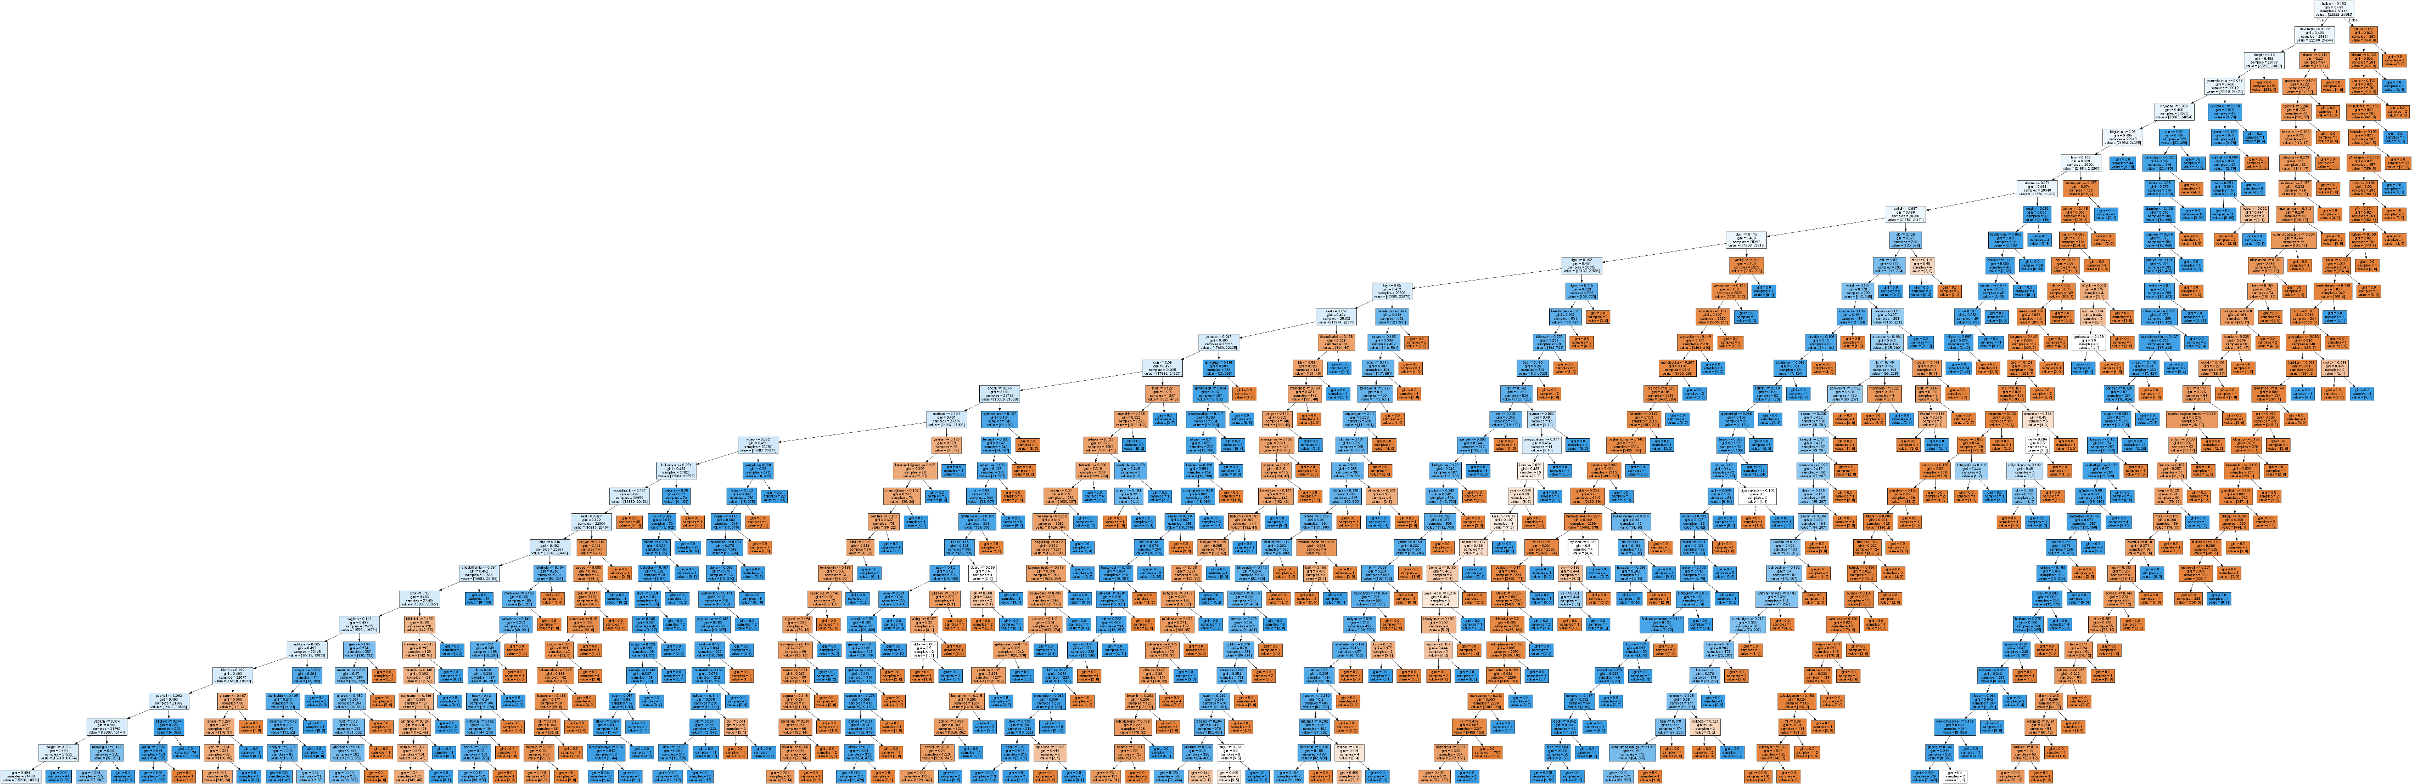
Results (Random Forest Tree)

Slide 16
Results (XGBoost)
Strong choice with 89% Acc.
Std dev. , Mean val. (0.40, 0.49)
%92 percent Acc. while detecting fake news online

Slide 17
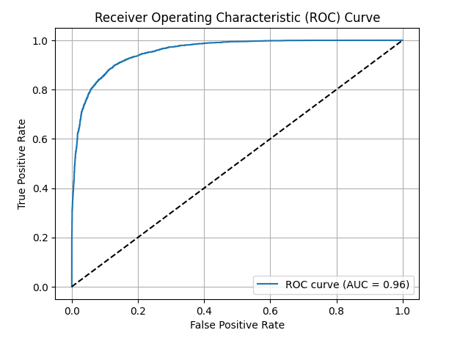
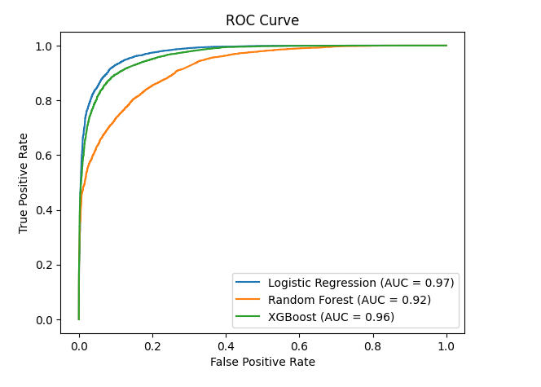
Comparisons: ROC Curve
Deep Learning Technique
Traditional Machine Learning Techniques

Slide 18
Comparisons: Conf. Matrıx
Deep Learning Technique

Slide 19
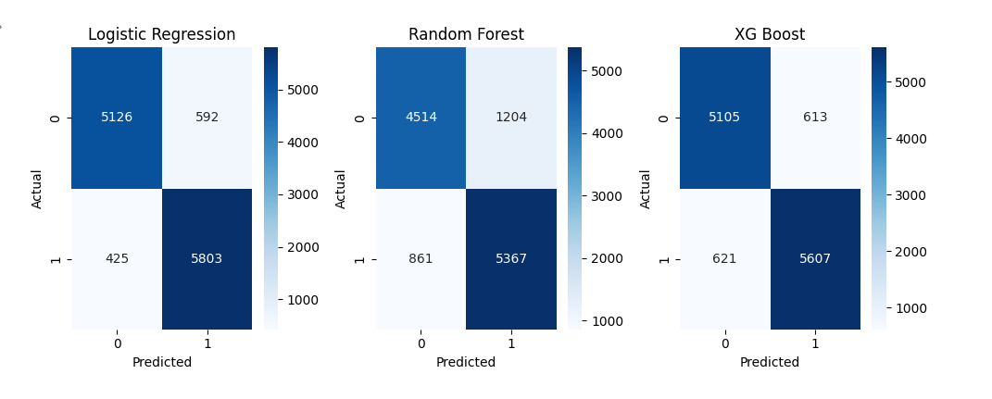
Comparisons: Conf. Matrıx
Traditional Techniques

Slide 20
Comparisons

Slide 21
COMPARISON BETWEEN RELATED WORKS
Paper& Year | Methods | Dataset | Accuracy | F1 | Precision
[1] [2018] | A: LSTM, B: LSTM with Dropout, C: LSTM + CNN | Custom dataset including 5,800 Tweets | A: 82.29 B: 73.78 C: 80.38 | A:40.59 B:30.93 C:39.70 | A:44.35 B:39.67 C:43.94
[8] [2020] | Random Forest (RF), Decision Tree(DT) | Custom Dataset with 25000 instances | DT:0.9634 RF:0.9359 | DT:0.982 RF:0.981 | DT:0.983 RF:0.980
[2] [2022] | LSTM,GridSearch, Random Search | ISOT, LIAR | LIAR:71.57 ISOT:99.65 | LIAR: 80.90 ISOT:- | LIAR:75.63 ISOT:99.52

Slide 22

Future Works
Multi-model data (text and images)
Expanding models
Improve performance
Keeping Dataset up-to-date

Slide 23

Conclusions
Solid foundation of detection.
Competitive solution for Turkish Language.
Social benefits of effective fake news detection.
Acknowledge limitations and the need for further research.

Slide 24
References
[1] Ajao, O., Bhowmik, D., & Zargari, S. (2018, July). Fake news identification on twitter with hybrid cnn and rnn models. In Proceedings of the 9th international conference on social media and society (pp. 226-230).
[2] Rajalaxmi, R. R., Narasimha Prasad, L. V., Janakiramaiah, B., Pavankumar, C. S., Neelima, N., & Sathishkumar, V. E. (2022). Optimizing hyperparameters and performance analysis of LSTM model in detecting fake news on social media. Transactions on Asian and Low-Resource Language Information Processing.
[3] Bhatt, G., Sharma, A., Sharma, S., Nagpal, A., Raman, B., & Mittal, A. (2018, April). Combining neural, statistical and external features for fake news stance identification. In Companion Proceedings of the The Web Conference 2018 (pp. 1353-1357).
[4] Raponi, S., Khalifa, Z., Oligeri, G., & Di Pietro, R. (2022). Fake news propagation: a review of epidemic models, datasets, and insights. ACM Transactions on the Web (TWEB), 16(3), 1-34.
[5] Tsai, C. M., & Xu, B. S. (2020, June). Automatic Differentiation Between Legitimate and Fake News Using Named Entity Recognition. In Proceedings of the 2020 3rd International Conference on Artificial Intelligence and Pattern Recognition (pp. 74-78).
[6] Helmstetter, S., & Paulheim, H. (2018, August). Weakly supervised learning for fake news detection on Twitter. In 2018 IEEE/ACM International Conference on Advances in Social Networks Analysis and Mining (ASONAM) (pp. 274-277). IEEE.
[7] Gangireddy, S. C. R., Long, C., & Chakraborty, T. (2020, July). Unsupervised fake news detection: A graph-based approach. In Proceedings of the 31st ACM conference on hypertext and social media (pp. 75-83).
[8] Ganesh, B., & Anitha, K. (2022, February). Implementation of Personality Detection and Accuracy Prediction for identification of fake and true news using Decision Tree and Random Forest Algorithms. In 2022 International Conference on Business Analytics for Technology and Security (ICBATS) (pp. 1-5). IEEE.
[9] Deepak, S., & Chitturi, B. (2020). Deep neural approach to Fake-News identification. Procedia Computer Science, 167, 2236-2243.
[10] Jose, X., Kumar, S. M., & Chandran, P. (2021, October). Characterization, Classification and Detection of Fake News in Online Social Media Networks. In 2021 IEEE Mysore Sub Section International Conference (MysuruCon) (pp. 759-765). IEEE.
[11] Narang, P., & Sharma, U. (2021, November). A Study on Artificial Intelligence Techniques for Fake News Detection. In 2021 International Conference on Technological Advancements and Innovations (ICTAI) (pp. 482-487). IEEE.
[12] Song, C., Ning, N., Zhang, Y., & Wu, B. (2021). Knowledge augmented transformer for adversarial multidomain multiclassification multimodal fake news detection. Neurocomputing, 462, 88-100.
[13] Zhang, C., Gupta, A., Qin, X., & Zhou, Y. (2023). A computational approach for real-time detection of fake news. Expert Systems with Applications, 221, 119656.
[14] Capuano, N., Fenza, G., Loia, V., & Nota, F. D. (2023). Content Based Fake News Detection with machine and deep learning: a systematic review. Neurocomputing.
[15] Sharma, D. K., Shrivastava, P., & Garg, S. (2022, March). Utilizing Word Embedding and Linguistic Features for Fake News Detection. In 2022 9th International Conference on Computing for Sustainable Global Development (INDIACom) (pp. 844-848). IEEE.

Slide 25

Thank you for Lıstenıng
1900005528- Ahmet Kaan Memioğlu
1900003587- Şükrü Erim Sinal
1900005485-Emrecan Üzüm

