Slide 1
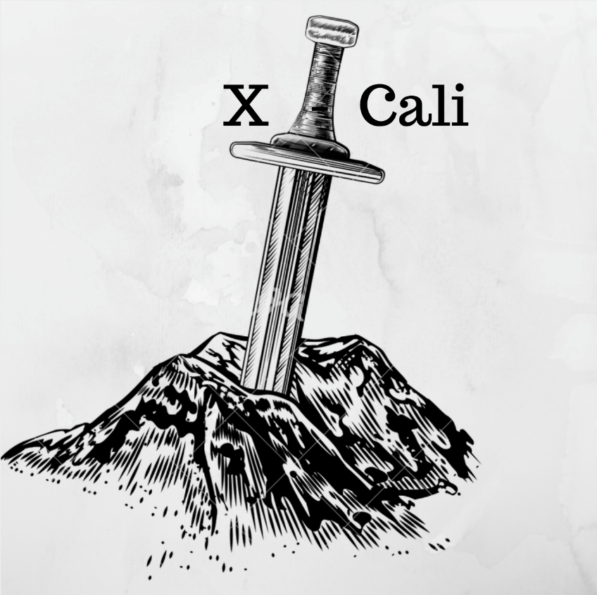
User Manual - 2
X-CALI DEMO
WARNINGS
X-Calibot is not suitable for use of children under 5 years old. Keep X-Calibot out of reach of children under 5 years old.
Do not use your X-Calibot for longer than 3 hours. Charge the LiPo battery immediately after having used it. Undervoltaged batteries may explode and may be harmful.
In case you notice a thickening on your battery, stop running your X-Calibot, disconnect the battery and contact X-Cali Customer Care.
Make sure that you have connected the terminals of the battery correctly, polarity reversal may ruin your X-Calibot.
Do not leave the plank on the holding point of your X-Calibot while not running it. Weight of the plank may be harmful for your device.
In case you notice smoke or burning smell while running your X-Calibot, immediately disconnect the battery and the powerbank and contact X-Cali Customer Care.
DISCLAIMER
X-Calibot is produced, calibrated and tested under room conditions and white fluorescent light. X-Cali Inc. do not accept any responsibilities for any kind of malfunctionings of X-Calibot caused by operation under any other enviromental conditions.
Power supply units of X-Calibot are designed and produced specifically for X-Calibot. Any power supply units other than box content are not suitable for X-Calibot. X-Cali Inc. do not accept any responsibilites for possible damages on X-Calibot caused by different power supply units.
Using guide of device is clearly described in User Manual. X-Cali Inc. do not accept any responsibilites for possible damages on X-Calibot caused by user error.
In case of any ambiguity, please contact X-Cali Customer Care.
4
1

Slide 2
User Manual - 2
X-CALI DEMO
WARNINGS
X-Calibot is not suitable for use of children under 5 years old. Keep X-Calibot out of reach of children under 5 years old.
Do not use your X-Calibot for longer than 3 hours. Charge the LiPo battery immediately after having used it. Undervoltaged batteries may explode and may be harmful.
In case you notice a thickening on your battery, stop running your X-Calibot, disconnect the battery and contact X-Cali Customer Care.
Make sure that you have connected the terminals of the battery correctly, polarity reversal may ruin your X-Calibot.
Do not leave the plank on the holding point of your X-Calibot while not running it. Weight of the plank may be harmful for your device.
In case you notice smoke or burning smell while running your X-Calibot, immediately disconnect the battery and the powerbank and contact X-Cali Customer Care.
DISCLAIMER
X-Calibot is produced, calibrated and tested under room conditions and white fluorescent light. X-Cali Inc. do not accept any responsibilities for any kind of malfunctionings of X-Calibot caused by operation under any other enviromental conditions.
Power supply units of X-Calibot are designed and produced specifically for X-Calibot. Any power supply units other than box content are not suitable for X-Calibot. X-Cali Inc. do not accept any responsibilites for possible damages on X-Calibot caused by different power supply units.
Using guide of device is clearly described in User Manual. X-Cali Inc. do not accept any responsibilites for possible damages on X-Calibot caused by user error.
In case of any ambiguity, please contact X-Cali Customer Care.
4
1

Slide 3
AGENDA
User Manual - 1
Poster Demonstration
Project and Company Description – G. Hande BAYAZIT
Solution Explanation – Burak SEZGİN
WHY XCALIBOT? – Taha DOĞAN
Video Demonstration
Practical Demonstration
Single Mode Maze Travelling
Master/Slave Mode
Connect the powerbank to RaspberryPi.
Make sure that green and red LED’s on RaspberryPi blink.
Connect the LiPo battery to the same colored supply terminals of motor driver.
Couple the wooden plank to the holding point on top of X-Calibot.
Choose the playing mode (master or slave) by using the switch on top of X-Calibot.
Place your X-Calibot in a maze.
Enjoy!
2
3

Slide 4
AGENDA
User Manual - 1
Poster Demonstration
Project and Company Description – G. Hande BAYAZIT
Solution Explanation – Burak SEZGİN
WHY XCALIBOT? – Taha DOĞAN
Video Demonstration
Practical Demonstration
Single Mode Maze Travelling
Master/Slave Mode
Connect the powerbank to RaspberryPi.
Make sure that green and red LED’s on RaspberryPi blink.
Connect the LiPo battery to the same colored supply terminals of motor driver.
Couple the wooden plank to the holding point on top of X-Calibot.
Choose the playing mode (master or slave) by using the switch on top of X-Calibot.
Place your X-Calibot in a maze.
Enjoy!
2
3

