Slide 1
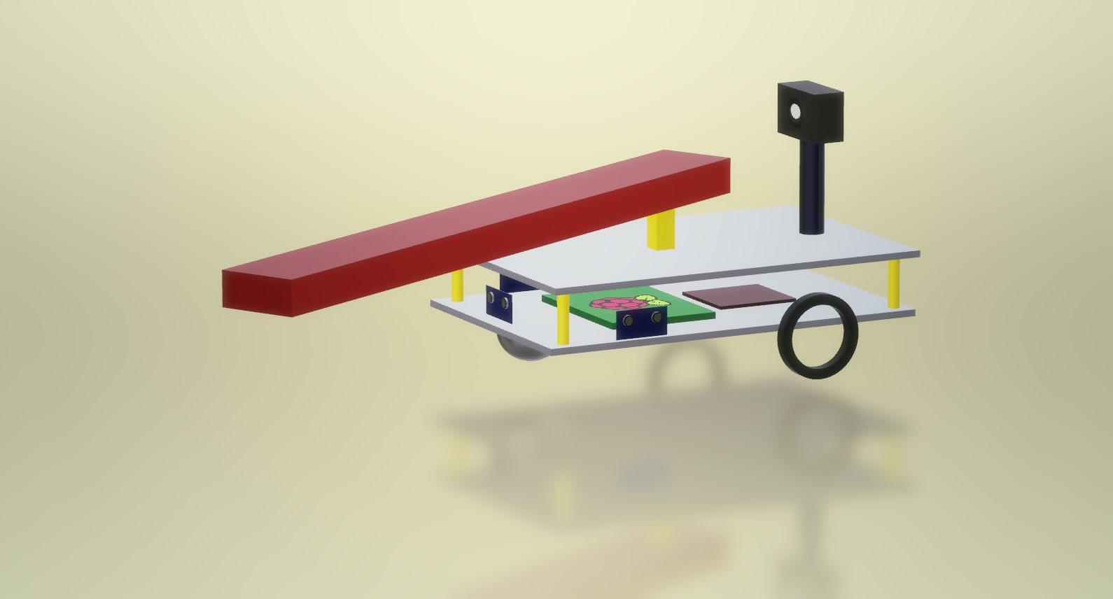
X-Cali Group
Burak Sezgin - 2094456
Taha Doğan - 2093672
Göksenin Hande Bayazıt - 2093441
Emre Doğan - 2093656
Oytun Akpulat - 2093201

Slide 3
«Robots collaboratively carrying a long object through an open-top maze»

Slide 4
Outline
Problem Statement
Design Process & Solution Approach
Solutions
Main Solution
Alternative Solution
Management
Test Plans

Slide 5
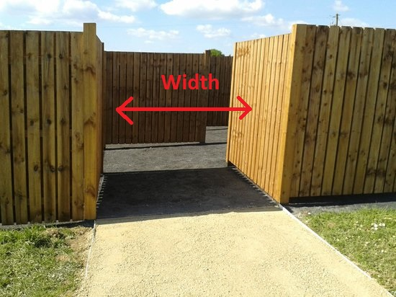
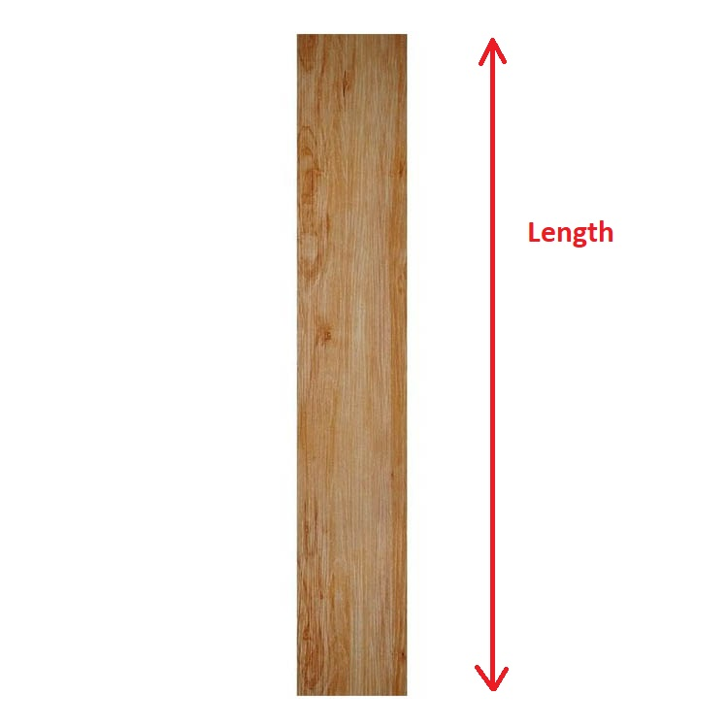
Related Specifications

Slide 6
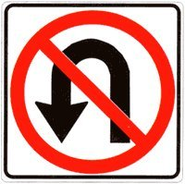
Problem Statement
Cannot make U-Turn at once

Slide 7
Main Problem:
Determining
And observing the other robot

Slide 8
Modes of Operation
Master
Slave

Slide 9
U-Turn Example
(I)

Slide 10
U-Turn Example
(II)

Slide 11
U-Turn Example
(III)

Slide 12
U-Turn Example
(IV)

Slide 13
U-Turn Example
(V)

Slide 15
Design Process & Solution Approach
Subsystems
Movement
DC Motors
Wheels
Sensors
Active sensors
Passive Sensor: Camera
Decision and Control
Solution Approaches
Image Processing
Advancing Hall Effect

Slide 16
Subsystems – Movement
Motor and Wheel
DC motor
Normal wheel
Mad Wheel

Slide 17
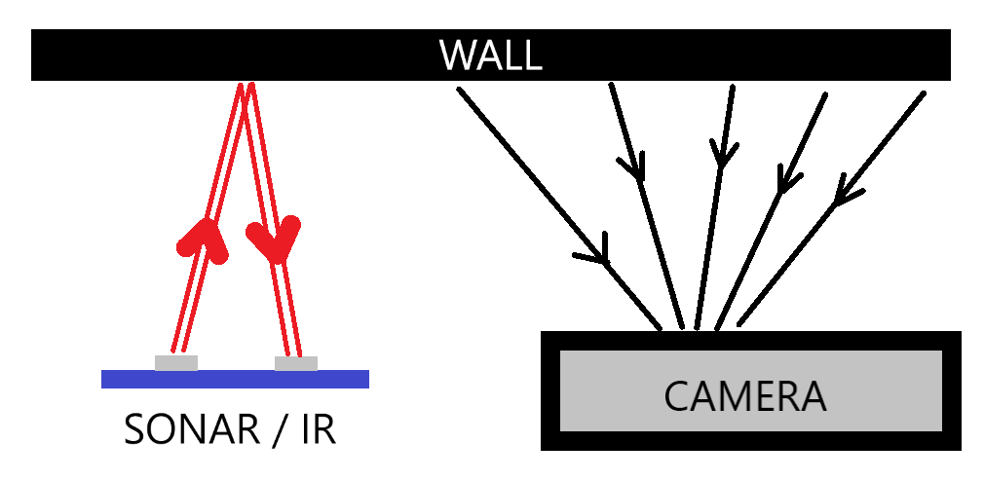
Subsystems – Sensors
Active Sensors: Proximity
IR sensors
Sonar Sensors
Passive Sensor: Camera

Slide 18

Subsystems – Decision and Control
Microprocessor Select: RaspberryPi3
Fast computational skills
Wi-Fi Connection
4 USB + SDCARD ports
Versatility on different applications: Image Processing
DC Motor Driver: L298P
Back EMF protection
Easy-to-use ports
Frequently used, many instructive videos

Slide 19
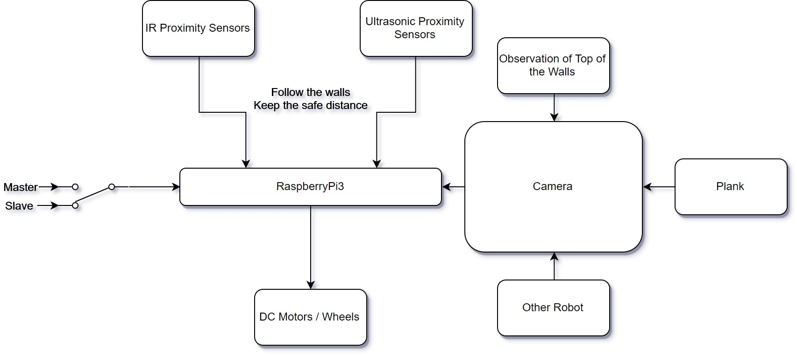
Solution Approach – I: Image Processing

Slide 20
Plank Detection
Binary Masking
Angle Detection

Slide 21
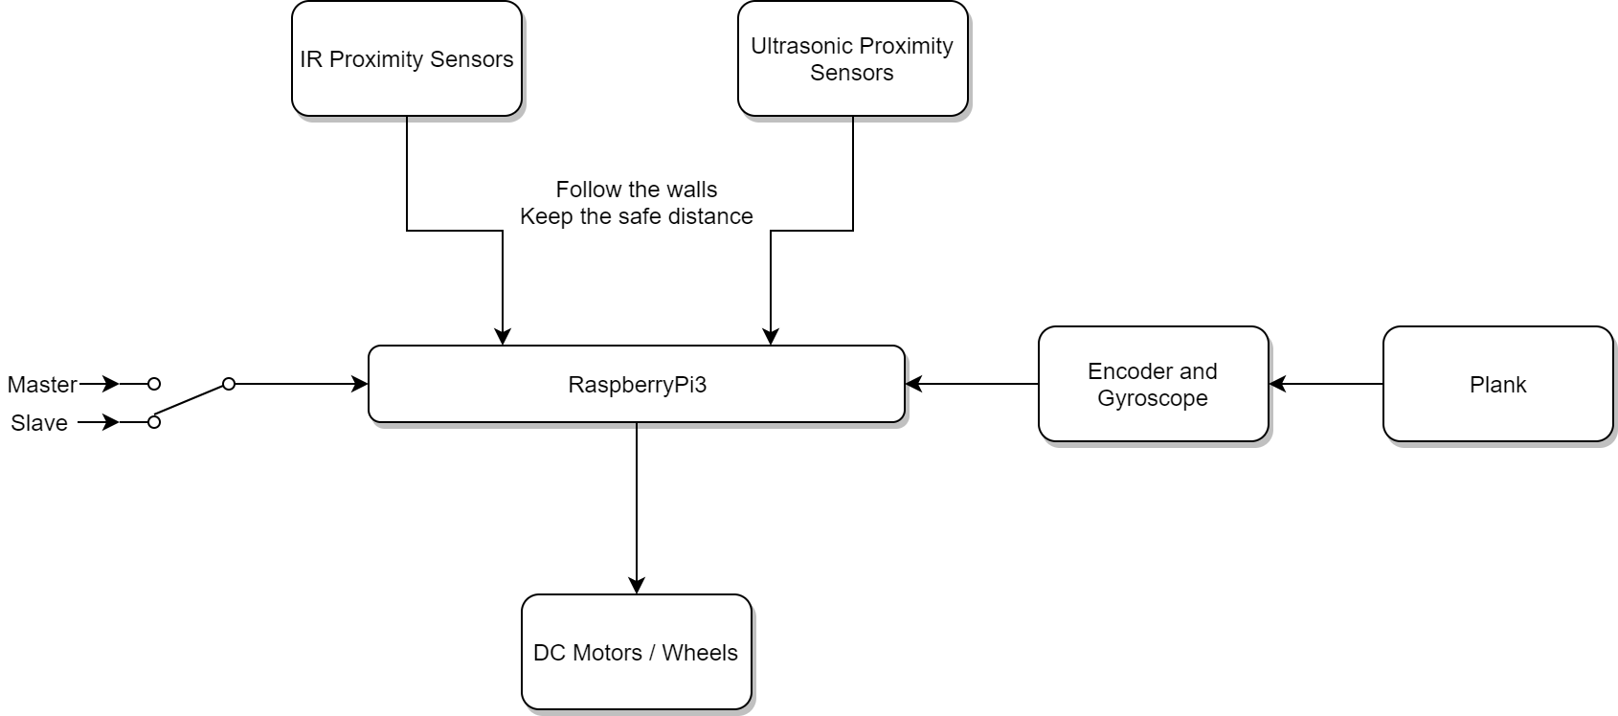
Solution Approach – II: Advancing Hall Effect

Slide 22
Solution Approaches (Technical Details)
Indirect communication between the robots
Angle of holding point
Image processing based
Motion-sensing based

Slide 23
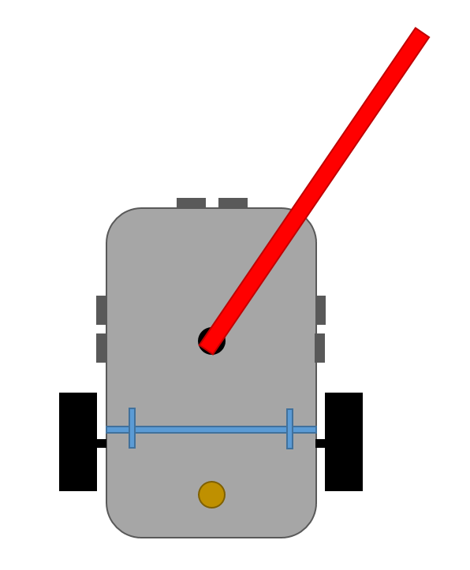
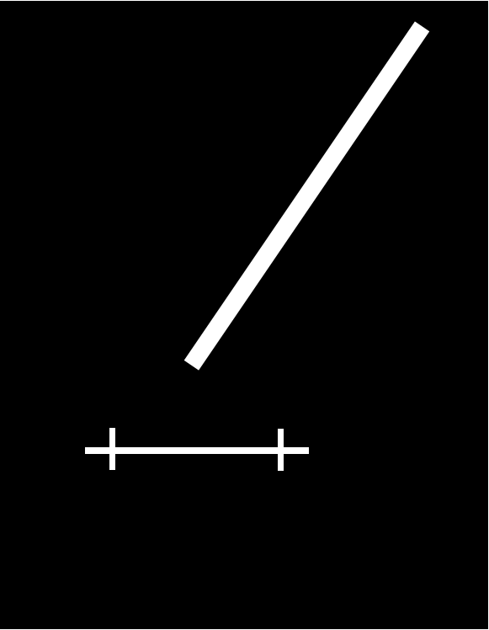
Solution I: Image Processing

Slide 24
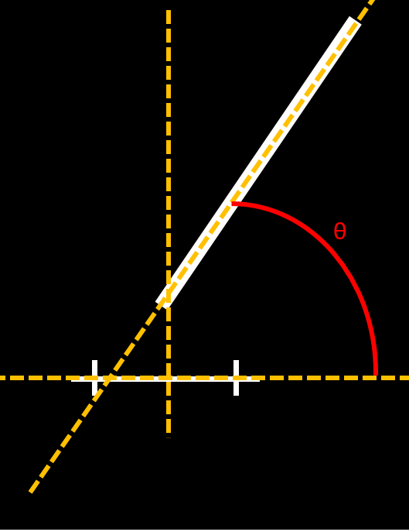
Solution I: Image Processing

Slide 25
Solution I: Image Processing
Feasible
Environment dependent
Reliability problems

Slide 26
Solution II: Motion-Sensing

Slide 27
Test Plans
Integration Plans
Conclusion

Slide 28
Test Plans
Proximity Sensor Measurements
DC Motor Starting Current Test
Response Time and Turning Angle Test

Slide 29
Integration Plans
Test procedure of the software design will be composed of two parts.
Detailed Documentation of the Software
Debugging Reports

Slide 30
Conclusion
Movement
Sensors
Control & Decision

Slide 31
Movement
DC motor was preferred because it provides two possible speed control methods:
PWM (Pulse Width Modulation)
Voltage Control

Slide 32
Sensors
Ultrasonic Sensor
Infrared Sensor
Camera

Slide 33
Decision & Control
Image processing
Hall Effect Sensor

Slide 34
Conclusion
We hope that the X-Cali Company will be a brand new and rapidly rising brand in this market at the end of this project.

