Slide 1
Design Process & Solution Approach
Subsystems
Movement
DC Motors
Wheels
Sensors
Active sensors
Passive Sensor: Camera
Decision and Control
Solution Approaches
Image Processing
Advancing Hall Effect

Slide 2
Subsystems – Movement
Motor and Wheel
DC motor
Normal wheel
Mad Wheel

Slide 3
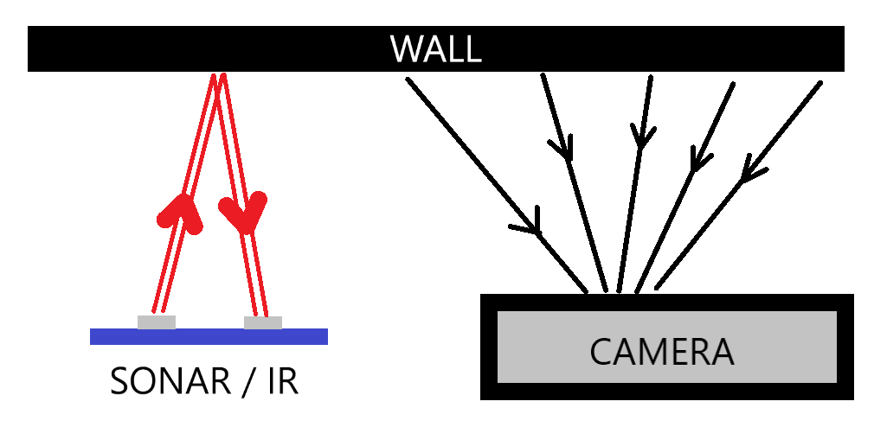
Subsystems – Sensors
Active Sensors: Proximity
IR sensors
Sonar Sensors
Passive Sensor: Camera

Slide 4

Subsystems – Decision and Control
Microprocessor Select: RaspberryPi3
Fast computational skills
Wi-Fi Connection
4 USB + SDCARD ports
Versatility on different applications: Image Processing
DC Motor Driver: L298P
Back EMF protection
Easy-to-use ports
Frequently used, many instructive videos

Slide 5
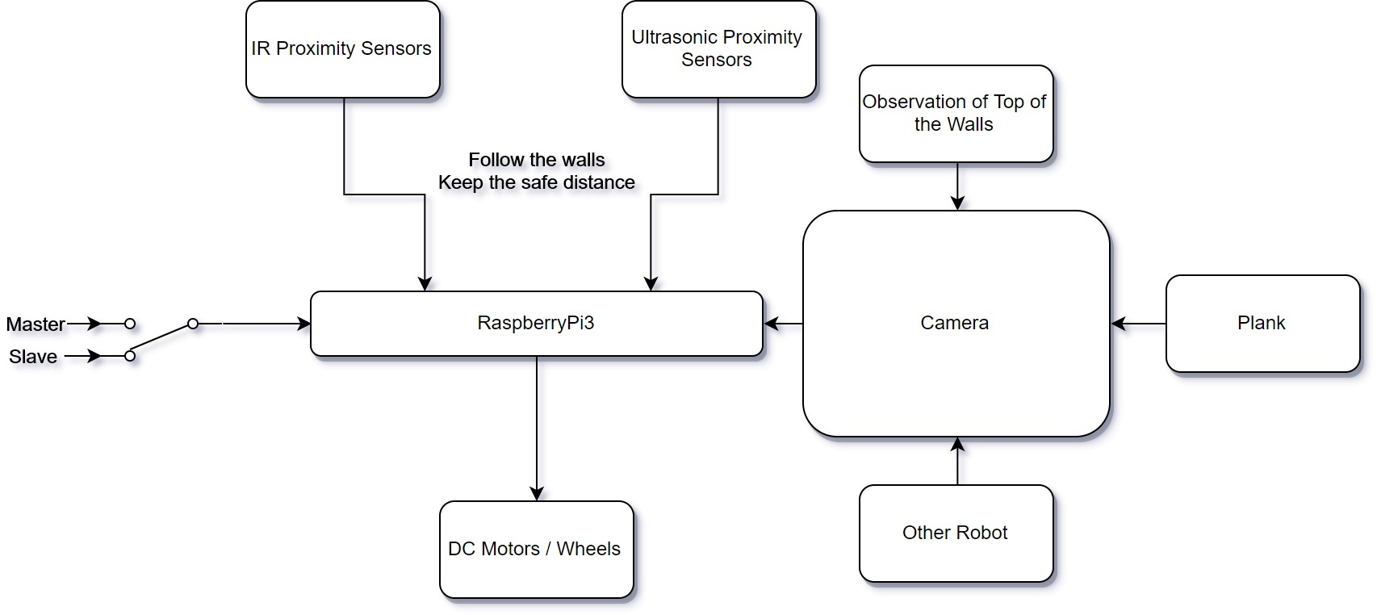
Solution Approach – I: Image Processing

Slide 6
Plank Detection
Binary Masking
Angle Detection

Slide 7
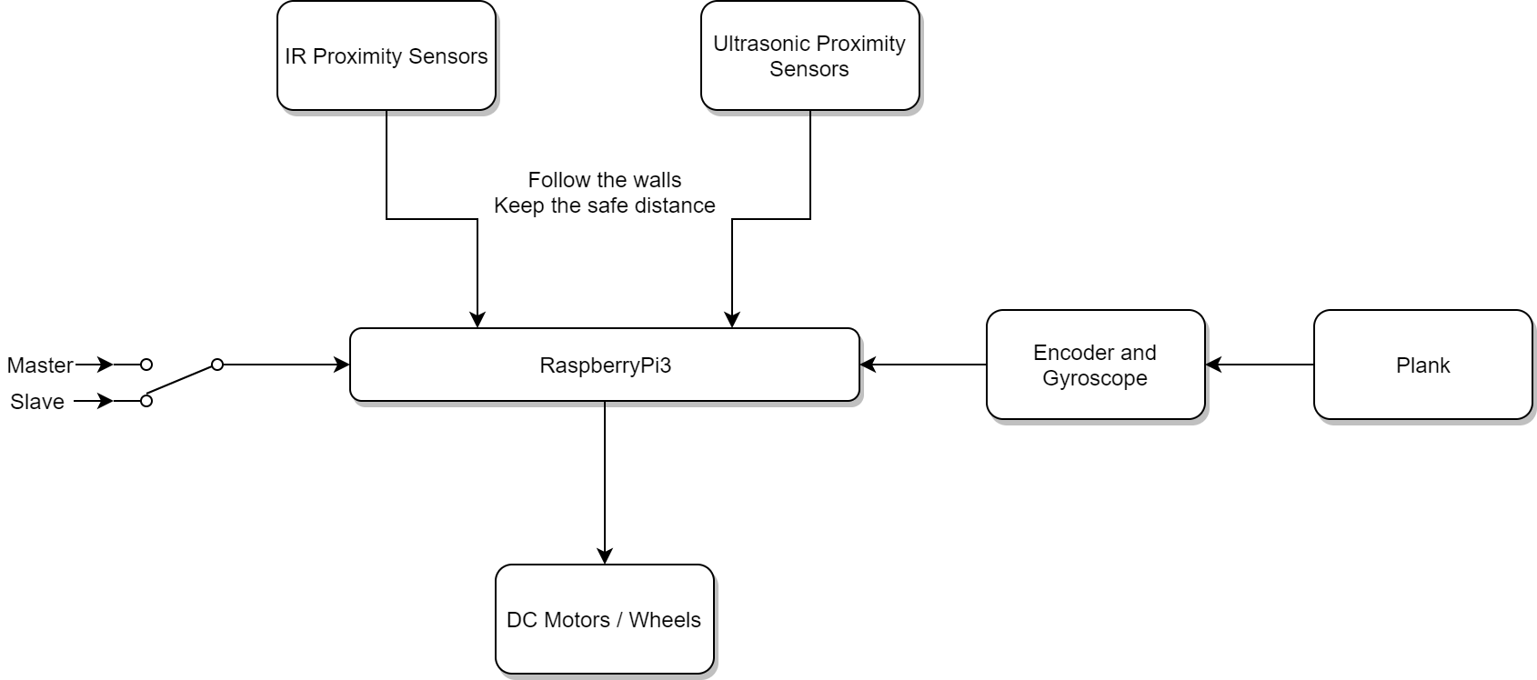
Solution Approach – II: Advancing Hall Effect

