Slide 1

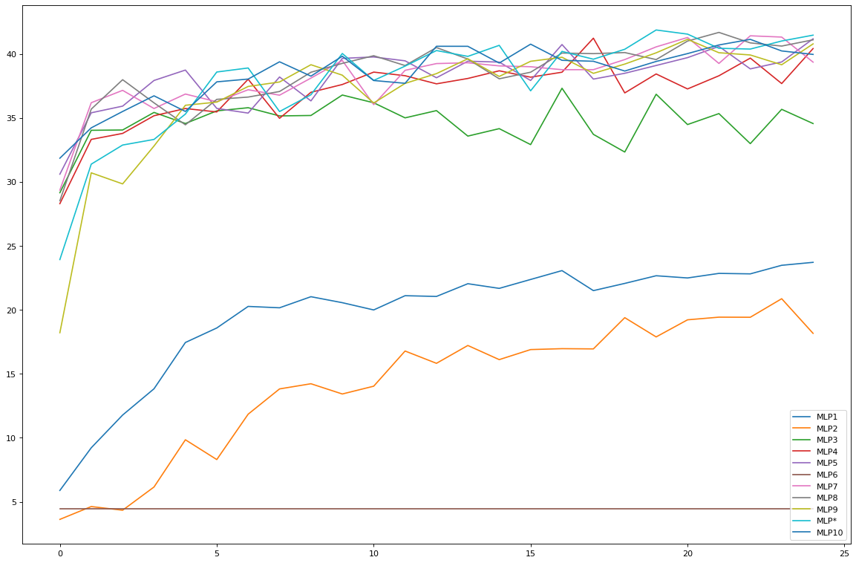
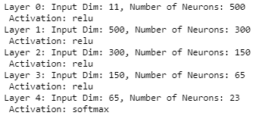
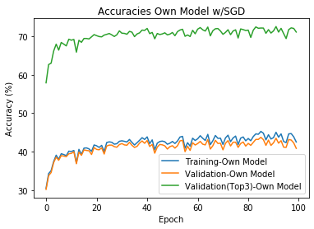
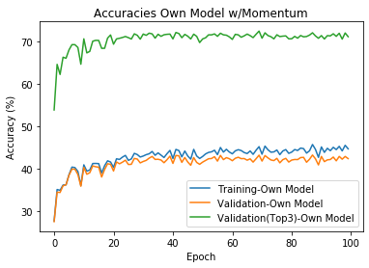
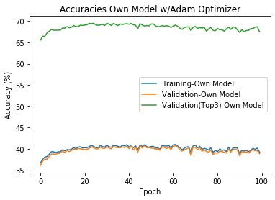
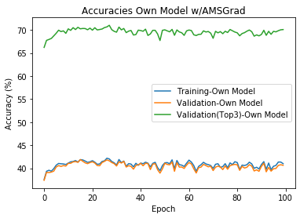
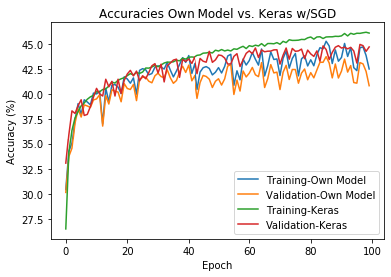
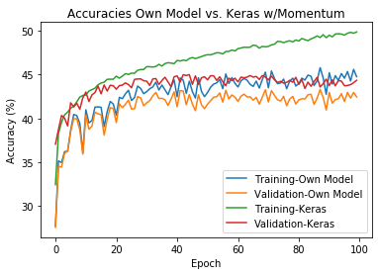
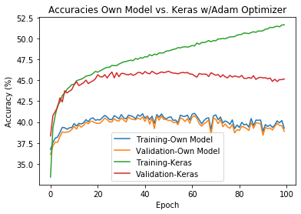
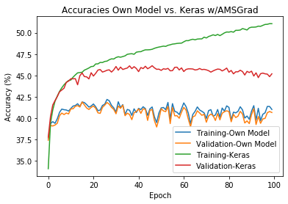
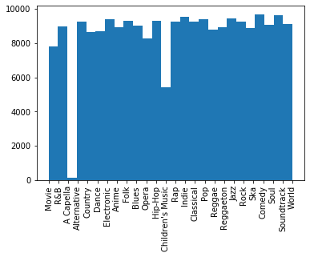
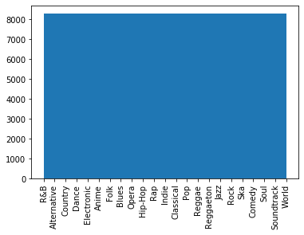
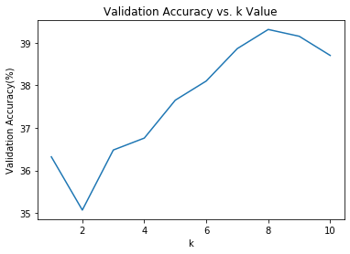
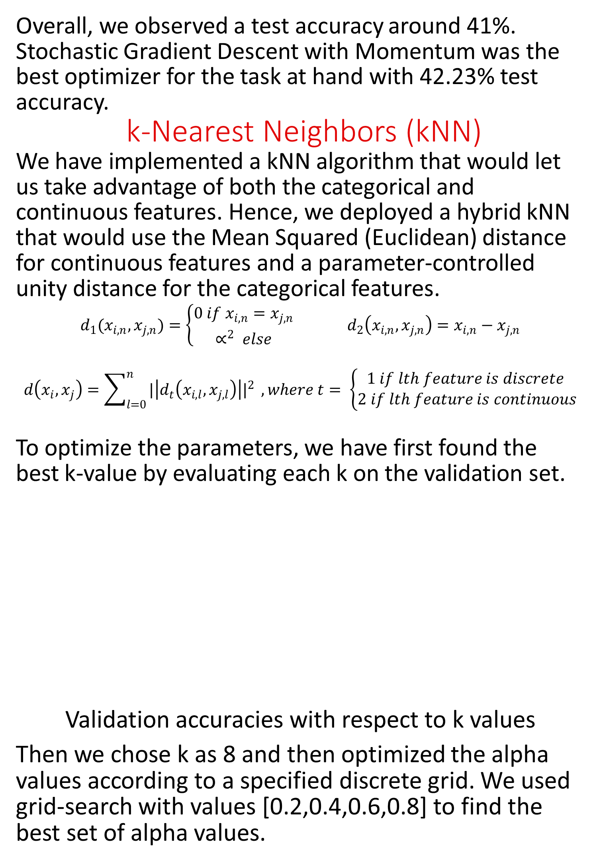
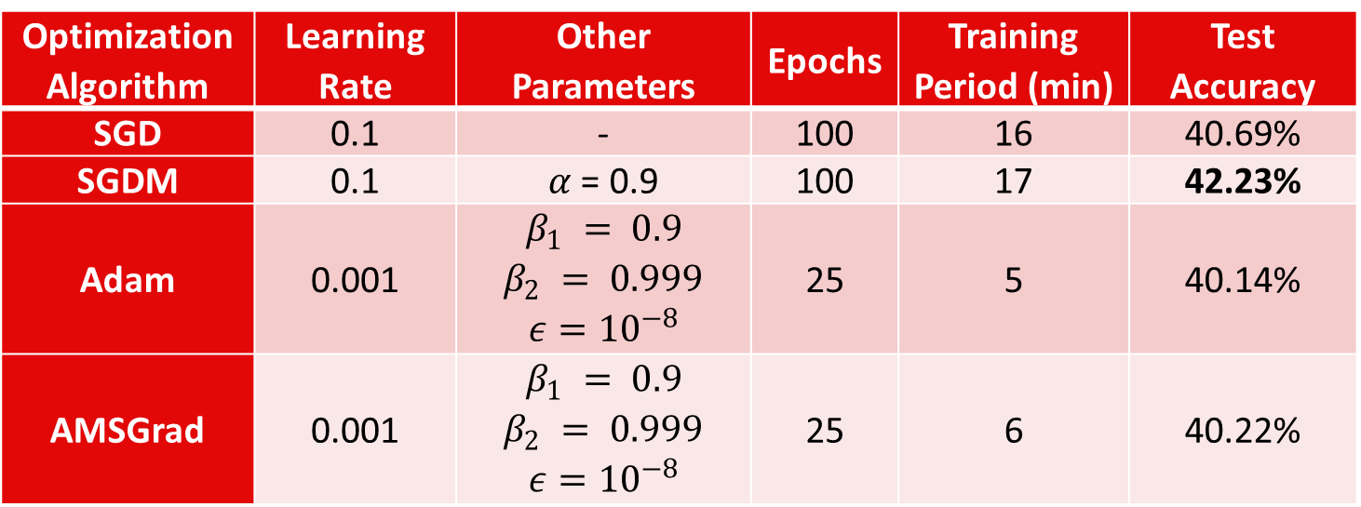
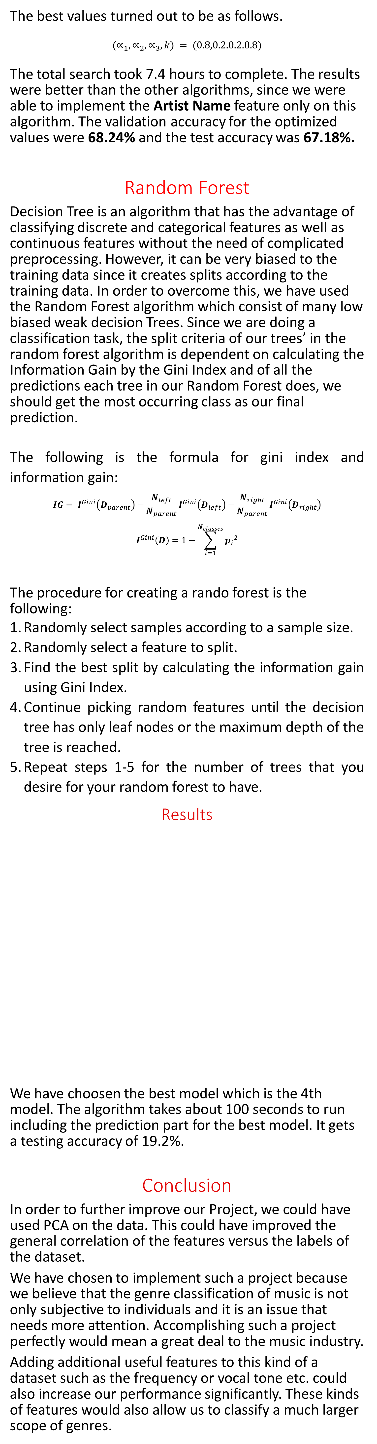
Music Genre Classification using Spotify API Metrics
Ayhan Okuyan & Emre Dönmez
Department of Electrical and Electronics Engineering, Bilkent University
{ayhan.okuyan,emre.donmez}[at]ug.bilkent.edu.tr
Overview
This project tries to classify the genre of a music according to the metrics that are extracted by Spotify API, rather than the conventional MFCC based neural network approaches.
We have preprocessed the data, since the data contained misclassifications and the sample sizes were non-uniform. The data consisted of both continuous and categorical features and we have selected our features based on the implemented methods.
We have used hybrid k-Nearest Neighbors (kNN), Random Forest, and Multilayered Perceptron (MLP) algorithms for classification. We have used a three-way split in each of our algorithms to optimize the algorithm parameters.
Dataset
We have used on the Spotify Tracks DB database [1]. The dataset has around 232 thousand songs which contain 26 different genres and 16 distinct features to learn with.
The reasons for choosing this dataset are the following: It has enough samples for training, validation, and testing; it has many features to choose from and train; it is suitable for the algorithms that we are going to use.
Most importantly since the features presented in the dataset such as danceability or instrumentality are very abstract, also the motive under the project is using these abstract features in order to decide on the genre of a song would be more unbiased.
In the dataset, we see that there are both discrete and continuous features and their scales differing heavily. The most important part of this data are the features, “danceability”, “instrumentalness”, “liveness”, “energy”, “valence” and “acousticness” since these are features that are extracted by Spotify for their own recommender systems.
Preprocessing Data
The data was distributed highly uneven between classes.
The validation accuracies over training epochs are given below with the chosen architecture.
The best values turned out to be as follows.
$$(∝_{1},∝_{2},∝_{3},k) = (0.8,0.2.0.2.0.8)$$
The total search took 7.4 hours to complete. The results were better than the other algorithms, since we were able to implement the Artist Name feature only on this algorithm. The validation accuracy for the optimized values were 68.24% and the test accuracy was 67.18%.
Random Forest
Decision Tree is an algorithm that has the advantage of classifying discrete and categorical features as well as continuous features without the need of complicated preprocessing. However, it can be very biased to the training data since it creates splits according to the training data. In order to overcome this, we have used the Random Forest algorithm which consist of many low biased weak decision Trees. Since we are doing a classification task, the split criteria of our trees’ in the random forest algorithm is dependent on calculating the Information Gain by the Gini Index and of all the predictions each tree in our Random Forest does, we should get the most occurring class as our final prediction.
The following is the formula for gini index and information gain:
$$IG= I^{Gini}\left(D_{parent}\right)−\frac{N_{left}}{N_{parent}}I^{Gini}\left(D_{left}\right)−\frac{N_{right}}{N_{parent}}I^{Gini}\left(D_{right}\right)$$
$$I^{Gini}\left(D\right)=1−\sum_{i=1}^{N_{classes}}{{p_{i}}^{2}}$$
The procedure for creating a rando forest is the following:
Randomly select samples according to a sample size.
Randomly select a feature to split.
Find the best split by calculating the information gain using Gini Index.
Continue picking random features until the decision tree has only leaf nodes or the maximum depth of the tree is reached.
Repeat steps 1-5 for the number of trees that you desire for your random forest to have.
Results
We have choosen the best model which is the 4th model. The algorithm takes about 100 seconds to run including the prediction part for the best model. It gets a testing accuracy of 19.2%.
Conclusion
In order to further improve our Project, we could have used PCA on the data. This could have improved the general correlation of the features versus the labels of the dataset.
We have chosen to implement such a project because we believe that the genre classification of music is not only subjective to individuals and it is an issue that needs more attention. Accomplishing such a project perfectly would mean a great deal to the music industry.
Adding additional useful features to this kind of a dataset such as the frequency or vocal tone etc. could also increase our performance significantly. These kinds of features would also allow us to classify a much larger scope of genres.
Then we implemented four optimizers:
SGD (Stochastic Gradient Descent)
SGDM (Stochastic Gradient Descent with Momentum)
Adam
AMSGrad
We have trained the network with all these optimizers to see which performed best.
We compared the algorithms written with their state of the art Keras implementations.
Forest Number | Sample Size | Number of Trees | Number of Features | Maximum Depth | Minimum Leaf Size | Validation Accuracy %
1 | 80 | 40 | 5 | 10 | 5 | 18.7
2 | 80 | 80 | 5 | 10 | 5 | 19.1
3 | 120 | 40 | 5 | 10 | 5 | 19.2
4 | 120 | 80 | 5 | 10 | 5 | 20.96
5 | 40 | 40 | 5 | 10 | 5 | 18.6
6 | 40 | 80 | 5 | 10 | 5 | 18.3
7 | 120 | 80 | 3 | 10 | 5 | 20.3
8 | 120 | 80 | 8 | 10 | 5 | 20.3
9 | 120 | 80 | 5 | 20 | 2 | 19.3
10 | 120 | 80 | 5 | 5 | 2 | 13.6
11 | 120 | 80 | 5 | 20 | 10 | 20.94
12 | 120 | 80 | 5 | 5 | 10 | 19.5
13 | 120 | 80 | 5 | 10 | 2 | 15.4
14 | 120 | 80 | 5 | 10 | 10 | 20.94
The distribution of data samples before and after preprocessing
We have fixed the misclassifications and removed the underrepresented classes. Then down sampled the data randomly to the same size for each class.
Multilayered Perceptron (MLP)
We have implemented a hard-coded generic neural network framework to train multiple different structures all within the same code structure. The framework is used to create networks with
Various number of hidden layers
Various hidden units in each layer
Initialization of weights using selectable normal distribution parameters.
Four different activation functions for each layer.
Sigmoid
Tanh
ReLU
Softmax (with Cross Entropy Loss)
Two different loss functions.
Cross-Entropy (CE)
Mean Squared Error (MSE)
Generic learning rate
Optimized the model using Stochastic Mini-Batch Gradient Descent update rule to find the optimal architecture.
Ten various architectures are observed. Most of the architectures saturated around the same range, and we have taken the most successful one. The important patterns found while iterating are given as.
ReLU is the choice of activation rather than bipolar options.
Output layer should be Softmax.
Cross Entropy loss should be used.
He initialization [2] should used for ReLU networks.
Results
Optimization Algorithm | Learning Rate | Other Parameters | Epochs | Training Period (min) | Test Accuracy
SGD | 0.1 | - | 100 | 16 | 40.69%
SGDM | 0.1 | $α$ = 0.9 | 100 | 17 | 42.23%
Adam | 0.001 | $$β_{1} = 0.9$$ $$β_{2} = 0.999$$ $$ε={10}^{−8}$$ | 25 | 5 | 40.14%
AMSGrad | 0.001 | $$β_{1} = 0.9$$ $$β_{2} = 0.999$$ $$ε={10}^{−8}$$ | 25 | 6 | 40.22%
Overall, we observed a test accuracy around 41%. Stochastic Gradient Descent with Momentum was the best optimizer for the task at hand with 42.23% test accuracy.
k-Nearest Neighbors (kNN)
We have implemented a kNN algorithm that would let us take advantage of both the categorical and continuous features. Hence, we deployed a hybrid kNN that would use the Mean Squared (Euclidean) distance for continuous features and a parameter-controlled unity distance for the categorical features.
$$d_{1}(x_{i,n},x_{j,n})=\left\{\begin{aligned}0 if x_{i,n}=x_{j,n} \\ ∝^{2} else\end{aligned}\right. d_{2}\left(x_{i,n},x_{j,n}\right)=x_{i,n}−x_{j,n}$$
$$d\left(x_{i},x_{j}\right)=\sum_{l=0}^{n}{{|\left|d_{t}\left(x_{i,l},x_{j,l}\right)\right||}^{2}} , where t= \left\{\begin{aligned}1 if lth feature is discrete \\ 2 if lth feature is continuous\end{aligned}\right.$$
To optimize the parameters, we have first found the best k-value by evaluating each k on the validation set.
Validation accuracies with respect to k values
Then we chose k as 8 and then optimized the alpha values according to a specified discrete grid. We used grid-search with values [0.2,0.4,0.6,0.8] to find the best set of alpha values.
References
[1] Spotify DB Tracks, Kaggle, https://www.kaggle.com/zaheenhamidani/ultimate-spotify-tracks-db/version/3, [Accessed: 7-Nov-2019]
[2] Kakaraparthi, “Xavier and He Normal (He-et-al) Initialization,” Medium, 29-Sep-2018. [Online]. Available: https://medium.com/@prateekvishnu/xavier-and-he-normal-he-et-al-initialization-8e3d7a087528. [Accessed: 09-Nov-2019].

