Slide 1

COMP 4811 Internship Presentation
Yaşar University, Computer Engineering
Emre efe yüksel
Student Number:22070001055
Ogem mühendislik
Berkay uz / Computer engıneer-transmıssıon expert
07.07.2025-04.08.2025

Slide 2
Presentation Outline
Brief Summary of the Internship
Description of the Company/Institution
Internship Activities
Assessment of the Internship
Conclusions of the Internship
References

Slide 3
Brief Summary of the Internship
Ogem Engineering is a company operating in the field of telecommunications. The company provides engineering solutions and services related to communication technologies and network systems.
- During my internship, I worked in the transmission unit, which is responsible for the analysis, monitoring, and improvement of transmission systems within the company’s telecommunication projects.
- As a computer engineering student, my responsibilities mainly involved data processing, analysis using tools such as Python and Excel, and supporting the team with reporting tasks. The team included telecommunication, electronics, and computer engineers, allowing me to experience interdisciplinary collaboration.

Slide 4
Description of the Company/Organization
Full Title: Ogem Mühendislik İletişim Makina Taşıma İthalat İhracat Sanayi ve Ticaret Ltd. Şti. Address: EGEMENLİK MAH. AYDINLAR CADDESİ NO:34/A IŞIKKENT-BORNOVA-İZMİR
Web: http://www.ogemmuhendislik.com.tr E-mail: [Email]
Brief History: Ogem Engineering, operating in the GSM and telecommunication sector, was founded in 2015 by partners with over 15 years of experience. The company name stands for “Honorable Entrepreneurial Workers” (Onurlu Girişim Emekçileri) and represents its core values of integrity, honesty, and quality service.
Sector and Services: The company operates in the telecommunication sector, offering:
Network design and installation,
Transmission systems optimization,
Performance monitoring and data analysis,
Maintenance and technical support.
Customers: Its main customers are telecommunication operators, private companies, and public institutions that require communication infrastructure and network services.

Slide 5
Internship Activities-1
1. My Role and Responsibilities
Worked in the Transmission Unit of Ogem Engineering, focused on telecommunication systems.
Main tasks included:
Data analysis and processing using Python and Excel.
Preparing technical reports summarizing transmission performance.
Supporting the team with performance evaluation and documentation.

Slide 6
Internship Activities-2
2. Key Activities
Analyzed transmission data to monitor signal quality and identify instability.
Visualized data using Matplotlib for better understanding of system behavior.
Collaborated in a multidisciplinary team with telecommunication, electronics, and computer engineers.
Participated in team meetings for project updates, performance reviews, and improvement planning.
Learned internal reporting standards and followed structured reporting formats.

Slide 7
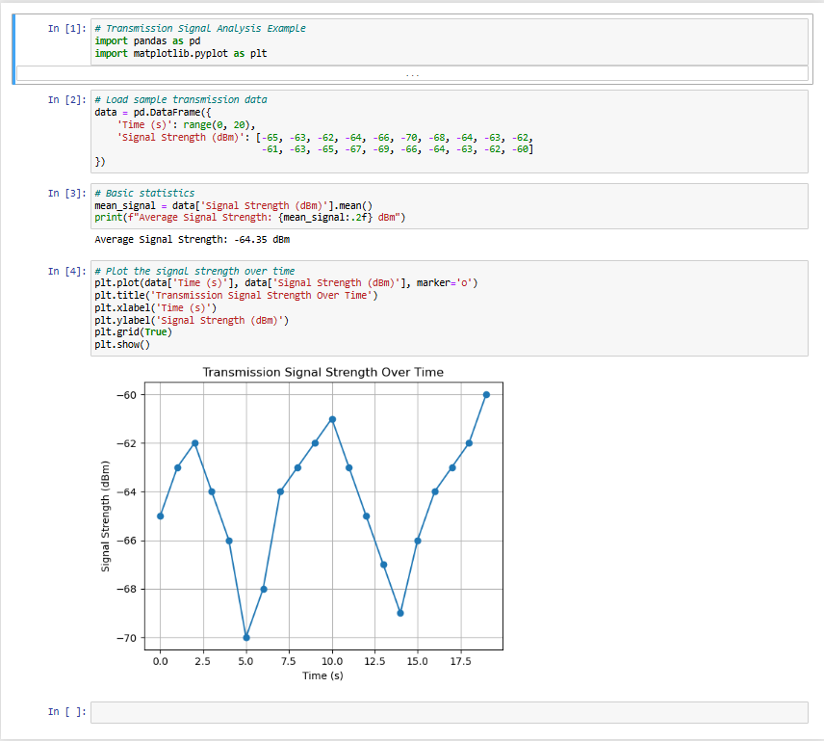
Appendix A – Example Python Code for Transmission Data Analysis
Explanation: This Python code simulates the analysis of signal strength data collected from a transmission system. The graph shows how signal strength varies over time, helping engineers identify potential instability or interference in the communication link.

Slide 8
Internship Activities-3
3. Tools and Technologies Used
Python – data processing, analysis, plotting graphs.
Excel – data processing, charts, and reporting.
Company-specific monitoring tools – for evaluating transmission performance.
Learned to apply ITU and IEEE telecommunication standards in practical tasks.

Slide 9
Internship Activities-4
4. Skills and Experience Gained
Technical skills: Data analysis, report preparation, signal performance evaluation.
Professional skills: Teamwork in a multidisciplinary environment, communication, and project collaboration.
Industry insights: Importance of standards, safety, data confidentiality, and efficient resource management in telecommunications.
Observed how theoretical knowledge from university is applied in real-world telecommunication projects.

Slide 10
Internship Activities-5
5. Key Takeaways
Real-world exposure to telecommunication systems engineering.
Improved problem-solving and reporting skills.
Understanding of cross-departmental collaboration and project workflow in a professional setting.

Slide 11
Assessment of the Internship
Knowledge and Skills You Need to Assess | Yes | Partial | No
Ability to work efficiently in intra-disciplinary and multi-disciplinary teams; ability to work individually. | X
Ability to write report and understand written reports effectively, to prepare design and product reports, to conduct effective presentations, and to give and receive clear and understandable instructions. | X
Acting in accordance with ethical principles, consciousness of professional and ethical responsibility; knowledge of the standards used in engineering practice. | X
Knowledge about business life practices such as project management, risk management, and change management; awareness of entrepreneurship and innovation; knowledge of sustainable development. | X
Knowledge about contemporary issues and the global and societal effects of engineering practices on health, environment, and safety; awareness of the legal consequences of engineering solutions. | X

Slide 12
Conclusions of the Internship
-This internship allowed me to understand how engineering knowledge is applied in the telecommunications industry.
-I experienced teamwork in a multidisciplinary environment and improved my skills in data analysis, problem-solving, and reporting.
-I also observed the importance of standards, safety, and efficient data management in the telecommunication sector, which strengthened my professional perspective.

Slide 13
References
[1] Python Software Foundation, Python Documentation, Available at: https://docs.python.org/3/ (Accessed: July 2025).
[2] Microsoft Corporation, Microsoft Excel User Guide, Available at: https://support.microsoft.com/excel (Accessed: July 2025).
[3] International Telecommunication Union (ITU), Telecommunication Standardization Sector Recommendations, Available at: https://www.itu.int/en/ITU-T (Accessed: July 2025).
[4] Ogem Engineering, Internal Technical Documents and Reports, İzmir, 2025.
[5] IEEE, IEEE Standards for Telecommunication Systems, IEEE Communications Society, 2020.
[6] Matplotlib Development Team, Matplotlib Documentation, Available at: https://matplotlib.org/stable/contents.html (Accessed: July 2025).

Slide 14

Thank you for your attention

