Slide 1
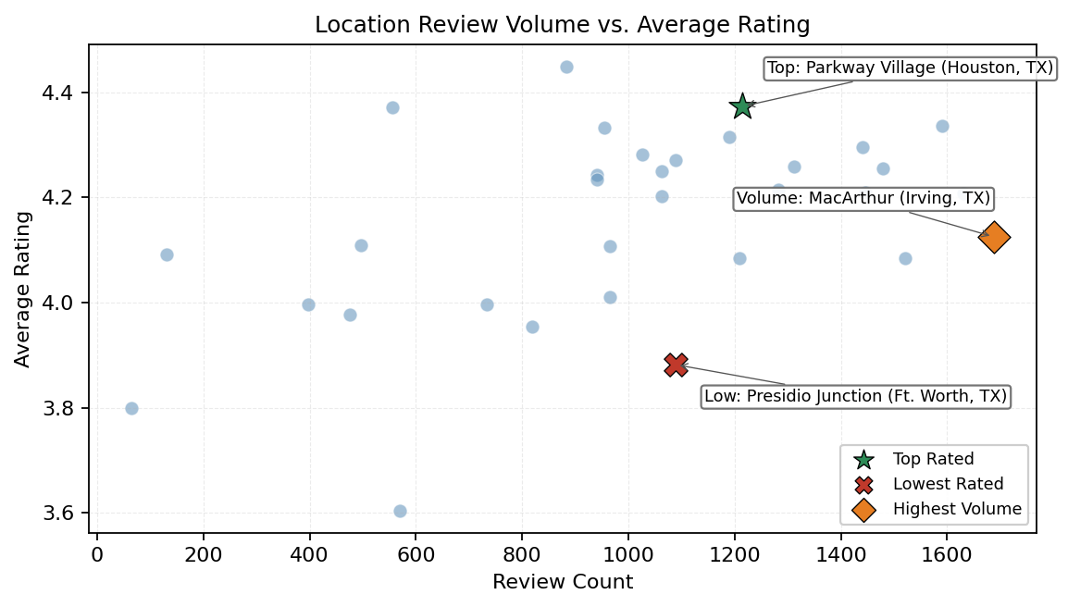
la Madeleine Location Review Insights
Key Highlights
Top rated location (>= 1044 reviews): Parkway Village (Houston, TX) with avg rating 4.37 across 1215 reviews.
Lowest rated location (>= 1044 reviews): Presidio Junction (Ft. Worth, TX) at 3.88; indicates service quality variance.
Highest volume location: MacArthur (Irving, TX) with 1688 reviews and avg rating 4.12.
Review-to-location match coverage is 100.0% (32232/32232).
Rating spread across stable locations is 0.49 points, useful for geo-prioritized deep dives.

