Slide 1
Serverless with Azure

Slide 2

About Us
Emre Kenci
Sr. Software Development Engineer
Commercial Software Engineering
emre.kenci@microsoft.com
twitter.com/emrekenci
github.com/emrekenci
İbrahim Kıvanç
Sr. Software Development Engineer
Commercial Software Engineering
ikivanc@microsoft.com
twitter.com/ikivanc
github.com/ikivanc
aka.ms/fsi-serverless

Slide 3
What is Serverless?
$
Abstraction of servers and operating systems
Event-driven/ instant scale
Micro-billing
Notes:
Abstraction of servers, infrastructure and configuration of operating system
Event-driven scale
Sub-second billing
Stateless
Serverless compute is a fully managed service. Some refer to it as Functions as a Service
OS and Framework patching is performed for you
There is zero administrative tasks and no need to manage any infrastructure
You just deploy your code (function) and it runs
Serverless compute scales quickly (almost instantly) and vastly
Automatically scales within seconds
No scale configuration is required (there is no way to configure scale or limits)
Scales to match any given workload. Scales from zero to handle tens of thousands concurrent functions invocations within seconds
Pay only for the time your code is running
Serverless compute reacts to events
React, in near real-time, to events and triggers
Triggered by virtually any event from Azure service or 3rd party services
Setup time, provisioning is long & costly

Slide 4
Benefits of Serverless
Reduced DevOps
Manage apps not servers
Faster time to market
Notes:
Abstraction of servers, infrastructure and configuration of operating system
Event-driven scale
Sub-second billing
Stateless
Serverless compute is a fully managed service. Some refer to it as Functions as a Service
OS and Framework patching is performed for you
There is zero administrative tasks and no need to manage any infrastructure
You just deploy your code (function) and it runs
Your code runs within seconds and for very short period of time
Serverless compute scales quickly (almost instantly) and vastly
Automatically scales within seconds
No scale configuration is required (there is no way to configure scale or limits)
Scales to match any given workload. Scales from zero to handle tens of thousands concurrent functions invocations within seconds
Pay only for the time your code is running
Serverless compute reacts to events
React, in near real-time, to events and triggers
Triggered by virtually any event from Azure service or 3rd party services
Setup time, provisioning is long & costly

Slide 5



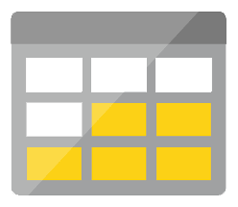




Serverless application platform components
Development
Platform
IDE support
Event Grid
Logic Apps
Functions
Manage all events that can trigger code or logic
Design workflows and orchestrate processes
Execute your code based on events you specify
Integrated DevOps
Local Development
Monitoring
Database
Storage
Security
IoT
Analytics
Intelligence
Visual Debug History

Slide 6
Serverless application platform components
Development
Platform
IDE support
Functions
Logic apps
Event Grid
Integrated DevOps
Developer productivity
Visual designer
Manage all events in one place
Triggers and Bindings
100+ connectors
Near real-time delivery
Local development
Flexible deployment options
Functions orchestration
Broad coverage
Monitoring
Database
Storage
Security & Access Control
IoT
Analytics
Intelligence
Visual Debug History

Slide 7
Key Indicators for Serverless

Slide 8
Key Indicators for Serverless
Stateless and scale
Not worth deploying a traditional backend
Workload is sporadic (high volatility of demand)
Dev ops favored versus dedicated ops
Lots of different services that need “glue”

Slide 9
Serverless scenarios: anything that responds to events
Timer-based processing
Real-time stream processing
Every 15 minutes
Find and clean invalid data
Clean table
Millions of devices feed into Stream Analytics
Transform to structured data
Store data in SQL DB
Mobile app backends
Real-time bot messaging
?
...
Photo taken and WebHook called
Stores in blob storage
Produces scaled images
Message sent to Chatbot
Chatbot sends
response
Cortana Analytics answers questions

Slide 10


Introducing Functions
Code
Azure Functions
Events + data

Slide 11
Azure Functions Demo

Slide 12
Patterns to Follow
Keep execution short and return quickly
Decouple tasks
Compile and or pack to optimize cold start times
Always use Application Insights
Code on Visual Studio or Visual Studio Code
Notes:
Similar to microservice patterns (12 factor)

Slide 13
Dynamic tier pricing
Pay per execution model - two meters, three units
Number of executions
Duration of execution x reserved memory
First million executions free.

Slide 14

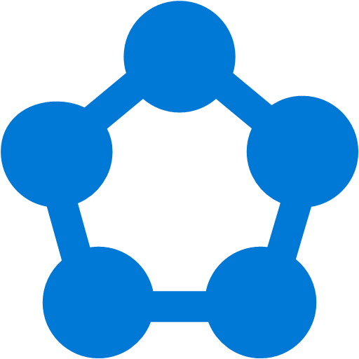








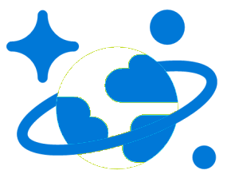
Modern computing is all about events

Slide 15
?
Managing events is important but cumbersome
?
?
?
?
?
?
?
?
?
?
?

Slide 16

What if all these events could be managed and directed from one place?

Slide 17
Azure Event Grid
Fully-managed event routing
Near real-time event delivery at scale
Broad coverage within Azure and beyond
Backbone of event-driven computing
Notes:
If you’ve done any UI work in the past, you might be familiar with delegates and event-driven programming. This has been a solved problem for a long time within application, now it is finally coming to the cloud.

Slide 18







Manage all events in one place
Event publishers
Event handlers
Blob Storage
Azure Functions
Resource Groups
Logic Apps
Azure Subscriptions
Azure Automation
Event Hubs
WebHooks
Custom Events
Notes:
It comes down to having a collection of event publishers and event handlers.

Slide 19
Ensure reliability and performance in your apps
Sub-second end-to-end latency in the 99th percentile
10,000,000 events per second per region
24-hour retry with exponential back off for events not delivered
Near real-time
Massive scale-out
High reliability
Notes:
We want to deliver reliable notification in near real-time, at massive scale. It needs to be highly reliable, you should be able to create items/messages that you can’t afford to lose.

Slide 20
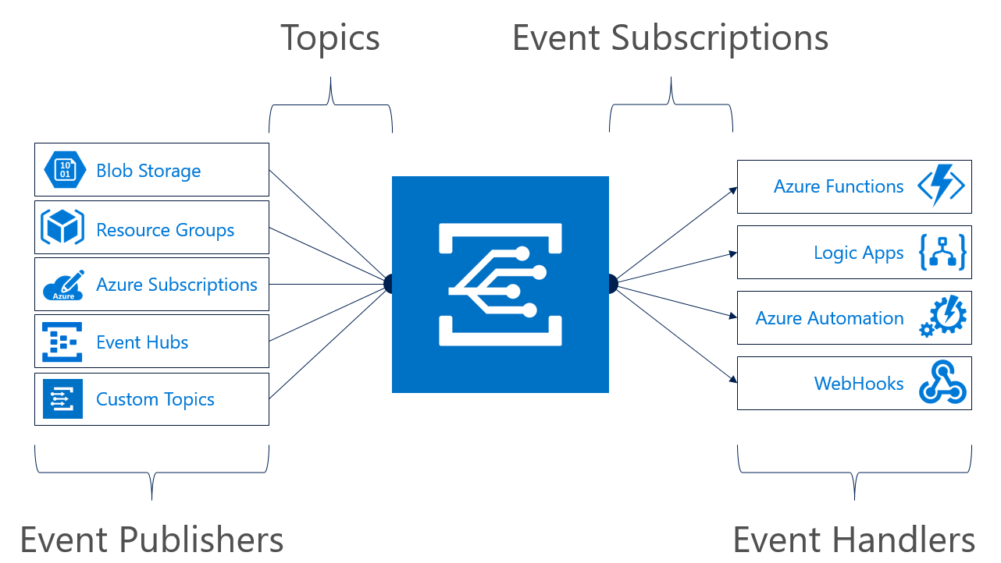
Concepts
Events: what happened
Event Publishers: where it took place
Topics: where publishers send events
Event Subscriptions: how you receive events
Event Handlers: the app or service reacting to the event
Notes:
Most topics in Event Grid are implicit unless you are using custom topics.

Slide 21
Event Grid guiding principles
Events are independent
Always available
Near real-time event delivery
At least once delivery
Dynamic scale
Platform agnostic (WebHook)
Language agnostic (HTTP protocol)

Slide 22
Event Grid Demo

Slide 23
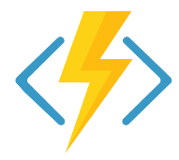
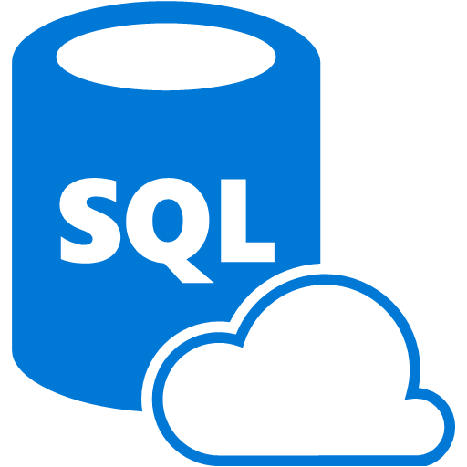

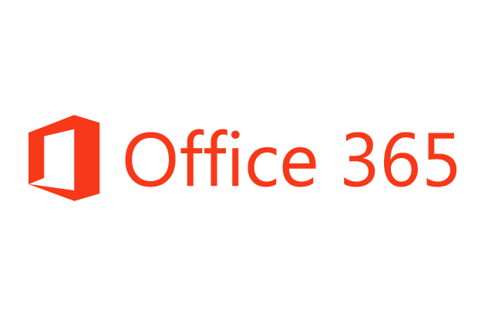
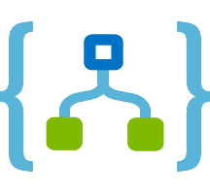

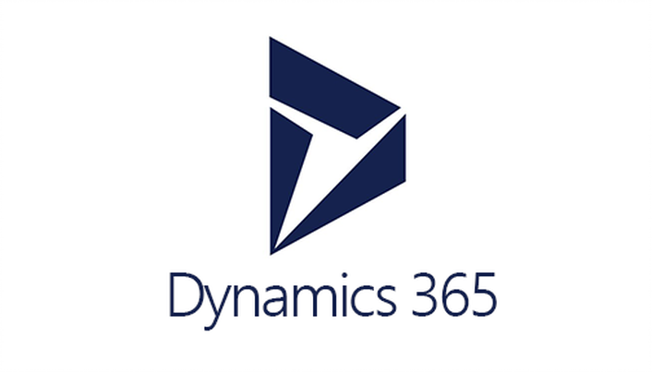


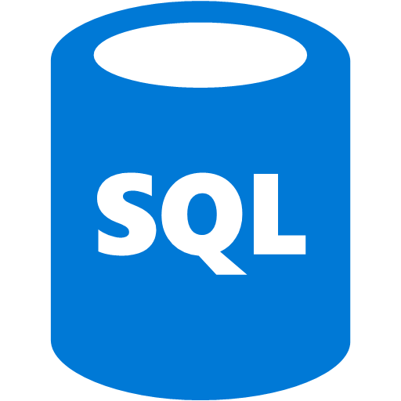
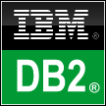



Logic Apps connects everything
Azure Functions
Service bus
Cognitive services
Logic Apps
Machine learning
On-premises data gateway
BizTalk server
Notes:
Logic Apps can integrate with “anything” (APIs) and solve small or complex problems. Automation in a secure and reliable environment fast and easy.
Connect Anything:
On-premises, hybrid and cloud
Mission critical, complex integration scenarios
Business productivity
Agile Business:
Quickly create workflows
Position to the future API centric
Transform Business:
Extract value from both (on-premises and cloud apps)
Build Holistic integration solutions.

Slide 24
Everything? Really?
Okay, not everything. But there are 200 connectors and in
preview is the ability to create custom connectors. And with
Event Grid, we have many more options as well.

Slide 25
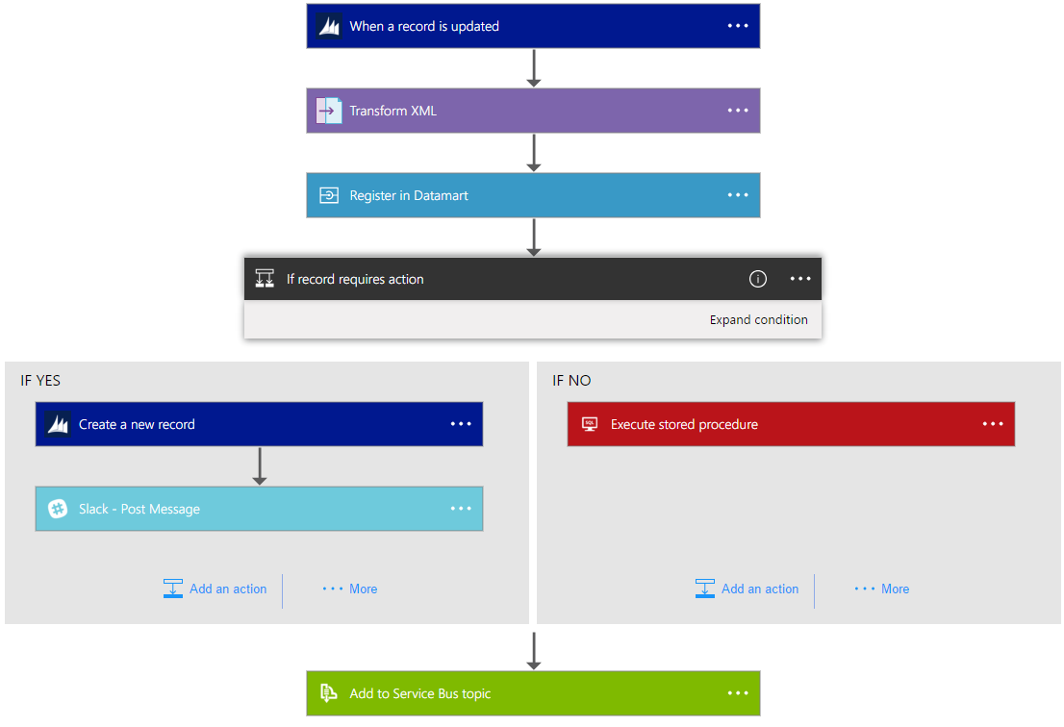
Logic Apps Workflow Designer
Workflow in the cloud
Powerful control flow
Connect disparate applications
No code designer for rapid creation
Also works within Visual Studio for added CI/CD

Slide 26
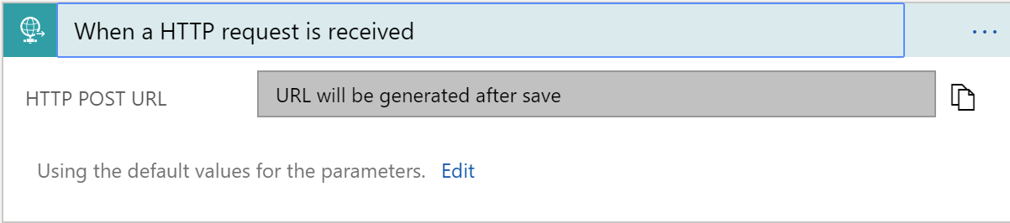
Triggers
All logic apps start with a trigger, typically a connector
Recurring and Adv. Scheduling
Polling
Webhook
Request

Slide 27
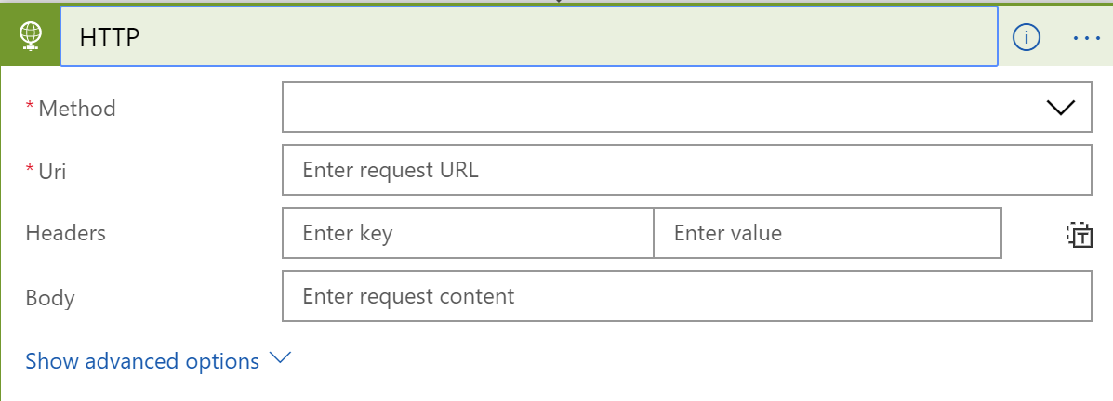
Actions
All logic apps continue with actions, which is also most of the time, a connector
Invoke APIs and Services
Behaviors
Variables
Expressions and Operators

Slide 28
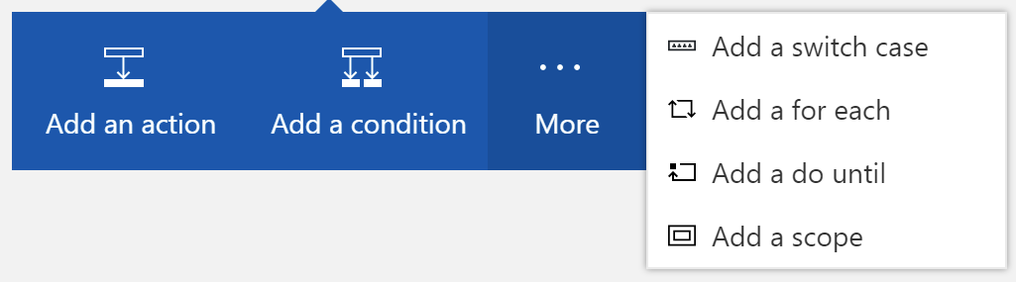
Workflow Features
To control your logic app's workflow, you can specify different paths for your logic app to run and how to process data in arrays, collections, and batches

Slide 29
Logic Apps Demo
Notes:
TIME MARKER: 10:40 A.M.

Slide 30
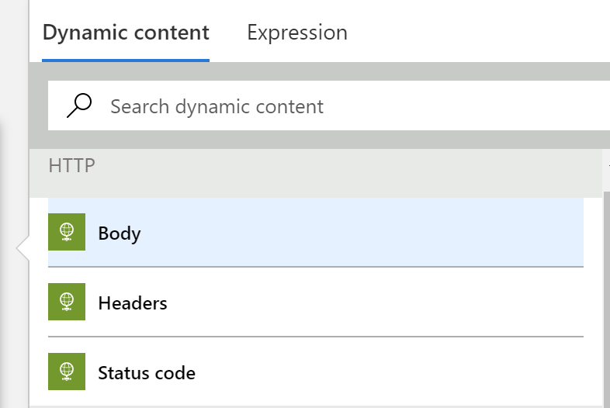
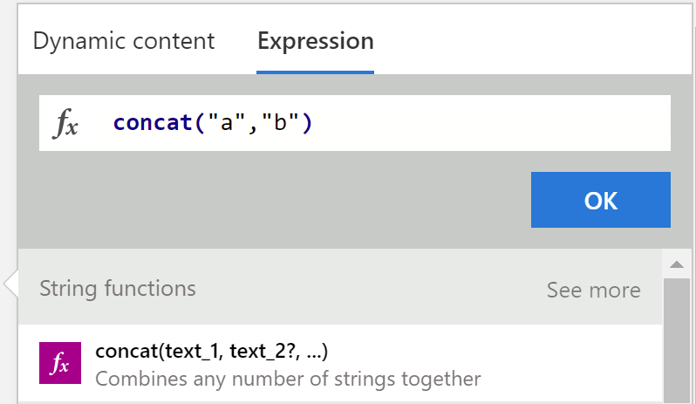
Tips and Tricks
Dynamic Content
Expressions

Slide 31
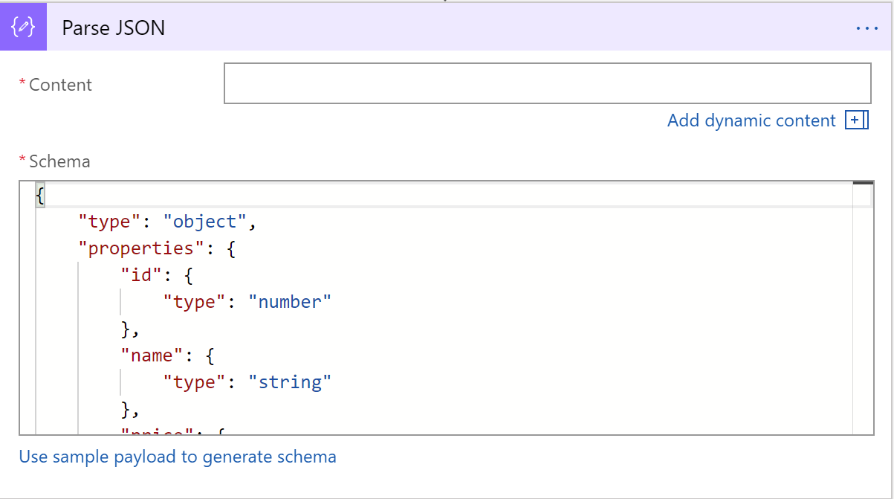
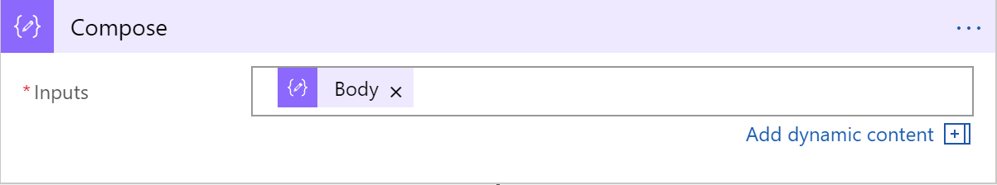
Tips and Tricks
Common shapes that will be used
Parse JSON
Compose
Notes:
Parse JSON – take a JSON object and convert to a specified schema
- constructing any output, including objects, arrays, and any other type natively supported by logic apps

Slide 32
Workflow Patterns

Slide 33
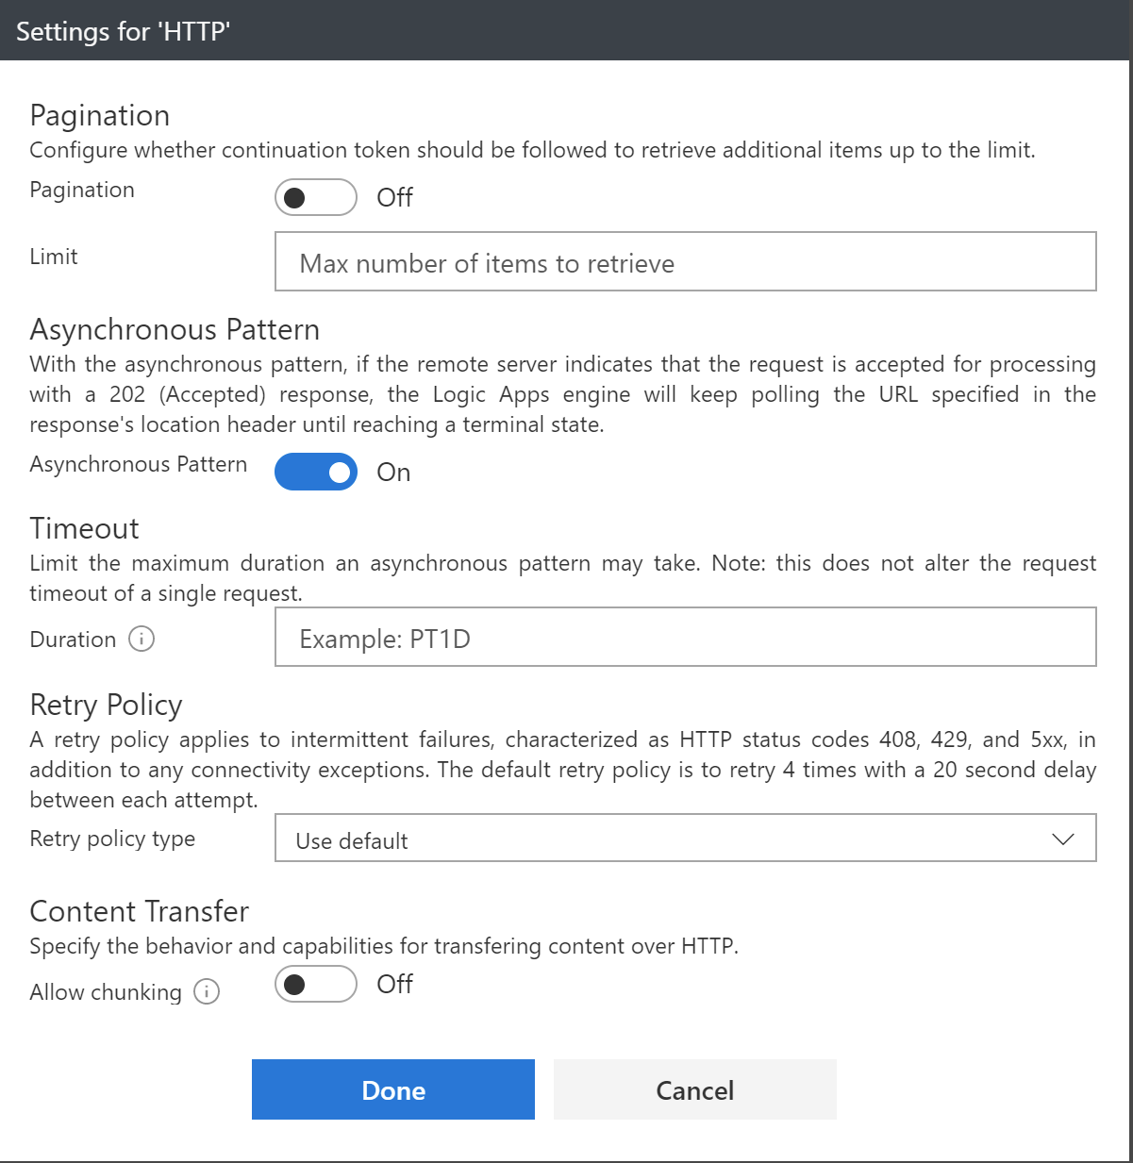
Error Handling
Notes:
Retry policy
Default, custom, and disabled
Run After
Conditional dependency control
Status: Succeeded, Failed, TimedOut, Skipped
Terminate
Early termination
Failed or Successful status
Scopes
Encapsulate a set of actions
Status: Determined by the status of the leaf nodes within the Scope
Succeeded: all must have succeeded
Skipped: all must have been skipped
Failed: any not succeeded or skipped

Slide 34
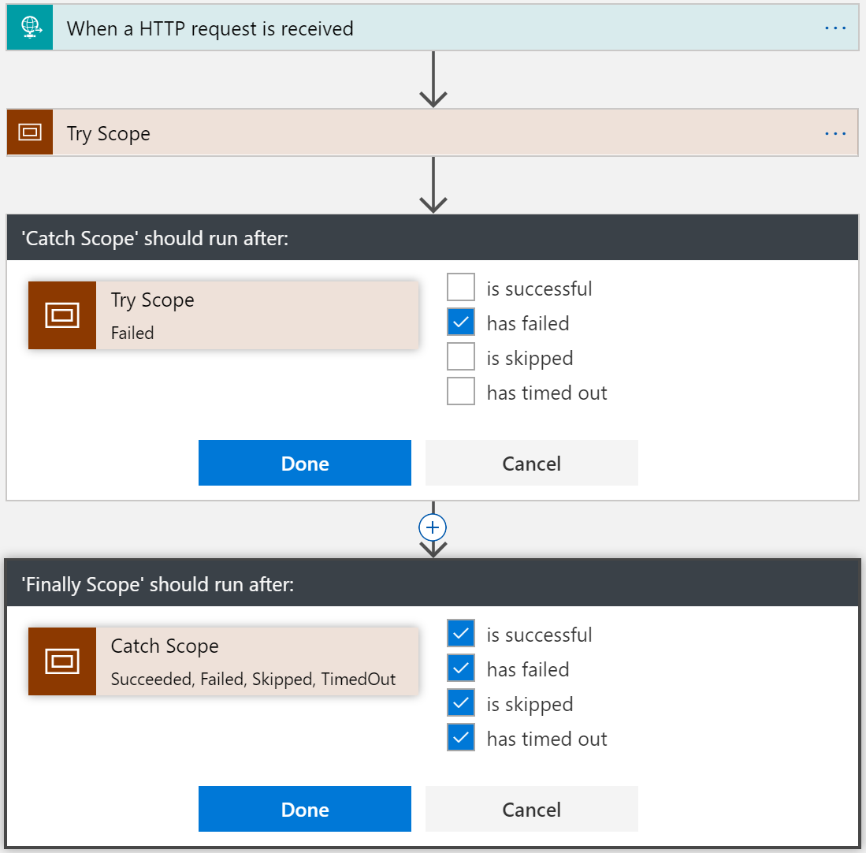
Try-Catch-Finally Pattern
Try
Put actions in a Try scope
Catch
Run after Try scope Failed
Finally
Run after Catch scope Succeeded, Skipped, TimedOut, or Failed
Notes:
Scopes
Encapsulate a set of actions
Status: Determined by the status of the leaf nodes within the Scope
Succeeded: all must have succeeded
Skipped: all must have been skipped
Failed: any not succeeded or skipped

Slide 35
Long Running Processing
Until Condition is met
Do-until loop
Evaluated condition, total time, or count
When a Timeout has occurred
Configure timeout action setting
While other work is being done
Parallel actions

Slide 36
Concurrency Control
Runs
Instances are created concurrently
Singleton trigger executions
Degrees of parallel execution
Only for non split-on polling triggers
For Each Loops
Collections handled concurrently
Sequential For Each
For each degrees of parallelism
Parallel actions
Explicit parallelization
Join with Run After
Do Until Loops
Runs sequentially

Slide 37
Advanced scheduling
// Occur on the last Friday of every month at 8:30am and 5:30pm
"triggers": {
"Recurrence":
"recurrence":
{
“startTime": "2017-11-01T15:30:30Z",
"frequency": "month",
"interval": 1,
"schedule":
{
"minutes": [30],
"hours": [8,17],
"monthlyOccurrences":
[
{"day": "friday", "occurrence": -1}
]
}
},
"type": "Recurrence"
}

Slide 38
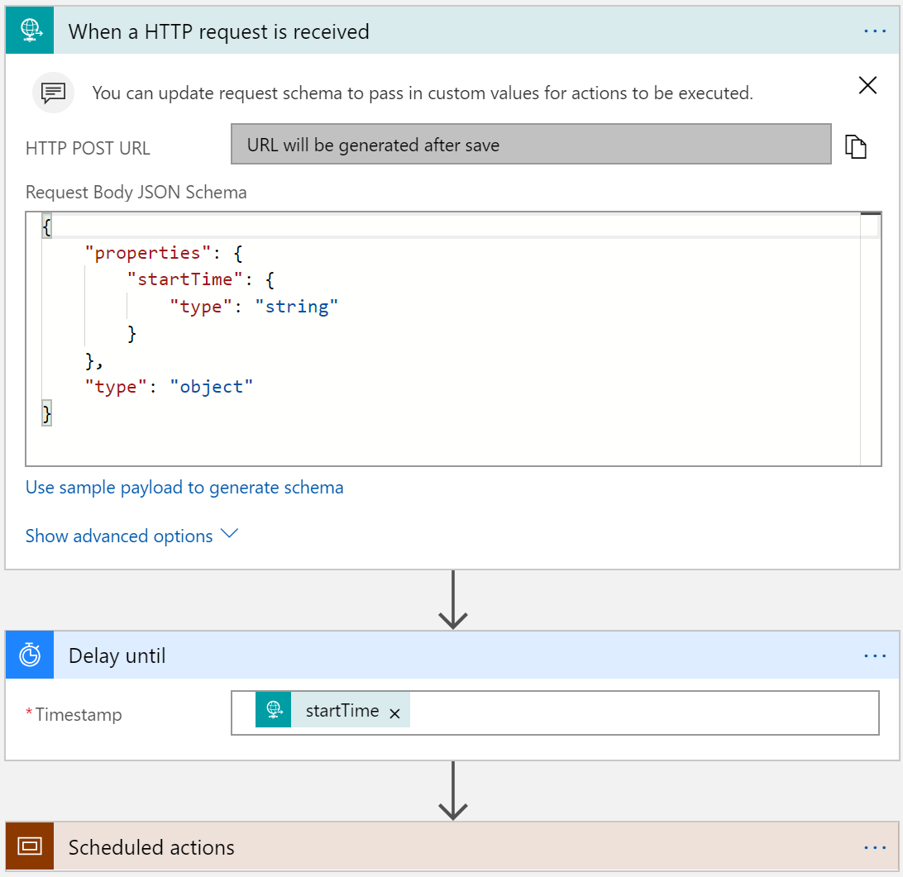
Run Once Jobs
Request trigger
Start time input
Delay Until (start time)
Instantiate millions of scheduled jobs

Slide 39

Batching
Grouping and processing messages
2 Logic Apps – sender and receiver
‘batcher’ aware of batching logic app
Batching logic app not aware of batcher(s) – 1:n
Partition within batch
Config
Event
Time based
Count Based
Size based (soon)
Batch
Trigger

Slide 40
Learnings
Know the Limits of Logic Apps
Consider the workflow – high throughput vs long running workflow
Understand the data structure
Leverage concurrency as much as possible
Consider side-by-side strategy for testing

Slide 41
Misconceptions and Gotchas
Not a lightweight BizTalk
Its not a silver bullet
Be aware of the workload (for loops, etc.)
Management is either in the portal or Visual Studio
ALM is defined in VSTS, but has short comings
There is not much guidance – but that’s why we are here!

Slide 42
Next Steps
For you
For your Company
Visit our Github page:
aka.ms/serverlesscontent
Functions Podcast:
http://azureninjas.cloud/episode/serverless
Event Grid article
https://msdn.microsoft.com/en-us/magazine/mt829271.aspx
CodeSlinger Serverless Event {bring us 2 or 3 business problems that can be solved with serverless and we will spend 2 days with your team building out the POCs}
Email Us: serverlessninjas@microsoft.com

Slide 43

Thank You!

