Slide 1
A survey on clustering in VANETs
Emre Kağan AKKAYA

Slide 2
Goal
Clustering can be used to strategically partition the network into smaller segments. This has many benefits:
Improve routing scalability & reliability
Optimising bandwidth usage
Information dissemination
Distribution of resources

Slide 3
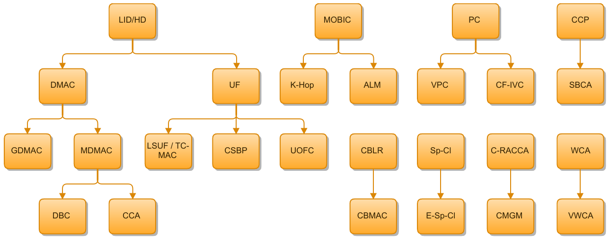
VANET clustering algorithms
Most of th

Slide 4
Different problems compared to MANET
Many clustering algorithms exist that work well in MANETs but which perform poorly in VANETs due to specific characteristics:
Rather than moving random, vehicles tend to move in organized fashion.
Most vehicles are restricted in their range of motion
Usually higher velocity and more difference in relative speed
May be within range but unable to comm. due to building, large vehicle etc.
Vehicular behaviour / driver intention
Most research focus on cluster stability which is strictly related to CH selection and maintenance!

Slide 5
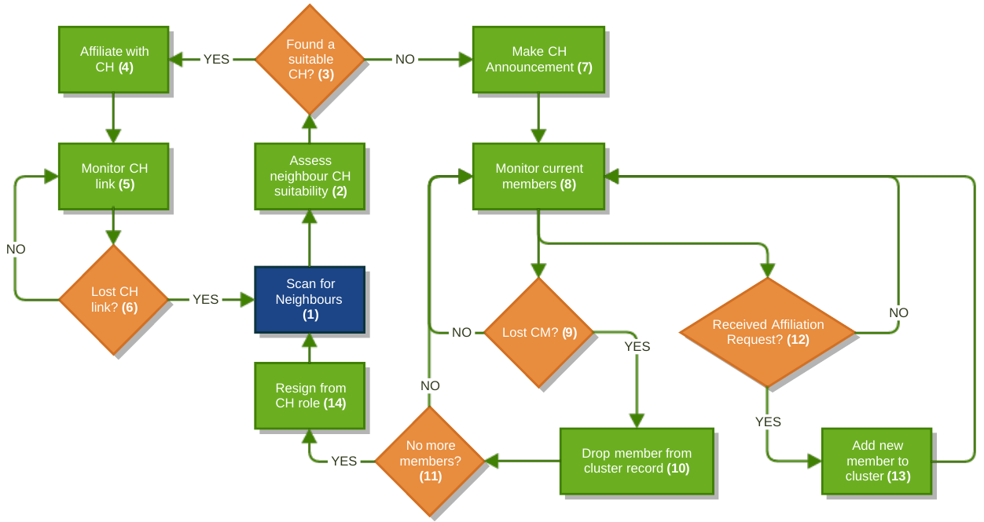
How does it work?

Slide 6
What’s the difference?
Almost every one of VANET clustering algorithms use the same flow yet they differ in these three specific problems:
Cluster head selection
Affiliation
Maintenance

Slide 7
CH selection strategies
Weighted network metrics
Most common approach
Nodes advertise their own fitness to be a cluster head
Weighted sum of various metrics such as uptime, distance, vehicle class, relative velocity, node degree etc.
Precedence
Also use weighted metrics but, unlike the previous approach, a node looking for a CH will make its own decision of the CH selection
Nodes seeking CH can act selfishly. May result in larger number of CH.
Timer
Wait for a period of time looking for a CH, if detected, affiliate with it. Otherwise announce yourself a CH
Hidden node problem - Multiple nodes may announce themselves CH,

Slide 8
CM affiliation strategies
Regular affiliation
Join request received from candidate member node, if accepted, CH insert its members table
Affiliation with handshaking
Use handshaking to decide whether or not to accept a node to be CM.
Limit the number of CM a cluster can have
May help prevent faulty affiliation
Increased overhead

Slide 9
Cluster maintenance strategies
CM updates
Hello messages sent by all nodes for neighbour discovery
or CH polls the cluster periodically and members respond with a unicast message
CH may drop non-responding CMs or vice versa - may caused by collisions or transmission errors
CH depreciation
CH may become sub-optimal for its role - Disbands the cluster in a controlled manner
Cluster merging
Hierarchical approaches try to merge smaller clusters to larger clusters
Some employs techniques to prevent unnecessary merging such as CH metric comparison with a set of threshold, link expiration time or difference in group velocities

Slide 10
Comments so far...
Still developing area which has fundamental shortcomings that needs to be addressed in order to be practically used.
Most of them are based on clustering methods previously proposed for MANET
Need to use VANET-specific metrics more often (e.g. driver intention detected by indicator signals or accelerometers, taking number of lanes into account during CH selection, )
Comm. modelling which properly reflect the real world as much as possible
Specific applications need specific solutions
Need for widely-accepted metrics & validation methods

Slide 11
References
S. Vodopivec, J. Bester, and A. Kos, “A survey on clustering algorithms for vehicular ad-hoc networks”, in Telecommunications and Signal Processing (TSP), 2012 35th International Conference on, July 2012, pp. 52-56.
R.S. Bali, N. Kumar, and J.J. Rodrigues, “Clustering in vehicular ad hoc networks: Taxonomy, challenges and solutions”, Vehicular Communications, vol.1, no.3, pp. 134-152, 2014.
C. Cooper, M.Ros, F. Safaei, D. Franklin, and M. Abolhasan, “A comparative survey of VANET clustering techniques”, IEEE Communications Surveys & Tutorials, 2016.
Z.Y. Rawashdeh and S. Mahmud, “A novel algorithm to form stable clusters in vehicular ad hoc networks on highways”, EURASIP J. Wireless Comm. and Networking, vol.1, pp. 1-13, Jan 2012.
Wang Z., Liu L, Zhou , M., Ansari N., “A position-based clustering technique for ad hoc intervehicle communication”, IEEE Transactions on Systems, Man, and Cybernetics, Part C (Applications and Reviews), 38(2), pp. 201,209, 2008.

