Slide 1
Recurrent Neural Networks
Emre Kağan Akkaya
N14128491

Slide 2
Outline
Problem
Method
Definitions
Implementation
Results
Conclusion

Slide 3
Problem
Recurrent neural networks (RNN) are powerful & popular models that have attracted great interest and shown promise in many NLP tasks.
RNN based language models:
Common uses include: speech recognition, machine translation, generating image descriptions etc.
Allows to score arbitrary sentences based on how likely they are to occur.
Also allows us to generate new text… Why? Because it is fun!
Aim of this project is to use RNN in order to generate Turkish text based on different training datasets.

Slide 4
What is recurrent neural network?
In a traditional neural network, it is assumed that all inputs are independent of each other. But if you want to predict the next word in a sentence, we better know which words came before it.
RNN are recurrent because they perform the same task for every element of the sequence with the output being depended on the previous computations.
One can assume they have a “memory”...
RNNs have two sources of input: the present and recent past
There is information in the input sequence itself, and RNNs use it to perform tasks that other networks can’t.

Slide 5
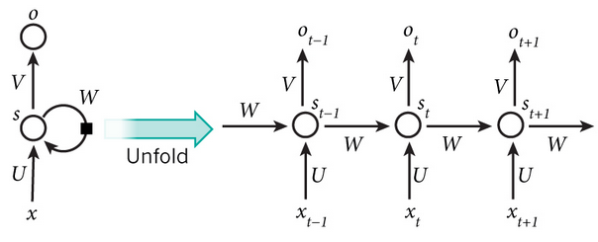
How does it work?
RNN shares the same parameters (U,V,W) across all steps
Unlike traditional deep neural networks which uses different params at each layer
Reduced # of params we need to learn!
x_{t} is the input at time step t.
s_{t} is the hidden state which is calc. based on the prev. hidden state and the input.
Training RNNs include backpropagation like others
But the gradient at each output depends also on the previous time steps… (Backpropagation through time/BPTT)
Vanilla RNNs trained with BPTT have difficulties learning long-term dependencies (that are far apart)
Vanishing or exploding gradient problem!

Slide 6
LSTM and GRU What are they?
Our goal is to calculate the gradients of the error (w.r.t U,V and W) and then learn good parameters using Stochastic Gradient Descent.
Gradient values are shrinking exponentially. Eventually vanishing completely…
That means those steps doesn’t contribute to what we are learning.
That’s problematic because the meaning of a sentence is often determined by words that aren’t very close.
Asd
Long Short-Term Memory (LSTM) and Gated Recurrent Unit (GRU) are specifically designed to overcome this problem.
Same architecture but different update function to compute the hidden state.
In this project, GRU have been implemented.

Slide 7
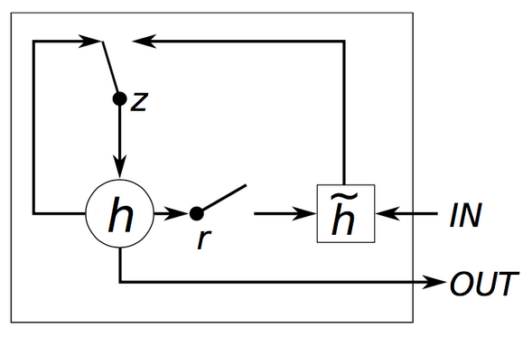
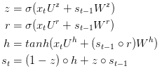
Gated Recurrent Units
GRU has two gates, a reset gate r, and an update gate z.
Reset gate determines how to combine the new input with the previous memory
Update gate defines how much of the previous memory to keep around.
(If we set the r to all 1’s and z to all 0’s = vanilla RNN)
They are called gates because sigmoid function σ squashes the values of vectors between 0 and 1.

Slide 8
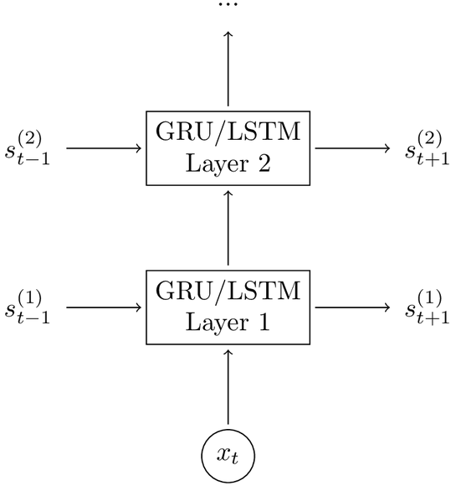
Gated Recurrent Units
Adding a second layer to the network allows our model to capture higher-level interactions
But they may lead to overfitting
Performance considerations...

Slide 9
Implementation
Download lots of Turkish text (Approx. 800MB of Turkish Wikipedia dump and various e-books)
Clean text from markup tags, metadata headers etc. (2.195.043 sentences)
Tokenize text into words (1.041.577 unique word tokens)
Remove infrequent words and build vocabulary with different sizes (2.000, 8.000, 10.000 etc.)
Prepend/append <start> and <end> tokens
Build training data matrices
The input to RNNs are vectors, not strings. So we map words to indices. (later, we will use them as one-hot vectors)

Slide 10

Implementation
Initialize the parameters U, V and W to small random values...
For each word in the input sentence, forward propagation (GRU, LSTM) make predictions representing the probabilities of the next word.
Predictions are random at first. Need to measure the errors it made! Cross-entropy loss function (o_{n} output predictions, y_{n} is the correct words)
Remember, the goal is to find U, V and W that minimize the loss.
Then calc. SGD to nudge the parameters into the right direction.
SGD also needs learning rate (how big of a step we should make in each update/multiply with the gradient values calculated by BPTT)
Decrease learning rate if the loss continues to increase!
For each N training examples
Generate sentences using model parameters at this step.
Also, save model parameters into a file so that we can use them once we know the model is trained enough.

Slide 11
What did I use?
Python 2.7
NLTK library
Work tokenization etc.
Theano
To perform operations on GPU
Provides efficient implementations for most of the mathematical functions

Slide 12
Simulation environment & parameters
Operating system | Debian GNU/Linux 6 (64bit)
CPU | 8 GHz
Memory | 16GB RAM memory
Vocabulary size | 6.000, 8.000, 10.000
Number of epochs | 20, 40
Hidden dimension size | 100, 120
Number of GRU layers | 2
SGD learning rate | 0.001

Slide 13
Results
Most of the generated text is nonsense…
olarak bir gerekir .
1967 yılında milli
bir mecmua ) .
köyün yeşil adlı sebebiyle tipi takım göç
dolayısıyla ilçesinin bilinir .
milletvekili yataktan dergisinde mektepten
hiçbir oğlundan kendi söylemeyi :
yaptığı doğru herhalde evladım ve sevgili arkasını bende .
anlıyordum söylemişti yeni ?
hayretle bıraktım olsa diye haydi …
gece buyurun ... dedi . ..
ankara'ya gelirim ... ... tekrar

Slide 14
Results
...but some of them are getting meaningful and grammatically correct:
içme suyu şebekesi
uzun 2010 yılında .
köyün ekonomisi tarım ve hayvancılığa dayalıdır .
ptt şubesi ve ptt acentesi yoktur .
15 mart 2010 tarihinde yapılan bir nüfus sayımına göre şehrin nüfusunun ve
köye ulaşımı sağlayan yol asfalt olup
köyde ilköğretim okulu vardır .
mahallenin adının nereden geldiği ve geçmişi hakkında bilgi yoktur .
Basically, it just needs parameter fine-tuning & more time to train...

Slide 15
Conclusion
RNN (specifically GRU) implementation in Python.
A pre-trained language model which can be used to generate TR text.
Still in progress… Training is a long process with this amount of data.
Turkish datasets or the scripts to generate them
Along with the source code, they can be accessed at https://github.com/emrekgn/tr-rnn
Future work
Word2vec or Glove can be used to further optimize results

Slide 16
Thank you for listening!

