Slide 1
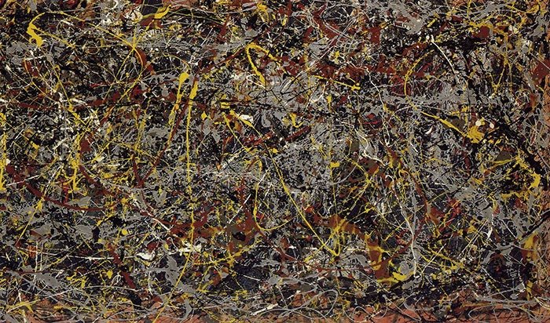
ART made by AI
by Emre Okcular
Generative Adversarial Models

Slide 2
Outline
Who is the artist ?
Creativity
Copyright
Generative Adversarial Models
Technical Look
Examples around the World
Future of Art and AI

Slide 3
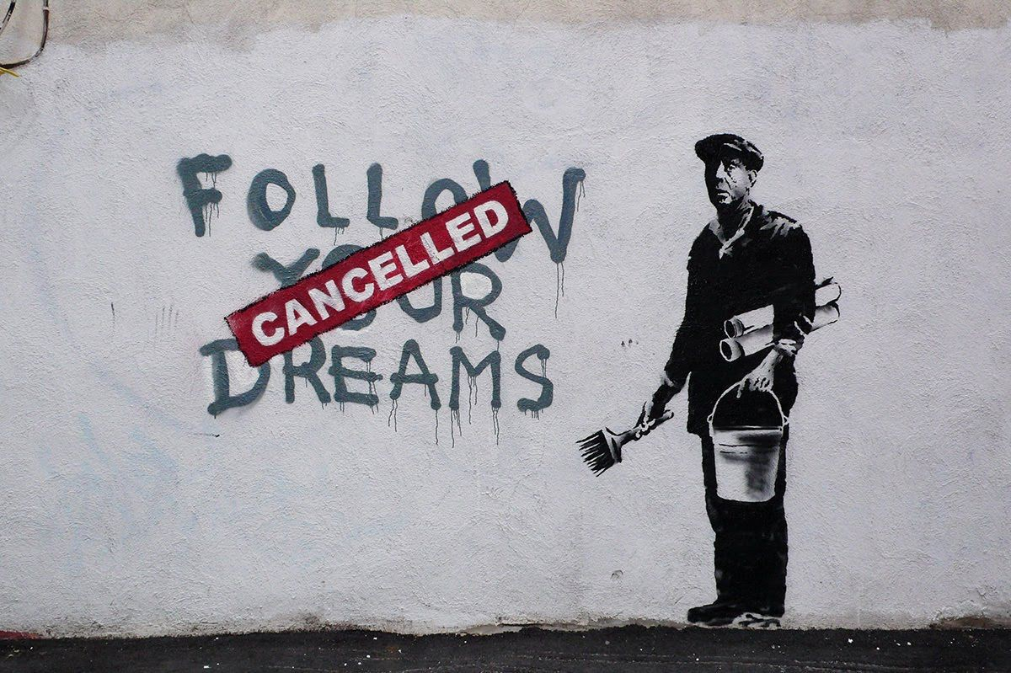
Who is the artist ?

Slide 4
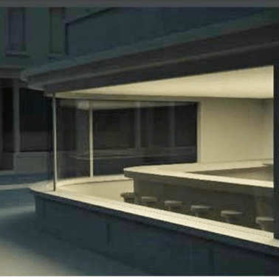
Creativity

Slide 5
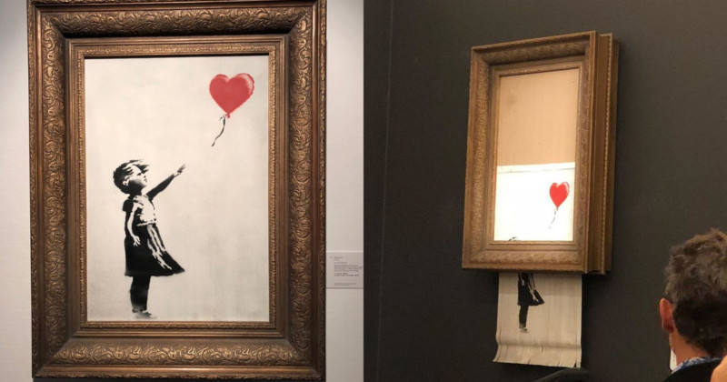
Copyright

Slide 6
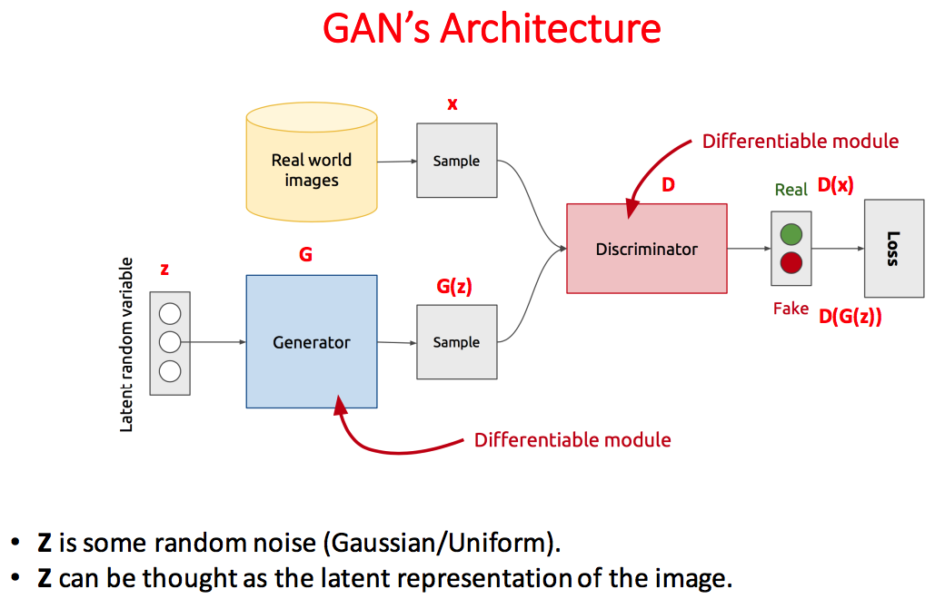

Slide 7

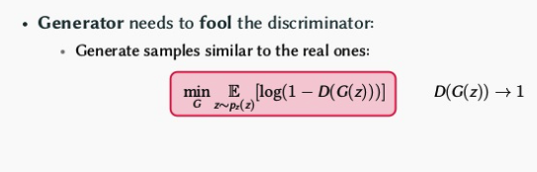
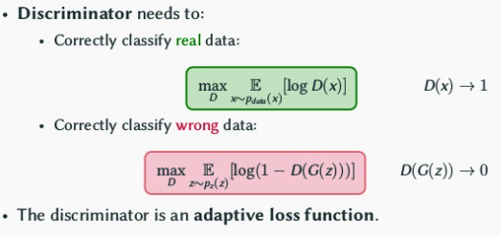
GAN Game

Slide 8
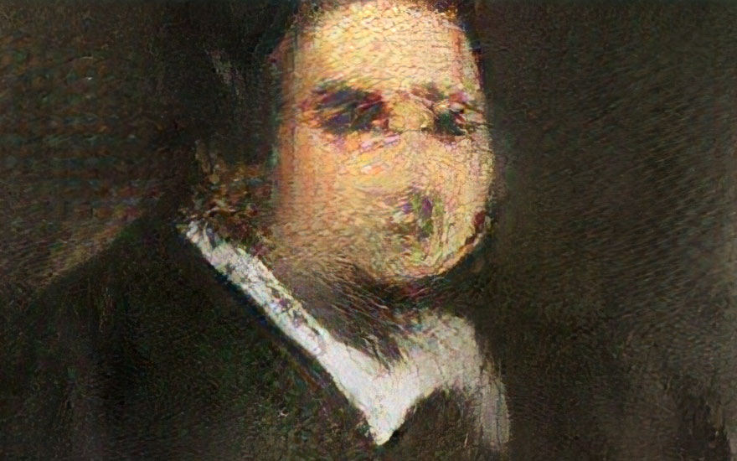
Machine
Creativity

Slide 9
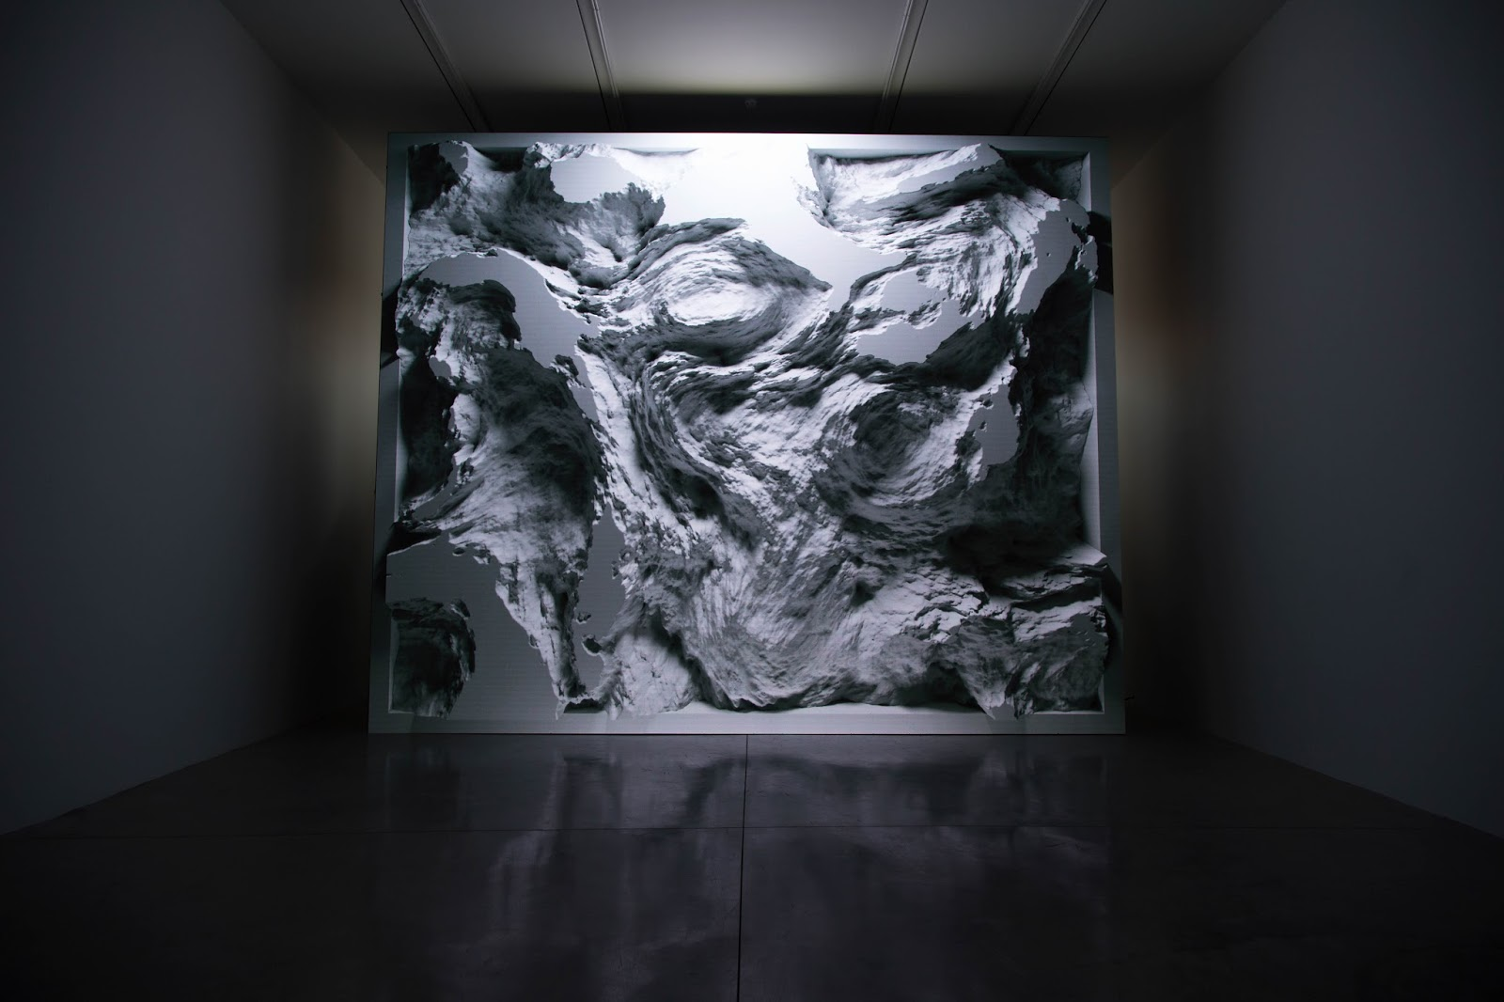
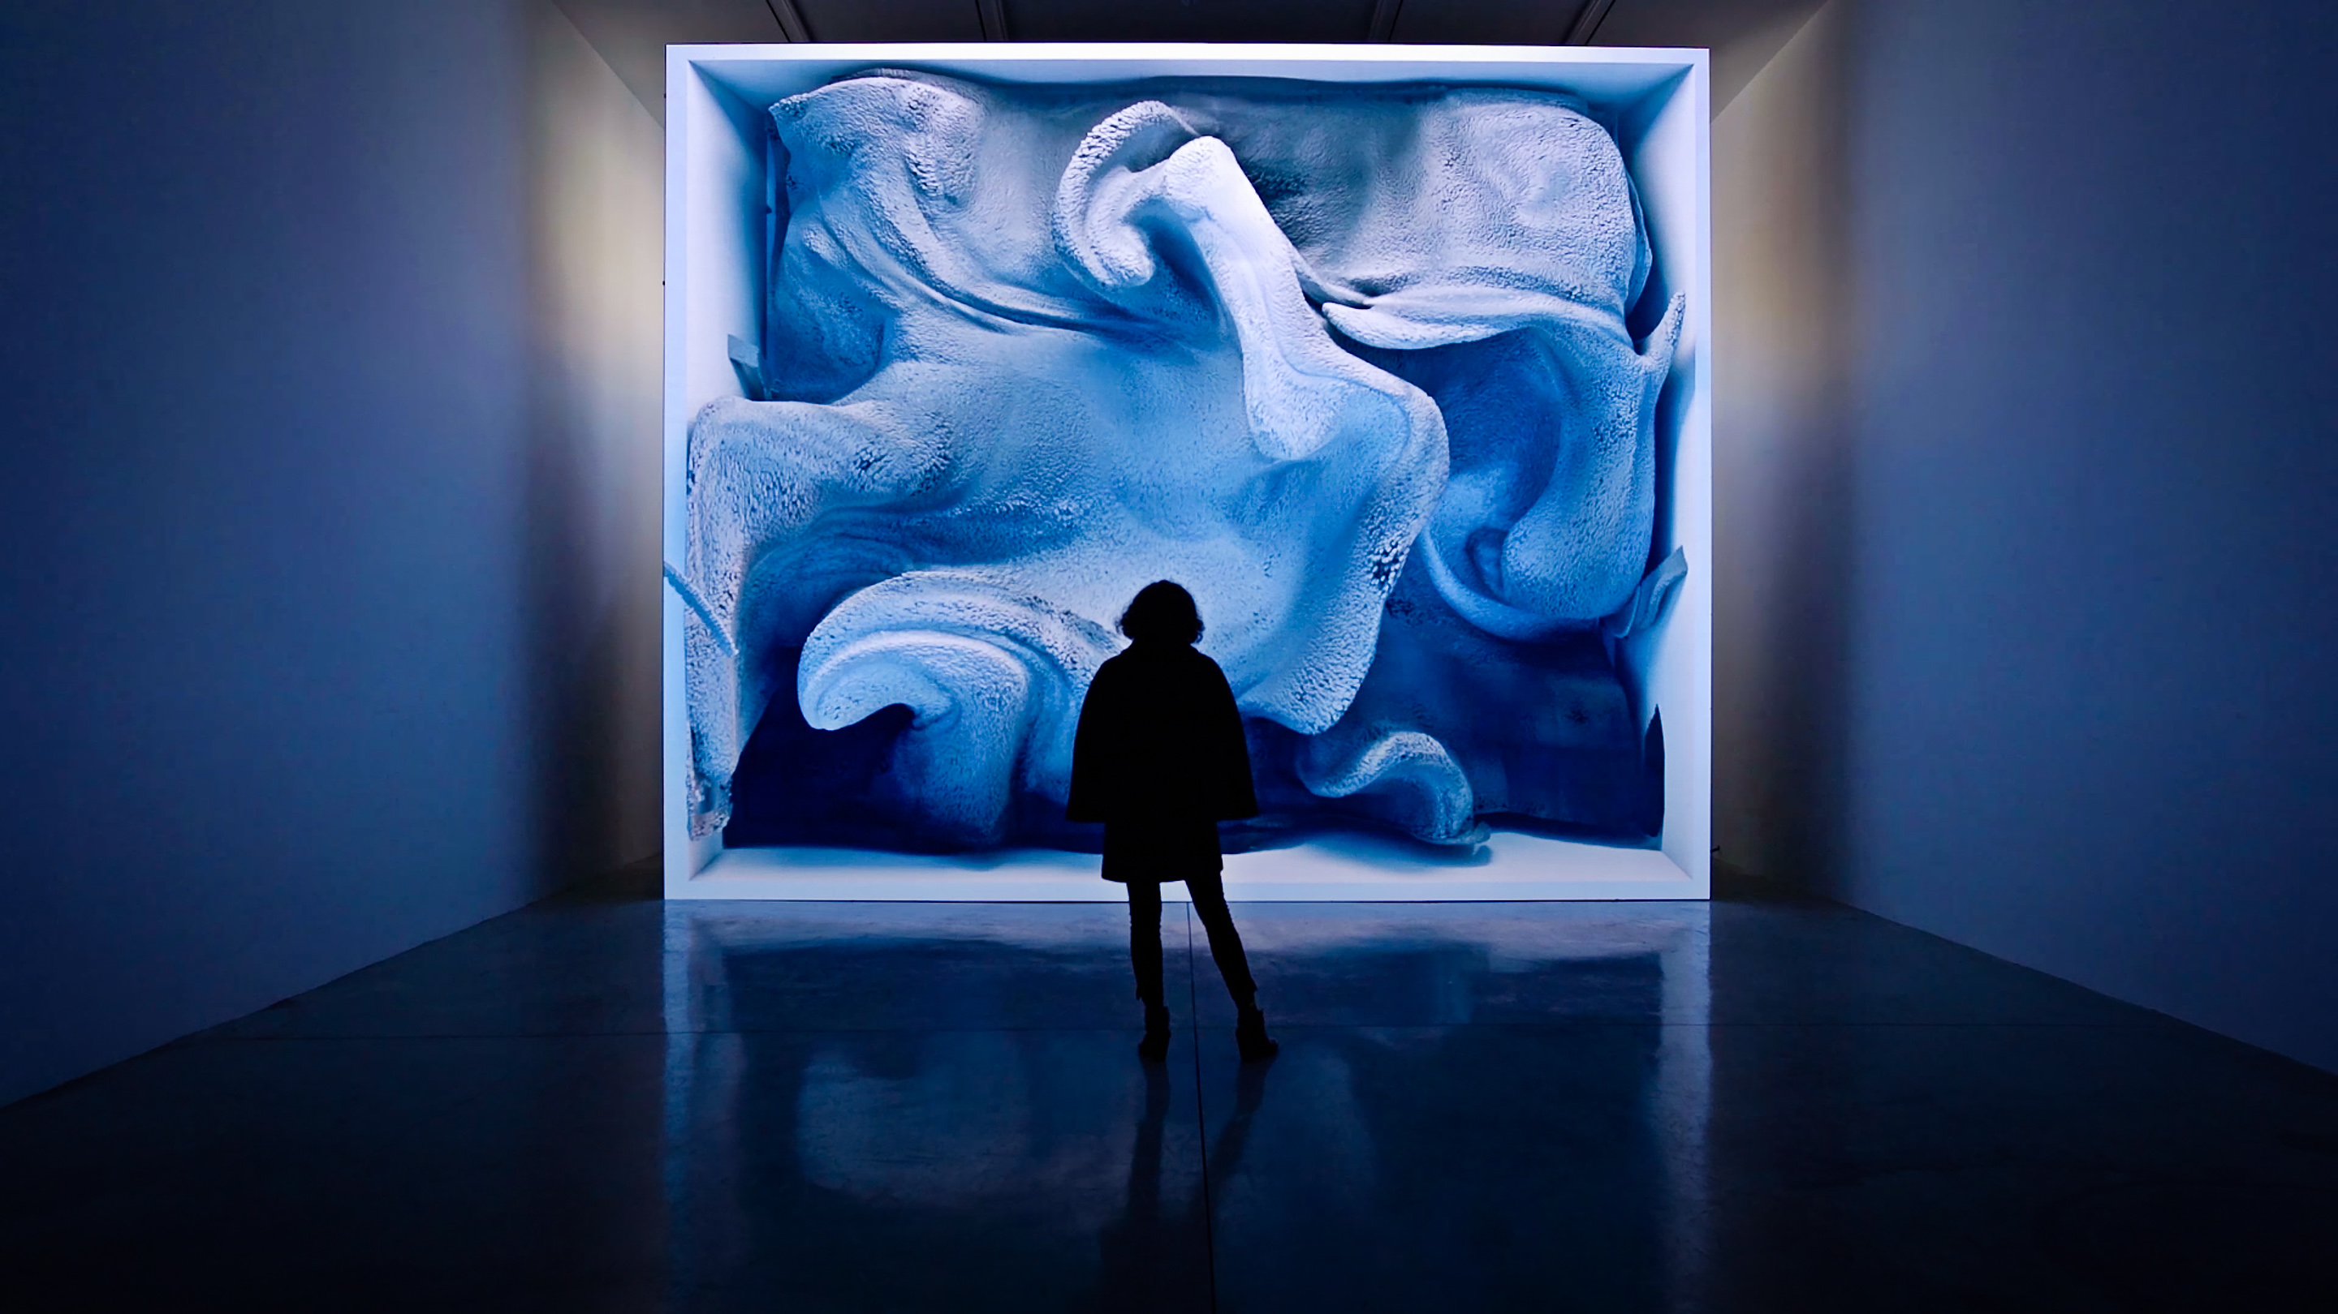
Refik Anadol

Slide 10
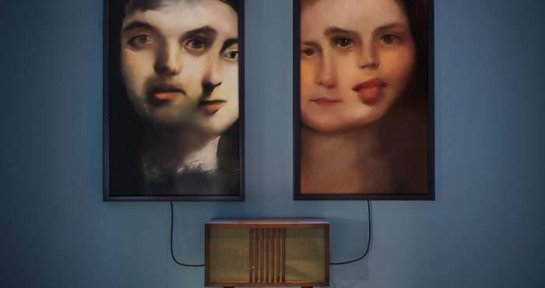
Mario Klingemann

Slide 11
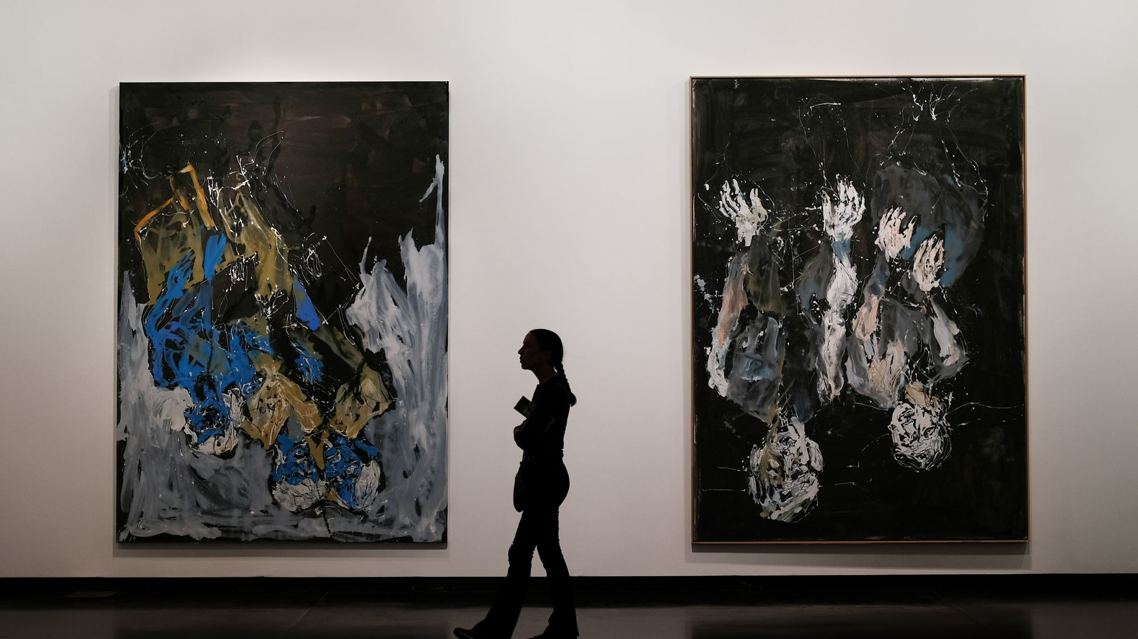
Could AI be the future of art ?

