Slide 1
Height, Depth and Face
Recognition of Person

Slide 2
Presented by:
Muhammad Usman
Emre Ozan Alkan

Slide 3
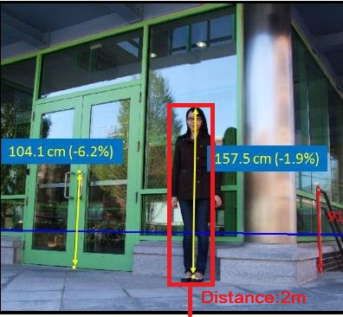
Our Goal
Person Detection
Depth Estimation & Height Estimation
Face Detection and Recognition

Slide 4
Only one camera
can be used

Slide 5
Person Detection
Depth Estimation & Height Estimation
Face Detection and Recognition

Slide 6
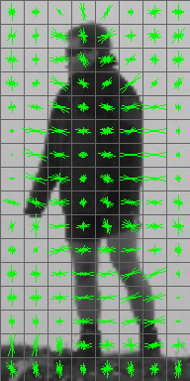
Person Detection
HOG Person detector
Histogram of Oriented Gradients. A type of feature descriptor to better
Generalize every subject so that we get
same descriptor even under different
conditions.
“Global” feature to describe a
person rather than a collection of “local” features.
Entire person is represented by a
single feature vector so easy!!

Slide 7
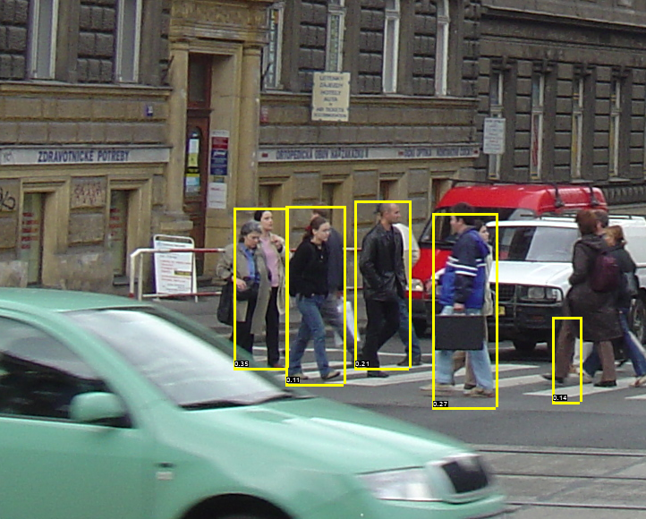
Person Detection
HOG Person detector
HOG Person detector uses a sliding Detection window, at each position HOG descriptor is computed.
The Descriptor is then shown to trained
SVM(support vector machine) classifier which classify it as either person or not.

Slide 8
Person Detection
Depth Estimation & Height Estimation
Face Detection and Recognition

Slide 9
Depth Estimation &
Height Estimation
We tested two different methods.
Using simple Geometry.[1]
Using Plane to plane homography.[2]

Slide 10
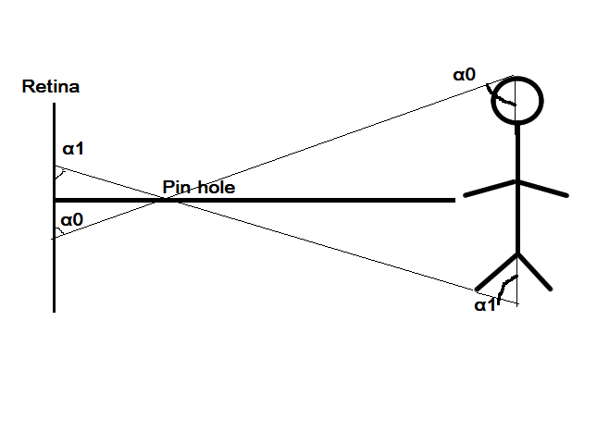

1. Using Simple Geometry
If we have calibrated camera then we can estimate height of person following given steps.
Calculate tilt angles of persons top most and bottom most points relative to camera axis.
We also have to provide camera’s height and tilt angle of camera.
Height of person can be calculated using given formula.
If we get height we can easily find the depth.

Slide 11
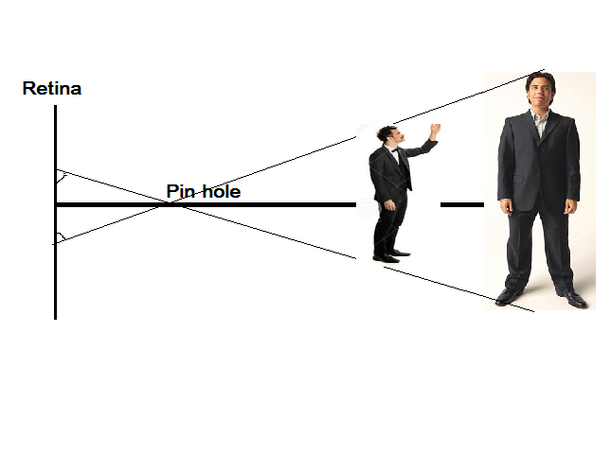
1. Using Simple Geometry
Drawbacks:
We have to calculate tilt angles and height of camera with precision as height and depth estimation depends on it.
This method only works correctly in distance close to camera and failed when object far as it doesn’t take into account projectivity. But Works well in closer distances.

Slide 12
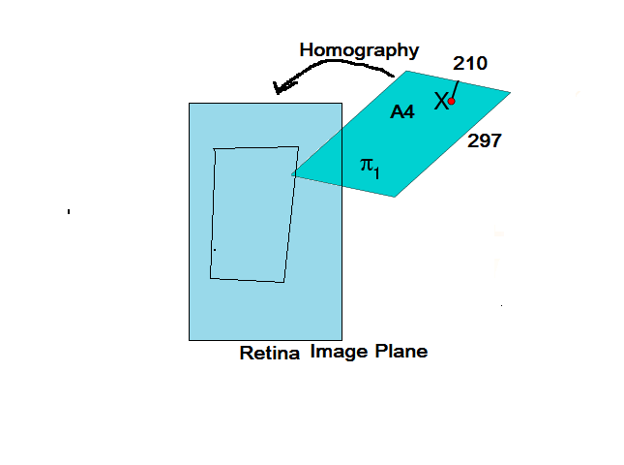
Using Basic Plane
to Plane Homography
Given an image of Planar Surface points on the image plane can be mapped into corresponding points in the world points by means of projective transformation called Homography.
Four corresponding points are enough to estimate this homography.
Our floor should be planar and camera focal length known.
Real distance between world point.

Slide 13
Using Basic Plane
to Plane Homography
Algorithm:
Given an image of planar surface estimate the image to world homography matrix H
Repeat
Select two points x1 and x2 on image plane.
Back project each image point into the world plane via 1 to obtain two World points X1 and X2.
Compute the Euclidian Distance d(X1,X2)
If we get depth we find height easily using similar triangles.
To Ease the Process: We used standard A4 size paper as our reference plane so that its easier to detect the points while configuring the system.

Slide 14
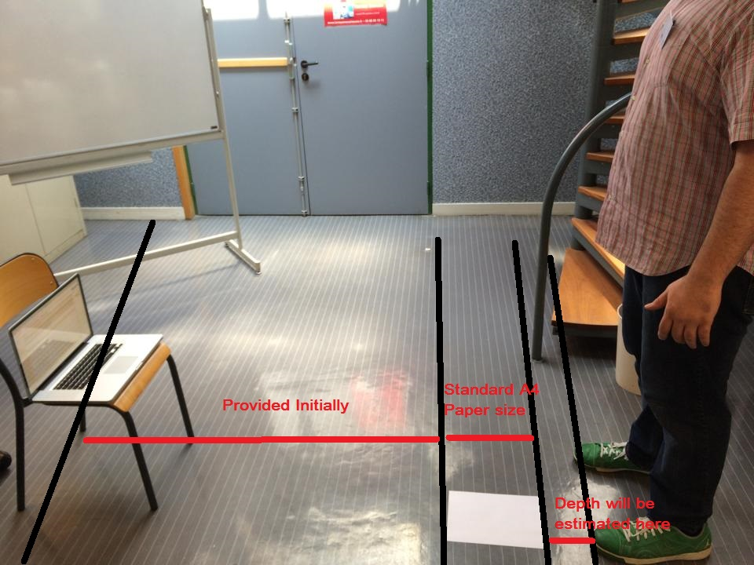

Slide 15
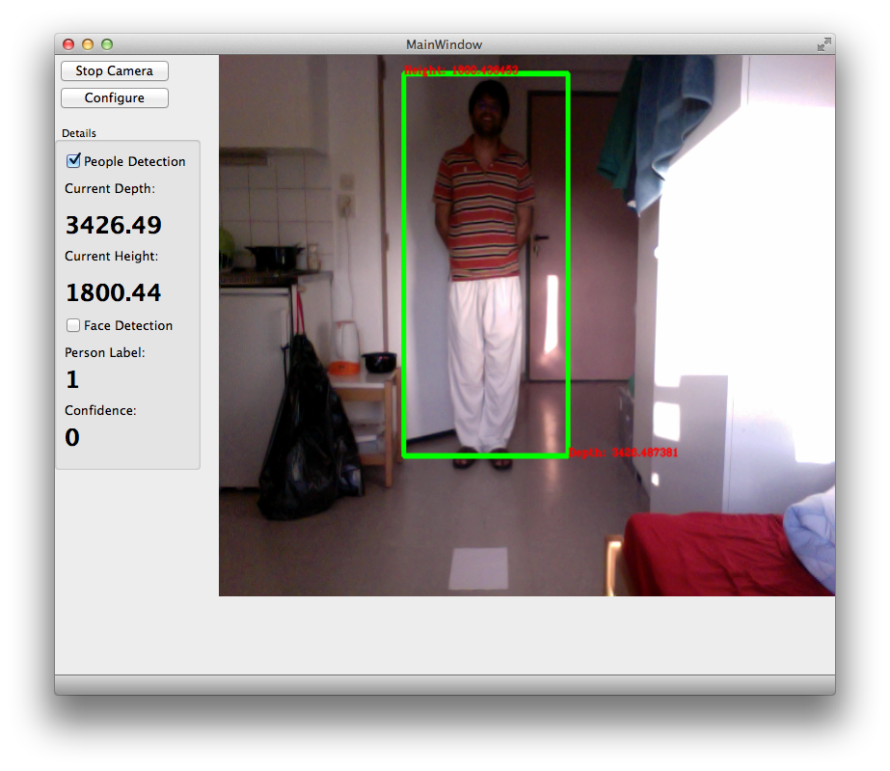
Using Basic Plane
to Plane Homography

Slide 16
Using Basic Plane
to Plane Homography
Results:
Using Homography | True Height | Mean Measured Height | Standard deviation of height | Mean Square Error
Subject 1 | 179 | 178.76 | 1.39 | 2.3%
Subject 2 | 190 | 186.5 | 1.59 | 2.7%
Using Simple Geometry | True Height | Mean Measured Height | Standard deviation of height | Mean Square Error
Subject 1 | 179 | 177.53 | 2.3 | 3%
Subject 2 | 190 | 180.5 | 7.59 | 15%

Slide 17
Person Detection
Depth Estimation & Height Estimation
Face Detection and Recognition

Slide 18
Face Recognition
For Face recognition we tried methods from both categories,
LDA which use Global Features, Focus on Entire Image, Les Accuracy
Local Binary Patterns (LBP) which uses Local Features which Focus on local features of the face, which help to identify and verify the persons using unique details in the image.

Slide 19
Linear Discriminant Analysis (LDA)
Dimensionality Reduction Technique
Searches for those vectors in the underlying space that best discriminate among classes.
Main idea is to find Linear Transformation such that feature clusters are most separable.

Slide 20
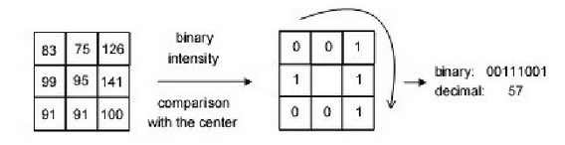
Local Binary Patterns (LBP)
LBP Operator summarizes the local special structure of image.
LBP is defined as ordered set of binary comparison of pixel intensities between centre pixel and its eight surrounding pixels. Decimal form of resulting eight bit word(LBP Code)

Slide 21
Local Binary Patterns (LBP)
Each Pixel of image is labelled with an LBP code.
Divide Image in blocks and compute LBP histogram for each block and combine them into one vector.
This vector is representing shape and can be used to compare different shapes(images).

Slide 22
Face Recognition Results
We used both methods and we draw following conclusions.
LDA method (fisher Faces) come out to be very slow and computationally heavy as it involve svd calculation and Its results were accurate as accuracy of 10%.
LBP method comes out to be relatively faster than LDA but again it didn’t provide us satisfactory results.

Slide 23
References:
István Kispál and Ern Jeges Human height estimation using a calibrated camera.
Antonio Criminisi, Single-View Metrology: Algorithms and Applications 2002.
Demo

