Slide 1


ADVANCED IMAGE ANALYSIS BILATERAL FILTERING
Presented By: Chalikonda Prabhu Kumar (ChaKon)

Slide 2
Contents
Introduction to Filtering
Problems in Filtering
Bilateral Filtering
Algorithm & Implementation
Results
Applications
Conclusion

Slide 3
Contents
Introduction to Filtering
Problems in Filtering
Bilateral Filtering
Algorithm & Implementation
Results
Applications
Conclusion

Slide 4
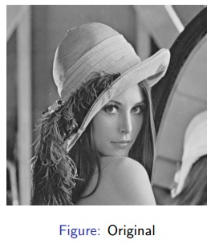
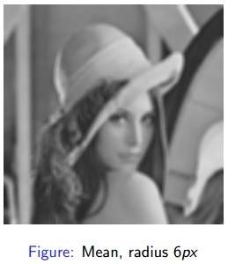
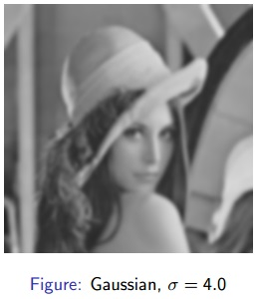
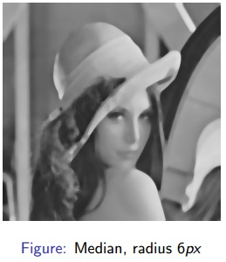
Introduction to Filtering
AIM: Smoothing image to reduce noise
Examples of Filtering like Mean, Gaussian and Median Filtering.

Slide 5
Contents
Introduction to Filtering
Problems in Filtering
Bilateral Filtering
Algorithm & Implementation
Results
Applications
Conclusion

Slide 6
Problems in Filtering
Mean Filtering : Blurs the image, removes simple noise and no details are preserved
Gaussian Filtering : Blurs the image, results related to mean filter, preserved details for small sigma values
Median Filtering : Preserves some details, good in removing strong noise.
Notes:
Here we need something more in filtering process not only smoothing but also for preserving information. Bilateral filtering gives better solution for this.

Slide 7
Contents
Introduction to Filtering
Problems in Filtering
Bilateral Filtering
Algorithm & Implementation
Results
Applications
Conclusion

Slide 8
Bilateral Filtering
Aim : Need to smooth regions but not to smooth edges.
This is non iterative, local and simple.
Smoothing should done as usual in the domain of image.

Slide 9
Bilateral Filtering
Should not smooth when pixels are not similar to preserve edges.
Bilateral image produce no phantom colors along edges in color images, and reduce phantom colors where they appear in the original image.

Slide 10
Contents
Introduction to Filtering
Problems in Filtering
Bilateral Filtering
Algorithm & Implementation
Results
Applications
Conclusion

Slide 11
Algorithm & Implementation
Algorithm Idea :
Smooth as usual in the domain of the image (E.g. Gaussian)
Do not smooth when pixels are not similar (Preserving Edges)

Slide 12
Algorithm & Implementation
Similarity Function :
Determines the amount of smoothing
Similar Pixels → Strong smoothing
Otherwise (edges) → No Smoothing
Similarity is based on human perception. Based on the intensity values of the pixel.

Slide 13
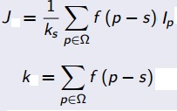
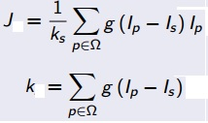
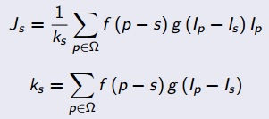
Algorithm & Implementation
Domain Filter + Range Filter → Bilateral Filtering
+ =
s coordinate of center pixel, p coordinate of current pixel, set of all pixels in local neighbor pixels.
Js is resulting pixel intensity. Is,Ip intensities of p & s.
f(p-s) measures the geometric distance between p & s.
g(Ip-Is) measures photometric similarity between Ip & Is.

Slide 14
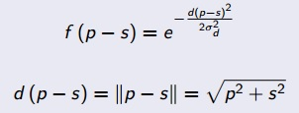
Algorithm & Implementation
Domain Weighting function
It is standard Gaussian filter.
d(p-s) is Euclidean distance between p & s.
If we increase the larger the domain parameter it blurs the image. It should choose based on the desired amount of low pass filtering.

Slide 15
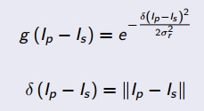
Algorithm & Implementation
Range Weighting function
It is Gaussian intensity difference
||Ip-Is|| measures the difference between two pixels.
If the image is amplified or attenuated range parameter should adjust.

Slide 16
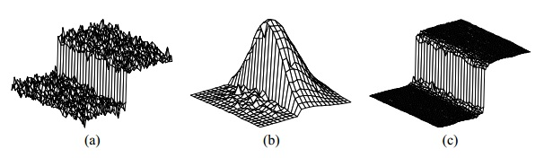
Algorithm & Implementation
When bilateral filter is centered on pixel on bright side of the boundary, the similarity function assumes close to 1 on same side and 0 for pixels on dark side.
The similarity function for window chosen in fig(b). The normalizer Ks weights for all pixels adds up to 1. As a result bright pixels at center replaced by average of bright pixels and dark pixels are ignored.
Good filtering by domain component and edges are preserved by range component fig (c).

Slide 17
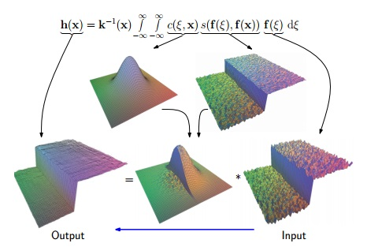
Algorithm & Implementation
Big Picture

Slide 18
Contents
Introduction to Filtering
Problems in Filtering
Bilateral Filtering
Algorithm & Implementation
Results
Applications
Conclusion

Slide 19
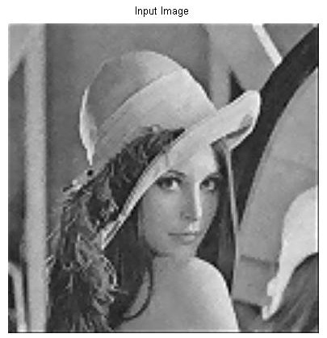


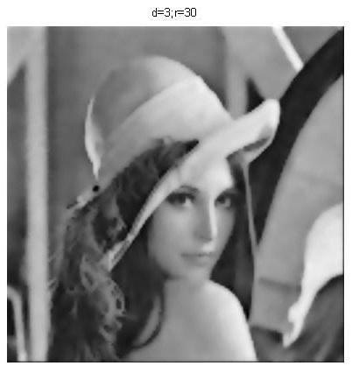


Results
Result images for different range and domain values.

Slide 20
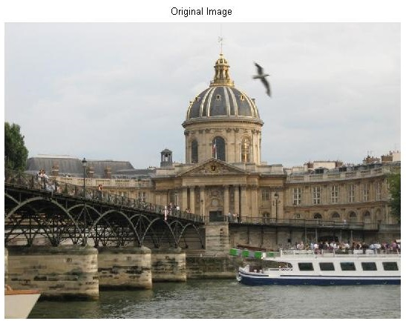
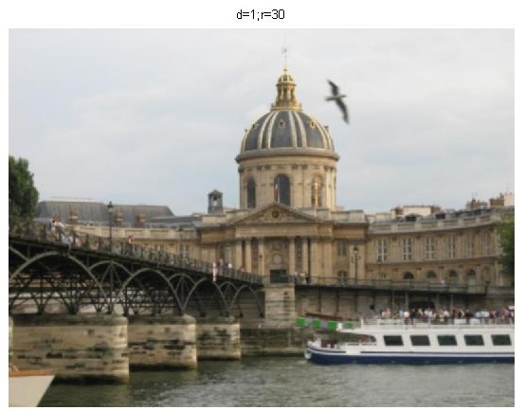
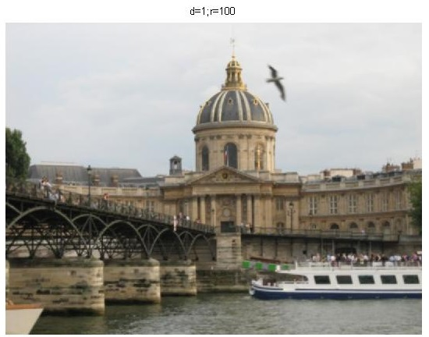


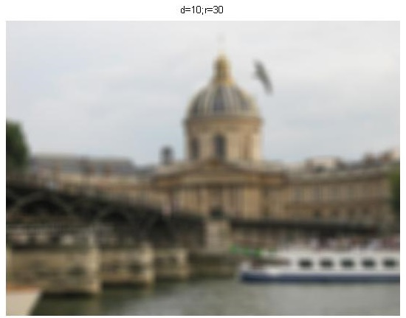
Results
Results for color images bilateral filter applied on each channel.
Notes:
When bilateral filter is applied for each channel the results are not that much effective because the intensity profile on each band is different & different contrast. Separate smoothing perturbs the balance of smoothing, and unexpected color combinations.

Slide 21
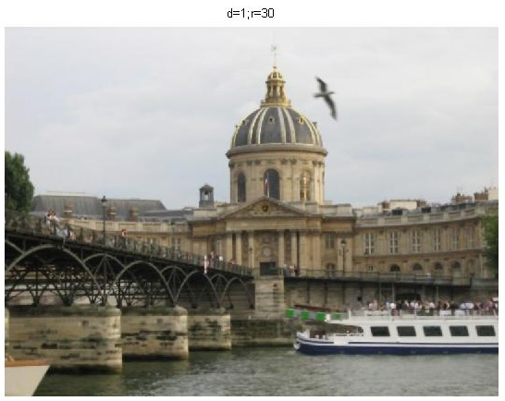



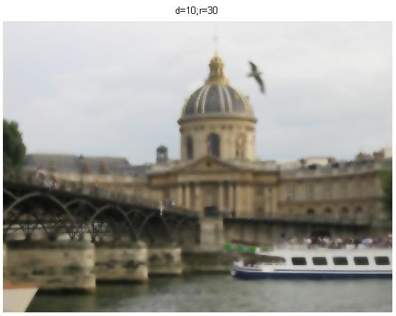
Results
Results for color images when bilateral filter applied on CIE-Lab space.
Notes:
only perceptually similar colours are averaged together, and only perceptually important edges are preserved.

Slide 22
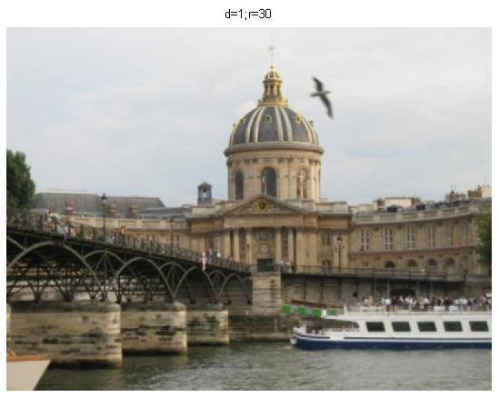
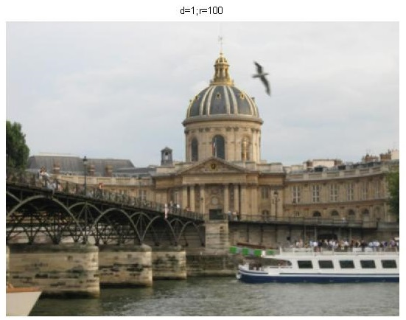

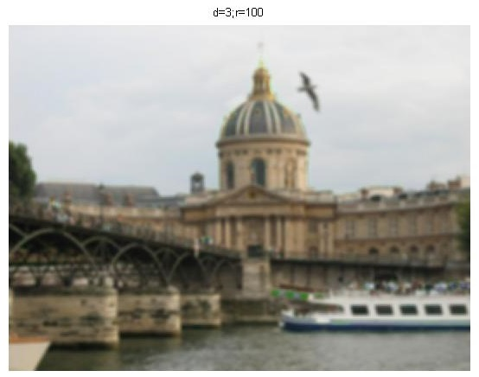

Results
Results for color images when bilateral filter applied on HSV color space.

Slide 23
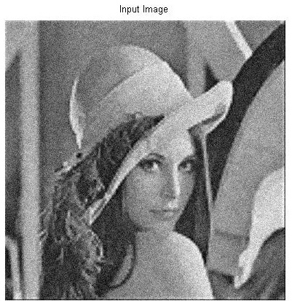
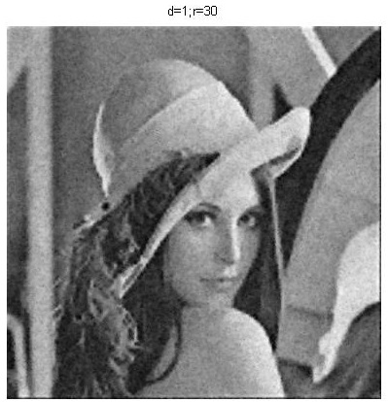


Experiments
Adding Gaussian noise to image.

Slide 24
Contents
Introduction to Filtering
Problems in Filtering
Bilateral Filtering
Algorithm & Implementation
Results
Applications
Conclusion

Slide 25
Application
De-noising
Picture simplification
Contrast reduction
Mesh smoothing and many more..

Slide 26
Contents
Introduction to Filtering
Problems in Filtering
Bilateral Filtering
Algorithm & Implementation
Results
Applications
Conclusion

Slide 27
Conclusion
Bilateral filtering is best for preserving more information (edges).
CIE Lab color space gives better output than bilateral filter applied on each channel.
Parameters of domain filter depends on image properties.
Details are lost with large range values but edges are preserved at all ranges scales that are below the maximum image intensity value.
Hard to analyze bilateral filtering because of non linear nature.

Slide 28
References
Bilateral filtering for Gray and Color Images by C.Tomasi & R.Manduchi
Course Slides
www.google.com

Slide 29


