Slide 1
OPENCV PROJECT COMPUTER VISION TOOLBOX
Emre Ozan Alkan
Visual Perception

Slide 2
Overview
Project Description
Objective
Results
Toolbox GUI
Functions and Results
Conclusion

Slide 3
Project Description
Objectives
Minimal Design
Usability
Parameter Manipulation
Fast prototyping
Results
Simple
Powerful

Slide 4
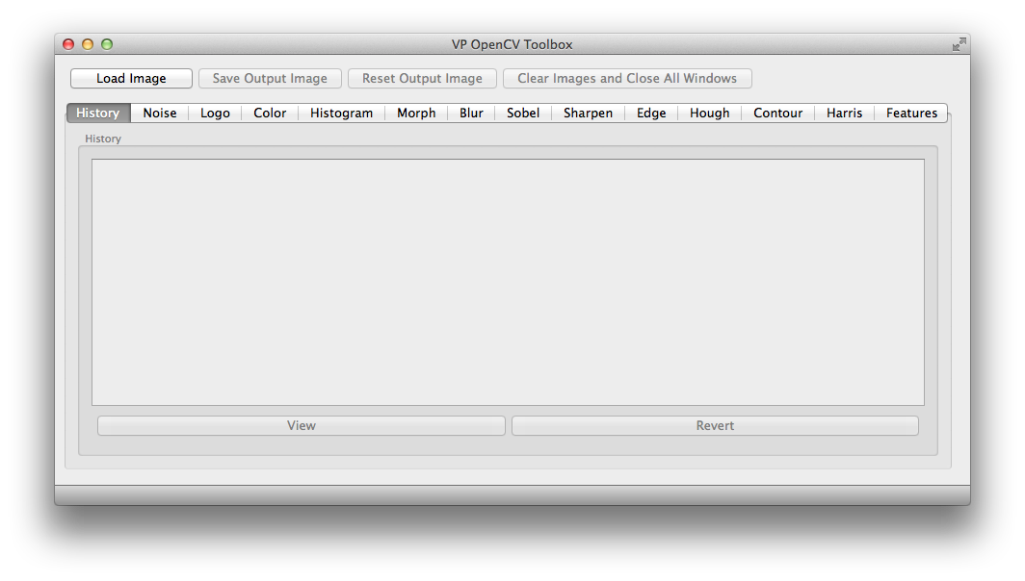
Toolbox GUI

Slide 5
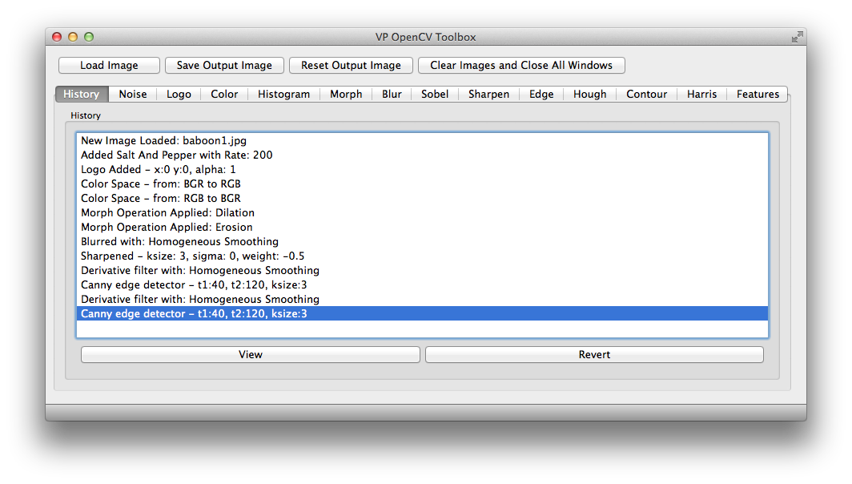
History

Slide 6
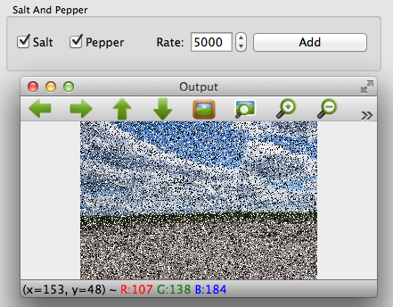
Noise

Slide 7
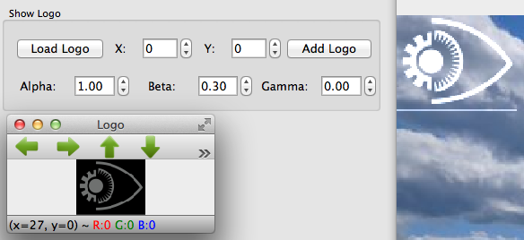
Logo

Slide 8
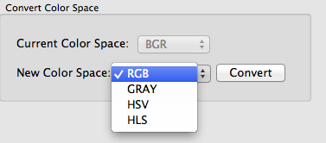
Color Space

Slide 9
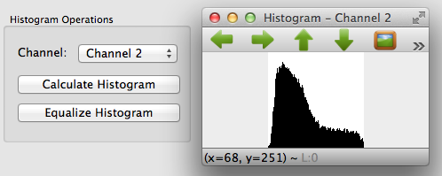
Histogram

Slide 10
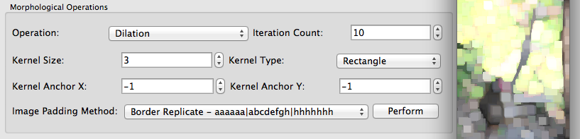
Morph

Slide 11
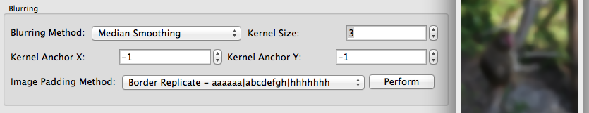
Blur

Slide 12
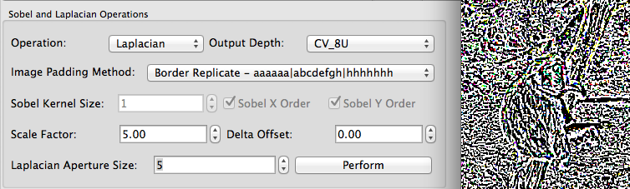
Sobel

Slide 13
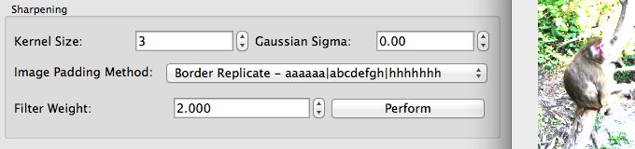
Sharpen

Slide 14
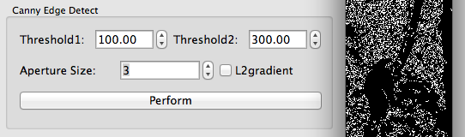
Edge

Slide 15
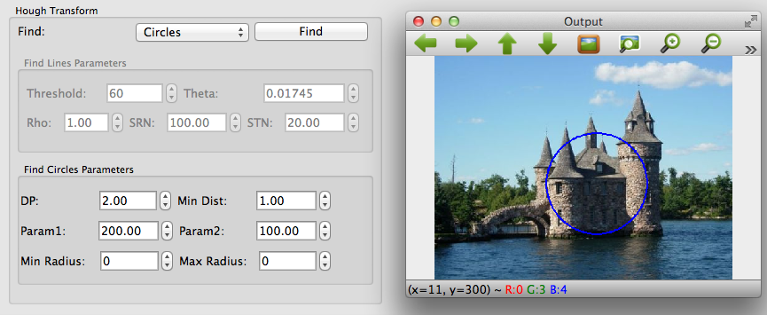
Hough

Slide 16
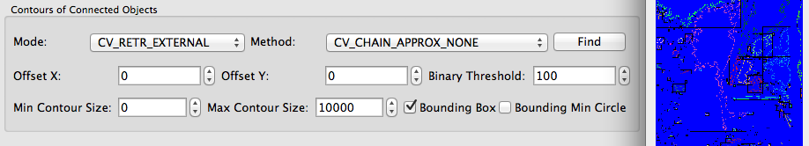
Contour

Slide 17
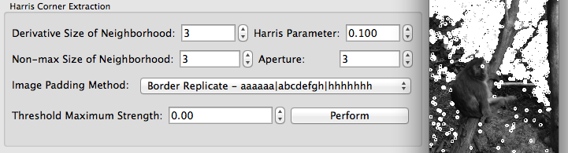
Harris

Slide 18
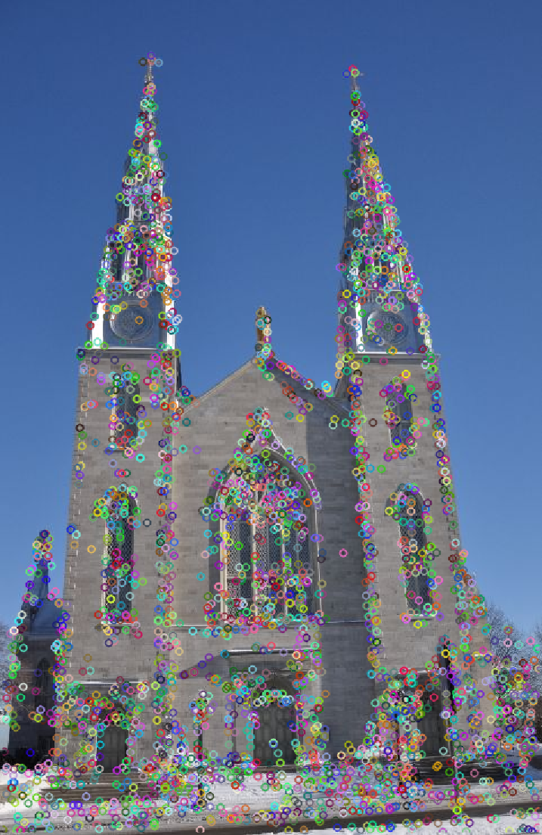
Features: FAST, SURF, SIFT

Slide 19
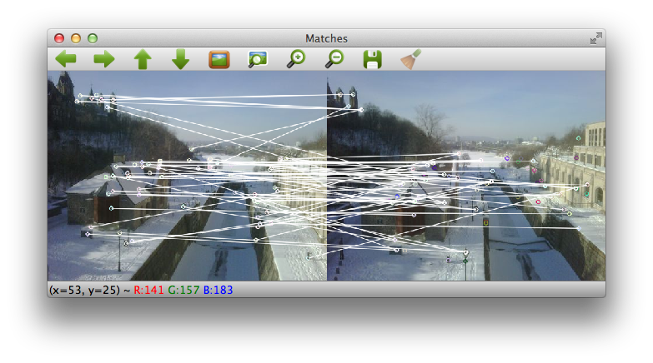
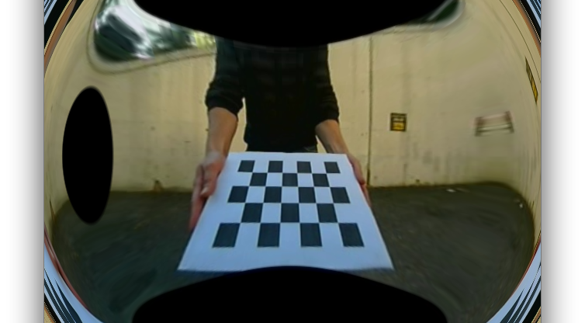
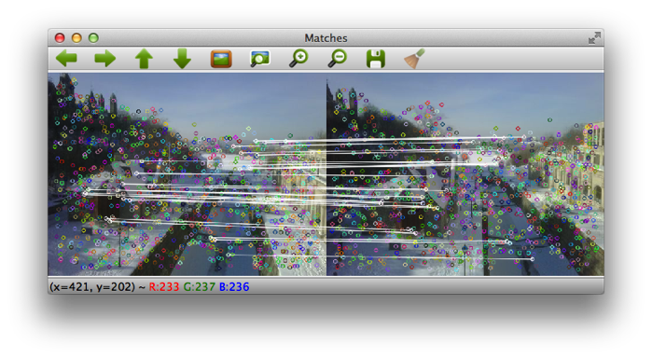
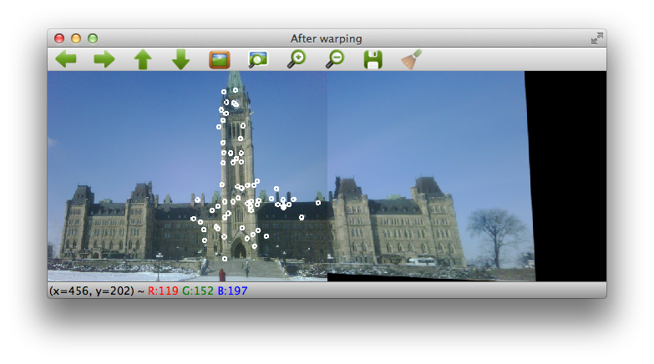
Estimation

Slide 20
Conclusion
Fast Prototyping
Simple to use
Powerful
Good User Manual for Parameters

Slide 21
Questions and Discussion and Demo
QUESTIONS ?

