Slide 1
OPENCV PROJECT COMPUTER VISION TOOLBOX
Emre Ozan Alkan
Visual Perception

Slide 2
Overview
Project Description
Objective
Results
Toolbox GUI
Functions and Results
Conclusion

Slide 3
Project Description
Objectives
Minimal Design
Usability
Parameter Manipulation
Fast prototyping
Results
Simple
Powerful

Slide 4
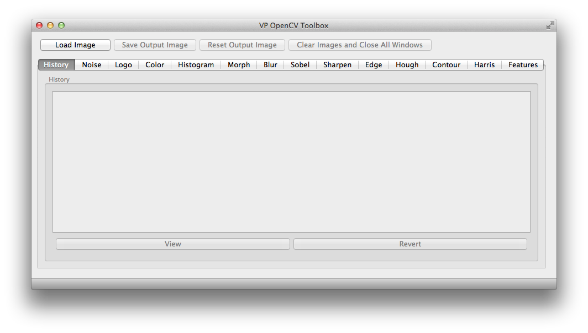
Toolbox GUI

Slide 5
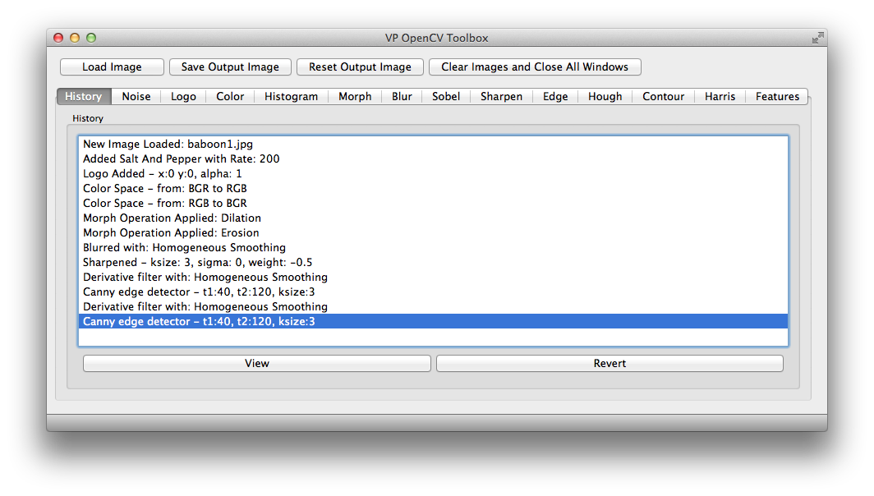
History

Slide 6
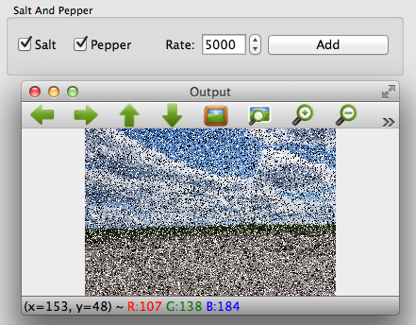
Noise

Slide 7
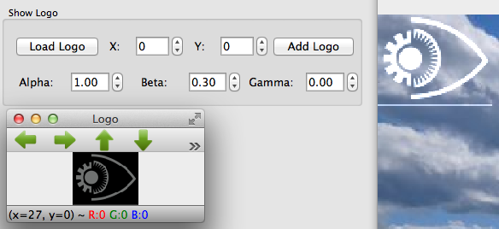
Logo

Slide 8
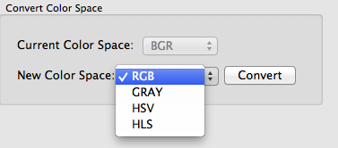
Color Space

Slide 9
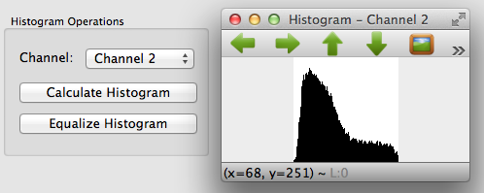
Histogram

Slide 10
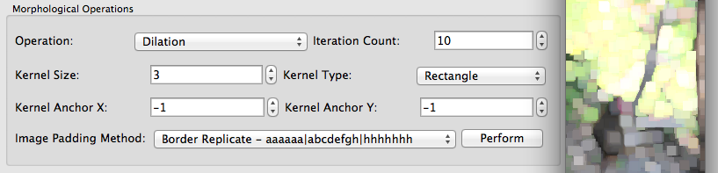
Morph

Slide 11
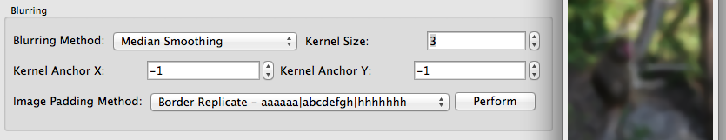
Blur

Slide 12
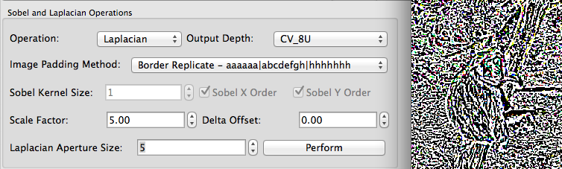
Sobel

Slide 13
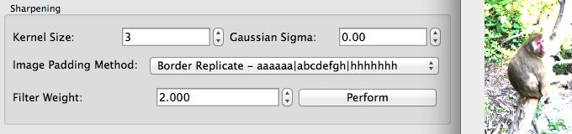
Sharpen

Slide 14
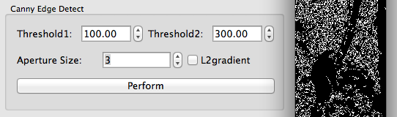
Edge

Slide 15
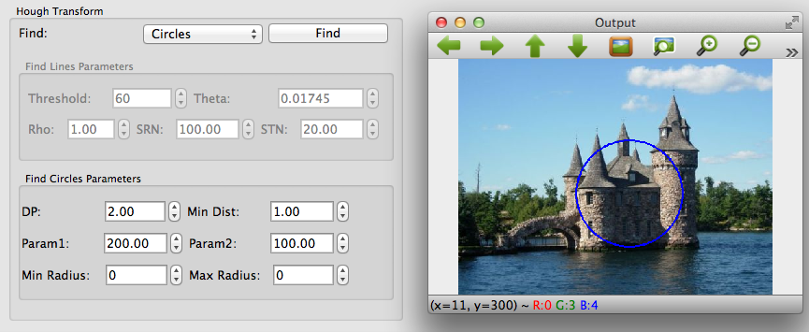
Hough

Slide 16
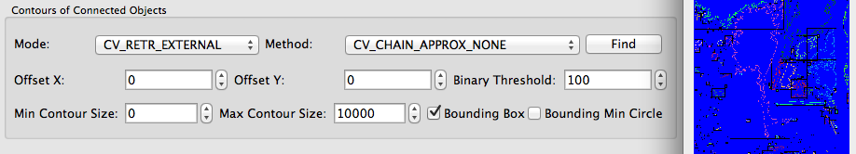
Contour

Slide 17
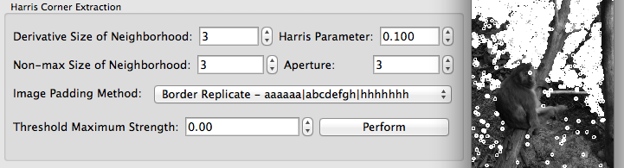
Harris

Slide 18
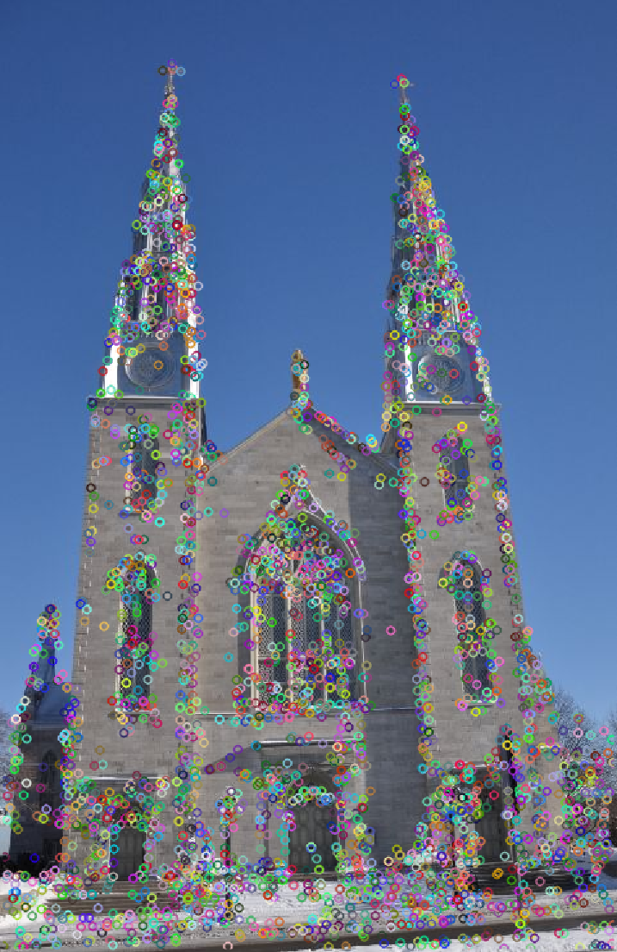
Features

Slide 19
Conclusion
Fast Prototyping
Simple to use
Powerful
Missing functionalities
Good User Manual for Parameters

Slide 20
Questions and Discussion and Demo
QUESTIONS ?

