Slide 1





Slide 2

IMDb Datasets (www.imdb.com/interfaces/);
Kaggle (https://www.kaggle.com/carolzhangdc/imdb-5000-movie-dataset/data )
Github (https://github.com/titubeta/oscars)
Data.world

Slide 3
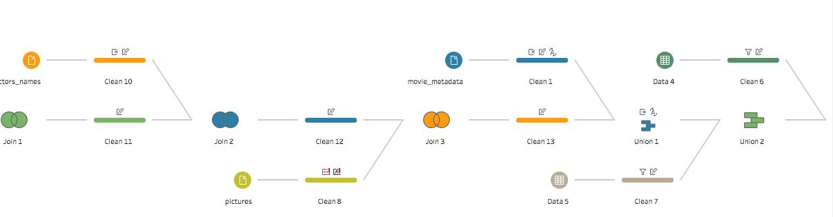
Tableau Prep for cleanse / process;
Unnecessary fields are removed
Fields are renamed
Some fields are split
Some fields are merged

Slide 4



Two methods are used to combine data sources;
Join
Union

Slide 5



3
My goal is to visualize correlation between different variables on movies such as;
Movie Budget – Movie Gross
Genres – IMDb Ratings

Slide 6



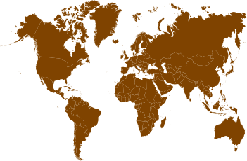





Facebook Likes – IMDb Ratings
Facebook Likes – Movie Gross
IMDb Ratings - Actors - Gross
Genres – Movie Gross
Academy Awards - Genres – IMDb Ratings - Actors
IMDb Ratings – Movies by Country
Oscars Best Picture Movies – IMDb Ratings – Genres
Oscars in Best Foreign Language Movies by Country

Slide 7

Finding simplified version of large IMDb datasets
Learning how to use Tableau’s features properly
Using Tableau Prep’s union and join methods without getting error or losing any data.
Splitting a field into two fields.
Fixing numbers (whole or decimal), string and date issues in Tableau.

Slide 8

I will try to visualize my data with 4 different Dashboards including between 12 – 16 Worksheets.
Dashboards’ topics will base on;
IMDb Ratings
Actors
Academy Awards
Genres

Slide 9



