Slide 1
CS 552.A : Data Science with Python
Analysis of Academic Authors in the Scopus
Ali Baki TÜRKÖZ
Emre ÖZTÜRK

Slide 2

Objective and Scope
This study comprehensively examines the academic structure and productivity of Turkey from the 1900s to the present using data obtained from the Scopus database. To better understand the changes and development of academic publications in Turkey over time, data is collected on various dimensions. The main variables examined include academic names, article counts, years, university names, titles, faculties, departments, genders, cities, and types of institutions.

Slide 3
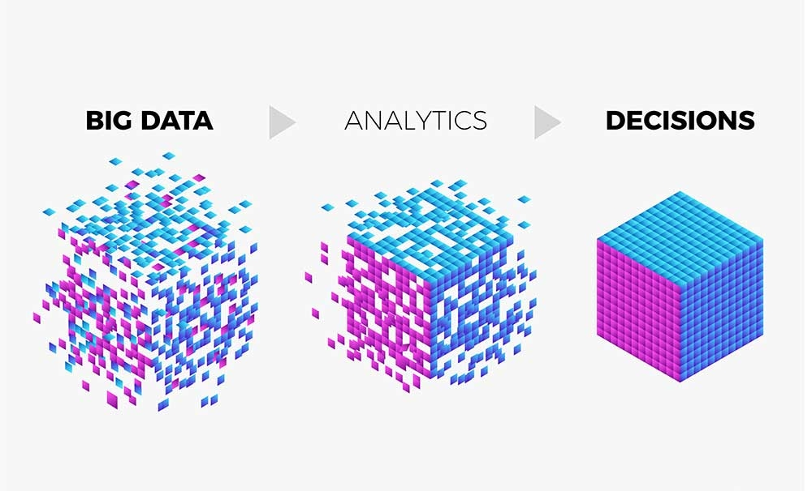
Data Processing Process
Data Cleaning and Standardization:
In this study, the collected data was carefully organized before being transformed into a meaningful and usable format. During the data scraping process, erroneous or misordered entries were identified and corrected, and the first and last name order was standardized. Additionally, it was observed that some data sources contained information in Turkish characters, while others used English characters. To prevent any errors during the matching process, all text data was converted to English characters, and this standardization process was applied meticulously, especially for the names of academics and other details.

Slide 4

Matching and Spelling Errors
Spelling Errors and Variations:
Due to the fact that individuals enter their own information in the Scopus database, spelling errors in university, department, and faculty names have been commonly observed. Additionally, variations such as academics having multiple names (e.g., "A. M. Celal Şengör") and differences in the English or Turkish spelling of university names were identified. To eliminate the impact of these issues during the matching process, all data was converted to English characters, and both the English and Turkish versions of university names were used. This approach was applied to both the Scopus and YÖK Atlas datasets.

Slide 5
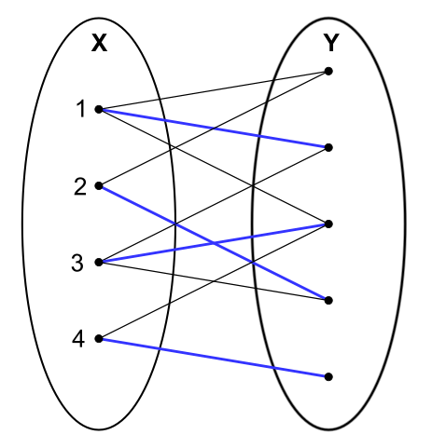
Matching
A binary clustering method has been developed to ensure accurate matching for individuals with the same first and last names but from different universities or departments. This method performs matching based on both the name and the university name to prevent confusion between different individuals with the same name. In this context, the algorithm independently evaluates multiple matches based on the number of publications authored by individuals with the same name at the same university. As a result, the number of articles written by different individuals with the same name and surname is compared.

Slide 6


Gender Classification
After the matching process was completed, gender classification was performed on the matched data. Initially, one of the available libraries, gender-guesser, was used. However, it was identified that the library did not always provide accurate results. To address this limitation, incorrect or unclear results were manually reviewed, and assessments were made according to cultural contexts.
In this process, particular attention was given to cases where certain names could belong to both males and females, and the accuracy of gender classification was improved. Additionally, due to the commonality of some names and cultural differences, misclassifications may have occurred when associating names with gender. To overcome these errors, open-source platforms such as Google and Wikipedia were utilized to determine the culturally appropriate gender for each name.
Certain ambiguous cases were addressed through manual review, taking into account cultural meanings and traditions to ensure accurate classification. As a result, the gender classification was completed with higher accuracy, and the obtained results were aligned with the analysis phase of the study.

Slide 7

Data Analysis
This study examines various dimensions of academic productivity in Turkey. The analyses are supported by data obtained from the Scopus database and YÖK Atlas sources. The dataset, covering the period from 1970 to the present, includes variables such as the number of publications, types of universities (public/private), cities, gender distributions, and faculty/department-based productivity.

Slide 8
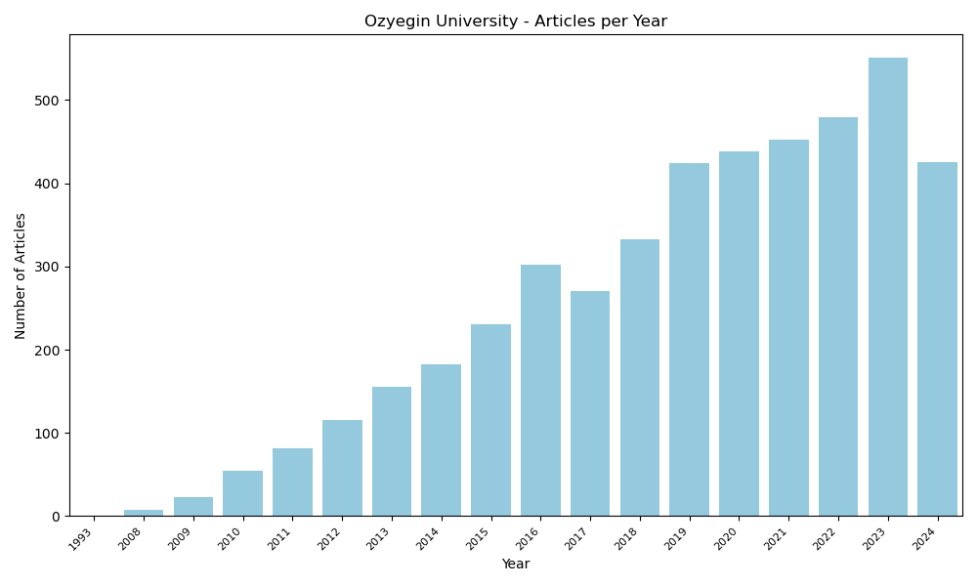
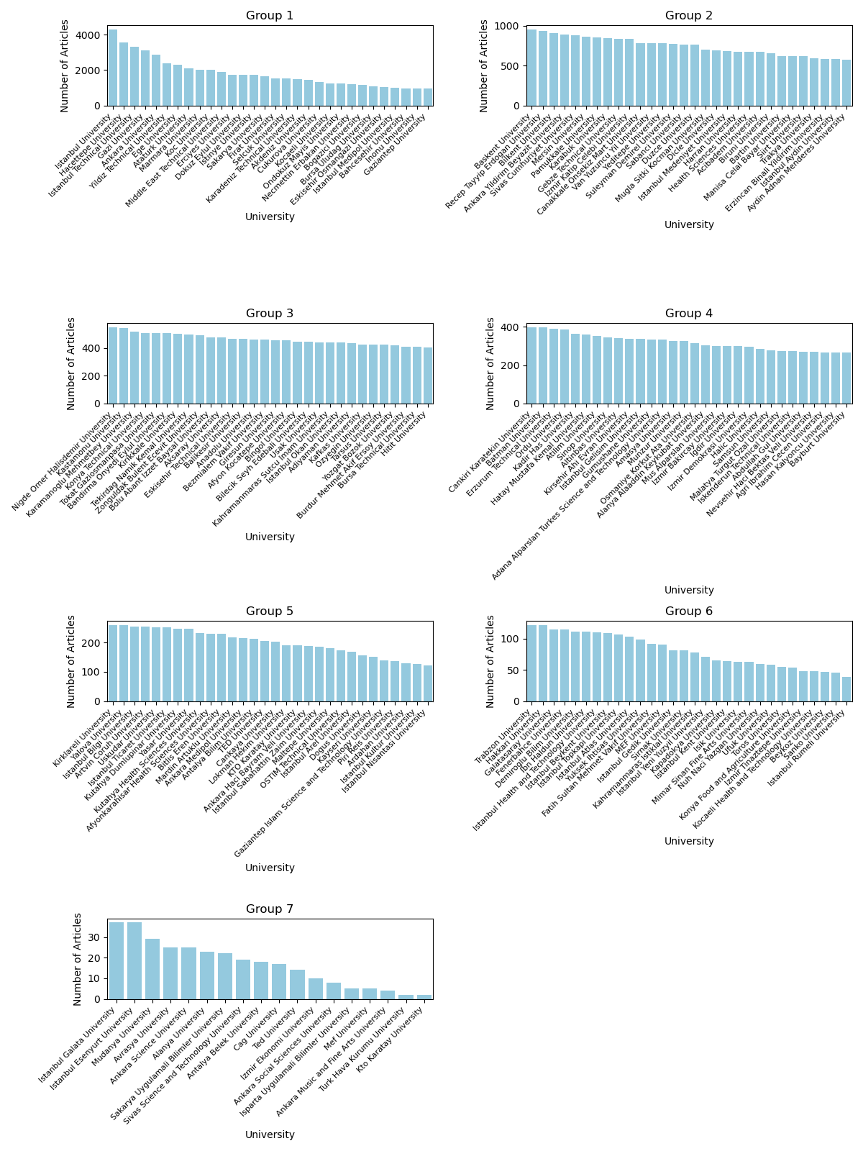
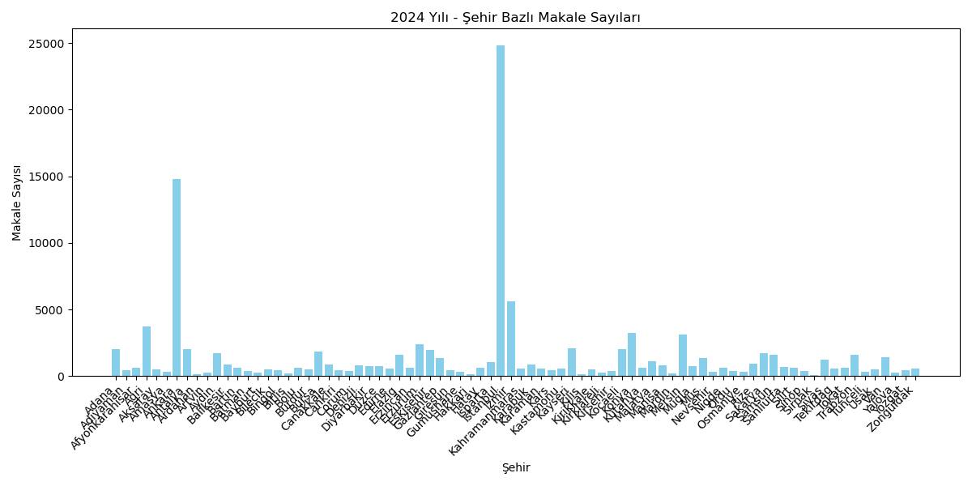
University and City-Based Productivity
Each graph presents the number of publications for universities in a specific group, sorted by university names. In 2024, the university with the highest number of publications was Istanbul University. Following Istanbul University, the universities with the most publications were Hacettepe University, Istanbul Technical University, Gazi University, Ankara University, Yıldız Technical University, Ege University, Atatürk University, Marmara University, Koç University, and Middle East Technical University.
Özyeğin University Article Per Year
This visualizes the differences in scientific productivity between cities in Turkey. It is observed that there are significant differences in the number of publications produced across cities. The cities that produce the most publications are typically large metropolises or cities that host major universities. These cities tend to have more research institutions, researchers, and research budgets. On the other hand, the cities producing the fewest publications are usually smaller cities or regions with weaker research infrastructure.
2024 University Based Number of Articles
2024 City Based Number of Articles

Slide 9
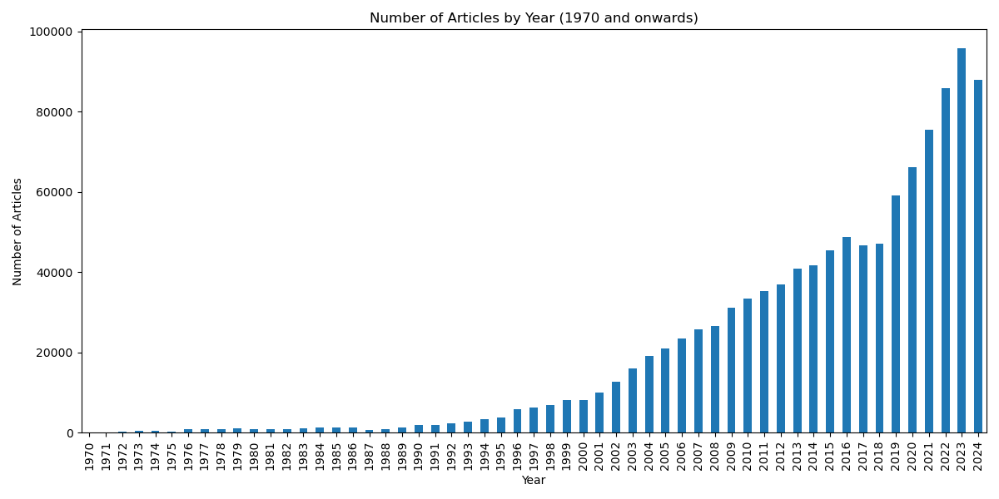
Paper Production by Year
Trends in academic productivity in Turkey from 1970 to the present have been examined, and the changes in scientific publication performance over the years have been analyzed. An upward trend is observed in the graph. This indicates that the production and sharing of scientific knowledge has been continuously increasing.

Slide 10
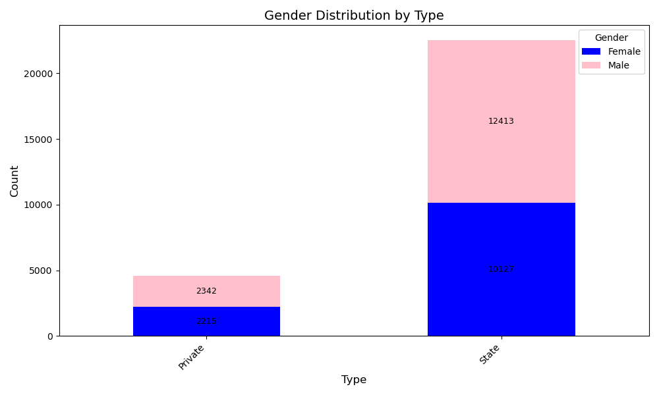
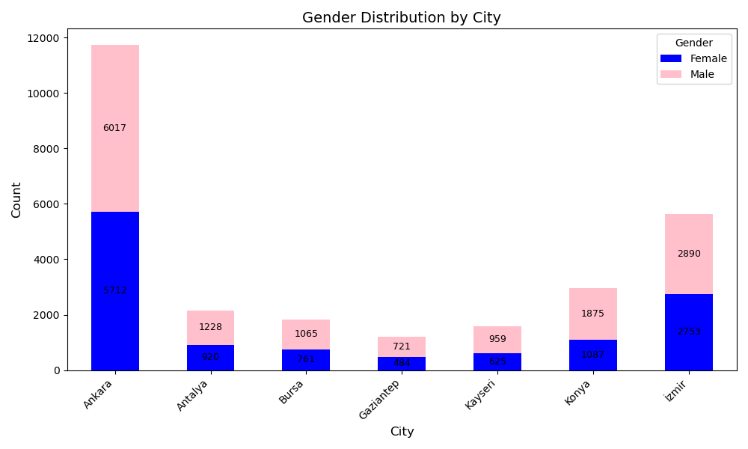
Gender and Academic Productivity
The effect of gender on academic productivity has been examined, with gender distributions analyzed according to cities and types of universities. Changes over time have also been evaluated. Although the number of male researchers is higher than that of female researchers in both categories (private and state), this gap is smaller in private universities (7 cities).
Ankara has a significantly higher academic population compared to other cities, and the proportion of male academics is generally higher than that of females across cities. These differences may be due to various factors, such as the socio-economic structure of the cities, the industrial sector, and migration movements.

Slide 11
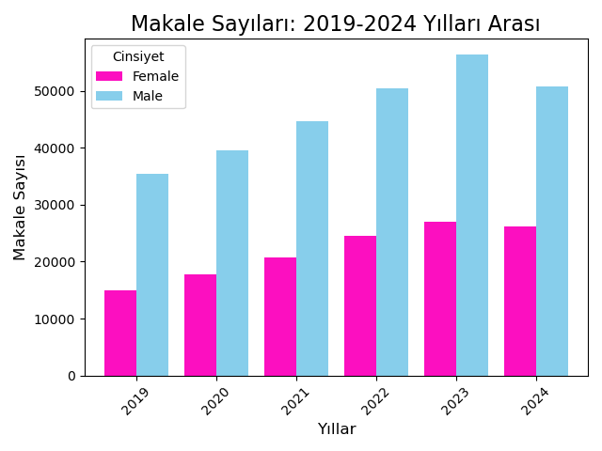
Gender and Academic Productivity-2
It shows the distribution of papers published between 2019 and 2024 in Istanbul based on gender. While an increase in the number of papers by both female and male researchers is observed, it is noticeable that male researchers have published more papers. This situation indicates that gender inequality still persists in the academic world. In some years, the dominance of males is more pronounced, while in other years, the gap is less significant. The lack of incentives for female researchers is one of the factors influencing this situation.

Slide 12
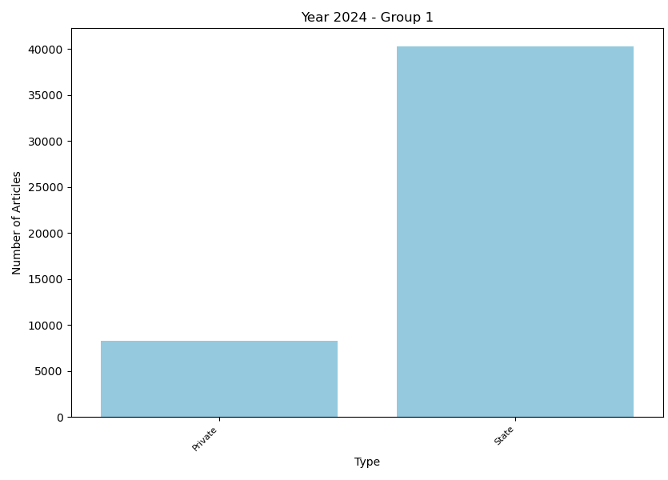
Productivity by University Type
It compares the number of papers in the 'state' and 'private' categories in 2024. State institutions may lead to intense paper production in certain fields by supporting research projects aligned with national priorities. Additionally, investments made by the state in universities and research centers contribute to creating a strong research infrastructure, which serves as a factor that increases paper production.

Slide 13
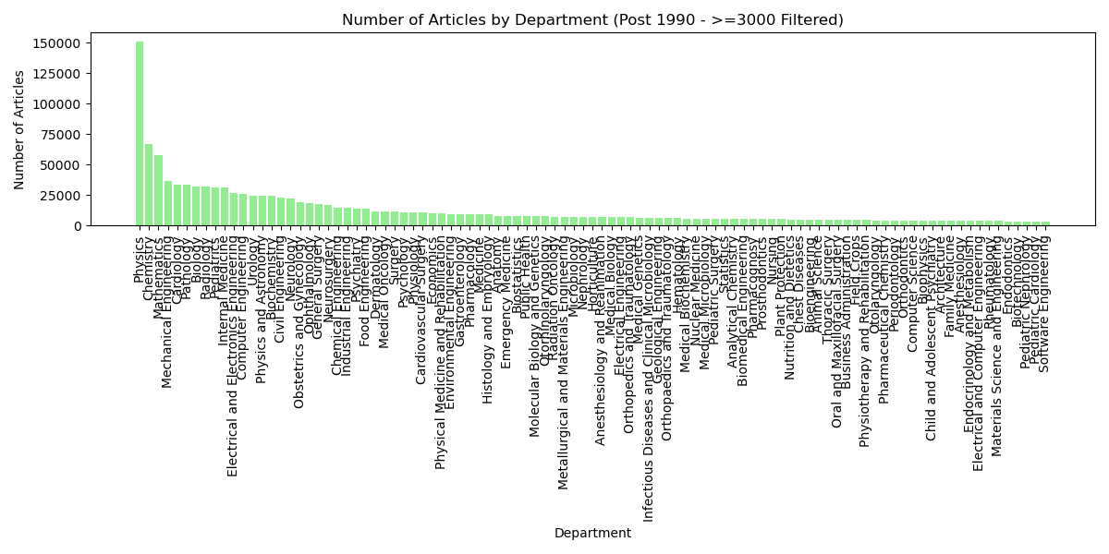
Department-Based Productivity
It compares the number of papers published in different scientific fields with at least 3,000 papers after 1990. The horizontal axis represents the scientific fields, and the vertical axis represents the total number of papers published in these fields. If the number of papers in similar or related fields is close to each other, it may indicate interdisciplinary work between these areas. For example, the close number of papers in 'Electrical and Electronics Engineering' and 'Computer Engineering' could highlight the strong collaboration between these fields.

Slide 14
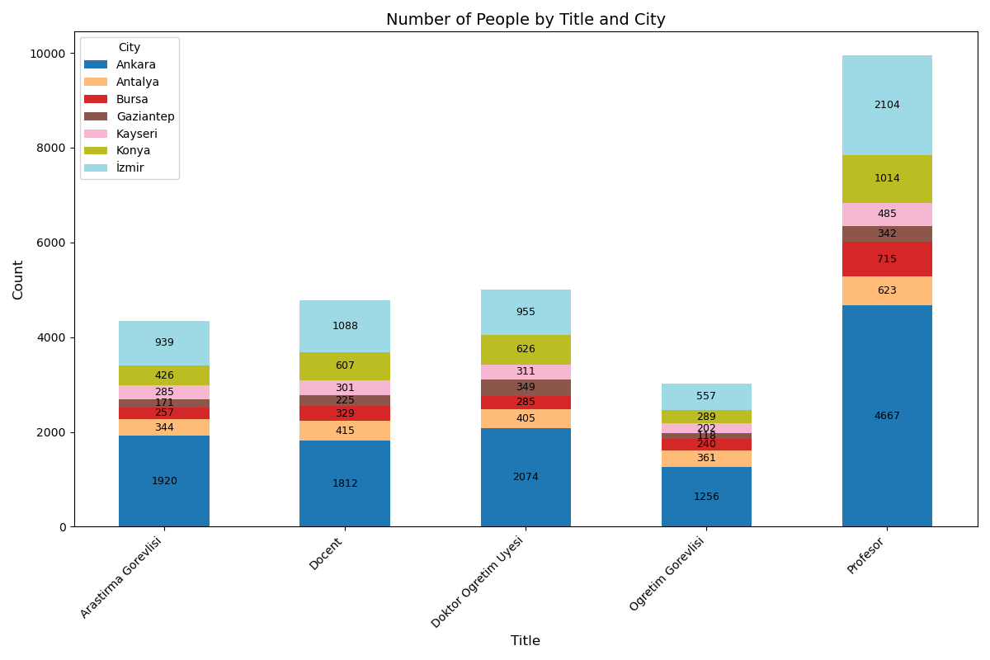
Title and City-Based Distribution (7 Cities)
Research topics in different cities have been analyzed, and academic areas of expertise have been identified. These analyses provide an overview of academic productivity in Turkey, evaluating relationships and trends among various variables.

Slide 15

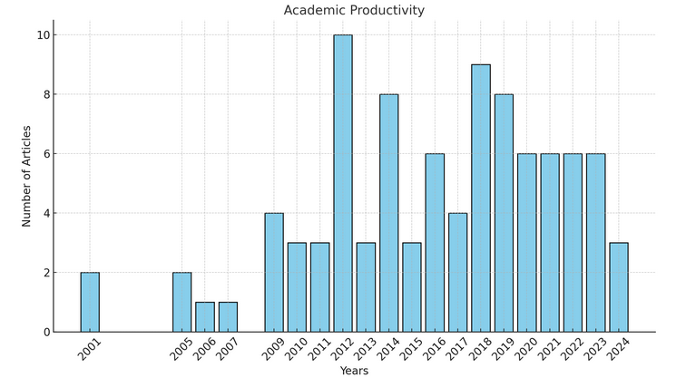
What about Our Professor?
With a total of 95 publications, this journey is a remarkable display of dedication and academic diligence. The annual distribution reveals a consistent model of academic contribution, highlighting an unwavering commitment to research and knowledge sharing.
In 2012, the highest productivity was achieved with 10 publications, while the lowest productivity was observed in 2006 and 2007, with only one publication. In recent years, particularly between 2020 and 2023, a steady production rate of 6 publications per year has been maintained. This demonstrates that academic work has been sustained at an impressive level, both with intense peaks from the past and consistent productivity in recent years.

Slide 16
Conlusion
This study examines the developments and trends in scientific publishing in Turkey. The number of scientific publications in Turkey has shown a significant increase due to the impact of digitalization. Large cities, particularly Istanbul, have become centers of scientific publishing. However, issues such as gender inequality persist, with male researchers publishing more articles than female researchers. Fields like medicine and engineering produce more articles compared to other disciplines.
In conclusion, scientific publishing in Turkey is experiencing significant growth, but there is a need to support female researchers and promote interdisciplinary collaborations. With these steps, Turkey could strengthen its position in scientific research. The graphs reflect the general state of scientific publishing in Turkey, but for more detailed analyses, statistical methods should be used to more clearly analyze the factors affecting scientific publishing.

Slide 17

Thanks!
In this study, I had the opportunity to comprehensively analyze academic productivity in Turkey. By examining the scientific contributions of academics and universities using data obtained from Scopus and YÖK Atlas datasets, I have reached significant findings. I would like to express my gratitude to my advisors for their valuable contributions, to the institutions that supported me in accessing the data, and to my colleagues in the academic community. Additionally, I thank everyone who listened to and participated in this presentation.
Wishing for continued growth in scientific endeavors…

