Slide 1

EE 470
DEEP LEARNING FOR COMPUTER VISION
COURSE PROJECT: PLANT DISEASE CLASSIFICATION CHALLENGE
Group 12
ALI BAKI TURKOZ
20190701070
EMRE OZTURK
20190701087

Slide 2

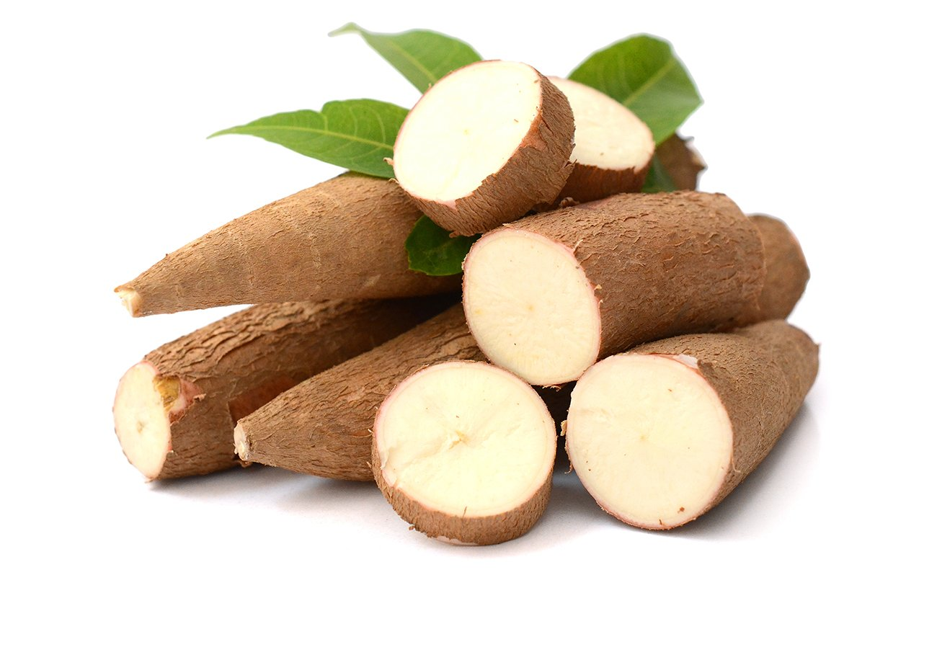
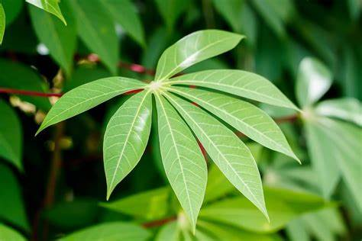
INTRODUCTION
Cassava is an important food source in tropical regions and holds significant economic value. However, various diseases affecting the cassava plant and the difficulty in detecting them seriously reduce its productivity.
In this project, our aim was to develop an artificial intelligence model to early diagnose and classify cassava leaf diseases.

Slide 3
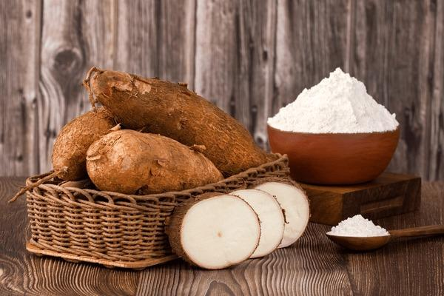
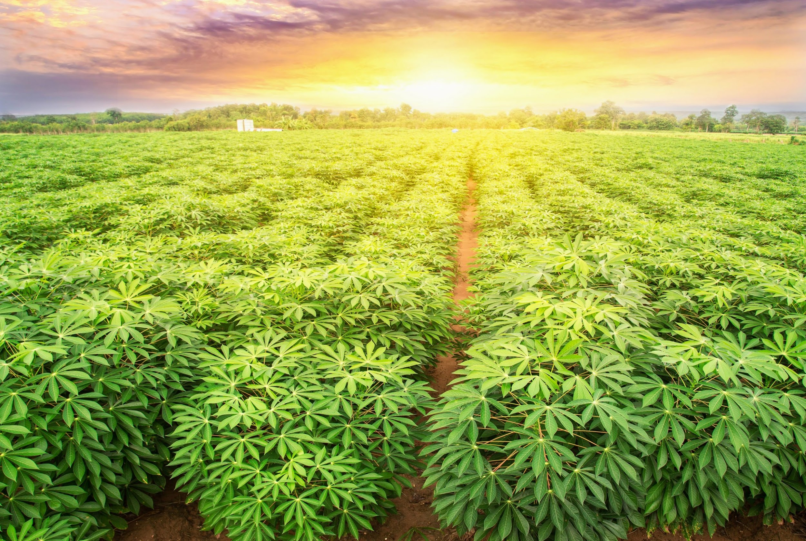
Cassava Plant
General Information
- Scientific Name: Manihot esculenta
- Family: Euphorbiaceae
- Common Names: Cassava, yuca, mandioca, tapioca
- Homeland: South America, especially Brazil and Paraguay
Botanical Characteristics
- Root: Cassava is grown for its large underground roots rich in starch. These roots are long and cylindrical, usually 5-10 cm in diameter and 15-30 cm in length.
- Leaves: The leaves are palmate-split and bright green in color.
- Flowers: The plant has small, white or yellow flowers, but usually does not bear fruit.
Usage areas
- Food: Cassava roots can be consumed directly after cooking or processed into flour, starch (tapioca) and other products. Cassava root is widely used in gluten-free diets, especially since it does not contain gluten.
- Industrial: Cassava starch is used in various industrial applications such as paper, textiles and adhesives.
- Animal Feed: The leaves and barks of the Cassava plant can be used as animal feed.
Nutritional Values
-Calories: Cassava root is rich in energy due to its high carbohydrate content.
- Vitamins and Minerals: It contains vitamins such as vitamin C, thiamine, riboflavin and niacin.
- Protein: Its protein content is low, so it is recommended to consume it with other protein sources for a balanced diet.
Potential Problems
- Diseases and Pests: Diseases such as Cassava mosaic virus (CMV), Cassava bacterial blight (CBB), Cassava brown streak disease(CBSD) and Cassava green mottle disease(CGMD) can damage the plant.
Economic and Social Importance
- Source of Livelihood: In many tropical regions, cassava is the main source of food and livelihood for millions of people.
- Food Safety: It provides food safety due to its durability and high efficiency in times of famine and economic crisis.
Cassava plays an important role as both a staple food and an economic crop, especially in developing countries. However, it must be consumed with correct processing and cooking methods.

Slide 4
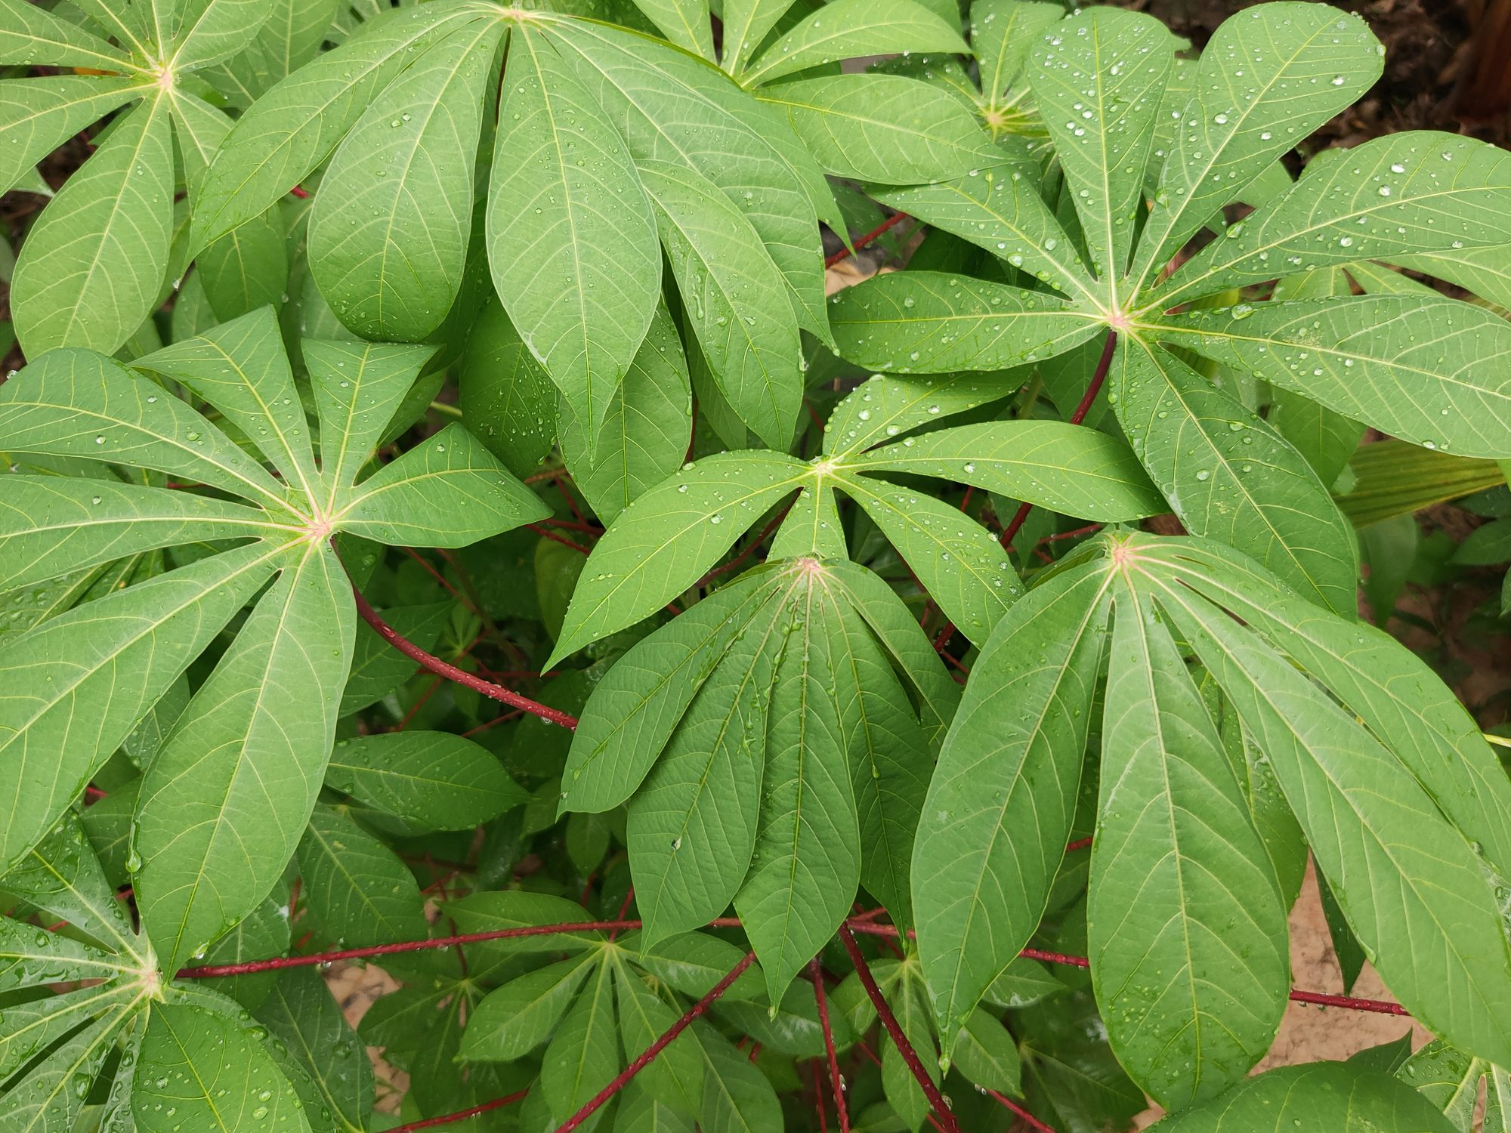

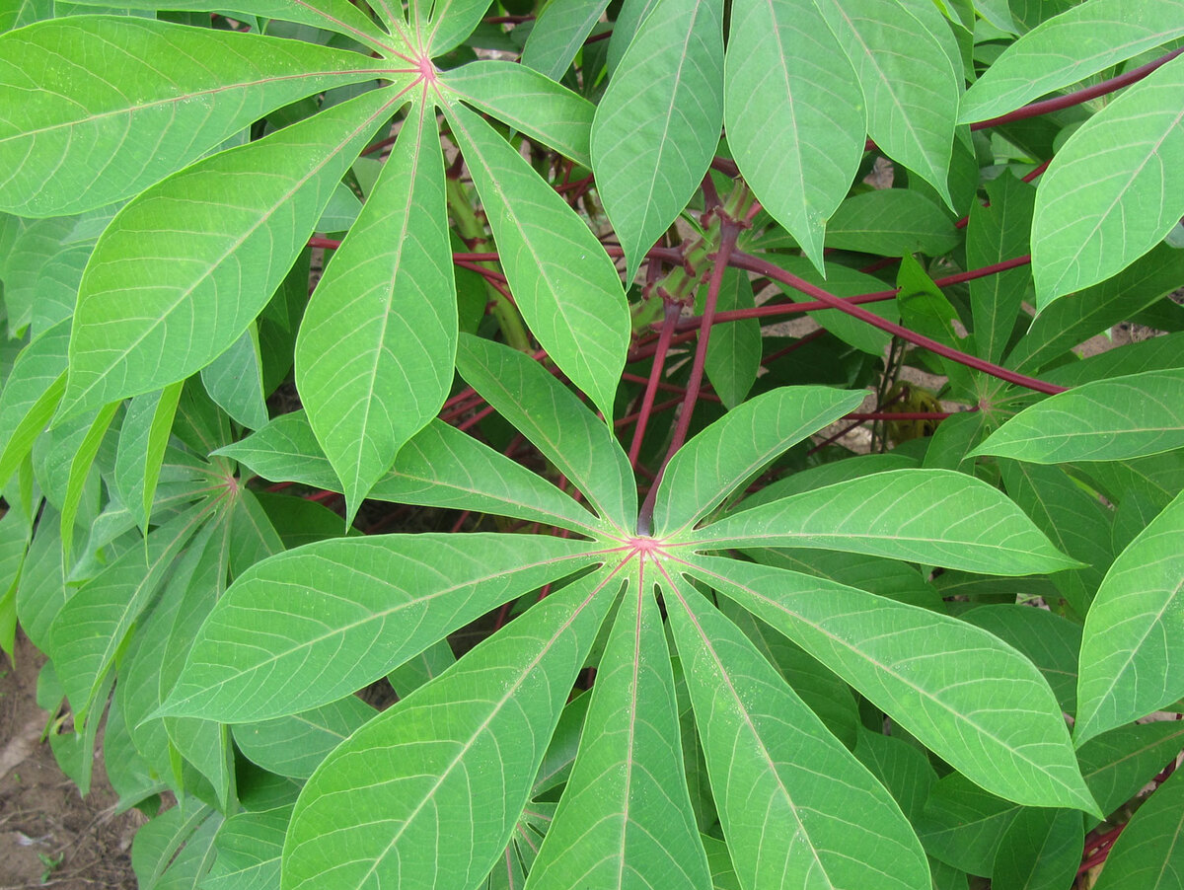



HEALTHY CASSAVA
The leaves of a healthy cassava plant are typically vibrant, glossy green in color, and evenly distributed. Leaves should generally be smooth and soft.

Slide 5
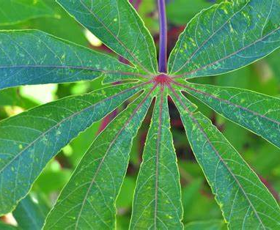
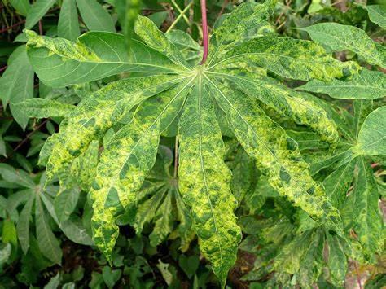
Cassava Mosaic Disease(CMD)
CMD is a predominantly found disease that plagues the Cassava crop.
The plants and leaves show stunted growth due to the infection.
Its features include the formation of mosaic-like patterns on the leaves, yellow-white spots, color change and deformities on the leaves.

Slide 6
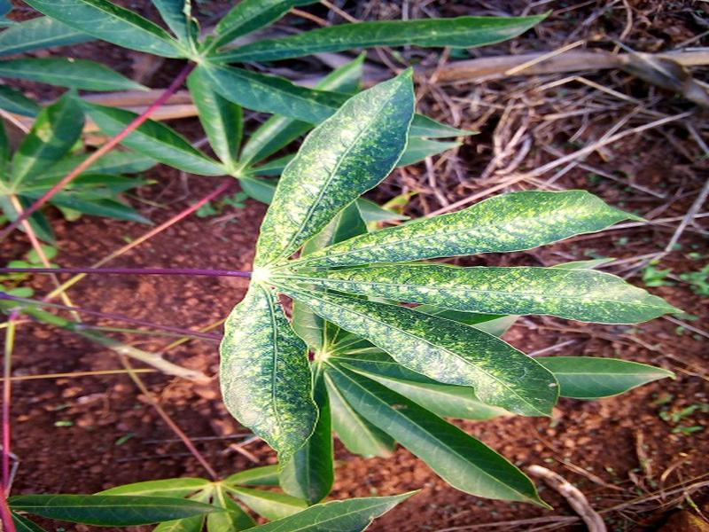
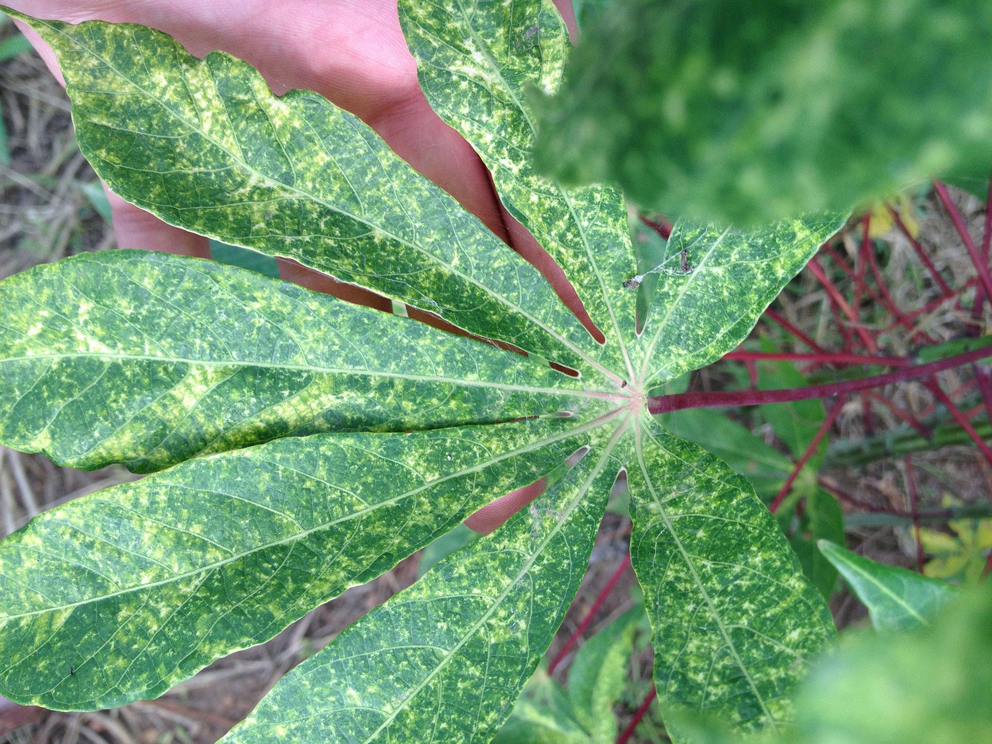
Cassava Green Mottle Disease(CGMD)
CGDM causes the formation of white spots on the surface of leaves and leads to a loss of chlorophyll during proliferation.
Depending on the severity of the infection, leaves may dry, shrink, and fall prematurely.
The main features to use for detection are white spots, mottled leaves and/or stunted leaves.

Slide 7
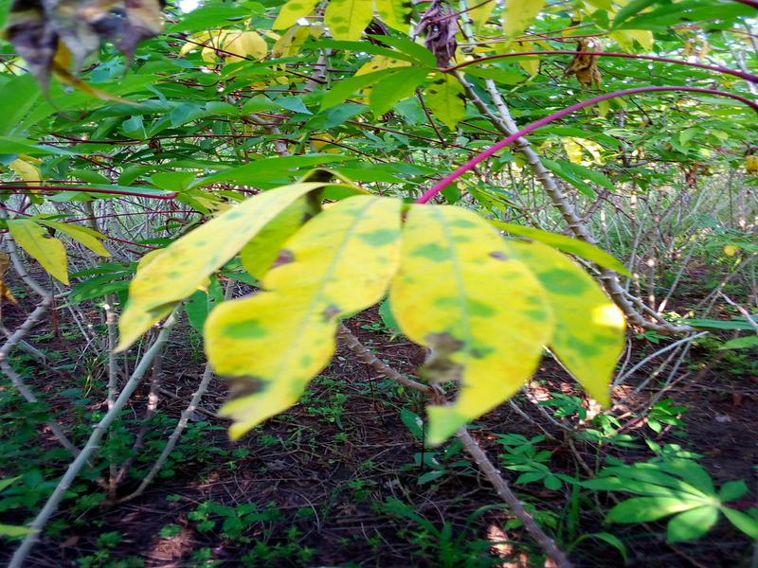
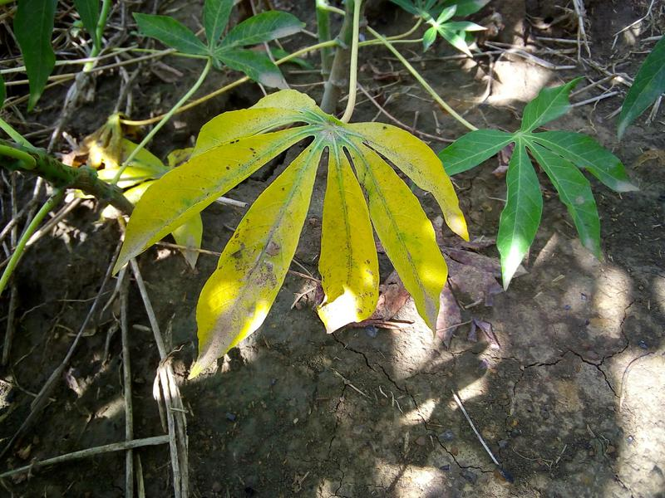
Cassava Brown Streak Disease
CBSD adversely affects the cassava plant. Whiteflies, arguably the most damaging insect pests, are vectors of the virus.
In the early stages of infection, CBSD symptoms appear as yellow striped patches amidst the usual green color.Over time, these yellow spots grow and merge to form larger yellow spots and the leaves become mottled.
Basic features to be used for classification; yellow spots, dark streaks on the stem and stunted leaves/roots.

Slide 8
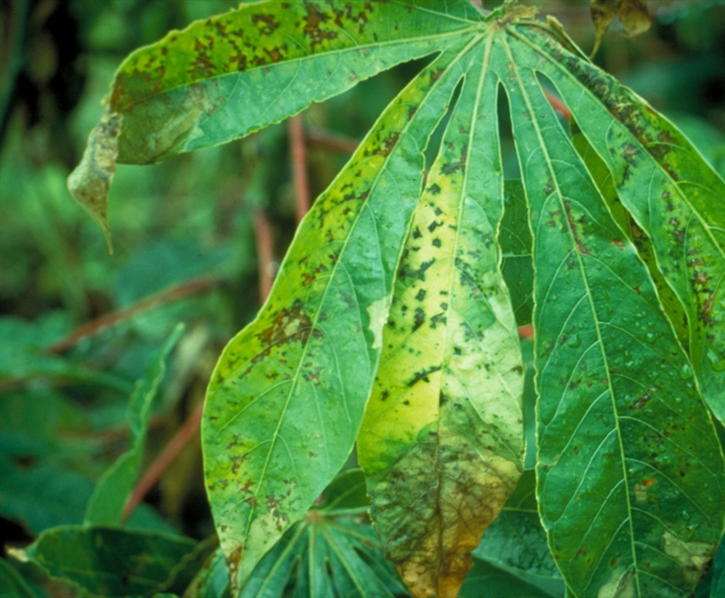
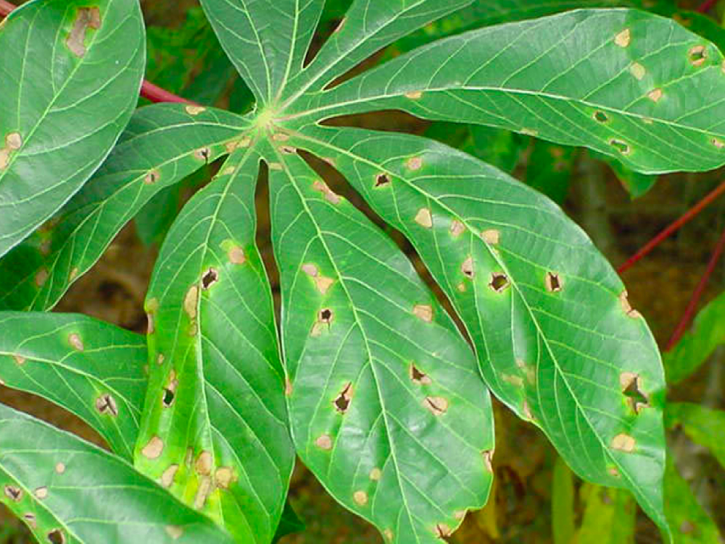
Cassava Bacterial Blight (CBB)
As the name suggests, is a bacterial disease that affects the crop. Humid environmental conditions are preferred.This causes leaves to wilt and drop prematurely when the infection becomes severe.
The main characteristics to be used for classification are black and angular spots and dried, fallen leaves.

Slide 9
Literature review
Various studies on the detection of Cassava plant diseases have been examined in our literature review. Ozichi et al. (2019) classified Cassava diseases using Cubic Support Vector Machine and Coarse Gaussian Support Vector Machine models. An accuracy rate of 83.9% was achieved in predicting the health status of the leaves through the application of the CSVM model.
On the other hand, Mrisho et al. (2020) conducted disease detection using deep learning and transfer learning techniques. Metlek (2021) classified the Cassava Leaf Disease Classification dataset using ResNet 50 and MobileNetV2 models. The extracted features were classified using Support Vector Machine and K-Nearest Neighbor algorithms. The images were divided into two groups, namely training and testing, according to the K-fold 5 value. Average highest success rates in training and test data were achieved, with success rates of 85.4% and 84.4%, respectively.

Slide 10
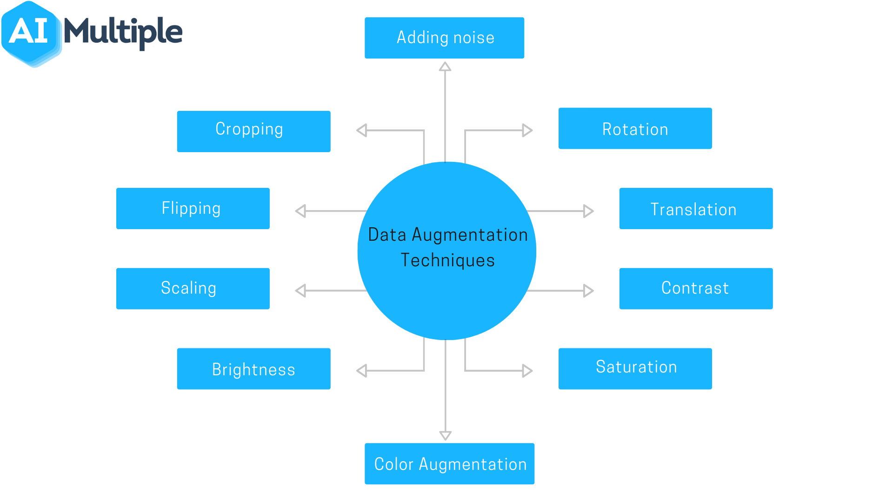
Dataset and Image Processing
For this project, we conducted three different experiments. Firstly, we utilized all training datasets. Then, we attempted to remove irrelevant images one by one from each class. Lastly, we set the number of images in all classes to the lowest class count, which was 987 images.
As a result, we utilized a large dataset comprising 10,965 images to achieve the best outcome. This dataset includes various images of healthy leaves and four different types of diseased leaves.
Our image processing steps are as follows:
- Resizing Images: All images were resized to fit the input dimensions of the model.
- Scaling: Images were normalized using a specific scaling factor.
- Data Augmentation: Various augmentation techniques were applied to enrich the training data.

Slide 11
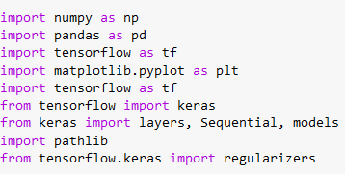
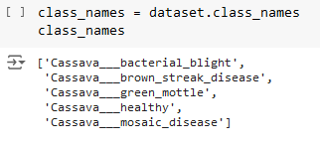


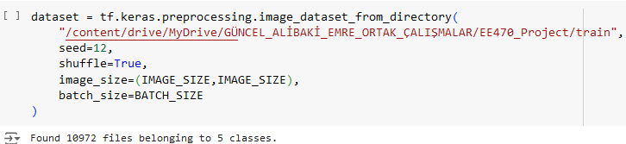
First Code Looking
Firstly, all the necessary libraries were imported.
The image dimensions, as well as the batch size, channel, and epoch numbers, were specified.
The datasets were accessed by providing the file path using the TensorFlow Keras libraries.
In the training file, the number of classes was indicated by accessing the subfolders.
As observed, the training data has been split. 80% of it is used for training, 10% for validation, and 10% for testing.

Slide 12
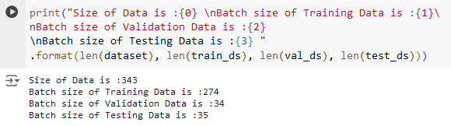

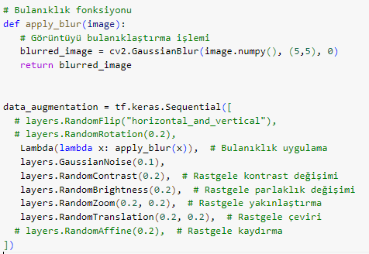
Pre-processing
The validation, test, and training data have been partitioned according to batch sizes of 32.
Before integrating our images into the network, we need to resize them to the desired dimensions. Additionally, to enhance the model's performance, we should normalize the pixel values of the images.
Data augmentation is performed to diversify the training data and enhance the model's generalization ability. Blurring is a technique aimed at reducing noise, allowing the model to focus on the overall features.

Slide 13
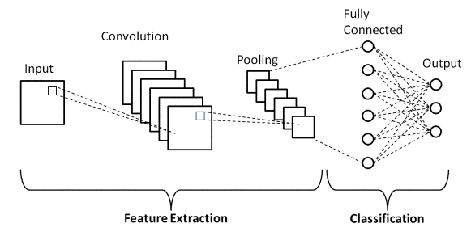
CNN BASED MODEL
In the project, a model based on Convolutional Neural Network (CNN) was employed. No pre-trained model was utilized; the code and model were constructed from scratch. CNNs are highly effective, especially in image classification tasks. The layers and features of our model were as follows:
- Input Layer: Accepts images of size 256x256 with 3 color channels.
- Conv2D Layers: These convolutional layers extract features from the images.
- Pooling Layers: Used to reduce the size of feature maps, typically employing MaxPooling.
- Fully Connected Layers: Dense layers used for feature classification.
- Output Layer: Utilizes the Softmax activation function to identify the healthy and diseased types categorized into 5 classes.

Slide 14
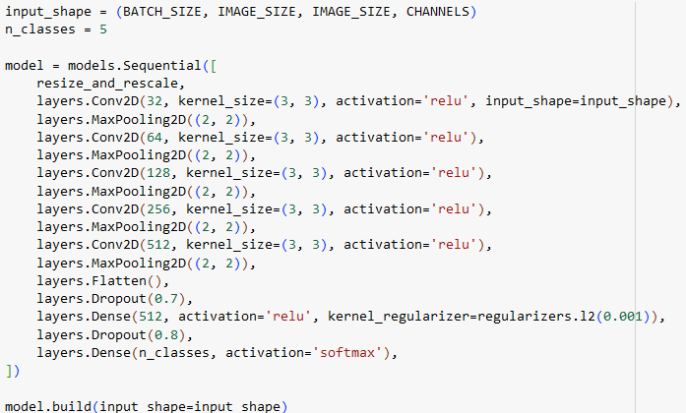
About Layers
Initially, we set the batch size to 32. This means that 32 iimages are processed at a time. We wanted to use a larger batch size, but Colab and GPUs didn't allow it. Having more GPUs means better training and better predictions for the model.
We set the image size to 256x256 as this size was deemed ideal. We wanted to use larger sizes, but again, Colab and GPUs didn't allow it. The value "3" represents the number of RGB color channels.
The first argument, 32, specifies the number of filters in the Conv2D layer. The second argument specifies the filter size.
MaxPooling layers are used after Conv layers to reduce the size, preserving the most significant features.
Dense layers are connected to all elements in the previous layer and are used to classify feature vectors. The Flatten layer converts the outputs of convolutional and pooling layers into a flat vector compatible with fully connected layers.
The Dropout layer helps prevent overfitting by randomly dropping inputs during training, allowing the network to learn different features. Finally, since there are 5 classes in our model, the Dense layer is set to softmax to get 5 different outputs.

Slide 15
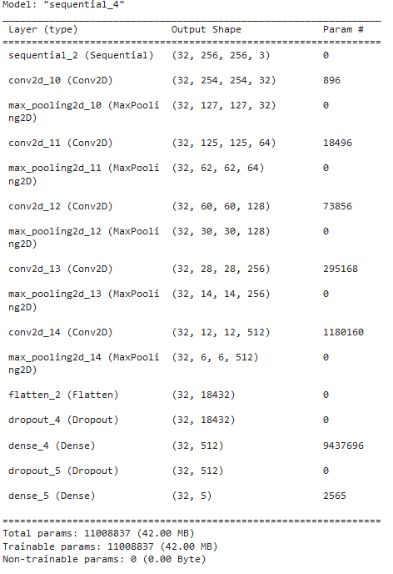
Model Summary
As observed, there are 11008837 trainable parameters. Having more parameters could potentially yield better results, but due to the large size of the training dataset, GPUs are most effectively utilized with image sizes set to 256x256.

Slide 16
RESULT OF THE TRAINİNG
After setting the necessary parameters and training the model, within the code, we split all the training data into 80% for training, 10% for validation, and the remaining 10% for testing. Following the training, the model was tested with internally selected data, resulting in an
Training Accuracy : %92.04
Training Loss: %57.51

Slide 17
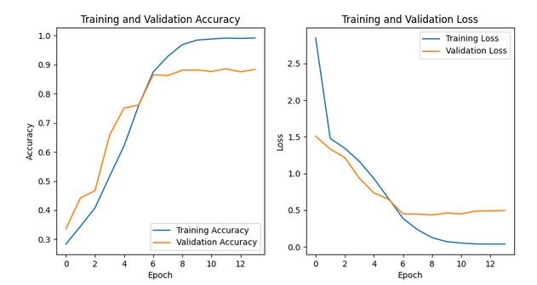
FİRST RESULT
As seen here, a model was trained from scratch, but it didn't perform well. Therefore, this model, which suffered from overfitting, was not used.Additionally, despite setting the epoch to 200, the training was completed very quickly, as seen, in around 12 epochs, which is a very short duration.

Slide 18
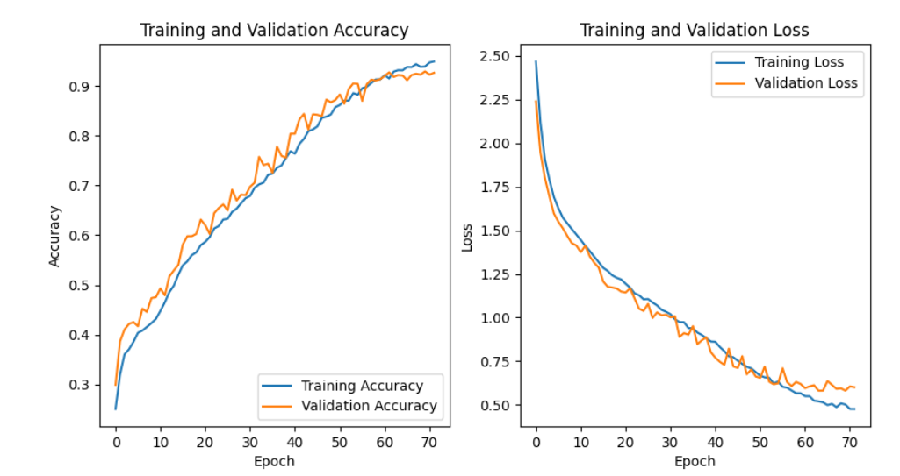
Second Result
After carefully adjusting the model parameters and layers, we conducted another training and testing experiment, and the results are as seen.

Slide 19
CONCLUSION
In this project, we developed a deep learning-based model to classify diseases in cassava plants. Initially, images of size 800x600 were resized to 256x256, and the model was trained. During training, early stopping was employed to prevent overfitting. Results were evaluated by examining accuracy and loss graphs of the model, leading to successful classification.
As a result, the model was saved as an h5 file, and the accuracy was calculated as 59.80% with 500 test data points.

Slide 20
Future Work
In the future, to enhance the model's performance, higher-quality images can be utilized, and class-specific preprocessing can be applied. Moreover, integration of deep learning models into portable devices and experimentation with different model settings using more computational resources are planned. These endeavors will significantly contribute to early and accurate diagnosis of cassava diseases.
The dataset's reliability is compromised as images are captured directly by farmers using their phones in the fields, leading to background noise exposure. Higher-quality images could have improved the model's robustness. Another limitation was computational resources; despite using Google Colab, the allocated GPUs were insufficient for experimenting with various model settings to enhance performance.

Slide 21

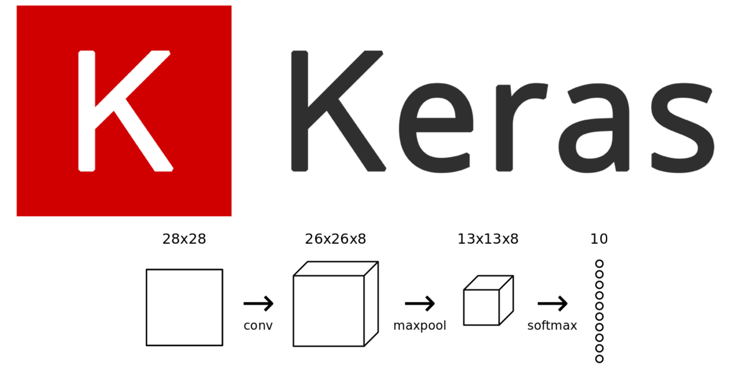

TECHNICAL CONSTRUCTIONS
https://colab.google/ (Nvidia Tesla T4 16GB RAM)
TensorFlow (Python, C, Java, Go, JavaScript, Swift): https://www.tensorflow.org/
Keras (Python): https://keras.io/
Nvidia GeForce RTX 4090 24GB RAM

Slide 22

Challenges
Inbalance Dataset
Excessive data volume, image size, and batch size could not be increased significantly,
Identification of erroneous data,
Blurry and dirty background.

Slide 23
REFERENCES
Projemiz boyunca faydalandığımız kaynaklar ve referanslar şunlardır:
- Ozichi, K. et al. (2019). "Cassava Disease Classification Using Support Vector Machines."
- Mrisho, R. et al. (2020). "Deep Learning and Transfer Learning for Cassava Disease Detection."
- Metlek, M. (2021). "Cassava Leaf Disease Classification Using ResNet 50 and MobileNetV2."

Slide 24


THANKS FOR WATCHING!
Do you have any questions?
Ali Baki TURKOZ
Emre OZTURK

