Slide 1
Impact of Fuel Prices & Holidays on Flights
DSA 210 Term Project
Emre Pamukçu - 22596

Slide 2
The Core Question
Flight pricing seems random. What drives it?
Are prices heavily influenced by external macro-factors?
Hypothesis 1: Higher global oil prices = more expensive tickets.
Hypothesis 2: National holidays = massive demand surges = expensive tickets.

Slide 3
Data & Enrichment
Three datasets merged for analysis:
1. Base Data: Kaggle (300k+ flight records in India)
2. Enrichment 1: WTI Crude Oil Prices (Investing.com)
3. Enrichment 2: Worldwide Holiday Database (National subset)
Target Variable: Ticket Price (INR)

Slide 4
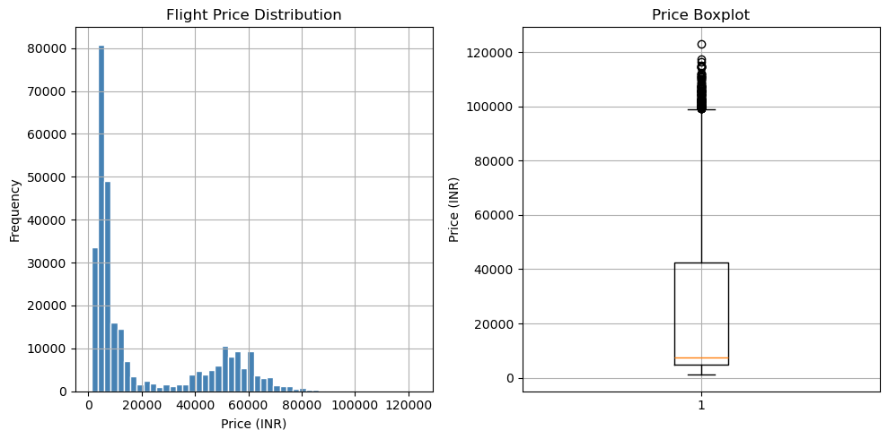
The Baseline: Price Distribution
A Heavily Skewed Market.
• Most flight tickets are clustered at the lower end (Economy).
• The long tail represents premium and last-minute tickets.

Slide 5
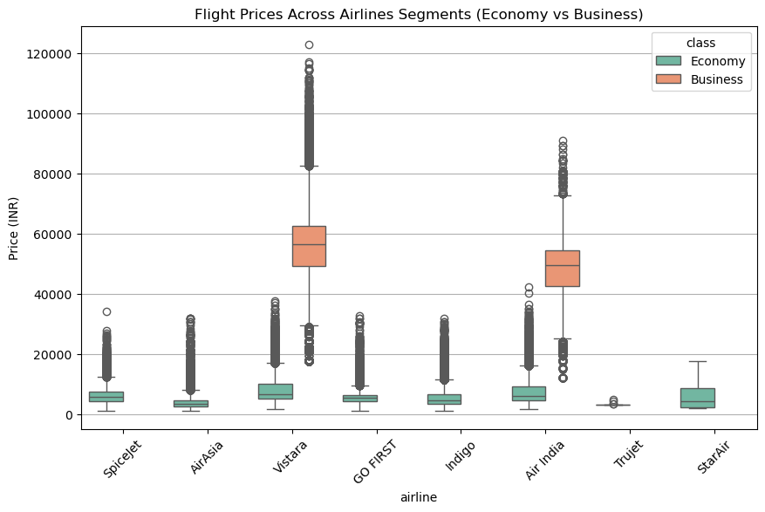
The Internal Factor: Cabin Class
The Great Divide.
• Business Class tickets are exponentially more expensive than Economy.
• Vistara and Air India dominate the premium market.

Slide 6
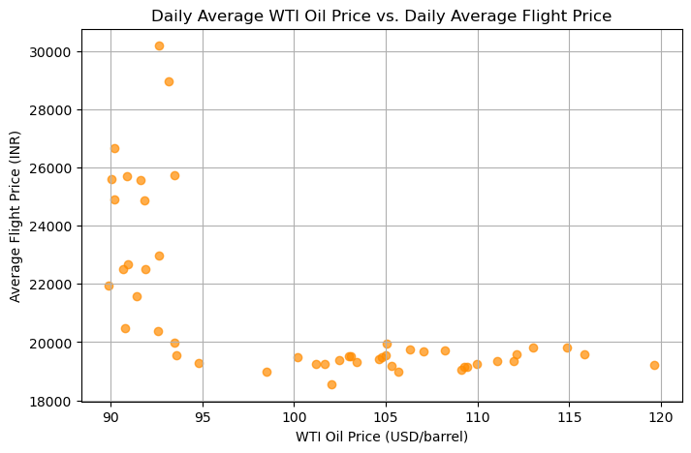
Surprise 1: The Oil Paradox
Hypothesis: Wrong.
• Pearson r = -0.65 • Prices fell as oil rose. • Reason: Airlines hedge fuel. Spot prices don't immediately hit ticket counters.

Slide 7
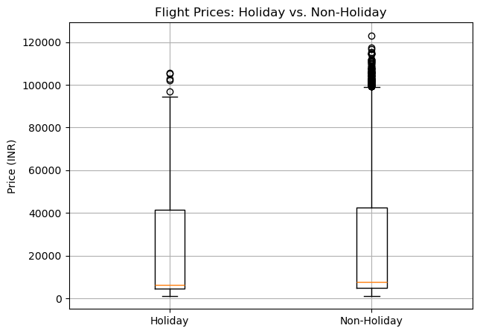
Surprise 2: Cheaper Holidays?!
Hypothesis: Wrong.
• Holiday Mean: 19,506 INR • Normal Mean: 20,946 INR • Statistically significant (p-value near 0).
Theory: Drop in expensive corporate travel outweighs leisure surges.

Slide 8
Predictive Modeling
Can an algorithm figure this out?
Baseline: Linear Regression
R-squared: 0.90 | RMSE: 6,995 INR
Heavyweight: Random Forest Regressor
Tuned via GridSearchCV (n_estimators=100, max_depth=15)
R-squared: 0.95 | RMSE: 5,110 INR

Slide 9
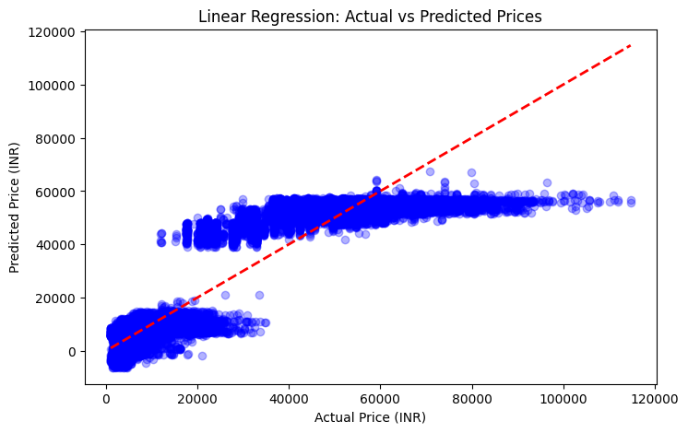
Baseline Model: Linear Regression
Good, but not great.
• While it tracks the general trend, you can see it struggles with higher-priced tickets.
• A straight line cannot perfectly capture airline pricing tiers.

Slide 10
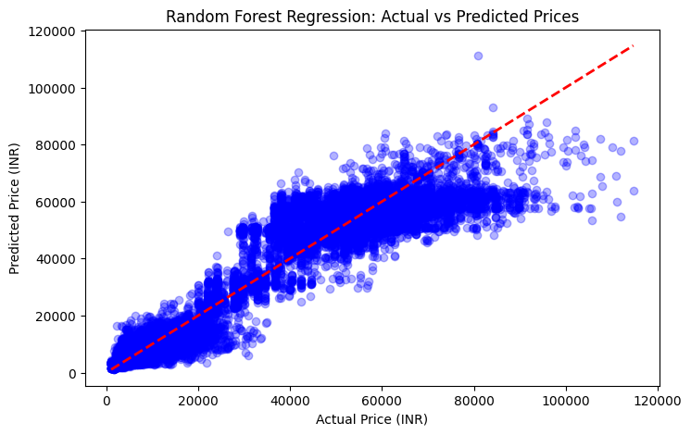
Random Forest Performance
The Clear Winner.
• Much tighter clustering around the prediction line.
• Successfully captures the non-linear jumps between Economy and Business class prices.

Slide 11
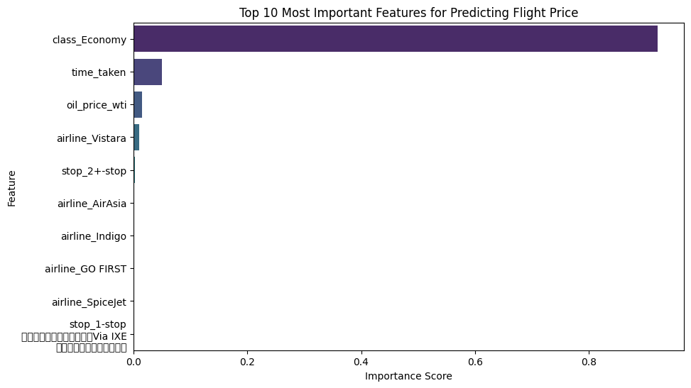
The Final Answer
Internal Factors Dominate.
• Cabin Class and Flight Duration dictate the price.
• External macro-factors (Oil, Holidays) have minimal predictive power.

Slide 12
Conclusion
Key Takeaways:
It's fun to blame global oil markets and holiday rushes for expensive tickets.
However, airlines price tickets strictly based on internal logistics (your seat and distance flown).
Hypotheses = Disproven.
Model = Highly Accurate (0.95 R²).

