Slide 1
GPU-Accelerated
LIF Spiking Neural
Network Simulator
Emre Sagir
Computer Engineering (GPU Programming Class)
Politecnico di Torino

Slide 2
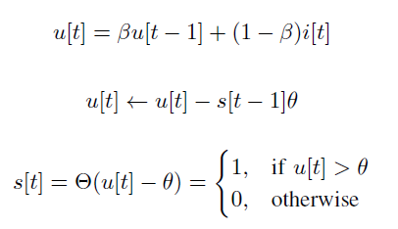


I. Background (Models)
A. Neuron Model
B. Synapse Model
C. Merge

Slide 3
II. Proposed Method
1- Exploiting the GPU’s parallel computing power
2- Different models, same work.
3- Results and Discussion
Basic GPU Model
Optimized
GPU Model
CPU Model
Torch (CPU)

Slide 4
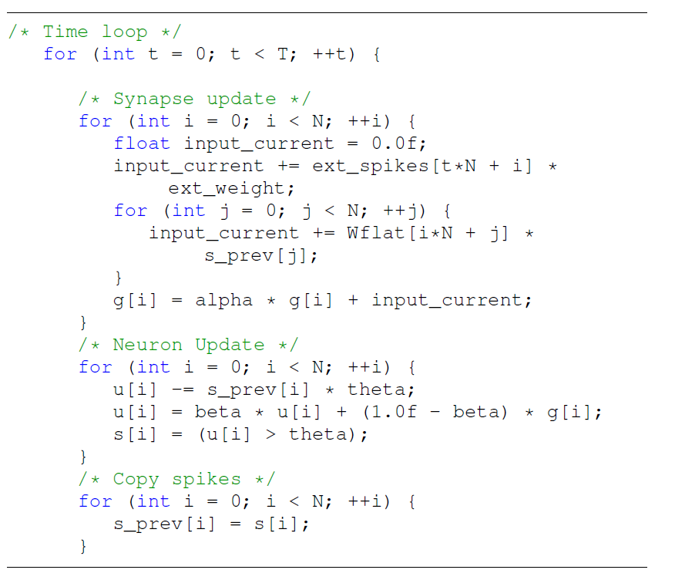
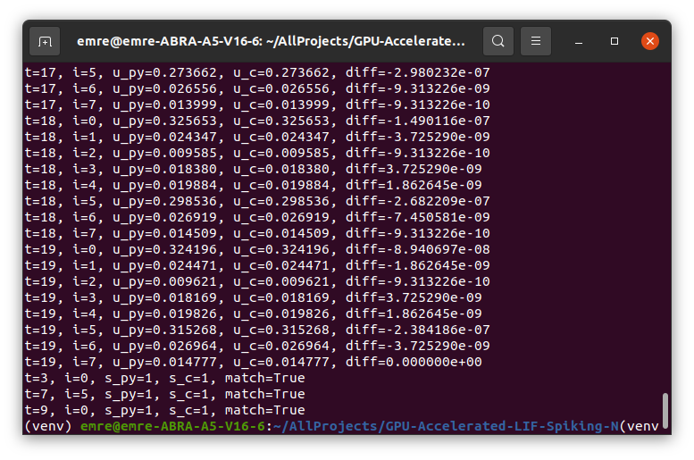
III. CPU Model and Torch
Given equations are implemented in C.
Torch and C version are compared.

Slide 5
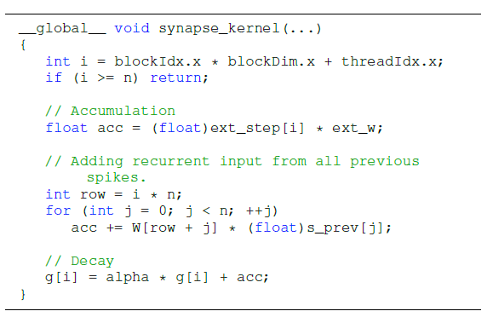
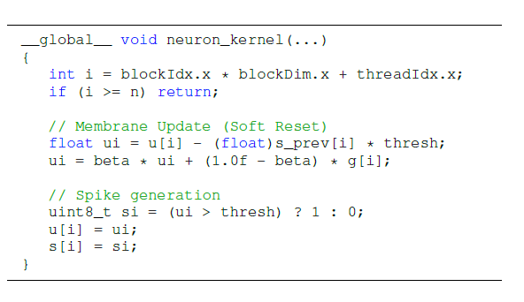
V. Basic GPU Model
2 Kernels, Neuron and Synapse

Slide 6
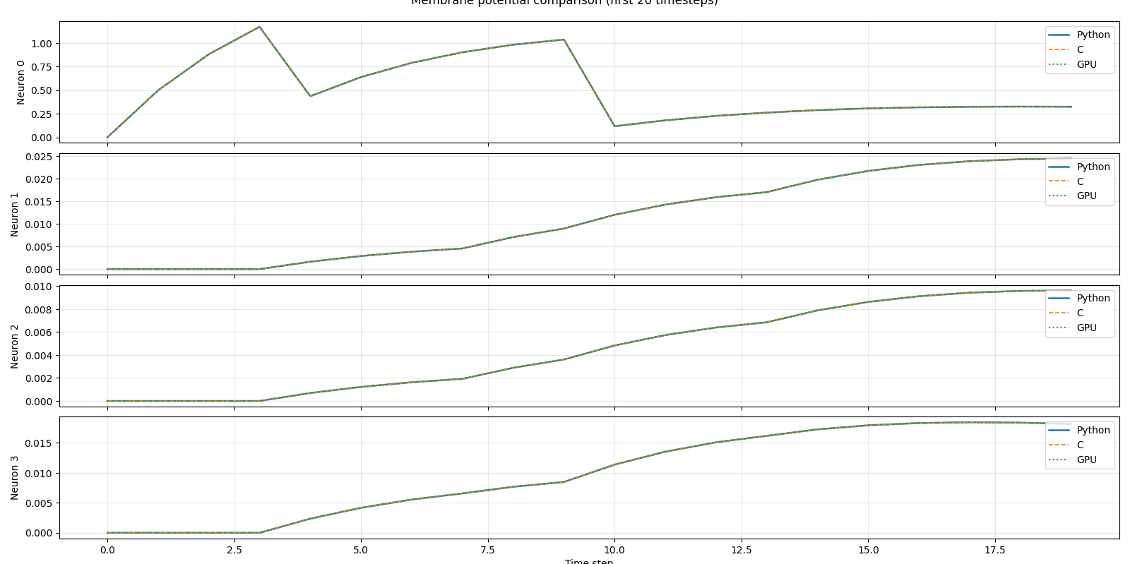
V. Basic GPU Model (cont’)

Slide 7
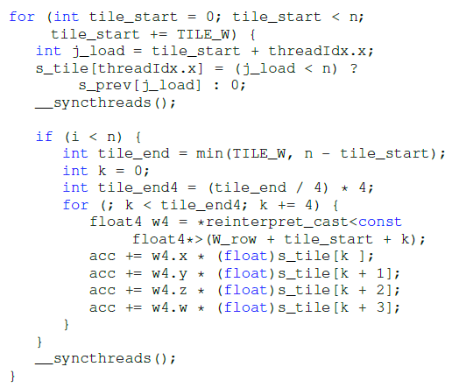
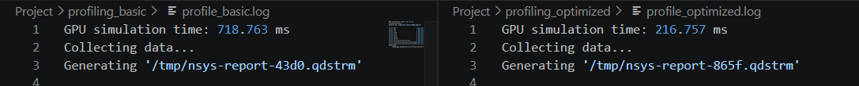
V. Optimized GPU Model
Optimization Techniques
Kernel Fusion
Shared Memory Tiling
Vectorized Loads

Slide 8
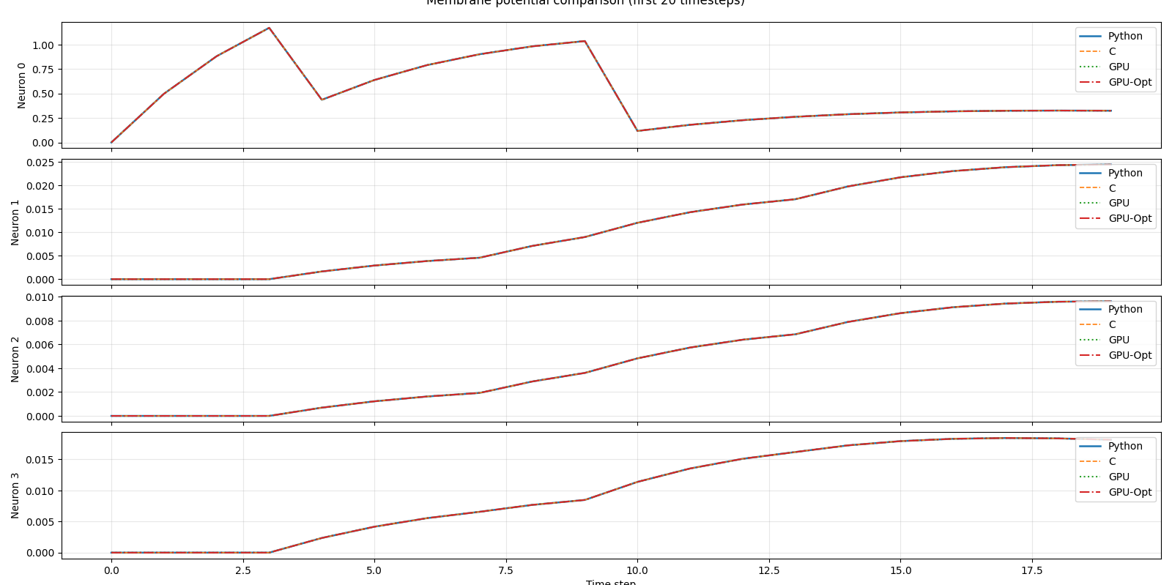
V. Optimized GPU Model (cont’)

Slide 9
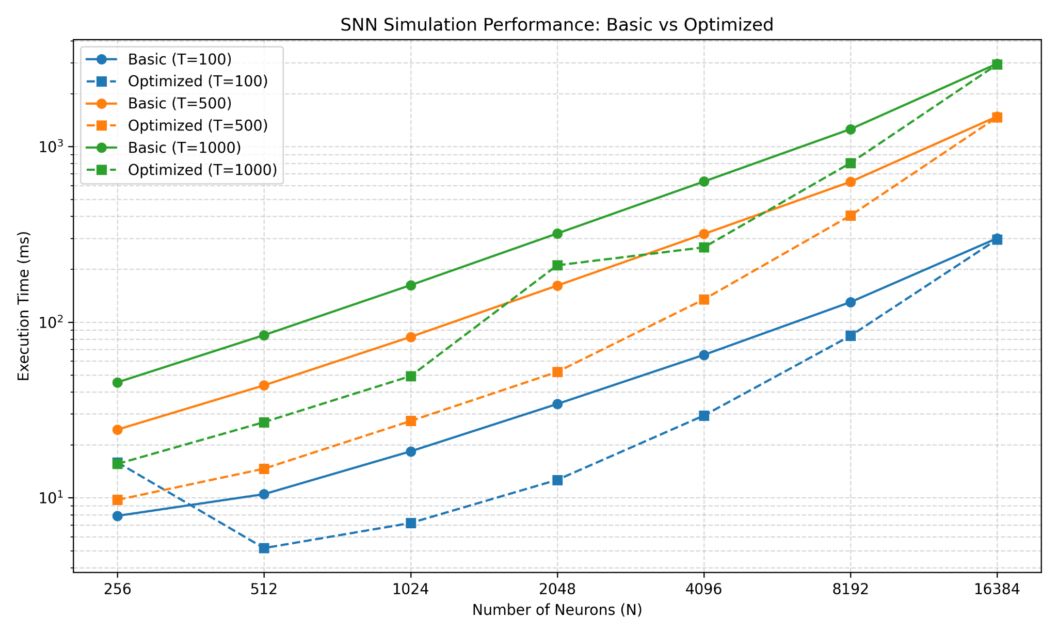
VI. Results and Performance Evaluation

Slide 10
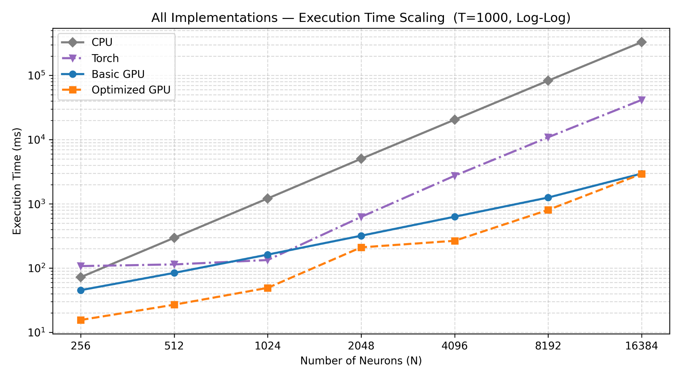
VI. Results and Performance Evaluation (cont’)

Slide 11
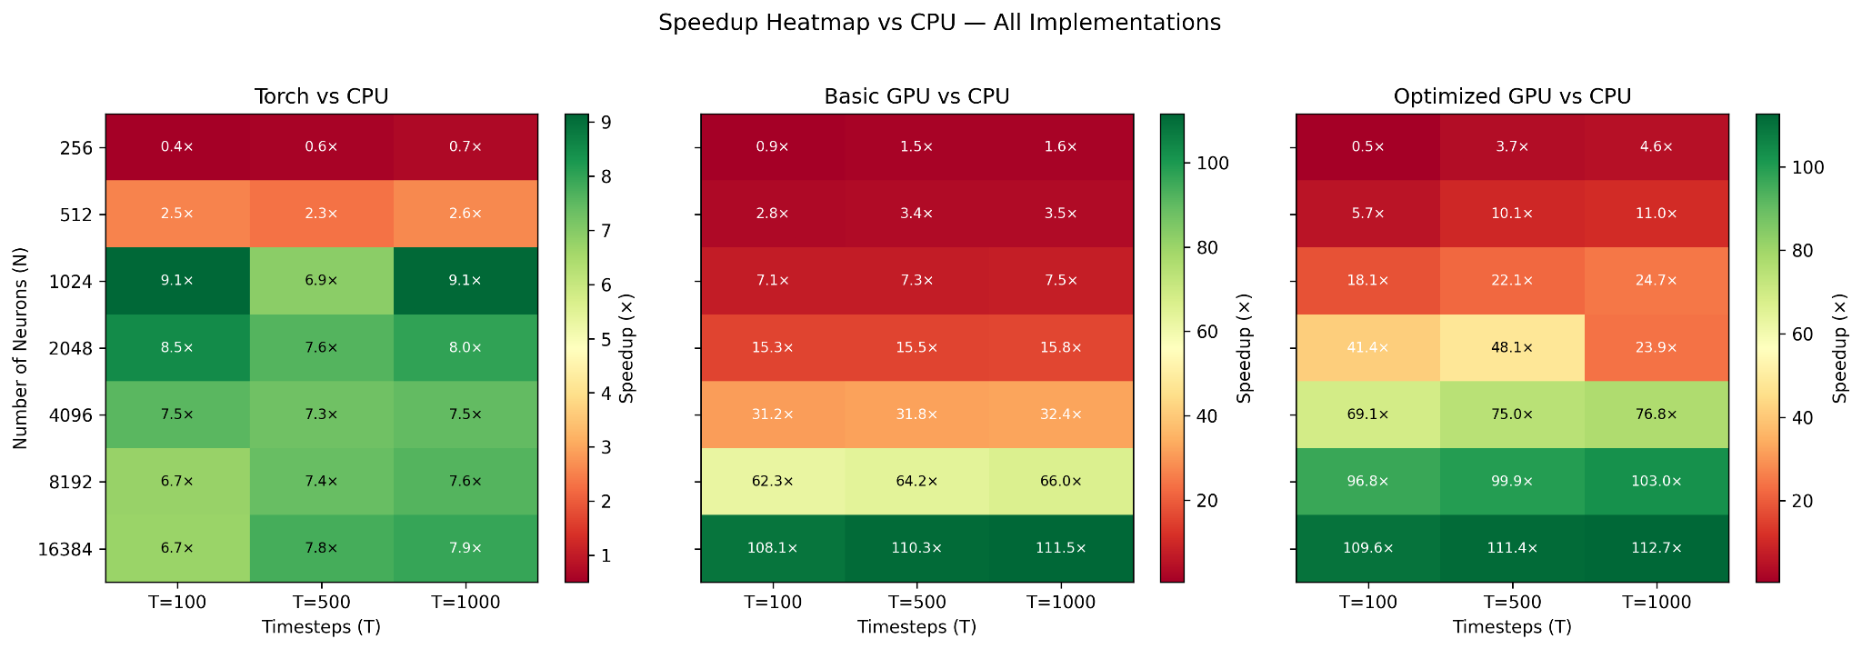
VI. Results and Performance Evaluation (cont’)

Slide 12
VII. Discussions
Up to 112.7 times lower latency.
Memory bandwidth bottleneck and saturation point
  The Optimized and the Basic versions converge at the high number of neurons (N = 16386)
Matrix transposition and sparsity
  W[i*n +j] —> W[j*n + i]
Related works
  CARLsim6, and GeNN

Slide 13
VIII. Future Work
Solid Proof-of-Concept
More generic
Code generator script
NIR (Neuromorphic Intermediate Representation) can be used

