Slide 1
Selecting the set of time points
So far (including in lungmap) based on ad-hoc decisions (Bar-Joseph, Nature Reviews Genetics, 2012).
Wanted to develop principled computational methods for selecting which time points to chose.
This is especially important for projects in which a large and diverse number of genomic and epigenetic datasets are being profiles (mRNA, miRNAs, methylation, ChIP-Seq for TFs etc.).
We use a very detailed sampling of a small subset of genes using nanostring and based on these we select a subset of the points for each of the genomics / epigentics experiments.

Slide 2
Spline based time points selection
Start with an ‘informed guess’ for the set of points (desired # of points is an input parameter).
Repeat:
- Fit optimal splines (number of control points) based on current time point values
- Evaluate error for points that are not used
- Replace one of the points in the set with another point not in the set if it reduces the left out error.
Stop when no improvement is possible.

Slide 3
Selected time points
Best informed guess” is initializing by points that are sorted by increasing absolute differences.
Selected $15$ time points from mRNA is:
[0.5, 1.0, 1.5, 2.5, 3.0, 4.5, 6.0, 7.5, 8.5, 9.5, 10.0, 12.5, 18.0, 24.0, 28.0
Top 10 solutions are similar to these selected points

Slide 4
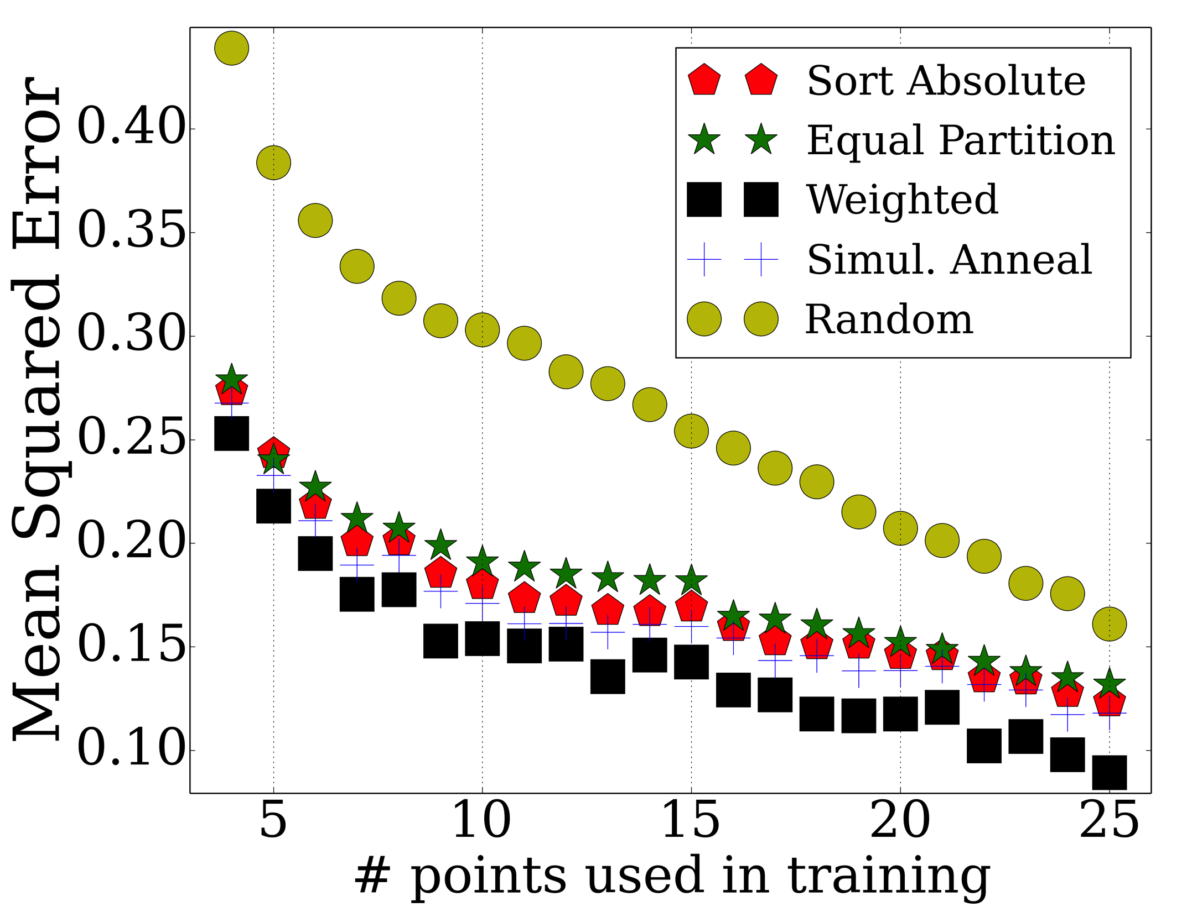
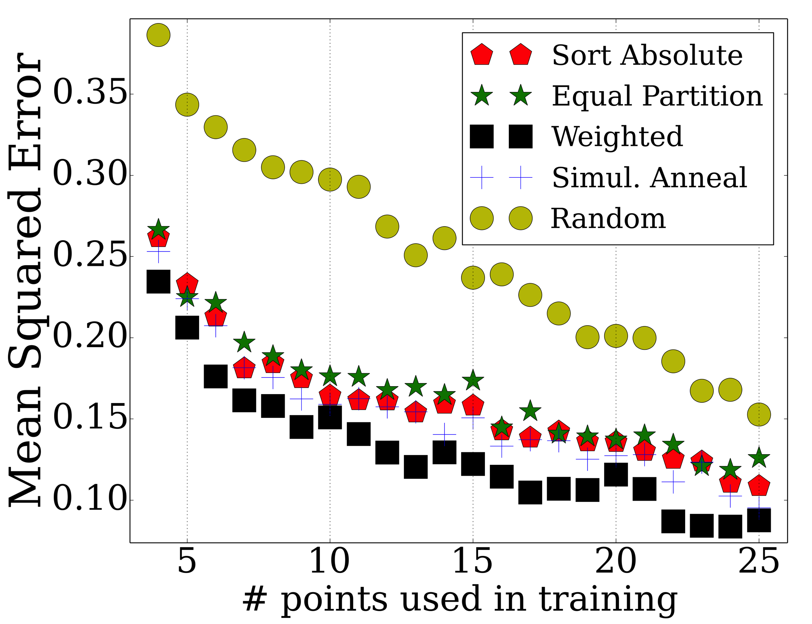
Error by increasing #points
Major performance improvement over randomly selected points
Performance
Remove last two points

Slide 5
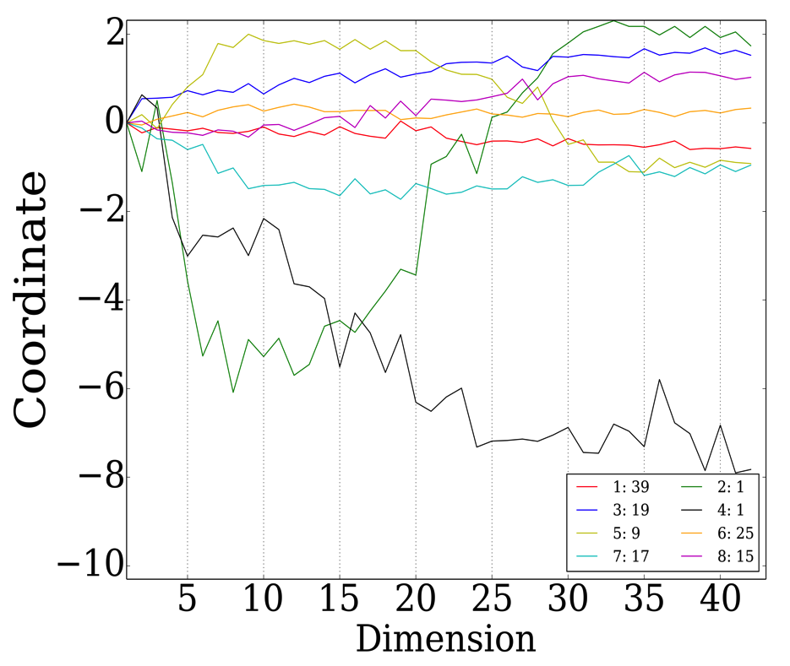
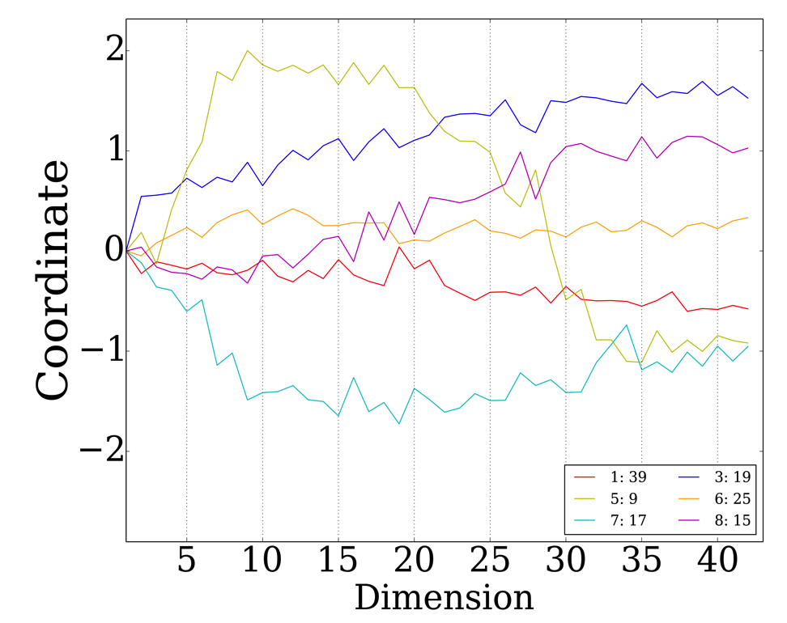
mRNA Cluster Analysis
6 stable clusters
Yellow cluster corresponds to the genes with non monotonic expression over time
Centroids
6 stable clusters

Slide 6
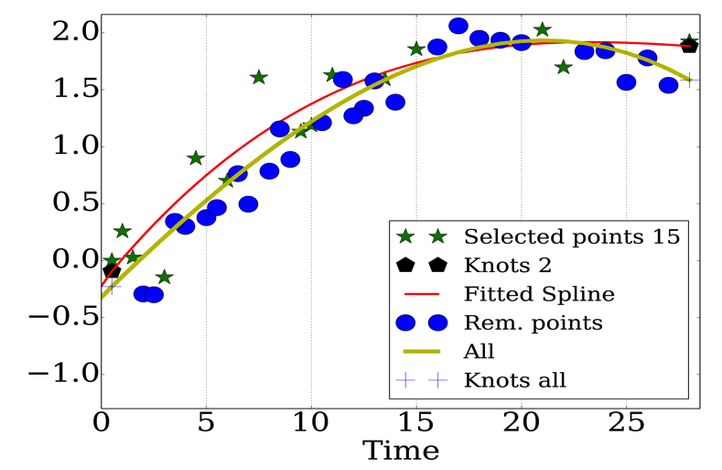
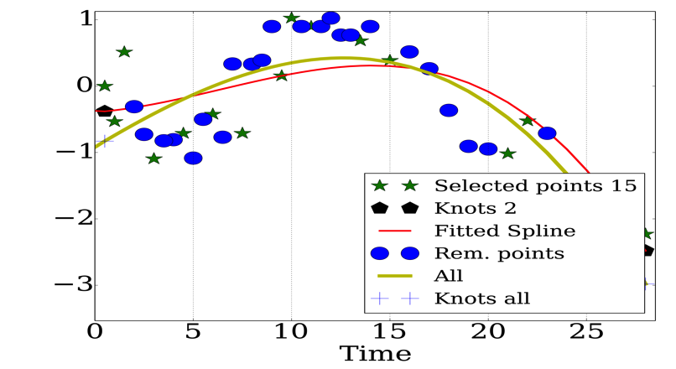
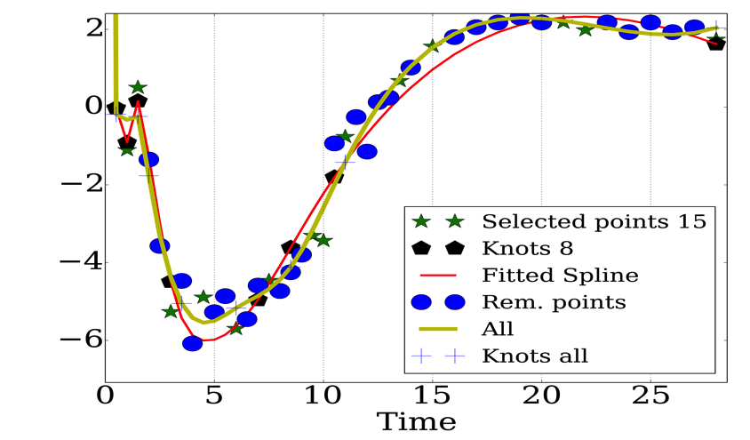
Detailed mRNA Gene Analysis
ELNA
PDGFRA
INMT

Slide 7
Spline vs. Linear Error
ELN(9.5703)
PDGFRA(8.3488)
LRAT(25.24)

Slide 8
Similarity of miRNA to mRNA
Using mRNA points gives 0.3312 error for miRNA
Optimal points for miRNA are quite similar(error 0.3042)
[0.5, 1.0,1.5, 2.5, 4.0, 5.0, 7.0, 8.5, 10.0, 12.0, 15.0, 19.0, 23.0, 28.0]

Slide 9
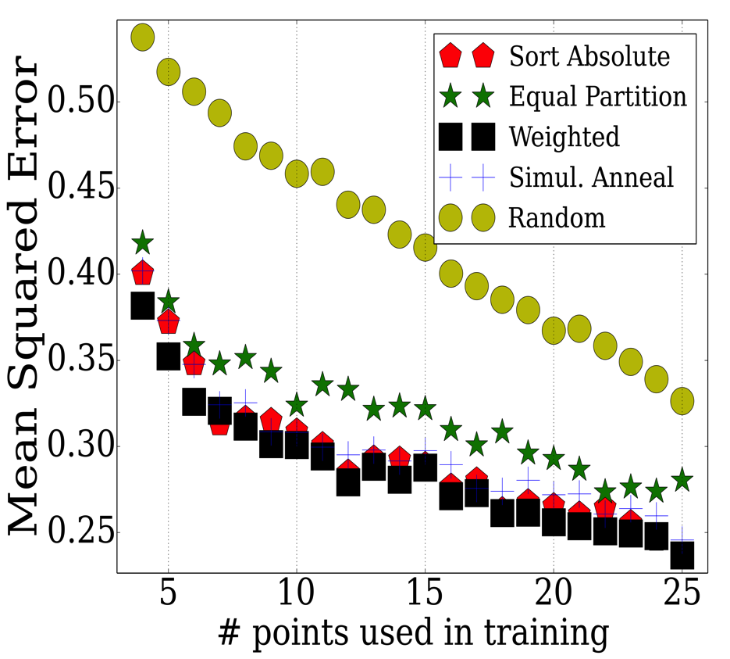
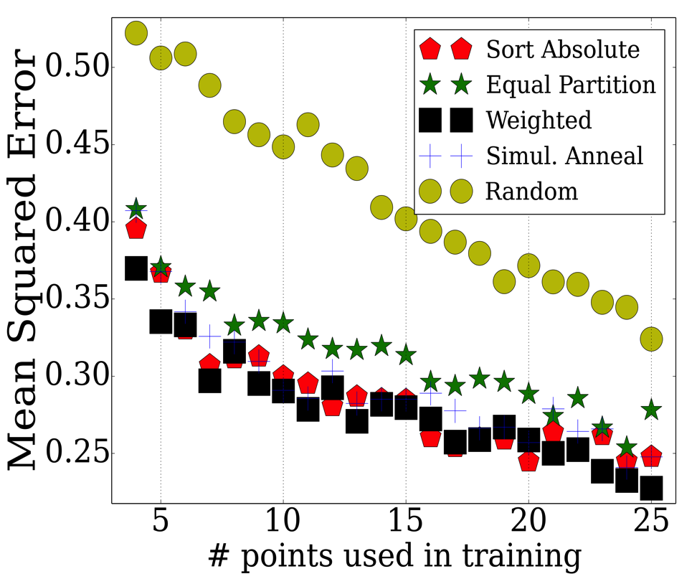
Comparing miRNA and mRNA Errors
Error is decreasing by increasing number of selected points in both datasets
Performance
Remove 27.0 and 28.0

Slide 10
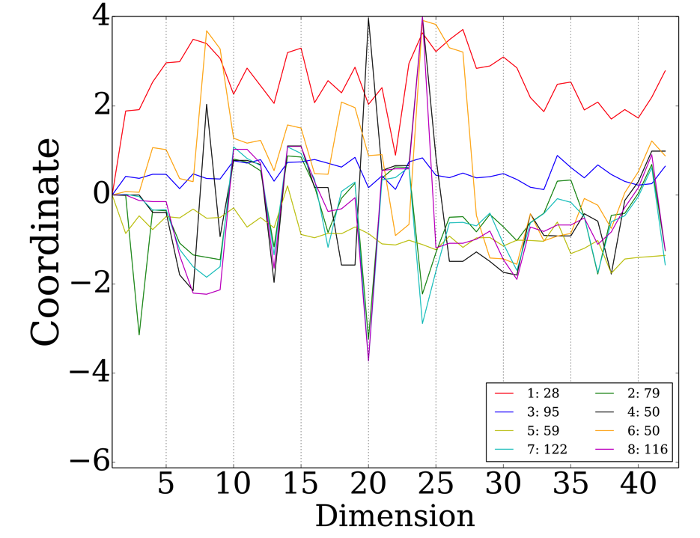
mRNA Cluster Analysis
8 stable clusters
Clusters change more frequently than mRNA data.
miRNA is noisier than mRNA data.

Slide 11
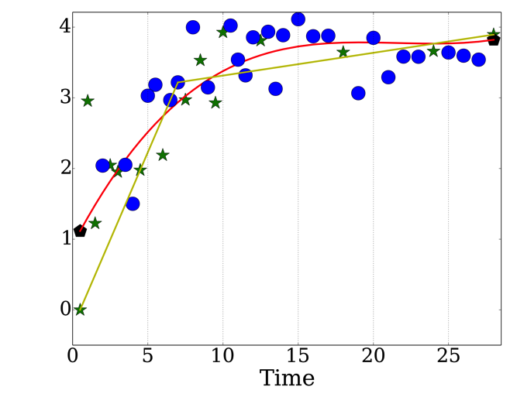
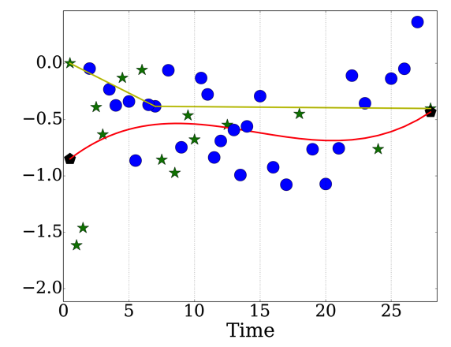
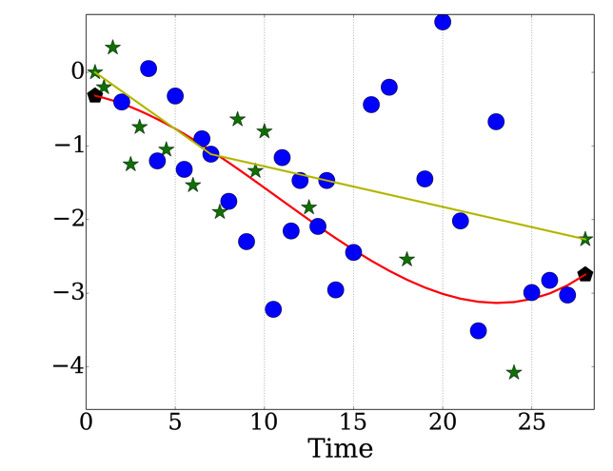
Detailed mRNA Gene Analysis
mmu-miR-200a
mmu-miR-100
mmu-miR-377

Slide 12
Conclusion
Carefully selected subset of time points is important in reconstructing whole gene-expression over time
Spline based reconstruction outperforms simpler linear reconstruction
Analysis of mRNA is a nice representative of larger miRNA study
Similar subset of time points can reconstruct both data

