Slide 1
Selecting the set of time points
So far (including in lungmap) based on ad-hoc decisions (Bar-Joseph, Nature Reviews Genetics, 2012).
Wanted to develop principled computational methods for selecting which time points to chose.
This is especially important for projects in which a large and diverse number of genomic and epigenetic datasets are being profiles (mRNA, miRNAs, methylation, ChIP-Seq for TFs etc.).
We use a very detailed sampling of a small subset of genes using nanostring and based on these we select a subset of the points for each of the genomics / epigentics experiments.

Slide 2
Spline based time points selection
Start with an ‘informed guess’ for the set of points (desired # of points is an input parameter).
Repeat:
- Fit optimal splines (number of control points) based on current time point values
- Evaluate error for points that are not used
- Replace one of the points in the set with another point not in the set if it reduces the left out error.
Stop when no improvement is possible.

Slide 3
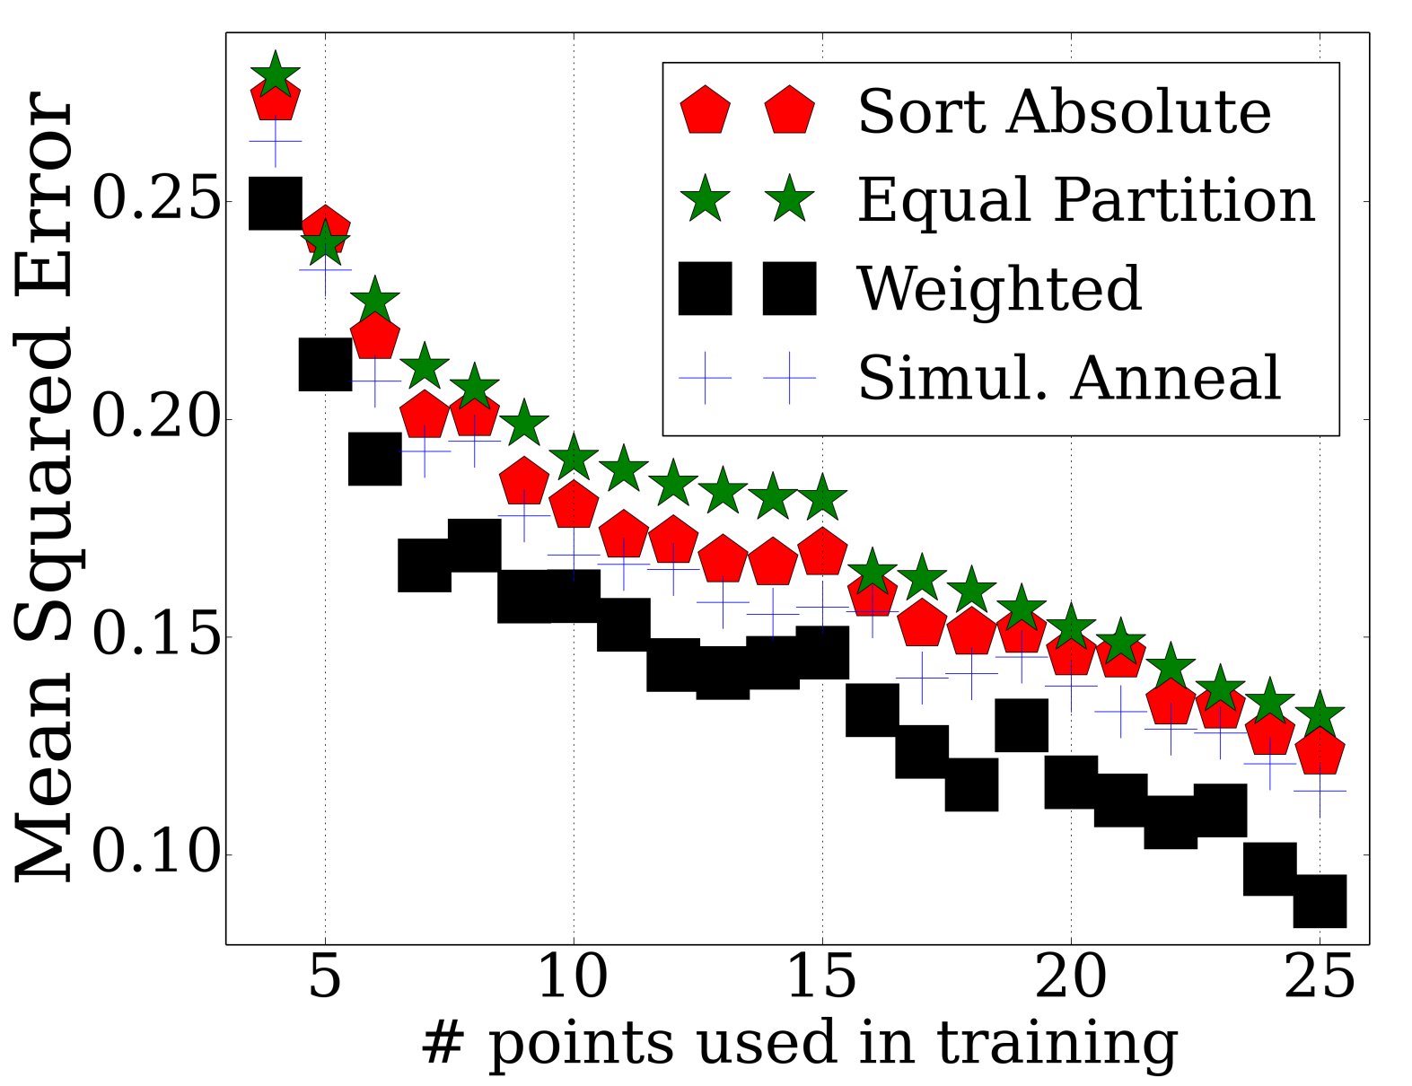
Error
Notes:
Add plot for initial error based on a random set of points.

