Slide 1
PWM SERVO MOTOR CONTROL 4-axis Robotic Arm Project Yunus Emre Selen

Slide 2
Outline
Pulse Width Modulation
Servo Motor Control
User Guide
Duty Cycle
Modes and Speeds
Block Diagram

Slide 3
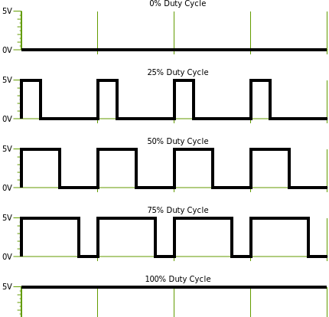
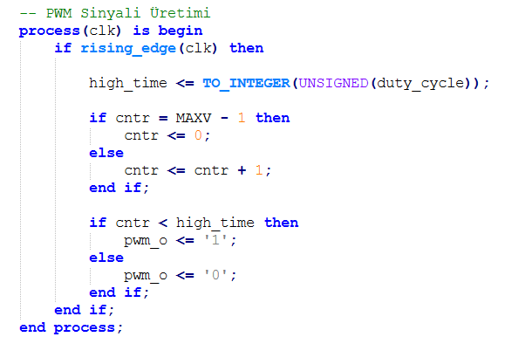
Pulse Width Modulation (PWM)

Slide 4
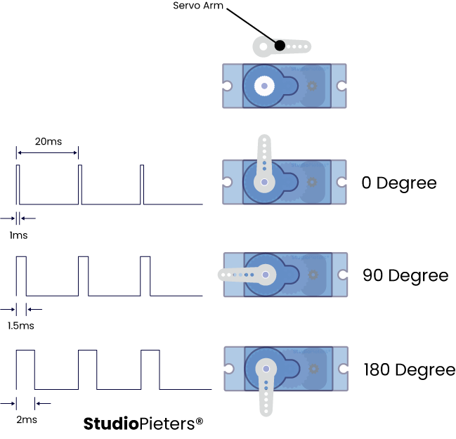
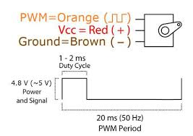
Servo Motor Control

Slide 5
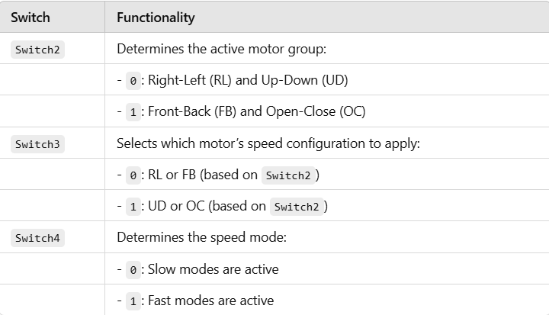
User Guide

Slide 6
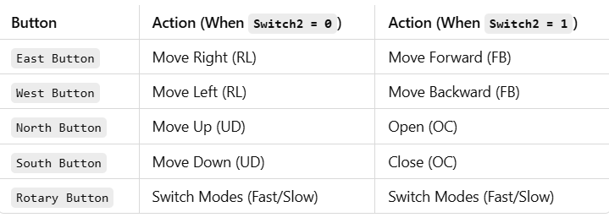
User Guide

Slide 7
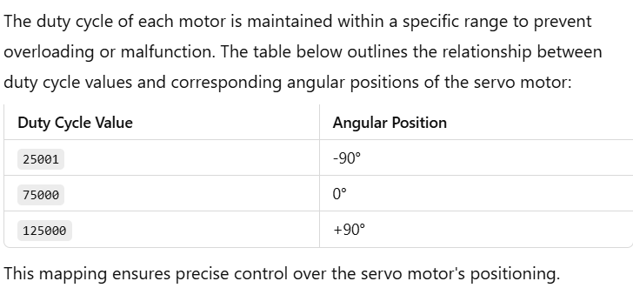
Duty Cycle

Slide 8
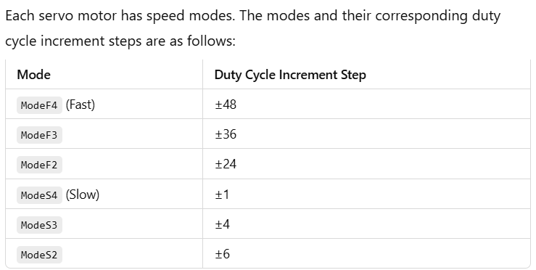
Modes and Speeds

Slide 9
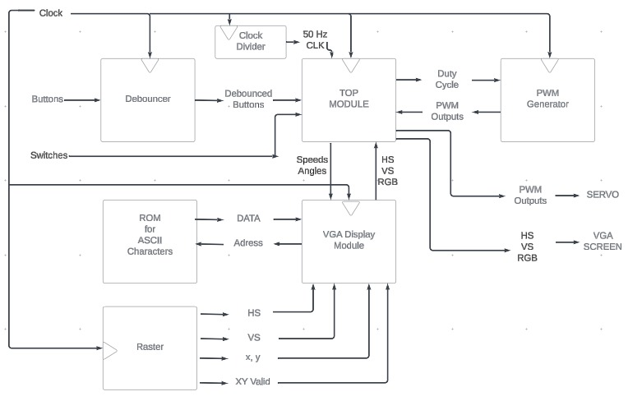
Block Diagram

Slide 10
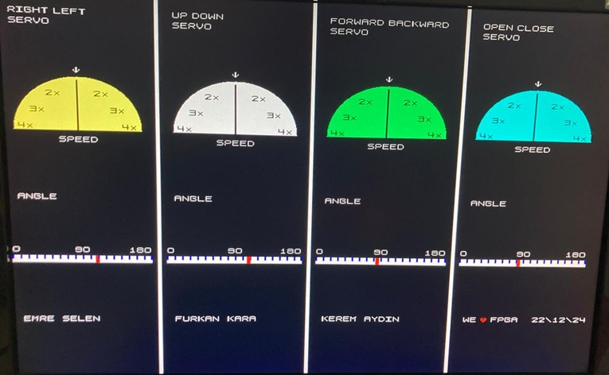
VGA Display Output

Slide 11
Thank You for Listening
Let’s See

