Slide 1
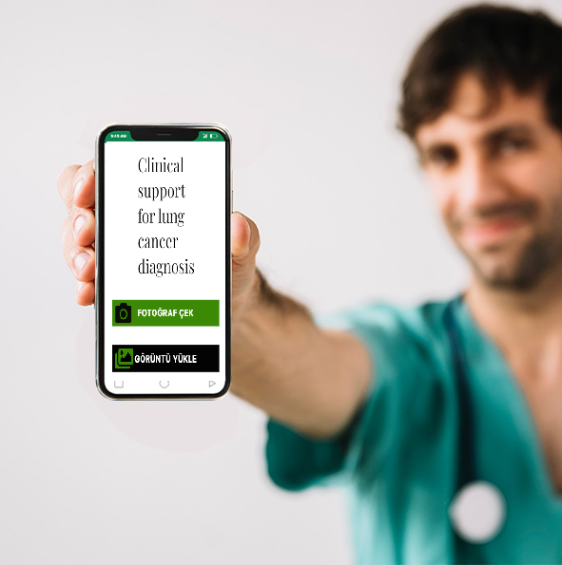

Clinical Support Mobile Application Development for Histopathology Images of Lung Cancer Based on TCGA Data.
Metin eklemek için tıklayın
Senior Design Project 2021-2022
Emre Taşkın

Slide 2

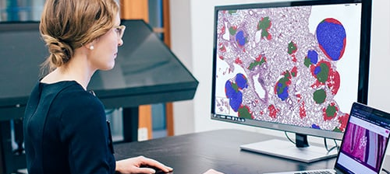
Goal-Motivation
Developing a mobile application to assist pathologists in diagnosing lung cancer.

Slide 3

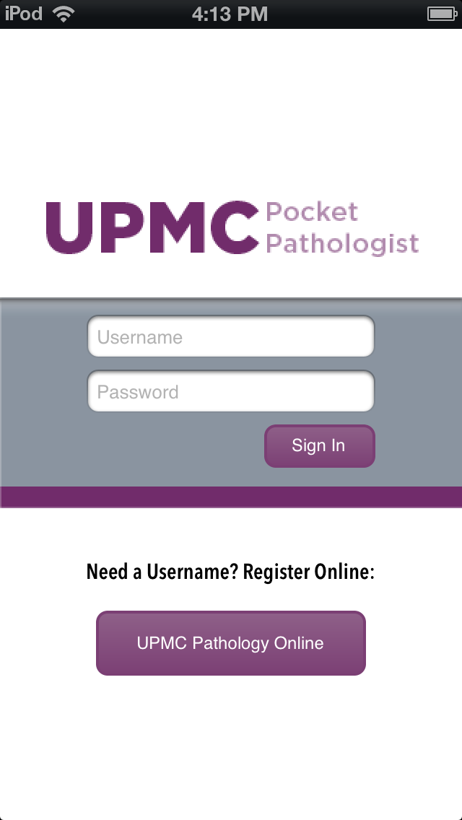
Market Analysis

Slide 4
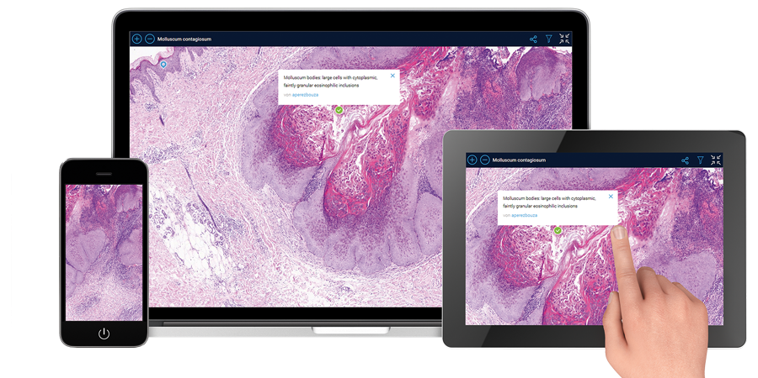
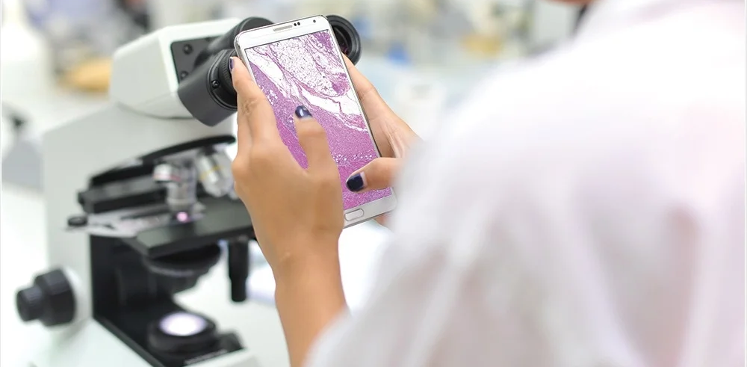
Benefits
Can be carried in pocket
Easy to access and use
Beneficial for human health.

Slide 5

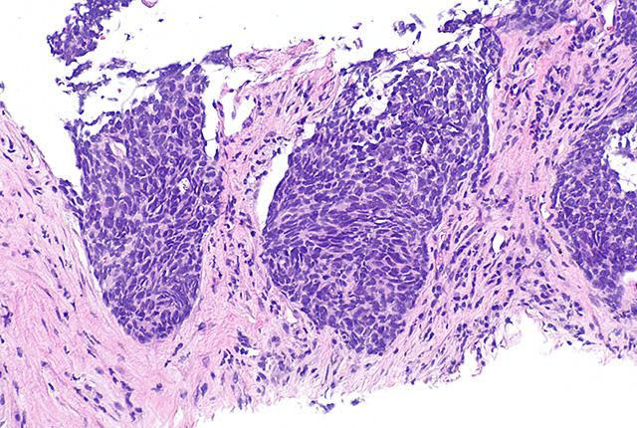


Work done so far
Installed R studio and necessary packages
Installed Android Studio
Downloaded HistoQC for data cleaning
Data download started

Slide 6
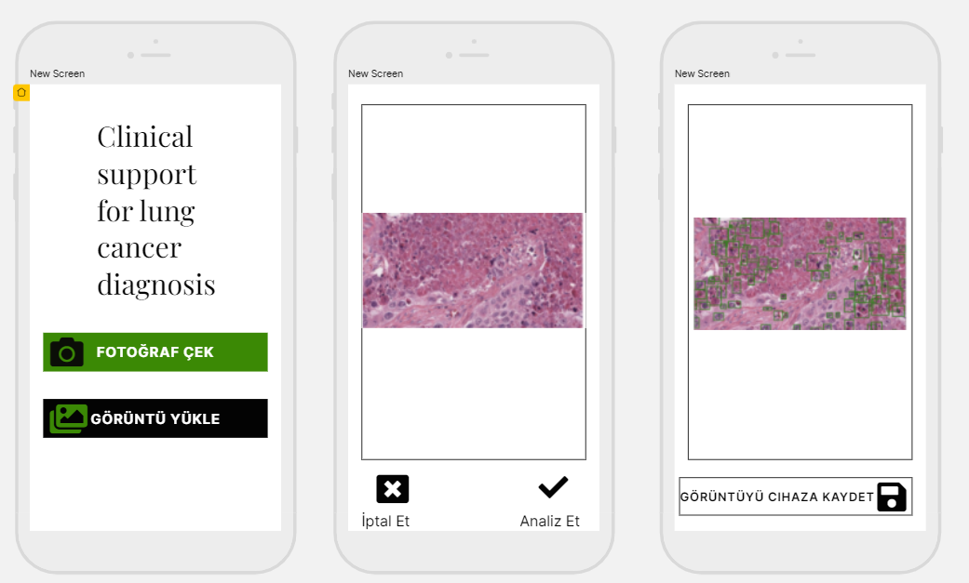
Mobile App Prototype

Slide 7
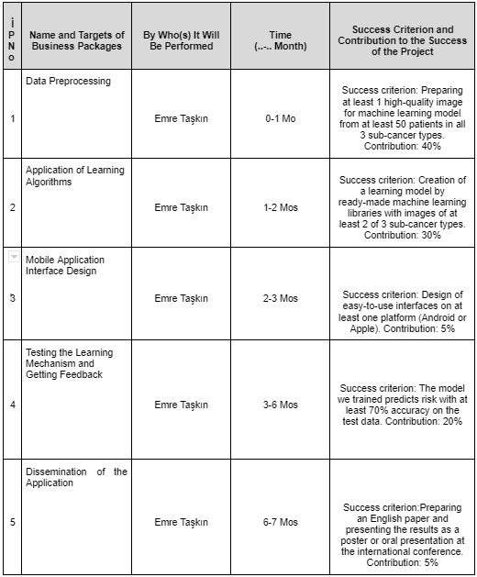
Timeline

Slide 8

Thank you for listening!
emretaskn57@gmail.com

