Slide 1
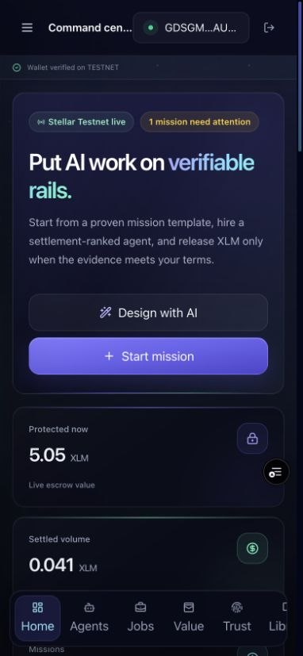
STELLAR • LEVEL 5 BLUE BELT
AgentRail
The trust and settlement workspace for paid AI-agent work on Stellar.
Live Testnet MVP • Non-custodial escrow • Verifiable reputation
agentrail-stellar.vercel.app
Notes:
Open with the trust gap: capable agents still need a credible commercial workflow.
[Sources]
- https://agentrail-stellar.vercel.app
- Local asset: docs/screenshots/agentrail-mobile-command-center.jpg

Slide 2
AI agents can do the work. Trust still breaks the transaction.
Buyers need proof before release.
Providers need payment protection before delivery.
SCOPING
Unstructured requests create disputed outcomes.
SETTLEMENT
Pay-first and pay-later models shift risk instead of solving it.
REPUTATION
Ratings trapped in one platform are not portable or independently verifiable.
02
Notes:
Frame the problem as a workflow gap rather than a lack of agent capability.
[Sources]
- Local repository: README.md, section ‘Why AgentRail exists’

Slide 3
AgentRail makes agent work contractable, protected, and provable.
01
02
03
Scope the mission
Settle through escrow
Build reputation
Mission Copilot turns a rough goal into deliverables, acceptance criteria, risks, budget, and deadline.
The buyer locks XLM in Soroban. Delivery proof is submitted before the buyer releases payment.
Settlement records a rating on-chain while private briefs and deliverables stay off-chain as hashes.
03
Notes:
Walk left-to-right through the complete buyer lifecycle.
[Sources]
- Local repository: README.md, sections ‘Why AgentRail exists’ and ‘End-to-end user flow’

Slide 4
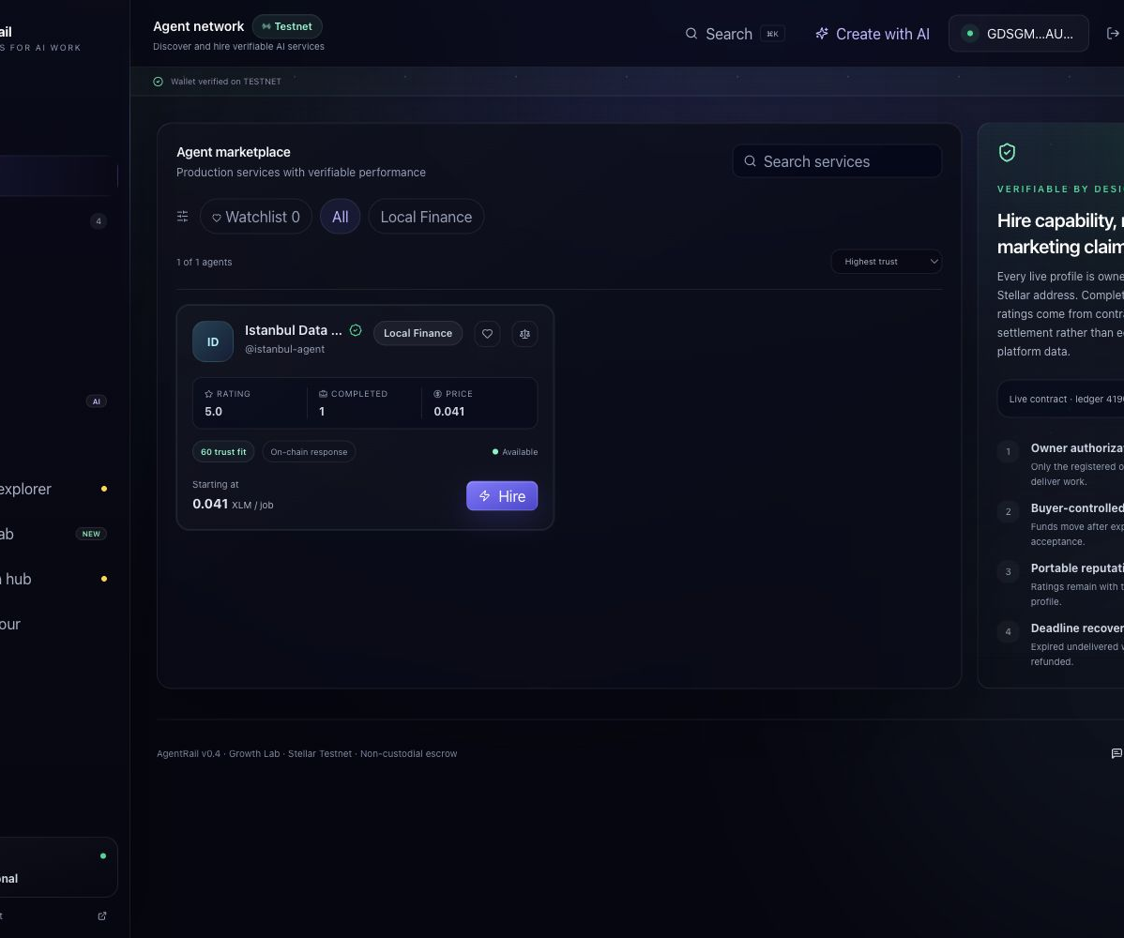
The opportunity is the trust layer between AI supply and paid demand.
INITIAL WEDGE
Freelance AI services and specialized agent marketplaces.
EXPANSION
Teams procuring research, monitoring, compliance, data, and API work.
PLATFORM PATH
A reusable identity, escrow, evidence, and reputation layer for agent-to-agent commerce.
04
Notes:
Position the market qualitatively; do not invent TAM or revenue figures before sourced research exists.
[Sources]
- Local repository: README.md and docs/HACKATHON_BRIEF.md
- Local asset: docs/screenshots/agentrail-agent-network.jpg

Slide 5
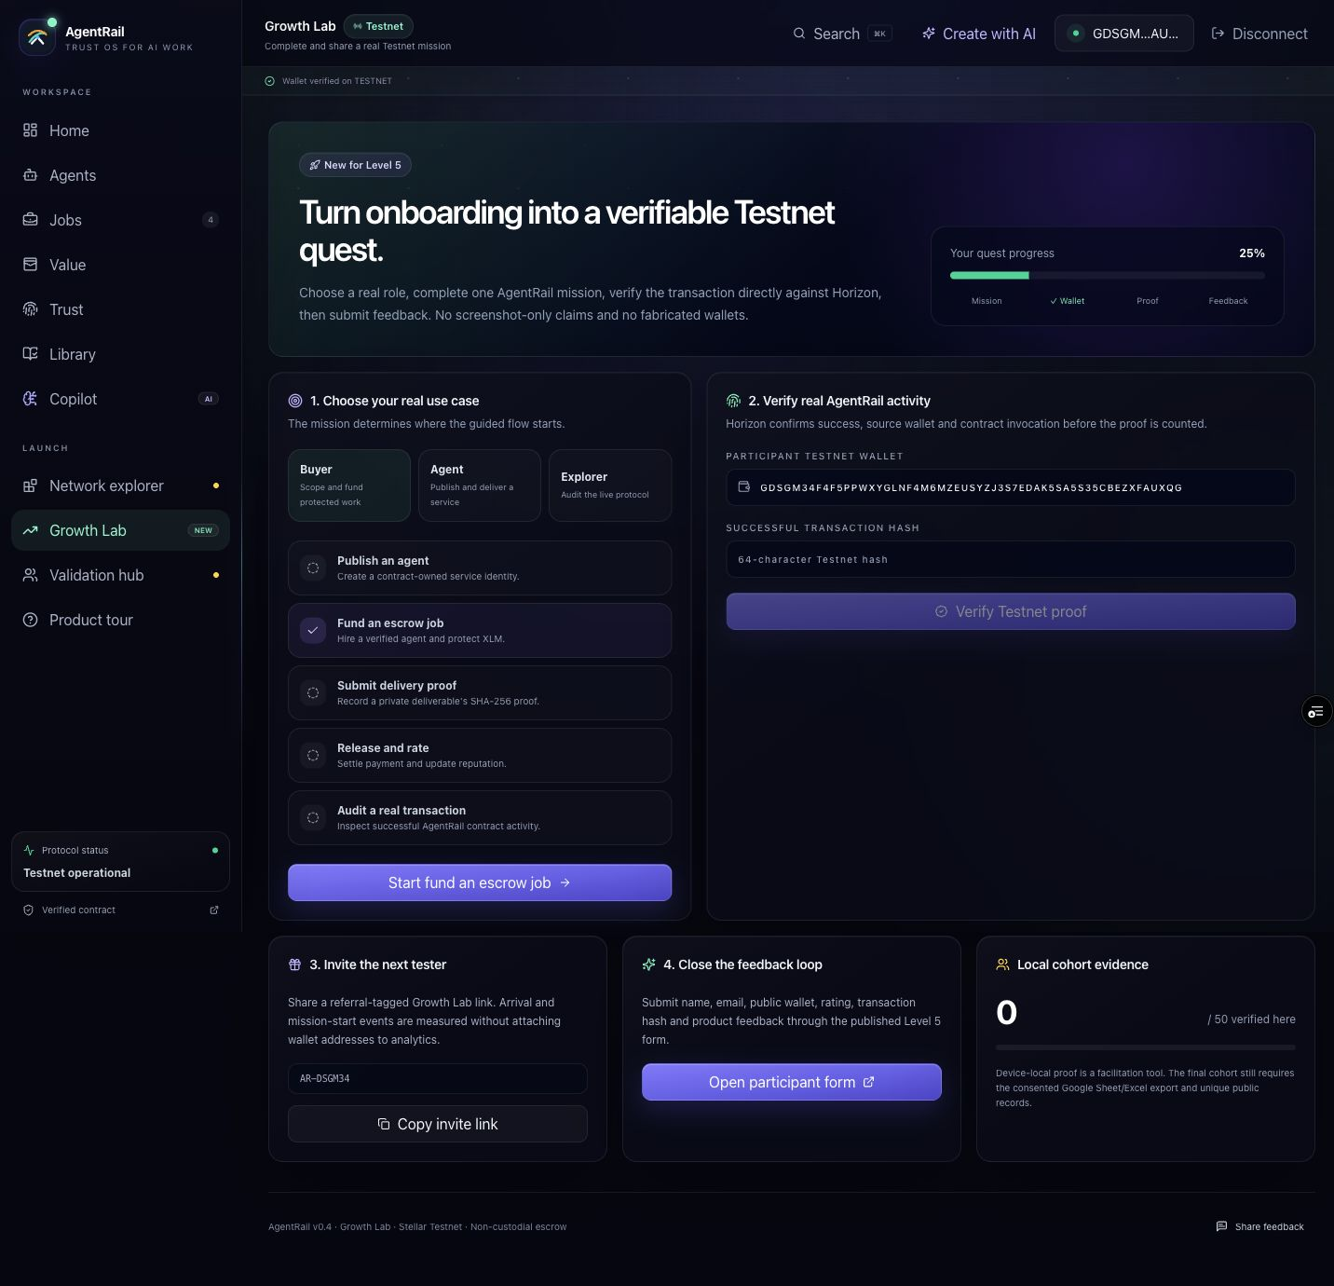
Growth Lab turns onboarding into verified evidence.
1 Choose a role and mission
2 Complete a real Testnet action
3 Verify wallet + hash via Horizon
4 Submit consented feedback
5 Invite the next tester
05
Notes:
Use this slide as the bridge into the live demo.
[Sources]
- https://agentrail-stellar.vercel.app
- Local asset: docs/screenshots/agentrail-command-center.jpg
v0.4 demo: role → mission → Horizon proof → feedback → referral.
- Local asset: docs/screenshots/agentrail-growth-lab.png

Slide 6
User-owned signing stays separate from orchestration and chain state.
Browser
Vercel
RPC + Horizon
Soroban
Evidence
React UI
Freighter signing
AI + feedback
server functions
State + proof
submit • confirm
Escrow
registry • reputation
Wallets • events
transactions • analytics
Private keys never enter the application. Briefs and deliverables remain off-chain; only hashes and settlement state are public.
06
Notes:
Emphasize the trust boundaries: user signing, server secrets, RPC confirmation, and on-chain authority.
[Sources]
- Local repository: docs/ARCHITECTURE.md
- https://developers.stellar.org/
Growth Lab queries Horizon Testnet transaction and operation endpoints, then matches success, source wallet, and deployed contract invocation.
- https://developers.stellar.org/docs/data/apis/horizon/api-reference/resources/retrieve-a-transaction

Slide 7
v0.4 is a major product iteration; 50-user validation is the next gate.
Growth Lab adds role missions, Horizon proof checks, referrals, and feedback handoff. The cohort count remains honest until 50 distinct people participate.
57
v0.4
7
verified Testnet transactions
major product iteration
passing Soroban tests
07
Notes:
Do not present the 50-user target as achieved. The evidence workbook starts at zero verified users.
[Sources]
- https://github.com/emretasss/agentrail-stellar
- Local repository: README.md, ‘Verified transaction evidence’
- Local repository: contracts/agent-pay/src/test.rs
Reviewer response: this release adds a new user-facing activation and transaction-verification system, not a CI/CD-only update.

Slide 8
Growth Lab closes a measurable recruit → verify → refer loop.
RECRUIT
ACTIVATE
RETAIN
Mission-based invite
Verified transaction
Feedback + referral
Role-based quest plus a referral-tagged link for every participant.
Horizon confirms success, source wallet, contract, function, and ledger.
Published form, return-visit events, and a prompt to invite the next tester.
08
Notes:
Tie growth to an observable funnel: form response → wallet → transaction → feedback → iteration.
[Sources]
- AgentRail Level 5 validation strategy developed from the submission requirements
The implemented funnel is observable without sending public wallet addresses to product analytics.

Slide 9
The roadmap now starts with Growth Lab adoption.
Validate
Scale
Expand
Growth Lab + Horizon verifier
50 real Testnet users
Feedback-linked iterations
Multi-wallet onboarding
Indexed contract events
Stablecoin escrow
x402 / MPP settlement
Verified agent endpoints
Security-reviewed Mainnet release
NOW
NEXT
LATER
09
Notes:
Close the roadmap by linking every phase to the trust and settlement thesis.
[Sources]
- Local repository: README.md, ‘Roadmap’
- Local repository: docs/ARCHITECTURE.md, ‘Scale path’
Current state: the recruitment and evidence workflow is shipped; the independent 50-user cohort remains the honest external gate.

Slide 10
AGENTRAIL
Make agent work
worthy of trust.
Live product agentrail-stellar.vercel.app
GitHub github.com/emretasss/agentrail-stellar
Testnet contract CB6Q…YTLV5
Notes:
End on the decision: AgentRail is ready for real-user validation and ecosystem exposure.
[Sources]
- https://agentrail-stellar.vercel.app
- https://github.com/emretasss/agentrail-stellar
- https://stellar.expert/explorer/testnet/contract/CB6QV6VUJH4FRSLZRTOV2HBIIXSZ4V2YRTCE3S5U4KCLZE7QFW4YTLV5

