Slide 1
PR News Monitor
Company and competitor news
in one place
Grouped stories with summaries and original coverage
01
Notes:
0:00-0:30
I built this for a PR team that needs to follow its company and competitors without reading the same story repeatedly. The demo tracks Equinix and Digital Realty, and the names are configurable in YAML. It shows grouped coverage with a short description and links to the original articles. I will show one story in the dashboard, then explain the main decisions and where I would improve it.

Slide 2
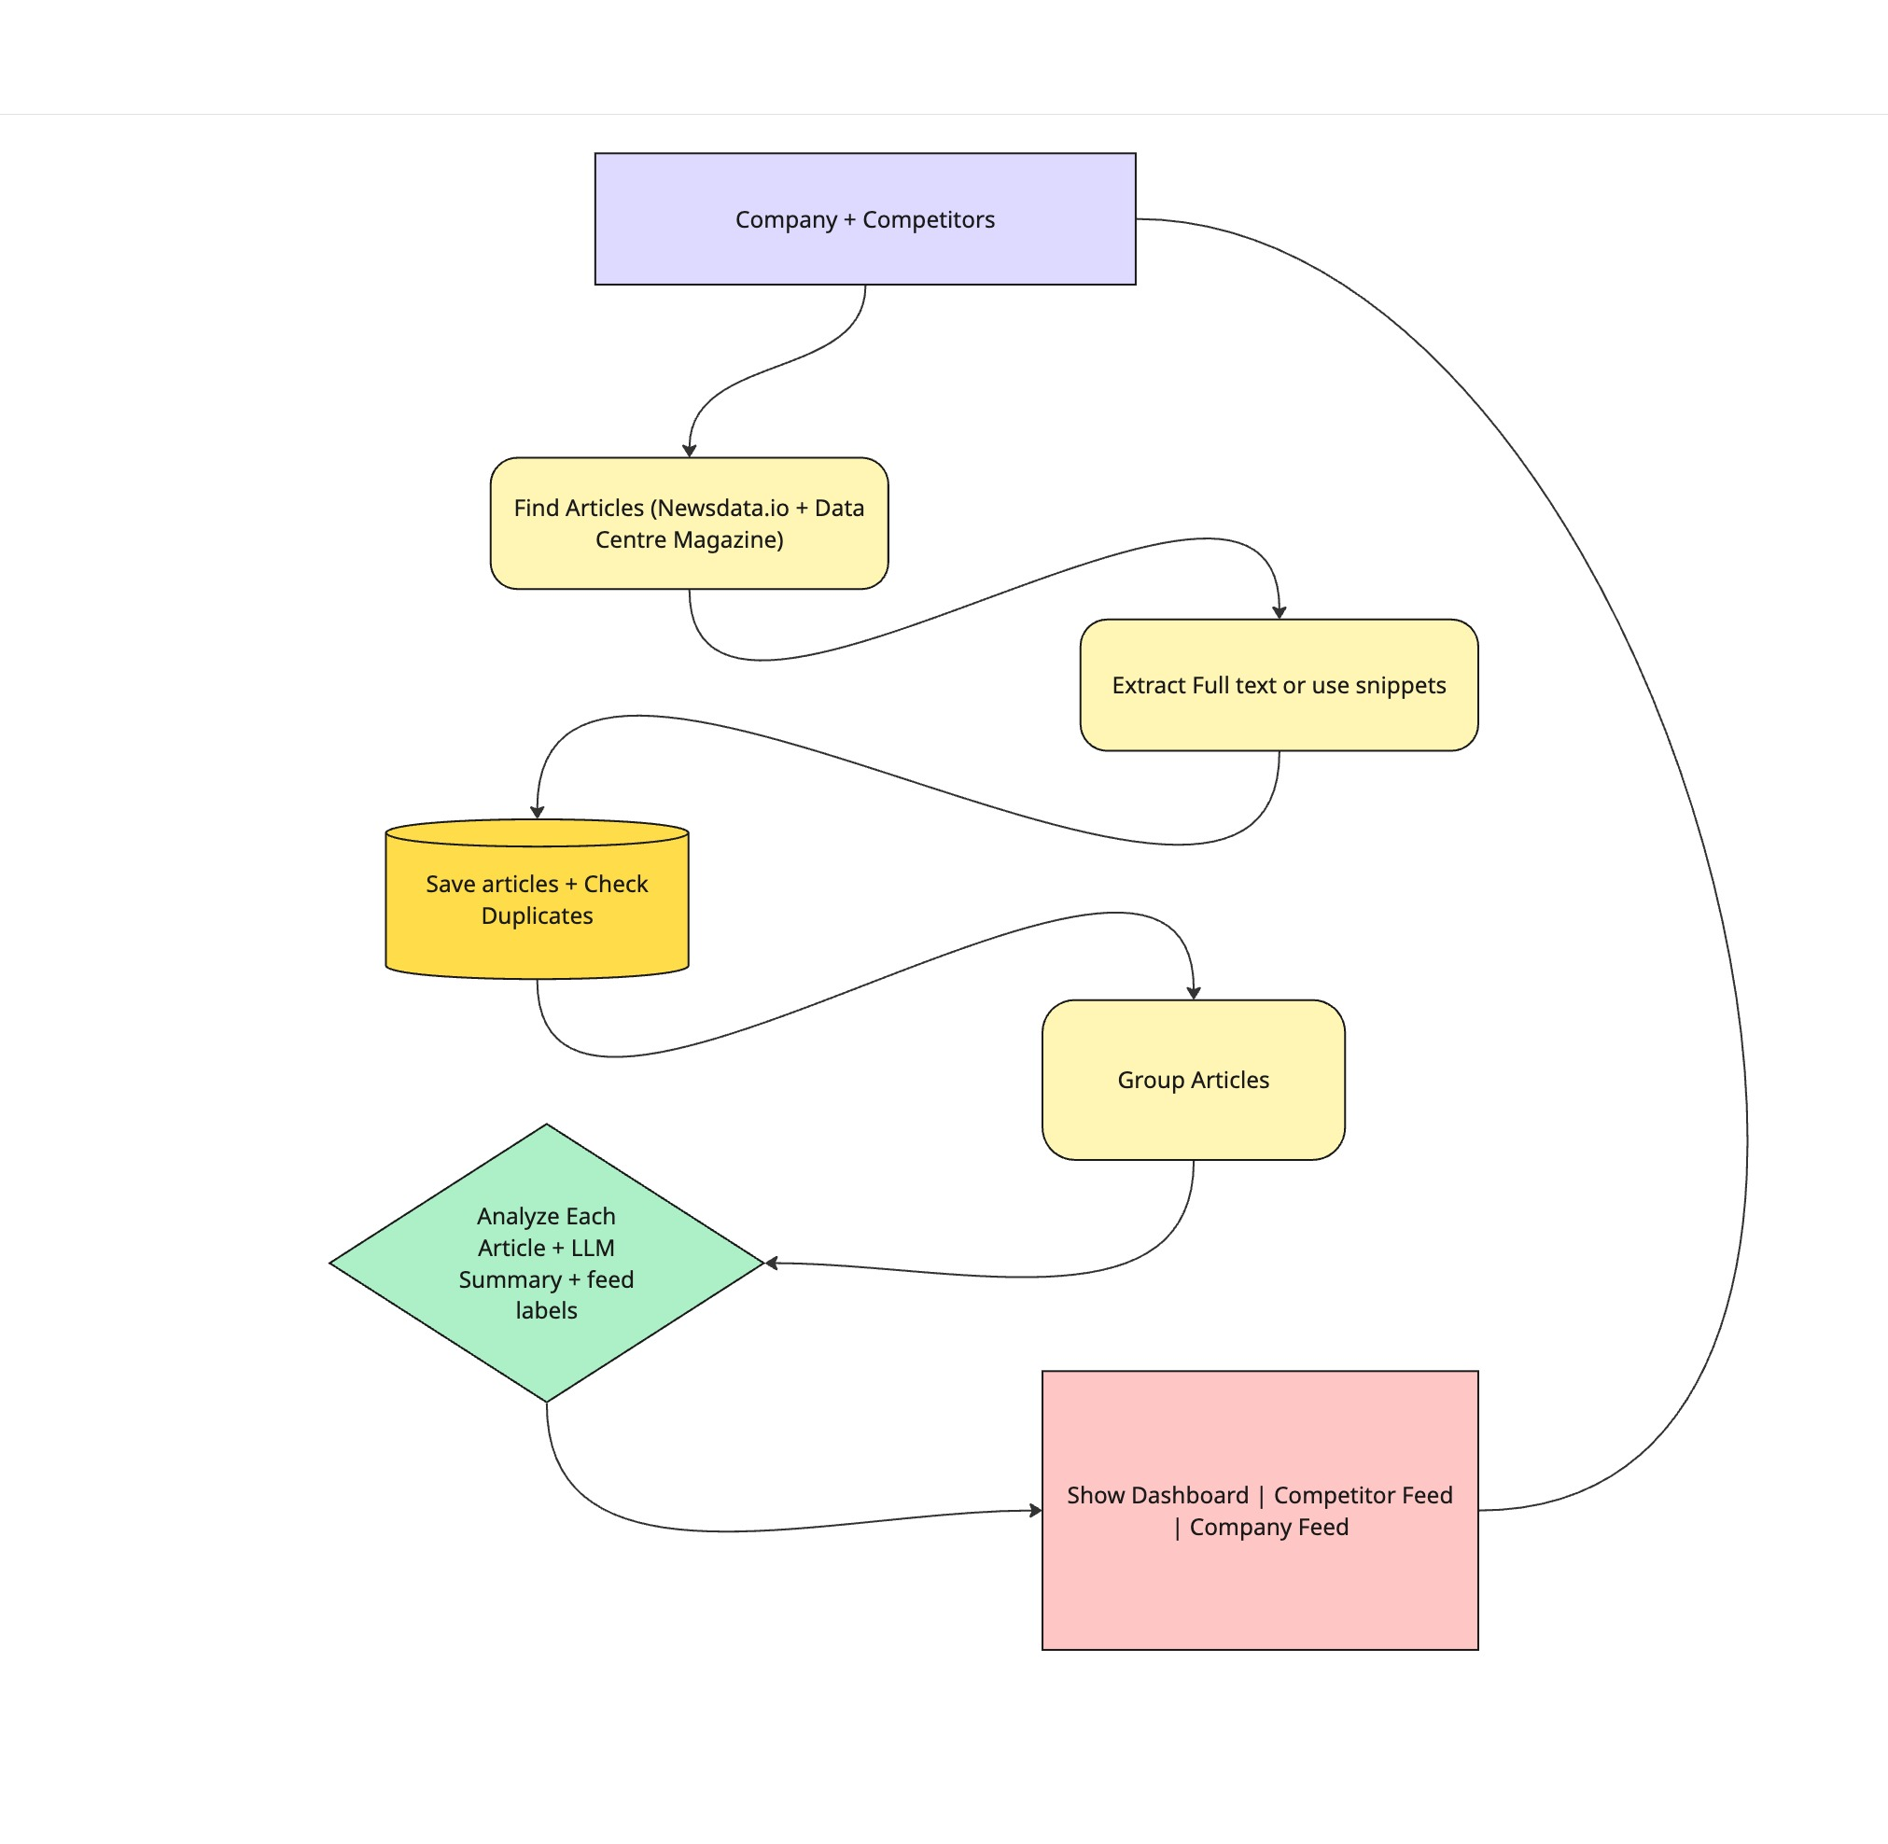
The complete flow
From monitoring scope to evidence-backed feeds. The industry feed reuses the same saved articles and analysis flow.
02
Notes:
0:30-1:00
This is the full implementation path: discovery from NewsData.io and Data Centre Magazine, full-text extraction, persistence, grouping, LLM analysis, and dashboard publication. The industry feed reuses the same saved articles and analysis flow, with no separate pipeline.

Slide 3
How a refresh works
1
Discover
NewsData.io and Data Centre Magazine
2
Extract and save
Full text when available, snippets when it fails
3
Group and analyze
Text similarity, then LLM summary and relevance
4
Publish
Save the completed snapshot and show both feeds
03
Notes:
1:00-1:50
A refresh runs four stages: discover, extract, group plus analyze, publish. The separation is straightforward: app.py handles presentation, pipeline.py coordinates the work, and the other modules own individual responsibilities. Normal page interactions only read saved results and never call the APIs.

Slide 4
Prototype now, prod when it earns it
Choice | Now | Prod trigger
Streamlit UI | One Python app, sync refresh | FastAPI + frontend for other clients
SQLite + lock | Durable, no service, one process | Postgres + queued jobs + shared lock
TF-IDF grouping | Cheap, deterministic | Embeddings verifier if eval proves misses
Mini + fallback LLM | Second model, strict schema | Re-pick from measured quality and cost
YAML config | Reviewable in git | Settings UI for non-technical editors
One container | Docker + named volume | Auth, secrets, backups, alerts first
04
Notes:
1:50-2:40
Each choice was cheap on purpose and has a defined prod exit. Streamlit becomes FastAPI plus a frontend when other clients need it. SQLite plus a process lock becomes PostgreSQL with queued jobs and shared coordination. TF-IDF gets an embeddings verifier only if a labeled sample proves misses. The mini model plus fallback gets re-picked from measured quality and cost. YAML becomes a settings UI for non-technical editors. One container gains auth, secrets, backups, and alerts before public use.

Slide 5
When things go wrong
Situation | What the user gets
Article extraction fails | Snippet coverage with a visible label
A source fails | Other coverage, or the previous snapshot
AI fails or reaches its budget | Headline and keyword fallback
Repeated refresh clicks | One refresh at a time in this process
Missing date or changed settings | Unknown date, or a clear refresh prompt
05
Notes:
2:40-3:30
I handled failures as part of the normal flow. Blocked extraction keeps the snippet with a visible label. One failed source still leaves the other. Total failure keeps the previous snapshot visible. A missing key, invalid output, or exhausted budget falls back to a headline and keyword match, trying a second model first when configured. A process-wide lock stops overlapping refreshes, and unknown dates stay unknown.

Slide 6
What I verified
145 passing tests
Local Python and the Linux container
Real sources, two-model fallback, OpenRouter checks
Docker health check and persistent SQLite volume
06
Notes:
3:30-4:10
145 tests pass locally and inside the Linux container, covering persistence, malformed responses, grouping, two-model fallback, UI reruns, and concurrent refreshes. Live checks cover both sources and OpenRouter, Docker runs non-root with a named volume that survived recreation. These checks demonstrate behavior, not summary accuracy.

Slide 7
What I would improve next
Quality first
Evaluate grouping, dates, relevance, and summaries
Before public use
Authentication, usage limits, secrets, and backups
As usage grows
Background jobs, metrics, and shared coordination
When users need it
Settings UI, story history, and richer interactions
07
Notes:
4:10-5:00
First, build a labeled news sample and measure grouping, relevance, and summary quality before changing models. For production: authentication, managed secrets, API limits, tested backups, scheduled jobs with retries, and metrics for failures and cost. Multiple workers justify PostgreSQL and shared coordination.

Slide 8
Every number is a budget
Discover: 25 per source, 7 days, 60-second budgets
Extract: 2 MB pages, 15 seconds, 50-word minimum
Group: 200 articles, 8 per story, 0.42 similarity
Analyze: 4k chars, 20 calls in 90s, 2 models
08
Notes:
Backup, only if asked
Every number is a budget: 25 articles per source, 7-day window, 60-second source budgets. 2MB pages, 15 seconds per article, 50-word minimum. 200 articles grouped, 8 per story, 0.42 similarity. 4k characters per article, 20 calls in 90 seconds, 2 models, 80-word summaries.

