Slide 1

Notebase
Study Material Sharing Platform
Keremalp Durdabak
Aynur Cemre Aka
Emre Uzun
Ataberk Çeliktaş
18070006028
18070006007
17070006006
17070006048

Slide 2
What is Notebase?
Provides extra study materials for students
Allows users to download and upload handwritten study materials
Provides mutual trust system among peers

Slide 3
Major features of Notebase
Uploading and Downloading a study material
AI system for checking authenticity and legitimacy
Searching for a specific course or material
Profile page for the user to see their previous uploaded and downloaded study materials

Slide 4
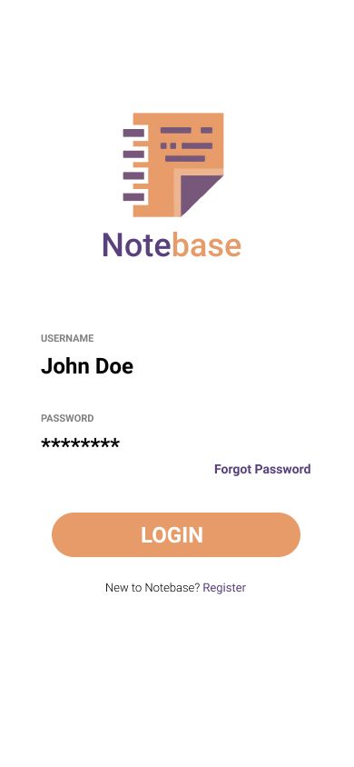
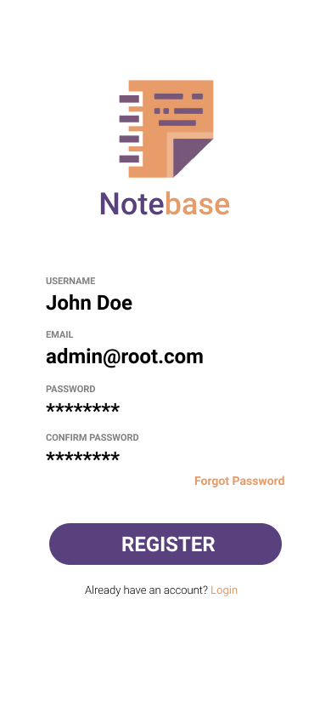
Notebase Interface Login & Register

Slide 5
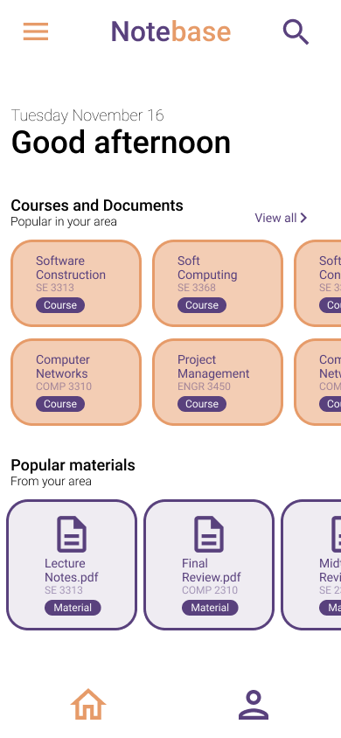
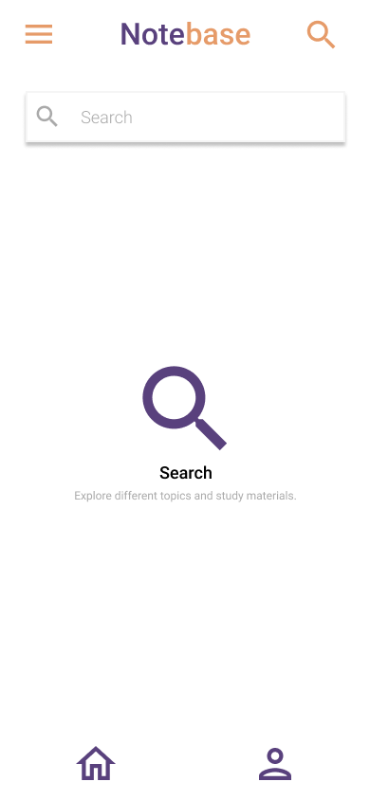
Notebase Interface Home & Search

Slide 6
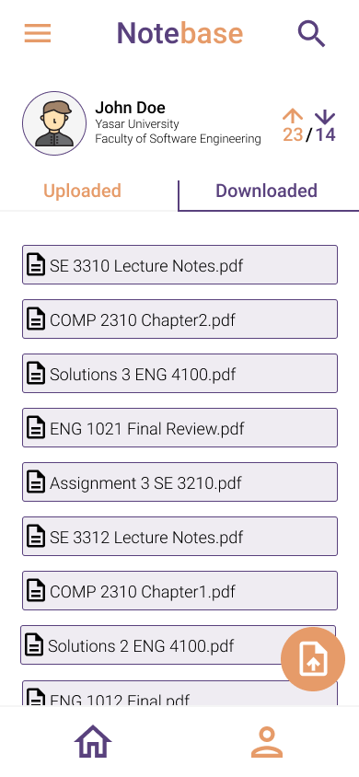
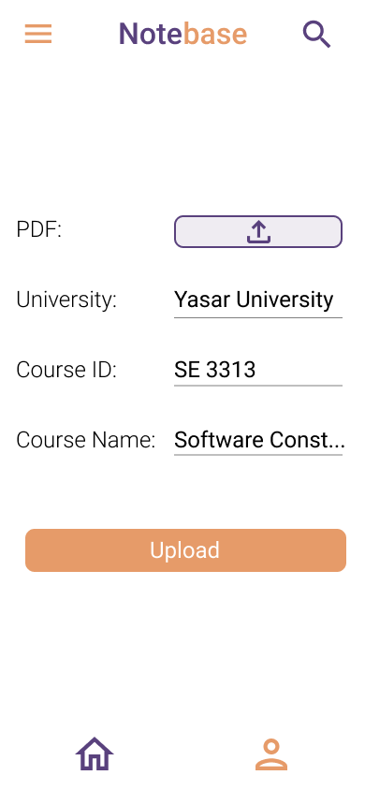
Notebase Interface Profile & Upload

Slide 7
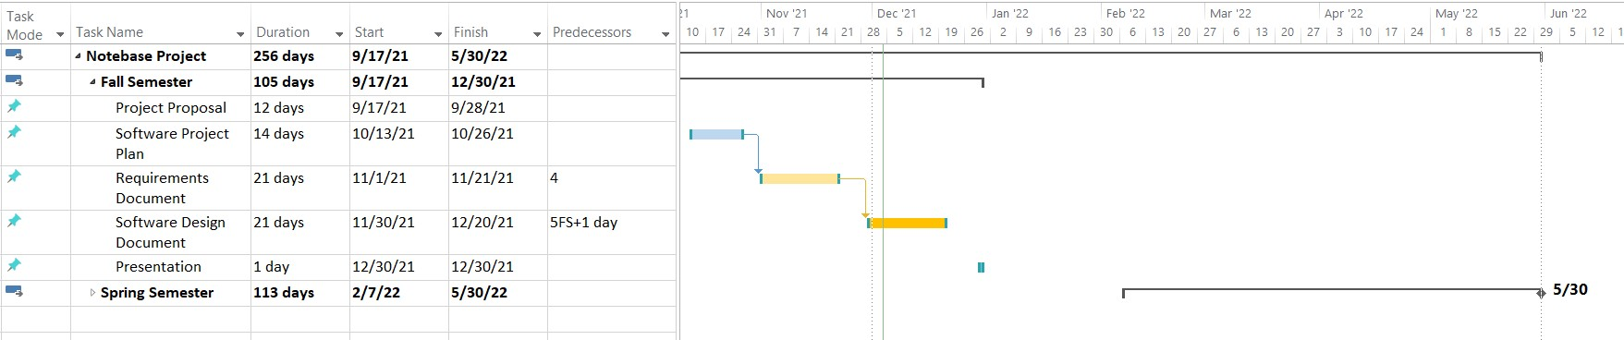
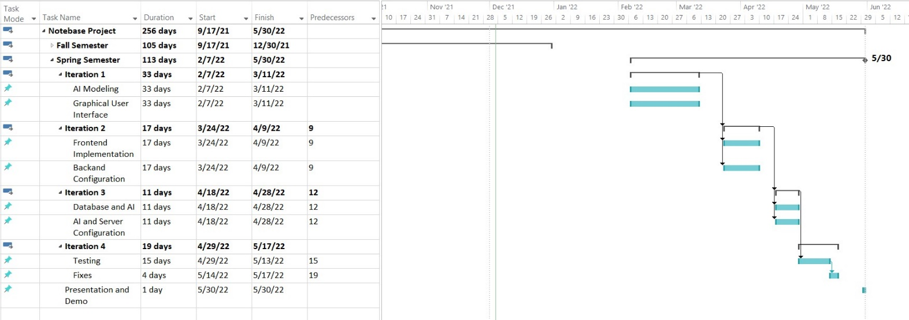
Gantt Chart Fall & Spring

Slide 8
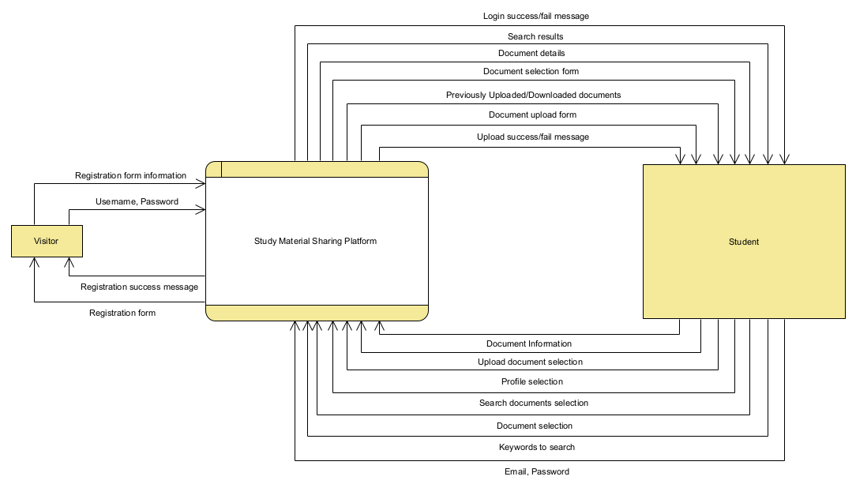
Data Flow Context Diagram

Slide 9
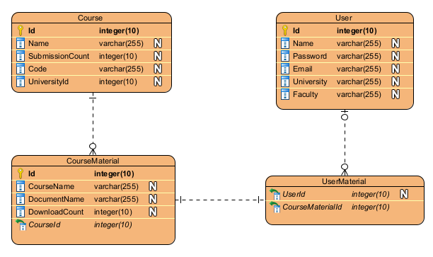
Entity Relationship Diagram

Slide 10
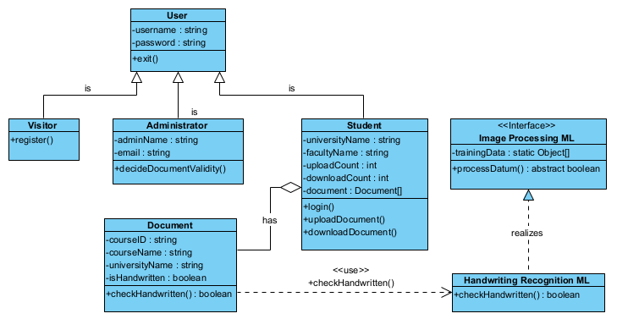
Class Diagram

Slide 11
Expected Outcomes
To submit a functional mobile and web-based note sharing application.
To implement an AI that will check the eligibility and authenticity of the notes that will soon-to-be uploaded to the system.
To create an incentivized uploading system where in order to display other notes, you need to upload your own notes to the platform.

Slide 12
Conclusion
Thank you for listening!

