Slide 1
Sunspots!
Emre Yurtbay – STAT 421

Slide 2
What are Sunspots?
Temporary phenomena on the Sun's photosphere that appear as spots darker than the surrounding areas
Sunspot occurrence can be used to help predict many things
Space Weather
Earth Climate
State of the Ionosphere
Data we are looking at are yearly sunspot counts
Wolf’s Number

Slide 3
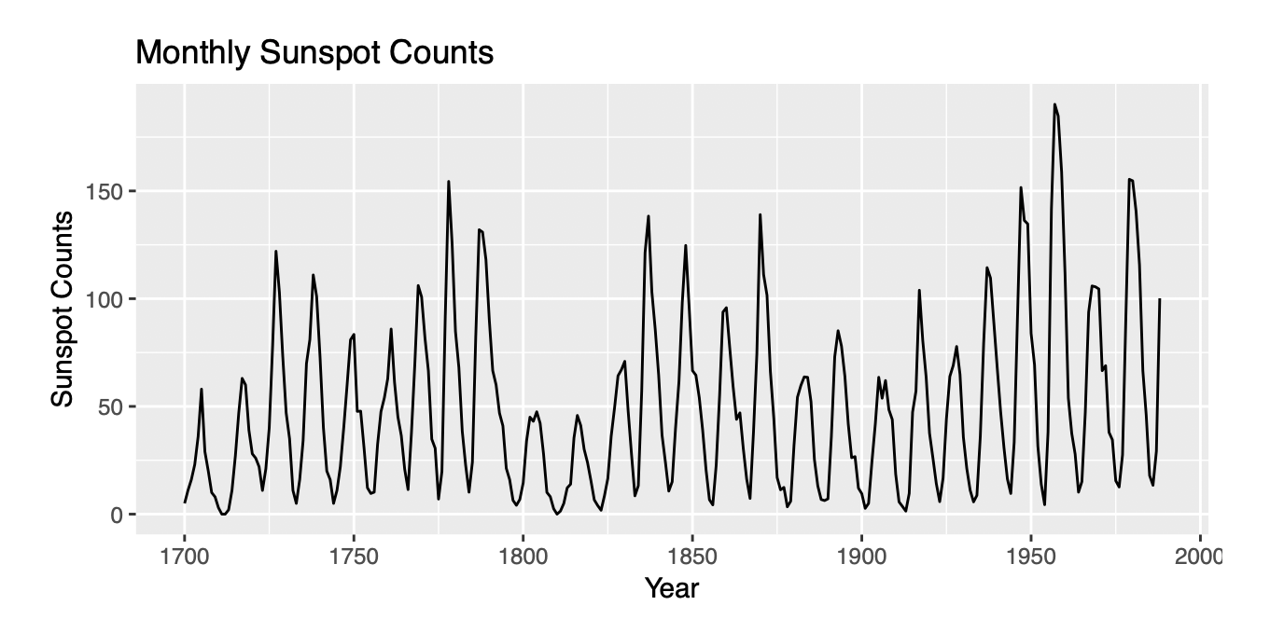
Key Questions and Objectives
Can we build a Hidden Markov Model to label years as having low, moderate, and high sunspot activity? Can we find the transition probability from one of these states to another?
Can we build a forecast that can help us accurately predict Wolf’s Number many years in advance?

Slide 4
Hidden Markov Model
Sunspots are a rather good phenomenon to model with a Markov chain because the present Wolf’s Number is heavily dependent on past Wolf’s Numbers
Fit an HMM of order 1 with 3 hidden states using depmix
S1 = High Intensity, S2 = Moderate Intensity, S3 = Low Intensity

Slide 5
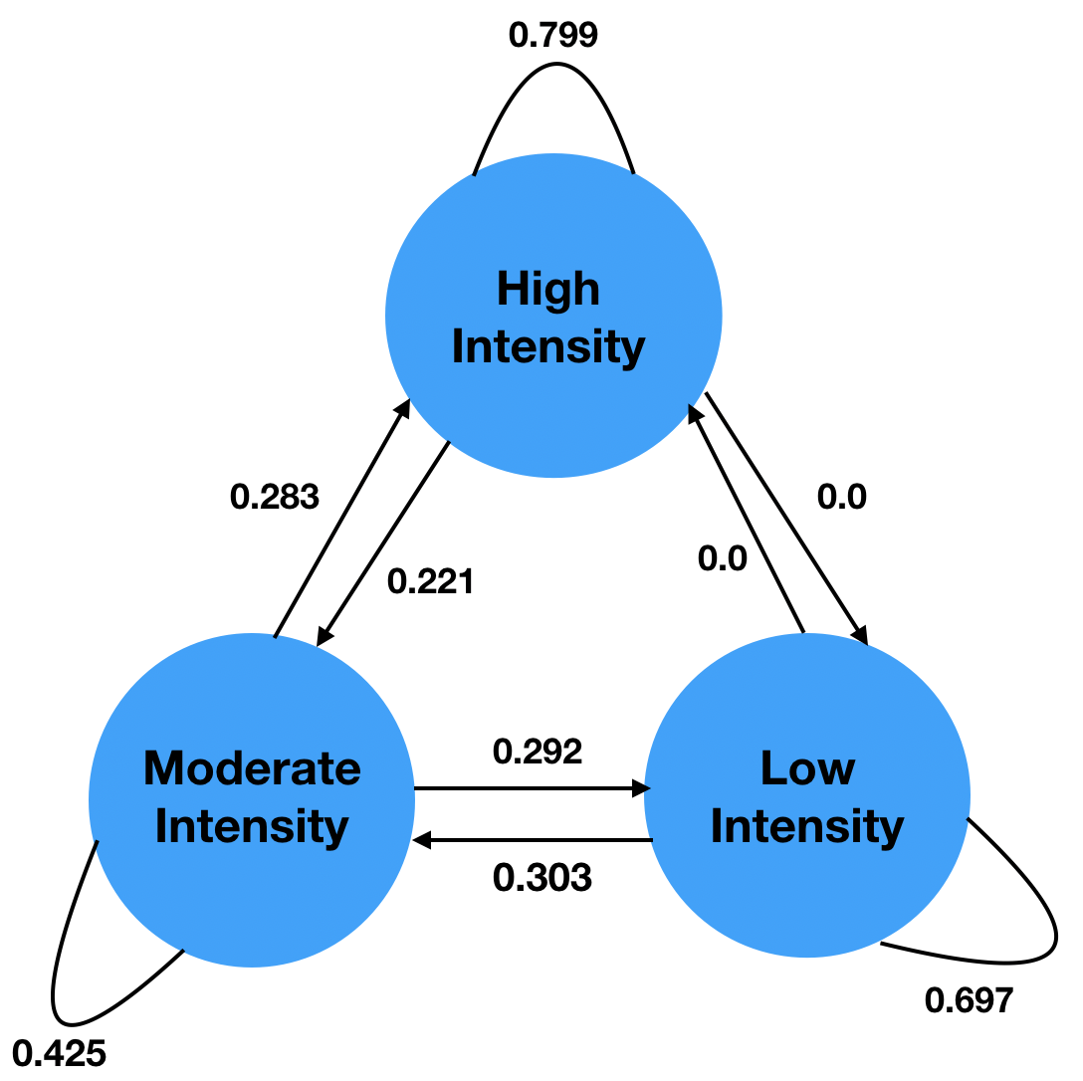

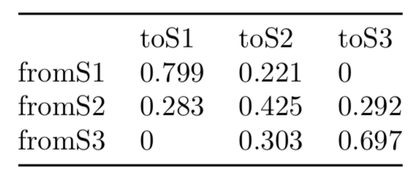
Graph Theoretic Representation

Slide 6
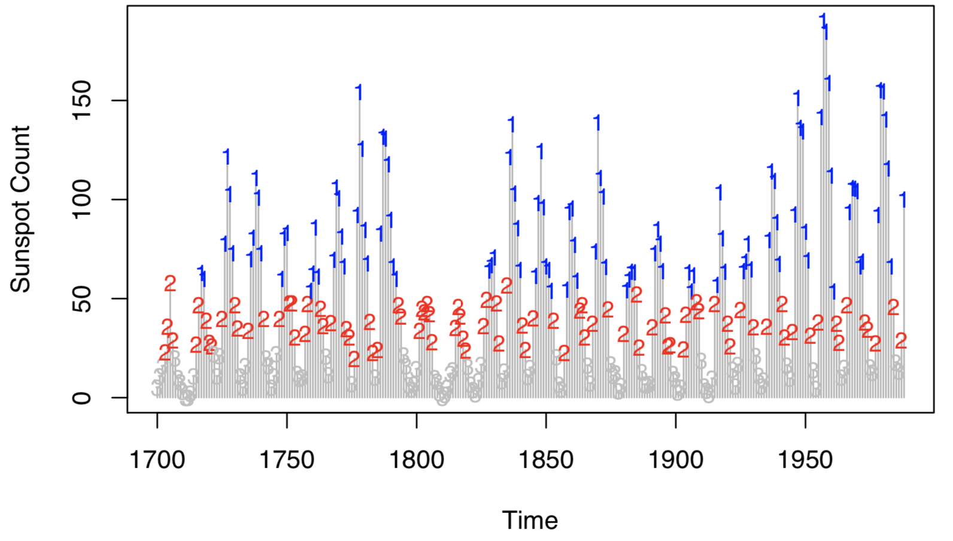

Slide 7
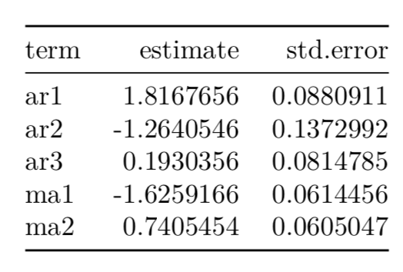
ARIMA Modeling and Forecasting
The Hidden Markov Model was very useful in 1 step ahead forecasts, but what if we want to forecast farther into the future?
Used auto.arima() to find the optimal ARIMA model
ARIMA(3, 1, 2)

Slide 8
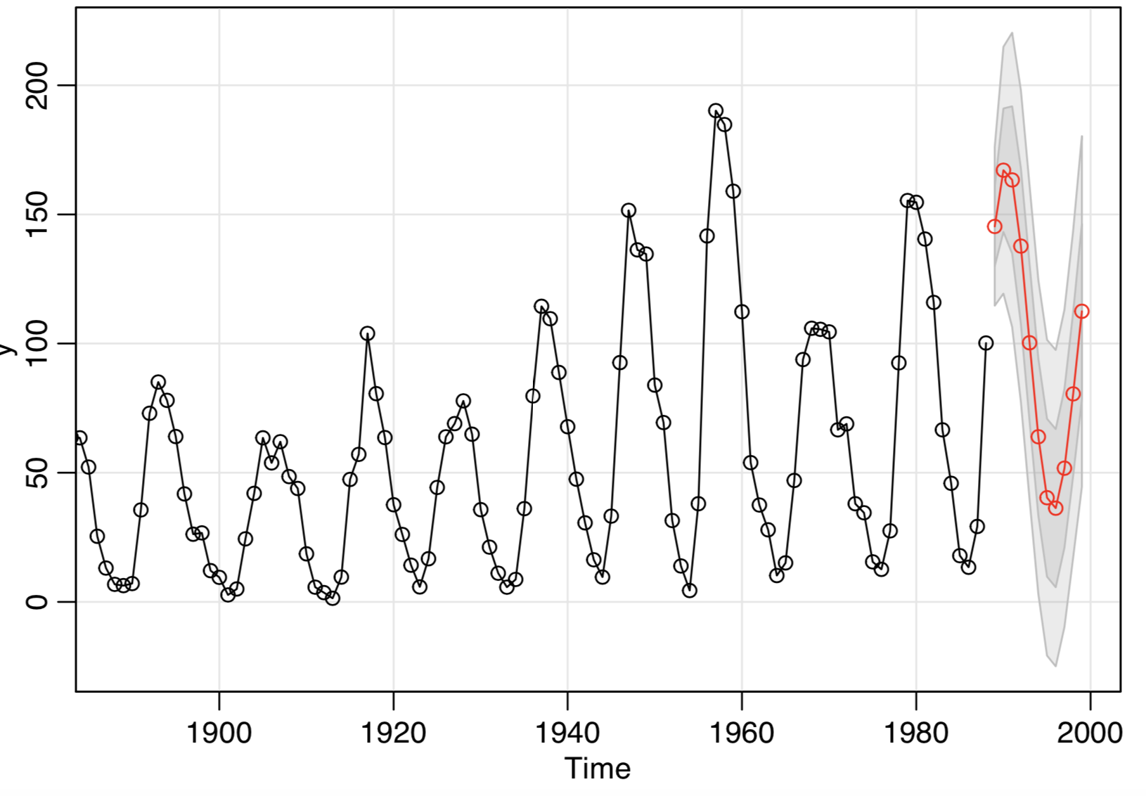

Slide 9
Conclusions
A Order 1 HMM seems to be a good way to describe the sunspot cycles
Using the HMM, we can produce 1 step ahead forecasts
An ARIMA forecast is very helpful for farther forecasts into the future

