Slide 1
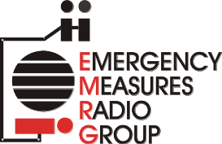
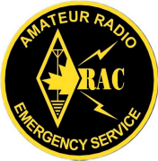
EMRG-404
Introduction To EMRG
EMERGENCY MEASURES RADIO GROUP
OTTAWA ARES
Two Names - One Group - One Purpose
INTRODUCTION TO EMRG
EMRG & It’s Members
Roles & Partnerships
Solutions & Services
Organization & Strategies
Version 1.1 Updated 2007-01-29
See Slide Notes For Additional Description & Details
Notes:
This training course provides an overview introduction for anyone wanting to know more about EMRG. The course is intended to be reviewed individually, or presented to a group.

Slide 2
WHO WE ARE
EMRG
& It’s
Members
Notes:
EMRG is not a club and it’s members are volunteers.

Slide 3
Organization
& Members
EMRG is a volunteer organization that acts as the interface between the Amateur radio community in Ottawa and the City of Ottawa Office of Emergency Management (OEM). It is through EMRG that the City would contact local radio operators for assistance in an emergency.
EMRG members are Federally licensed Amateur radio operators, who have volunteered to donate their time and use their equipment, to prepare for and provide communications during an Emergency or Disaster.
EMRG has a long history in Ottawa since the 1950s.
Notes:
EMRG is an organization that provides a function, that brings together Amateur radio volunteers with the organizations that could use these volunteer communications services in an emergency.
There is no money exchanged for EMRG services, although partners do fund projects and supplies, as well as EMRG members donate time, materials and equipment to ensure EMRG can provide communications when required.

Slide 4
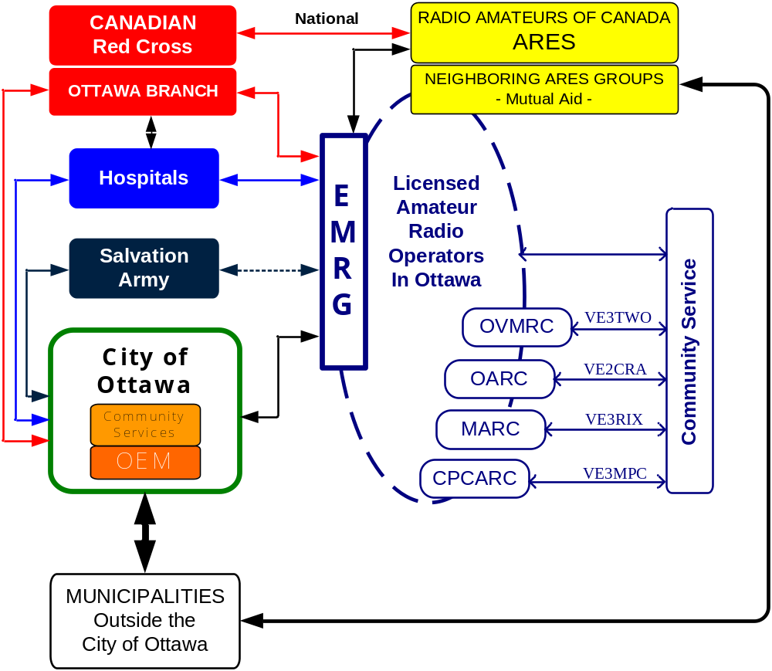
INTERFACES WITHIN THE COMMUNITY
Notes:
EMRG provides an administration and planning function which is the interface between the Amateur radio community in Ottawa and groups who may require Amateur radio communications in an emergency.

Slide 5
Amateur Radio
EMRG is also known as Ottawa ARES. ARES is a National Amateur radio program and EMRG is the ARES group for Ottawa. There are two names, but one group, with one purpose.
Amateur radio is a hobby based on radio communications
  There are many aspects to the hobby, such as talking with people, trying to contact new places, communicating over distance, satellite communications, equipment design, computer-radio integration.
  EMRG is made up of the group of Amateurs who also share an interest in Community Service.

Slide 6
WHO WE SERVE
ROLES
&
PARTNERSHIPS
Notes:
It is as important to understand what EMRG does as it is to know what EMRG does not do. Effective emergency communications requires planning, which starts with knowing what is required and who requires it.

Slide 7
MAIN ROLE
Provide radio communications to support humanitarian response.
The three main humanitarian response groups in Ottawa;
  City of Ottawa Community Services
  Ottawa Red Cross
  Salvation Army
These organizations do not have radio systems and normally rely on phones and cell phones for communications.
Notes:
In an Emergency or Disaster, there may be hundreds or thousands of people who have been displaced from their home. These people are the general population who may or may not have non serious injuries, and cannot return home. Some people will be separated from family members
Humanitarian response refers to the groups who take care of the general population, providing shelter, water, food, clothing and information. Coordination and information gathering requires communications. The groups providing humanitarian support, do not have dedicated communications systems. They rely on phones and cell phones, which may have failed or be overloaded.
The main client for EMRG communications services in Ottawa, is the City of Ottawa Community Services Department. Community Services is responsible for operating shelters.
The other main client is the Ottawa Red Cross. The National Amateur Radio organization, Radio Amateurs of Canada (RAC) and the National Red Cross, have a signed Memorandum of understanding for Amateurs to provide radio communications for local and National Red Cross.

Slide 8
OTHER ROLES
HOSPITALS
Provide a back up radio communications solution, for the Hospitals existing emergency management radio system. (14 sites)
FIRST RESPONDERS - Police, Fire, Paramedics
In extreme cases, EMRG could be asked to provide communications solutions to link key sites that are without phone or radio communications, or offload existing systems of non critical communications if they are overloaded.
  EMRG is NOT a back up for the hundreds of radios used daily by Police, Fire and Paramedics. The capacity required to replace the whole system is beyond the limits of what Amateur radio can supply.
Notes:
The Hospitals have a dedicated radio system for sharing emergency management information between the hospitals. This is not the same radio systems used for Paramedics to communicate with emergency departments.
EMRG can be called upon by the Hospitals to augment this system if more capacity were required or to replace the system if it failed.
The greatest myth in Amateur radio, is that in a crisis, Amateur radio will be brought in to provide replacement of failed Public Safety radio systems or to provide interoperability between First Responders.
A Crisis is not the time to bring in outsiders with no training.
Public Safety radio systems are very expensive, because they are dedicated to their task (built to handle the load) and have controlled fail mechanisms to reduce system capability based on types of failures, rather than a total system failure.
Amateur radio in Ottawa lacks sufficient channel capacity, radio coverage and radios to replace the multi-user, multi-channel trunked radio system in Ottawa.

Slide 9
EMERGENCY RESPONSE
& AMATEUR RADIO
AMATEUR RADIO INVOLVEMENT
Paramedics
Police
Fire
No Activity
First
Response
Limited Focused Support Activity
First Response
Support
Relationship Management
For Amateur Radio
Emergency Management
Depends On
Local Requirements
Special Services
(Hospitals, Search & Rescue, etc)
Main Area Of Activity
For Amateur Radio
Humanitarian Response
(General Population Care)
EMERGENCY RESPONSE PYRAMID
Notes:
The pyramid provides a pictorial representation of the groups involved in the response to a large scale emergency, with their relative position in terms of timing in the response and the number of people they can directly assist.
First Responders, Police, Fire and Paramedics, are the first groups to respond to any event. They evaluate the situation and escalate as required.
In daily events, First Responders may not require any outside support, or only limited support, such as Public Works delivering barricades for Police.
First Responders can only care for a limited number of people at a time. Their objective is to stabilize the location, situation or people, so they can be transferred to other groups such as to a Hospital or shelter.
The General Population in an emergency is a large group of people displaced from their home and possibly frightened and with minor injuries. These people are cared for by the humanitarian groups, Community Services, Red Cross and Salvation Army. The supporting groups do not have a dedicated communications system for providing support. They rely on cell phones, desk phones and the Internet on a day to day basis.
Amateur radio is needed by and can provide great value, in support of the humanitarian effort in an emergency.

Slide 10
PRIMARY FOCUS
EMRG
PRIMARY
FOCUS
Wide Spread
Communications Disruption
Devastating Disaster
Possible Limited Area
Communications Disruption
Emergency - Disaster
People Needing
Assistance
Earthquake
Tornado
Communications Systems
Operating Normally
Normal 1ST Response
Red Cross PDA
“The Big One”
Power Outage
Fire
Accident
Theft
ICE Storm
Plane Crash
Area Of
Impact
Amateur Radio
Involvement
NOT Involved
Most Opportunities
To Help
&
Greatest Opportunity
To Preplan
Best Effort With
What Is Available
Notes:
The drawing shows response to emergency events, divided into 3 broad categories;
Normal 1st Response is the day to day emergency response, such as a fire or car accident. Communications systems are working, there are no people displaced, and support from Amateur radio is not required.
Emergency - Disaster includes events or situations which either have a large impact in a small area or a more minor impact over a larger area. There may be some communications systems overload or failures, but typically in small areas.
Devastating Disaster is the “Big One” that causes mass damage over a large area. It is difficult to plan what will happen and how to respond until the event takes place. Depending on the impact of the event, local response may not be possible, so the response effort would come from outside the area.
Most Amateur radio groups prepare for the Big One, which may never happen and if it does happen, may cause enough devastation to the local infrastructure and volunteers, leaving them unable to respond.
The middle category, Emergency - Disaster, will likely occur at least once every few years. These events provide a great opportunity for Amateur radio to help, because there either is no other alternative or Amateur radio can add communications capability that makes it much easier to manage the event.

Slide 11


PARTNERSHIPS
E M R G
Ottawa
ARES
Secondary
Partners
Primary
Partner
Emergency Measures Unit
Office of Emergency Management
H
Community
Services
Fire
Paramedic
Police
Individual Partnerships & Agreements
City of Ottawa
The City of Ottawa, Office of Emergency Management (OEM) is the primary EMRG partner. In the event that there are insufficient EMRG resources, OEM will assign priorities for EMRG.
Notes:
The primary partner for EMRG is the City of Ottawa Office of Emergency Management (OEM). The EMRG Team Leader answers to the OEM Manager or their designate.
It is through OEM that other groups within the City of Ottawa request EMRG services. For example, if Community Services requires communications for shelters, they identify the requirement to OEM, who would then call EMRG. While OEM is the primary interface for EMRG, if EMRG is deploying to support Community Services, EMRG will take its direction from Community Services.
The City of Ottawa has various agreements between individual departments within the City and the other local agencies such as the Hospitals, Red Cross and Salvation Army. EMRG also has partnerships with these agencies. In an emergency, if there are not enough EMRG volunteers to support all the requests, EMRG will take its direction from OEM on where to deploy it’s resources. OEM would prioritize the requirements in discussion with the agencies making the requests.

Slide 12
EMRG- City of Ottawa
Relationships
Community Services
Main User EMRG Services
Police-Fire-Paramedics
Communications Centres
Liaise With EMRG
No Plans For Using EMRG
Office of Emergency
Management (OEM)
Manage The Relationship
Provide Funding
Activate EMRG For The City
Ottawa Fire Service
Provide Infrastructure
(Communications Room)
(Equipment Storage)
(Repeater Sites)
The City of Ottawa is made up of many departments and EMRG has different relationships with each. The main client within the City of Ottawa that uses EMRG communications, is Community Services.
Notes:
EMRG effectiveness is the result of a partnership between OEM and OFS, in order to supply communications for Community Services. This triangle of 3 key City Departments is the foundation for the EMRG – City of Ottawa partnership.
EMRG has contacts in communications for Police, Fire and Paramedics, but their plans are not build on the use of Amateur radio.

Slide 13
OTTAWA FIRE SERVICE
OFS is the prime infrastructure partner for EMRG, working in partnership with OEM, OFS provides;
  Dedicated EMRG Radio room at Fire Dispatch with access to antennas on the roof and the tower
  Storage space for equipment
  Radio repeater sites at key locations in the City
  Surplus radio equipment
  Access to the training centre
Notes:
The Fire Department has traditionally been responsible for emergency planning in most Municipalities, including most of the Municipalities that now make up the City of Ottawa. Larger areas, such as the old Regional Municipality of Ottawa Carleton or now the City of Ottawa, have a dedicated department responsible for emergency planning.
Ottawa Fire Service (OFS) continues it’s support role for Amateur radio and is an important provider of infrastructure for EMRG.

Slide 14

SHELTER OPERATIONS
Shelters in Ottawa are managed by the City of Ottawa, Community Services, using partnerships with local volunteer groups.
Shelter
Management
Community
Services
Communications
Food &
Clothing
Registration & Inquiry
First Aid
The Ottawa Red Cross PDA (Personal Disaster Assistance) program is responsible for incidents with up to 50 people displaced, such as a large fire. This is a situation where EMRG could be providing communications support directly to Ottawa Red Cross.
Notes:
In the City of Ottawa, shelters are managed by the City’s Community Services Department. Community Services has partnerships and agreements with local volunteer organizations to provide various services to operate shelters.
EMRG provides communications to directly support the Community Services Dept and also provides communications to support other volunteer groups who also provide services to Community Services.

Slide 15
WHAT WE PROVIDE
Solutions
&
Services
Notes:
EMRG can provide radio communications, but what does that mean?
Radios can be used to provide many different types of communications solutions.

Slide 16
Amateur Radio
Communications
VOICE
Radio to radio
Radio Telephone
DATA
Text messages
File transfer
Email
Communication Types
One to One
One to Many
Managed Group
Multi Channel
Multi Type (voice & data)
Operational Models
Point to Point (Direct)
Repeaters (Extended coverage area)
Portable Repeaters
Cross band repeaters
Network Configurations
1.8-30 MHz
50 MHz
144 MHz
220 MHz
440 MHz
900 MHz
1.2 GHz
Frequency Bands
Notes:
Amateur radio communications solutions have 4 functional components that define the solution. Each functional component has a different impact on the capabilities of the solution.
To the end user, the solution is a simple communications link between the locations they need to communicate.
COMMUNICATIONS TYPES: There is Voice & Data communications and within each of those, there are sub functions.
OPERATIONAL MODELS: The most common model is the one to many, where all locations are on the same radio channel. There are other models which can be used in parallel to meet different requirements.
NETWORK CONFIGURATIONS: Most communications requires some form of network infrastructure. Point to Point (Direct) has a limited distance that can be supported.
FREQUENCY BANDS: Multiple bands allows operations to be on different frequencies so they do not conflict and these frequencies have different characteristics. Lower frequencies go further, but have larger antennas. There are tradeoffs but there are also options.

Slide 17
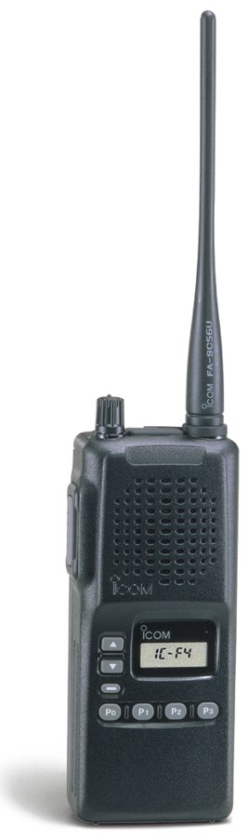

OPERATIONAL MODELS
Network
Control
Station
One to One
One to Many
Individuals or specific locations
Shelters
Network
Control
Station
Managed Group
Dispatch Centres or Hospitals
Notes:
ONE TO ONE
One To One is a dedicated communications path (channel) between two people, who may be moving around, holding the radio, in a vehicle or at a fixed location.
ONE TO MANY
One to many is a typical dispatch type communications where a central site controls the flow of information and the information typically flows between each end unit and the central control site.
MANAGED GROUP
Some groups are already well disciplined in radio operation and have equal status, so they can operate on their own. There is a net control station to ensure that Amateur rules are met and that communications within the group does function properly.

Slide 18

BANDS & MODES
Multiple Bands = More Collocated Radios
There are limits on how many radios can operate on the same band in the same location at the same time. Solutions that can be used in permanent sites, are not easily transportable.
The frequency difference between channels and physical distance between antennas helps limit interference, but these options are not always available. Using different bands eliminates interference, making emergency deployment much easier.
Single Site Using
Multi Bands & Channels
Individual Sites
144 MHz
144 MHz
440 MHz
220 MHz
Notes:
In an emergency, there may be other organizations or agencies that are operating on frequencies near the Amateur bands, or there may be a requirement for more than one Amateur station in a location. When radios are operating too close together, they may interfere with each other. In a permanent site, there are options using filter cavities to operate multiple radios in one location, even from a common antenna.
In a temporary site, radios can interfere with each other, so having the ability to deploy on a different band is an option to solve the problem, by moving to a different band.

Slide 19

Extending
Communications
Working communications can be extended into an impacted area. This could be within the City of Ottawa, or through Mutual Aid, it could be into a neighboring Municipality.
IMPACTED AREA
(Phone & Internet Not Working)
Voice Channel(s)
Telephone Access
Data Channel(s) & Email Service
Local Voice Channel
(Community Repeater)
EMRG / OFS
Radio Sites
Extend Communications Into Impacted Areas From Locations That Have Working Service
Repeater
PSTN
Internet
Telephone
Notes:
While it is always possible that the Disaster is widespread, there is a much higher probability that only a portion of the City has been impacted. EMRG can use a mix of local “Community Repeaters” within the impacted area and wide area repeaters which are located outside the impacted area.
The Wide Area repeaters can be used to extend voice, phone and data communications, from the working area, into the impacted area.

Slide 20
RADIO REPEATERS
Repeaters link users within an area who cannot otherwise communicate directly, radio to radio. The coverage area could be City wide, within a local community or between a few buildings.
Repeater
Telephone
Repeaters can be for voice or data communications and can interface to the telephone network and the Internet.
Internet
Notes:
Repeaters are an important part of EMRG communications. While Amateurs can provide some communications simplex, without repeaters, it is not as effective.
Some repeaters can be configured to provide an interface to the telephone network or the Internet.

Slide 21
REPEATER STRATEGY
RELIABILITY
Repeaters must be dependable
  Withstand continuous use for days in an emergency
  Generator backup, with battery backup in case of generator failure
  Quality parts and workmanship
  Regular testing and maintenance
DIVERSITY
Some repeaters may not be functional in an emergency, so sufficient capacity is required to maintain effective coverage with some infrastructure loss.
  More than one site that can cover an area
  Sites independent of other radio systems
CHANNEL CAPACITY
User requirements and message volumes will vary, so more than one repeater and coverage area is required to effectively meet user needs.
  Multiple repeaters on different bands
  Channels should meet user through put volume and speed. Some groups may need a dedicated repeater so messages never wait.
Notes:
Creating an effective repeater network requires some work. Repeaters used for emergency communications must be reliable.

Slide 22
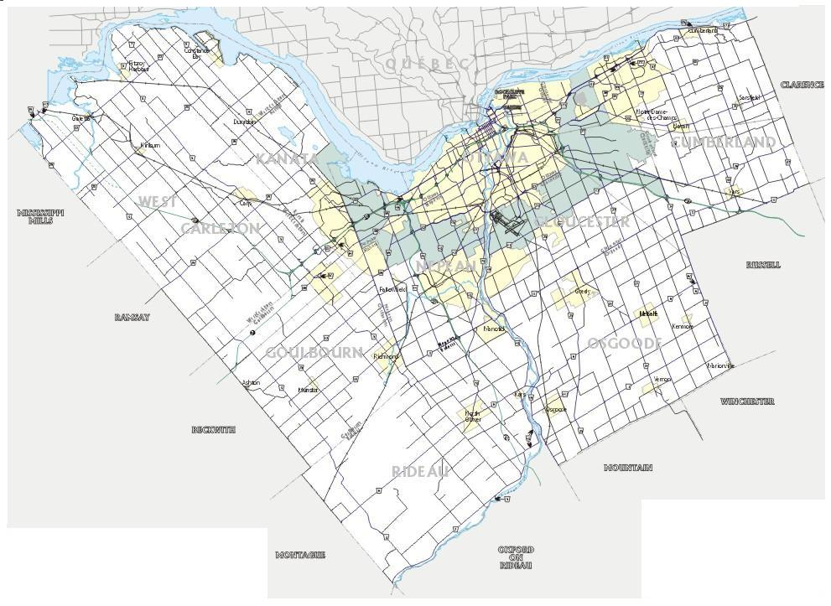
CITY WIDE
REPEATERS
VE2CRA is a club repeater that provides City wide coverage and is diverse in location and power grid.
Camp Fortune
VE2CRA
VHF
Randall
VE3OCE
VHF
Barrhaven
VA3OFS
VHF
Repeater signal decreases over distance and depending on terrain. At the edge of the coverage area, portable radios and mobile radios typically will not provide reliable operation.
There is no single repeater that can cover the full City of Ottawa. By using several repeaters, most areas are covered and are accessible from key locations.
Notes:
EMRG operates two wide area repeaters that can be accessed from the City core and from most other areas in the City. These repeaters are important for sharing information across the City, and provide diversity in case one should fail.
The Ottawa Amateur Radio Club (OARC) operates a repeater on Camp Fortune in Quebec, which is available for use in an emergency. This provides another radio channel and increased diversity.
It is possible that more than one wide area repeater could be required in an emergency.

Slide 23
COMMUNITY
REPEATERS
E
NW
Carp
Diefenbunker
VHF Community Repeater, providing coverage in the East End.
Proposed VHF Community Repeater, providing coverage in the West End.
W
S
SW
Boundary for area with repeater installed or under construction
Community Repeaters provide a voice channel serving a community of interest, for communications within the local area.
(The actual repeater coverage will overlap in some areas and fall short in others.)
Boundary for area proposed for a Community Repeater
Notes:
Not all information needs to be shared City wide. Community repeaters focus on specific areas of the City. This could be to share information between several local sites, or to support a local citizen patrol.
The objective is to implement a series of community repeaters to cover all areas of the City. The locations are based on regional areas and where there is a suitable antenna available.

Slide 24
SPECIALITY
REPEATERS
PROPOSED:
Local UHF coverage for 100
Constellation & Algonquin Collage
Linking to wide area VHF repeaters
Randall
VE3OCE
UHF
The Randall UHF repeater covers the Urban core and can be used to link dispatch centres, hospitals or other central locations.
(Currently Under Construction)
Notes:
Repeaters can be used for special applications to provide a specific function.

Slide 25
OUR PLAN
Organization
&
Strategies

Slide 26
ORGANIZATION
EMRG deploys to support partner agencies who are responding to an emergency.
EMRG has it’s own emergency organizational structure to effectively deploy, and support partner agencies in an emergency.
Notes:
EMRG does not respond to events, that is what partner agencies do. EMRG deploys to support the responding partner. It is a subtle difference, but it is important to understand.

Slide 27
NORMAL STRUCTURE
Management
Team
This model is used on a daily (routine) basis to provide a structure that supports planning, training, practice and preparation for deployment in an emergency.
People are assigned to each role on a permanent basis.
Team Leader
Exercise Planning
Equipment
Membership
Harold - VE3UNK
Membership
Man of Many Hats
Technical
Training
Web Page
MEMBERSHIP - Active
MEMBERSHIP - In-active
Notes:
The normal structure has names assigned to specific roles on a permanent basis.

Slide 28
DEPLOYMENT
STRUCTURE
Information & Finance
are Partner Agency
responsibilities
Team Leader
Safety
Liaison
Planning
Operations
Logistics
No names associated with the roles until there is a deployment, then roles are assigned based on who is available.
The Team Leader is the person in charge, which may or may not be the person who is the Team Leader on a daily basis.
Roles can be added or removed based on the size of the incident.
Staging
Net Control
(1 or more, people/nets)
EOC Radio
Operator
Shelter Radio
Operator
Relay Station
Operator
The EMRG Deployment Model is based on IMS, but is not IMS. The Team Leader is not an Incident Commander. EMRG is a communications module that plugs into other organizations IMS structure.
Notes:
The Deployment Model is only used when there is an event and people are assigned to roles based on who is available. If an event goes for several days, there must be more than one person for each position, in order to cover each shift.

Slide 29
DOCUMENT
STRUCTURE
Notification Plan
EMRG-103
Used By Partner Agencies
To Contact Us
REFERENCE
Membership List
EMRG-104
Frequency List
EMRG-207
Activation Plan
EMRG-105
Technical Reference
EMRG-206
Ready To Deploy
SUB PLANS
Partner & Critical Site
Contacts EMRG-101
FORMS
Operations Plan
EMRG-106
Red Cross Plan
EMRG-107
Emergency Communications
Log EMRG-501
Equipment Operation
EMRG-205
Hospital Plan
EMRG-108
Resource Tracking
Log EMRG-501
Resource Assignment
Chart EMRG-501
Mutual Aid Plan
EMRG-109
Begin Shutdown
Deactivation Plan
EMRG-111
Dispatch Centre Personnel Report EMRG-501
Document
Management
Document List
EMRG-001
Debrief Plan
EMRG-112
Document Distribution
List EMRG-104
Most documents are posted on the web site: www.emrg.ca
Notes:
The EMRG document structure is based on a series of documents, rather than one large operations document. With multiple documents, it is easier to maintain and it is also possible to send only the information required for a specific purpose.
For example, partner agencies what to know how to contact EMRG in an emergency, which is the Notification Plan (EMRG-103). They are not interested in what radio will be deployed or how the EMRG call out tree functions.
Document writing is an ongoing task. Not all documents are complete.

Slide 30
PROJECT PRIORITIES
1. Maintain Existing Infrastructure
  Ensure existing infrastructure is complete, robust, documented and people are properly trained
2. Voice Communications City Wide
  Expand voice communications infrastructure (repeaters) to support communications between any locations, urban or rural, within the City of Ottawa
  Build an inventory of basic radio equipment (radios, power supplies, antennas & coax) to ensure sufficient equipment is available to provide consistent reliable radio communications from deployed locations
3. Data Communications In Urban core
  Establish a basic data communications network, to provide coverage within the urban core.
Notes:
EMRG has identified a series of projects that can be used to improve capabilities. The project priorities are the starting point to ensure that there is a solid base on which to build networks and process.

Slide 31
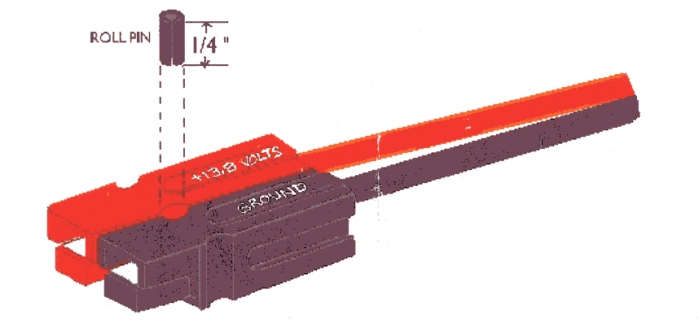
STANDARDIZATION
Standard interfaces make dissimilar equipment universal
Radio standardization usually means buying all the same models of equipment. EMRG has a collection of different makes and models of equipment, each with it’s own style of connector. Even the same style of connector will be wired differently across vendors.
EMRG has developed a Standard Radio Interface (SRI) that allows any piece of radio equipment to be wired to the standard connector, allowing plug and play exchange of equipment. This is important for quick replacement of defective equipment in an emergency.
EMRG has also selected a standard DC power connector, so all radios, power supplies and batteries can also be exchanged easily.
All EMRG equipment will eventually be wired with the standard interface, thanks to the project funding from the City of Ottawa Office of Emergency Management (OEM)!

Slide 32
www.emrg.ca
The EMRG web site provides information related to Amateur radio emergency communications, specifically as it relates to the City of Ottawa.
Team Leader: Peter Gamble - VE3BQP
(pgamble@emrg.ca)

