Slide 1
EMERGENCY MEASURES RADIO GROUP
OTTAWA ARES
Two Names - One Group - One Purpose
General Meeting
2007-01-27
Notes:
This training course provides an overview introduction for anyone wanting to know more about EMRG. The course is intended to be reviewed individually, or presented to a group.

Slide 2
The Year In Review
EMRG maintained a steady successful pace forward last year, with several significant accomplishments and a good start to 2007!

Slide 3
The Year In Review
EMRG has a Training Coordinator – Tom Zinck VE3NFA.
Repeater VE3OCE VHF was upgraded.
EMRG received radio equipment from City Radio site.
Red Cross Radio system nearly complete.
Repeater VE3OCE UHF on the air.
Next phase of EMRG strategy ready to go, meeting with Community Services in February.
The City continues to fund EMRG with $1000 grant.
Numerous projects ready for 2007.

Slide 4
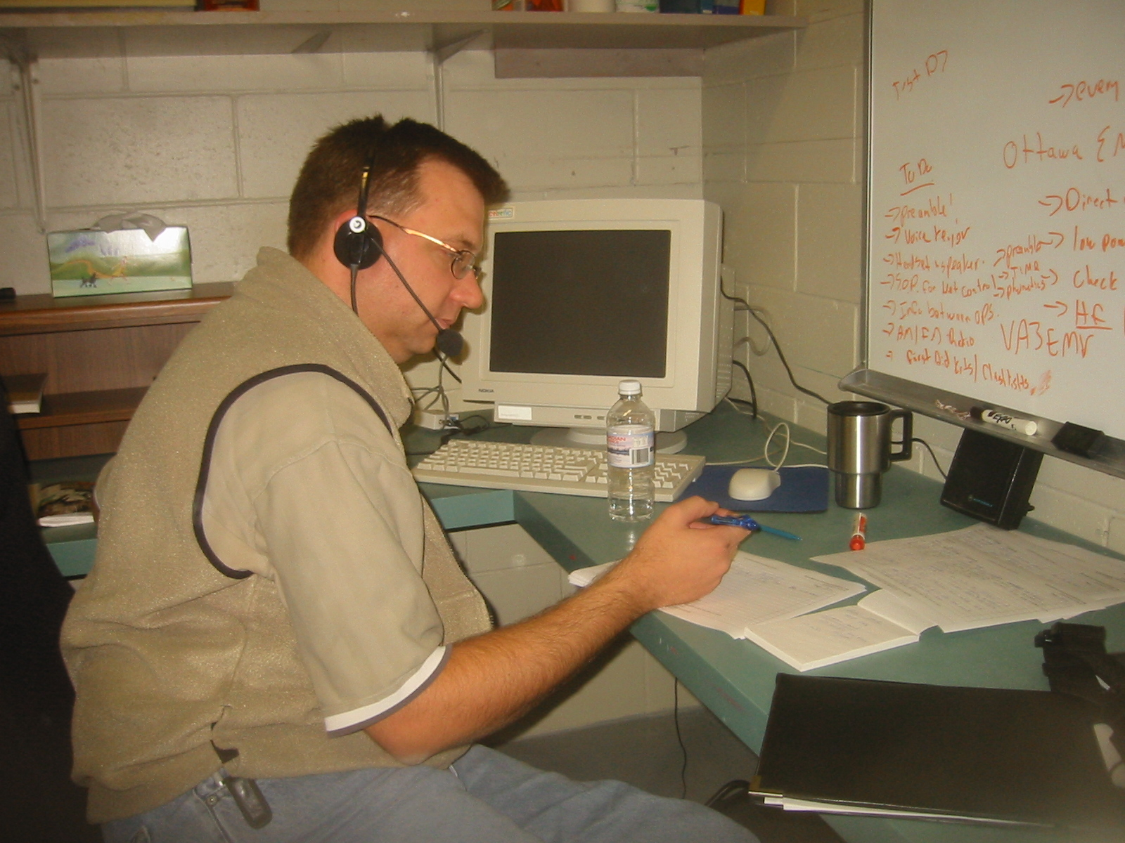
Training Coordinator Tom Zinck

Slide 5
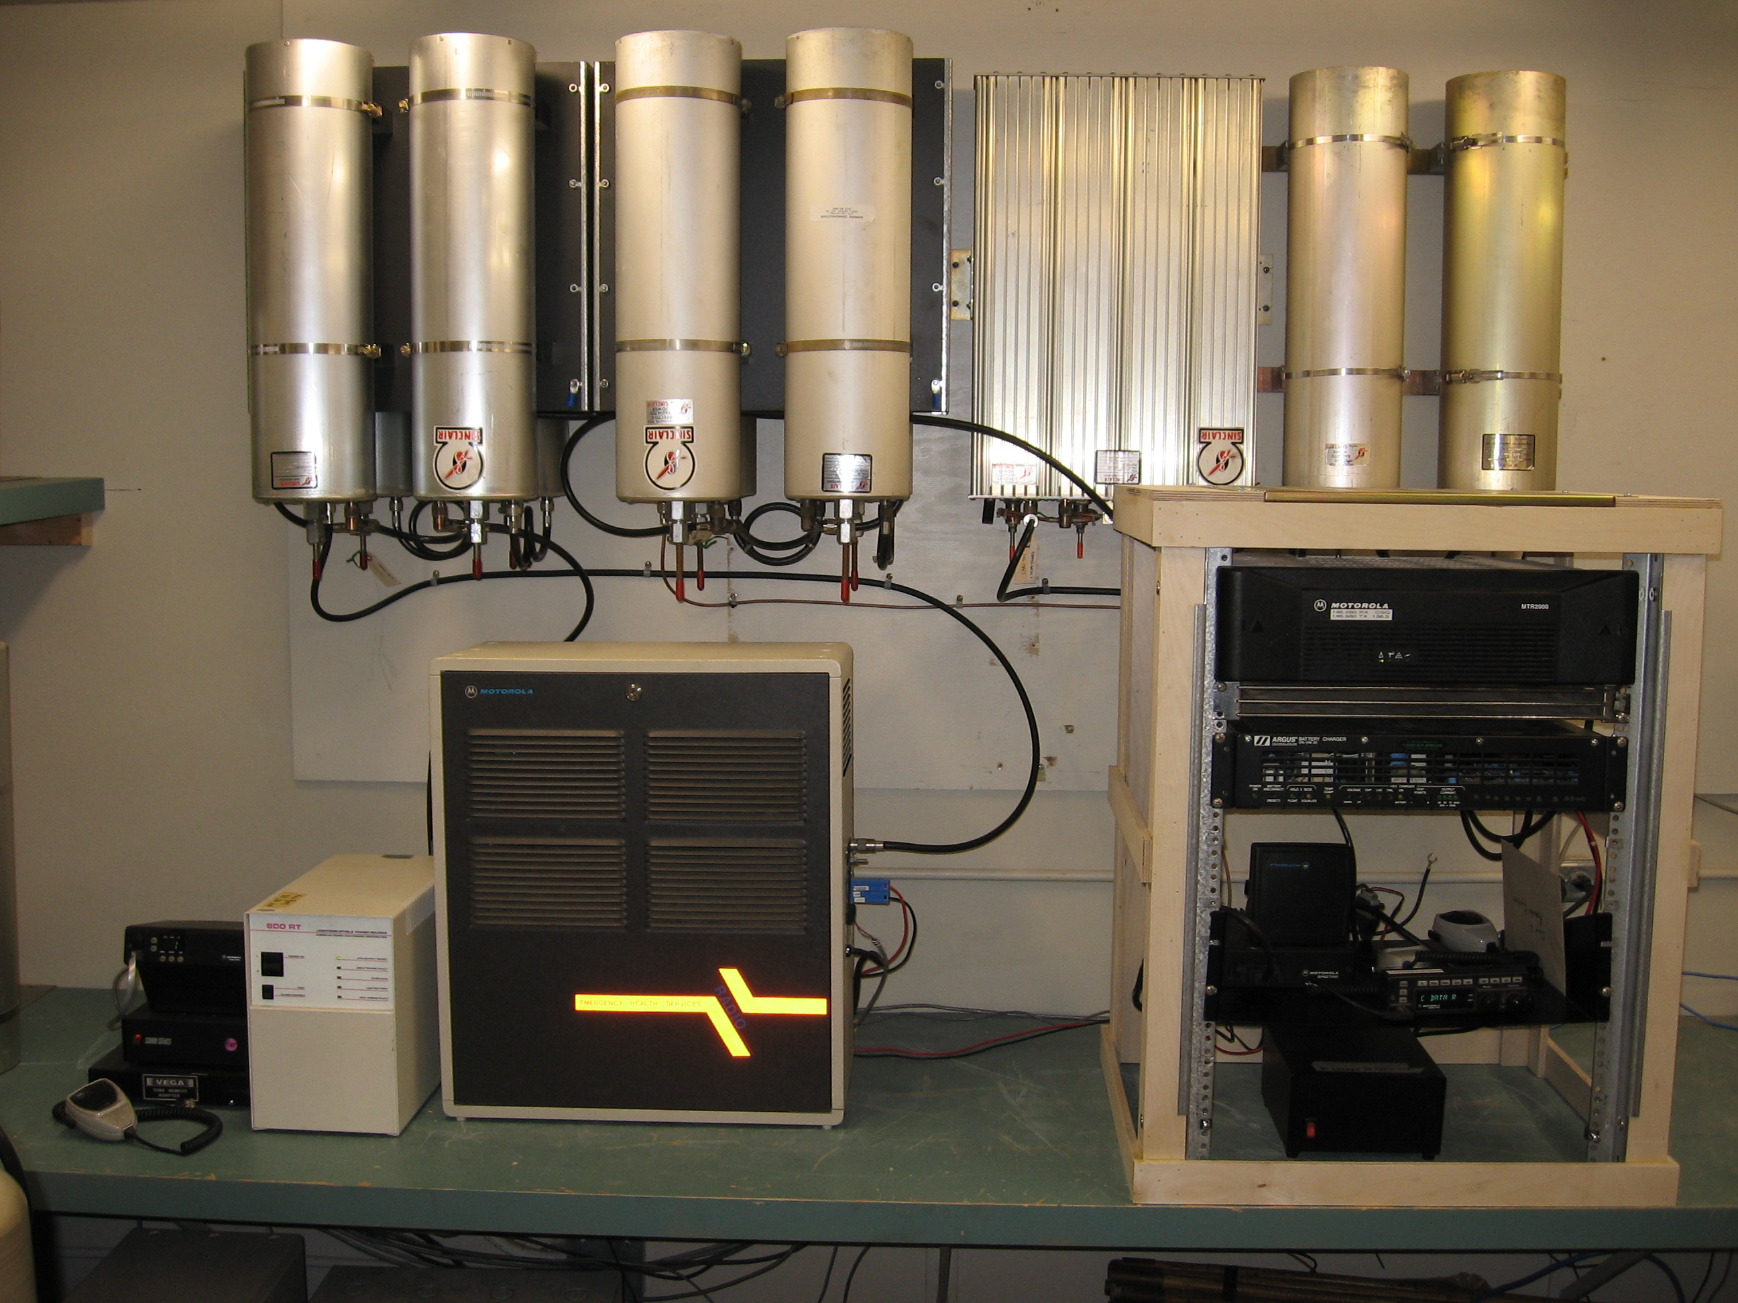
VE3OCE VHF
New Repeater
1
2
5
3
4

Slide 6
The New Repeater
ANTENNA
  Antenna = 8db gain
  Antenna Height = 90 ft Above Ground
  Ground Height =
  Antenna Cable = Andrews 7/8” Heliax
POWER
  Onsite Generator Backup
  Wired for external Generator Backup
  Battery Backup = 100AH (6 to 7 hours operation)
REPEATER
  Radio = Motorola MTR-2000
  Power = 30 W Continuous
CONTROLLER
  Internal to Radio

Slide 7
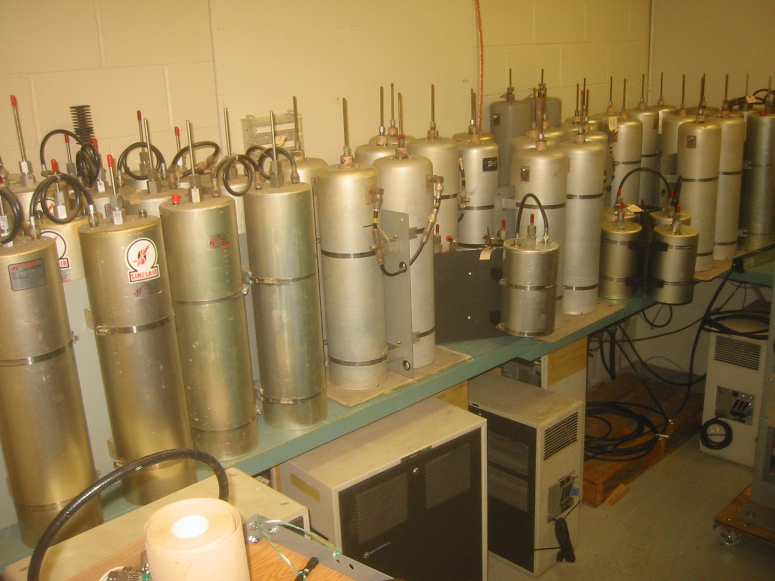
Carlington Heights
Equipment

Slide 8
Red Cross Radio
Nearly Complete

Slide 9
VE3OCE
UHF Repeater
TX 443.800 RX: 448.800

Slide 10
EMRG - City of Ottawa Relationships
It has taken some time to understand the role of different groups within the City of Ottawa. What we now know is that EMRG depends on 3 key relationships within the City.
Community Services
Main User EMRG Services
Police-Fire-Paramedics
Communications Centres
Liaise With EMRG
No Plans For Using EMRG
Office of Emergency
Management (OEM)
Manage The Relationship
Provide Funding
Ottawa Fire Service
Provide Infrastructure

Slide 11
Community Services
Community Services is the Primary User of EMRG services based on past history and the fact that Community Services does not have a radio system, and normally relies on phones and cell phones for communications.
EMRG takes its role very seriously and we want to make sure that when called, we offer effective communications solutions that meet their needs.
I will be meeting with Community Services on February 2 to discuss how to further develop the relationship, so EMRG can better understand their requirements.

Slide 12
$$$
  The City of Ottawa is continuing their $1000 yearly grant.
  The grant covers project materials and maintenance
  Outstanding activities that need a business case for funding include Antenna Work and UHF repeater equipment.

Slide 13
Numerous Projects
Ready For 2007
The original EMRG 1 year plan was overly optimistic and really included 4 to 5 years worth of work. EMRG is currently midway through the plan.
1. Maintain Existing Infrastructure
  Ensure existing infrastructure is complete, robust, documented and people are properly trained
2. Voice Communications City Wide
  Expand voice communications infrastructure (repeaters) to support communications between any locations, urban or rural, within the City of Ottawa
  Build an inventory of basic radio equipment (radios, power supplies, antennas & coax) to ensure sufficient equipment is available to provide consistent reliable radio communications from deployed locations
3. Data Communications In Urban core
  Establish a basic data communications network, to provide coverage within the urban core.

Slide 14
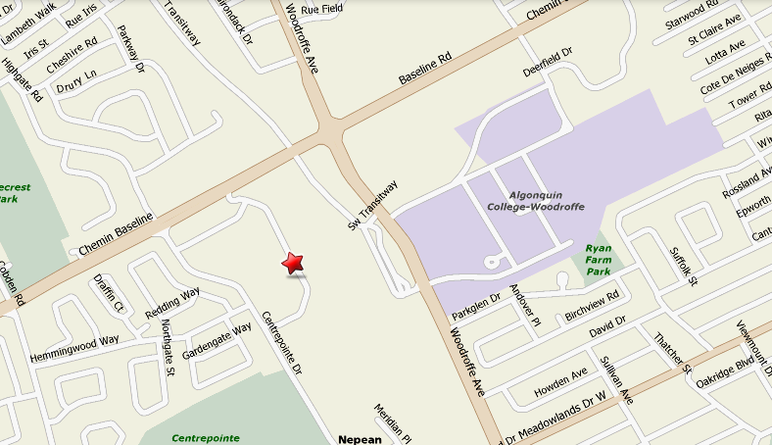
Example Project
UHF Repeater -VHF Link
Repeater
VHF
UHF
UHF
Repeater
VHF
Link Radio
Stn 21
100 Constellation Cr.
BF

Slide 15
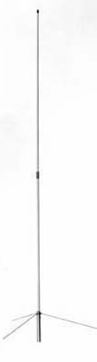
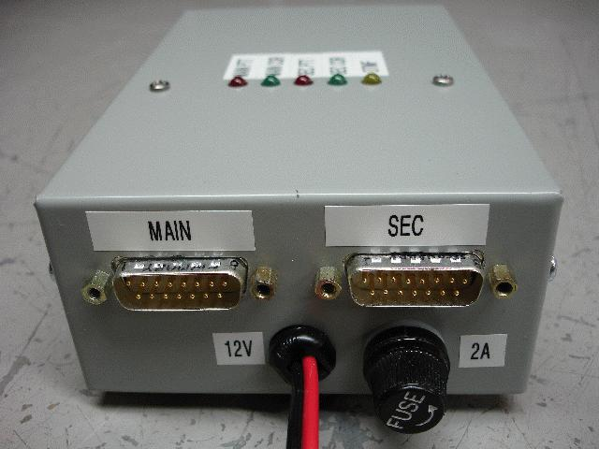
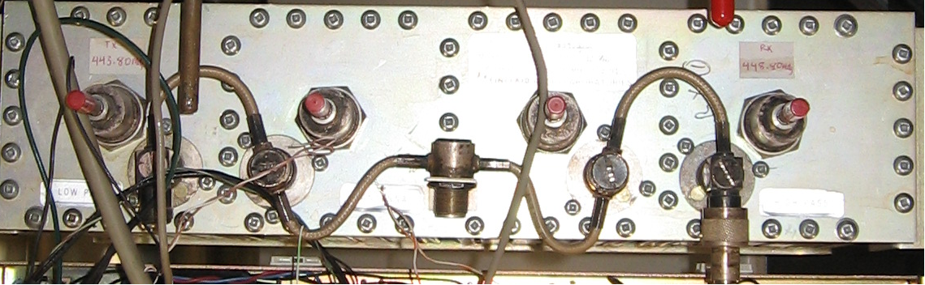
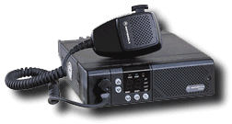
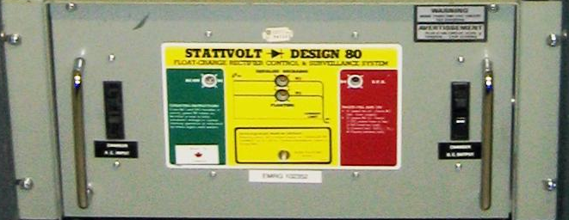


Linking Repeater Parts
UHF Repeater
UHF Duplexer
DC Power Supply / Battery Charger
New 100 AH Battery

Slide 16
EMRG 2007 STRATEGY
Meetings
Meetings are opportunities to get people together for group think sessions, training, or exercises, with a brief EMRG information session. There are typically 3 General Meetings per year; September, January and May/June.
Training
The key objective for this year is to continue to implement the training plan. While training has been taking place in the past, there was no overall strategy for course structure, content, development paths for members, The training strategy is to offer 5 courses per year.
Exercises
Exercises provide an opportunity to practice skills, identify areas that need improvement and work together as a group. The exercise strategy is to complete 3 exercises per year.
Recruitment
Recruitment is an ongoing task aimed at maintaining the membership level. The strategy is to maintain visibility within the Amateur radio community through presentations at local Amateur radio club meetings and the yearly EMRG booth at the Ottawa Amateur Radio Club fall Hamfest. This year EMRG will attempt to find someone who will specialize in recruiting suitable new members.

Slide 17
EMRG Management Team Looking For New Participants
The management team meets every 3rd Wednesday of the month to discuss EMRG issues, set objectives for EMRG, make decisions and plan general meetings.
The objective is to have a team that represents the cross section of EMRG members, so an interested new ham can provide as much value as a old timer.
The only requirement is an interest and willingness to participate. Bench warmers are not required.
If you are interested, talk to Peter Gamble today, drop an email or give a call. Feel free to inquire for more information before making any commitment.

Slide 18
Community Event
Participation
By choice, EMRG was never involved in providing communications for community events, leaving this to the local clubs.
Community events are a great way to test equipment, deployment techniques and radio skills.
The EMRG management team has discussed the idea of getting involved in a yearly event, such as Tour Nortel.
The final decision is yours.
  How many people would be prepared to support communications for a community event?

Slide 19
EOC CHANGES
External Tri-band Antenna
Tri-band Mobile Antenna On Ceiling
Low Power
Simplex
VHF
VHF
144
UHF
UHF
440
VHF
220
VHF
220
WiFi Access Point
VHF
144
RADIOS
Computer
TNC
VHF
144

Slide 20
www.emrg.ca
The EMRG web site provides information related to Amateur radio emergency communications, specifically as it relates to the City of Ottawa.
Team Leader: Peter Gamble - VE3BQP
(VE3BQP@RAC.CA)

Slide 21
DTMF KEYPAD
EMRG needs a source for DTMF keypads. These would be installed into all permanent radio locations, as well as into the Standard User Interfaces.
1
2
3
A
4
5
6
B
7
8
9
C
*
0
#
D
We need someone to look for options, try some things out and deliver a proposal with a source for keypads and any optional wiring required to make it work on a standard radio microphone input.

Slide 22
Randall Countertop
EMRG needs someone with woodworking skills and space, to prepare 2 countertops, 7’-8” x 24”. The plywood can be delivered pre-cut, then the edging must be added and the surface must be finished with a durable stain and clear coat. (You may have ideas on how this should be done)
The existing countertop was used for a workshop, so the surface is not in good shape. More importantly, the plywood used for the original counter emits a foul odour, which is worse when it is humid.
The original counter was U shaped, while the new counter will have counters on each side, with the end open for easy access to the white board on the end wall.
The counters are made from ¾ plywood, with a good finish on one side, such as maple. The counters are 24” x 7’-8”, with a 2” x 3/4 “ hardwood trim on all edges.

