Slide 1
EMRG ARES
Update

Slide 2
EMRG <-> ARES Meeting
Most recent one in April 2010
ARES Capital and Seaway Districts teamed-up (for the usual reasons)‏
District Mutual Aid Plan = DMAP
Call-out Exercise + "To go" kits
Each group presented what's new

Slide 3
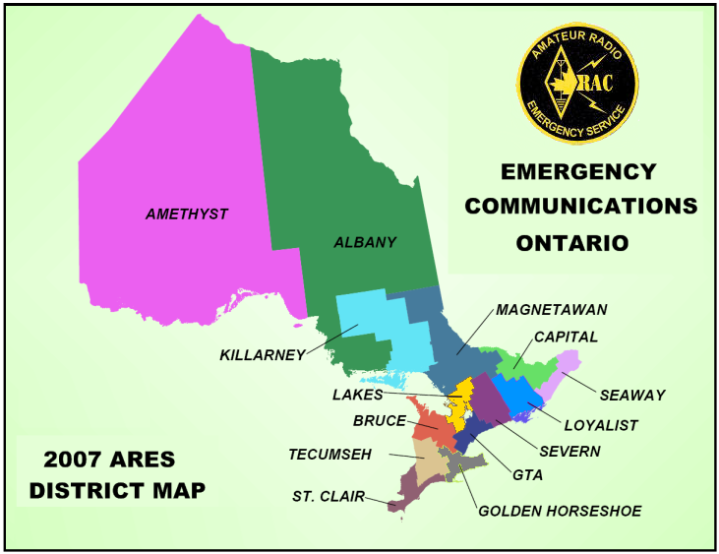

Slide 4
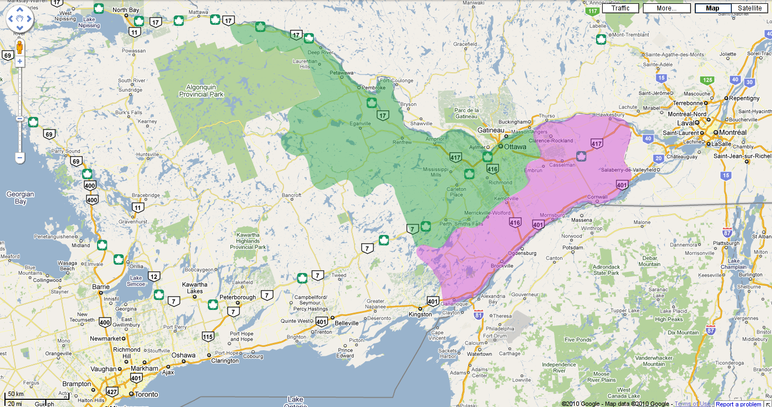

Slide 5
Capital/Seaway Groups
Renfrew County West ARES
Renfrew County East ARES
Lanark/North Leeds ARES
Ottawa ARES (EMRG)‏
Prescott-Russell ARES
Cornwall (Seaway Valley) ARES

Slide 6
District Mutual Aid Plan
http://seawaycapital-ares.org
Document ratified by all groups
Defines procedure for requesting and giving support to other groups
Checklist suggesting what to ask and what info should be provided

Slide 7
DMAP Exercise
Scenario described over the phone
Calls made to some EMRG members
Forms filled out (in triplicate)‏
Talk-in net and sign-in table
Basic weekender supplies checked
Climbed onto the virtual bus

Slide 8
http://emrg.ca

