Slide 1
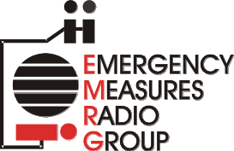
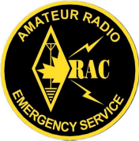
EMRG-403
Training Course
EMERGENCY MEASURES RADIO GROUP
OTTAWA ARES
Two Names - One Group - One Purpose
Cross Band Repeaters
Date Of Last Change: 2009-11-04
Version: 1.1

Slide 2
Course Introduction
Course Number: EMRG-403
Course Name: Using Cross Band Repeaters
Instructor Led: Optional
Prerequisites:
  None
What You Should Learn From This Course:
  From this course you should understand the benefits, limitations and proper methods to set up and use a cross band repeater
Recommended Reading:
  EMRG-409 Intro To CTCSS
  Read your radio manual if your radio has cross band repeat capability.
Emergency Measures Radio Group (EMRG) - Ottawa ARES

Slide 3
What Is An
In Band Repeater
Transmit & Receive are in the same band. This is a typical Amateur VHF or UHF repeater used every day.
Requires a Duplexer to separate Receive and Transmit signals, or separate antennas several hundred feet apart
Emergency Measures Radio Group (EMRG) - Ottawa ARES

Slide 4
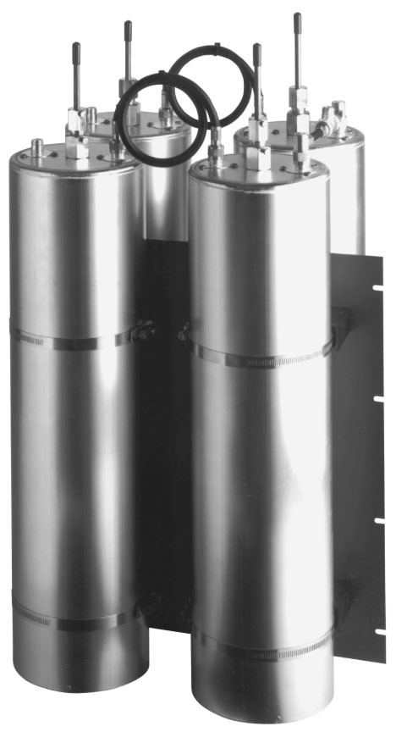
DUPLEXER
Adds or separates signals from the same band, where the signals are close enough together in frequency, that the attached equipment is not able to reject the unwanted signal.
Tunable to Pass the desired frequency and Reject the undesired frequency
Used for repeaters and full duplex base stations
Emergency Measures Radio Group (EMRG) - Ottawa ARES

Slide 5
What Is A
Cross Band Repeater
Transmit & Receive are in different bands, typically VHF and UHF
Supports uni-directional or bi-directional repeating
Several configurations;
  fixed site used to link neighbouring systems
  mobile permanently installed in a vehicle
  movable, made from mobile or portable radios.
Can use separate antennas for each band, or a Diplexer and dual band antenna
Emergency Measures Radio Group (EMRG) - Ottawa ARES

Slide 6
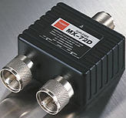
DIPLEXER
Adds or separates signals from different bands, where the signals are far enough apart in frequency, that the attached equipment is able to reject any unwanted signal without impacting the desired frequency.
Not tunable -fixed frequency bands
Used for multi band radios with a single multi band antenna
Emergency Measures Radio Group (EMRG) - Ottawa ARES

Slide 7
The Value Of Cross Band
Interoperability - Used by Public Safety to link agencies on different bands
Extends portable radio coverage
  Used every day by Public Safety as a Vehicle Repeater
  Used by Amateurs to extend range, or extend coverage into a building, such as a shelter in an emergency.
Compact compared to an in band repeater.
  Easy to make portable unit
  Some Amateur mobile radios have a built in cross band repeater capability.
Emergency Measures Radio Group (EMRG) - Ottawa ARES

Slide 8

One Way Repeat
(Uni-Directional)
One way repeating used when the portable radio can hear the repeater, but cannot transmit back due to distance, buildings or lower power.
VHF
VHF
UHF
Dual Band
Portable
Dual Band
One Way Repeater
VHF
Repeater
One Way Repeater receives from the portable radio on a simplex frequency on another band, and transmits to the repeater on the repeater input frequency
Emergency Measures Radio Group (EMRG) - Ottawa ARES

Slide 9
One Way Repeat continued
(Uni-Directional)
Two configurations;
  Cross Band: One Way Repeater and portable radio must be dual band
  In Band: One Way Repeater must have a duplexer
Benefits:
  Repeater tail is not a problem. The one way repeater is not receiving from the main repeater
  Full duplex operation when dual band radios used (talk & listen at same time)
Emergency Measures Radio Group (EMRG) - Ottawa ARES

Slide 10

Two Way Repeat
(Bi-Directional)
Bi-directional repeating used when portable radio cannot receive the repeater reliably, AND cannot transmit back to the repeater due to distance, buildings, lower power.
Portable radio transmits and receives on simplex frequency to cross band repeater and cross band repeater transmits and receives on repeater frequencies.
UHF
VHF
UHF
Cross Band Repeater
VHF Repeater
Emergency Measures Radio Group (EMRG) - Ottawa ARES

Slide 11
Two Way Repeat
(Bi-Directional)
Benefits:
Extends Receive and Transmit for reliable communications in both directions
UHF portable has good building penetration, while VHF has greater range
Problem:
While many Amateur radios have a cross band repeat functionality, not all implement it well. Set up your radio and test it with someone else, to confirm that the audio is clear and the repeater works as you expect.
Emergency Measures Radio Group (EMRG) - Ottawa ARES

Slide 12

In Building Example
VHF
UHF
Cross Band Repeater
In The Parking lot
VHF
Repeater
UHF Radio
Inside Building
Emergency Measures Radio Group (EMRG) - Ottawa ARES

Slide 13
Extended Coverage Example
VHF
UHF
Cross Band Repeater
On High Point
VHF
Repeater
Portable or Mobile
Radio Below Hill
Emergency Measures Radio Group (EMRG) - Ottawa ARES

Slide 14
CAUTION: Only One Direction At A Time
Cross band repeaters can receive on VHF & UHF at the same time, so long as they are not transmitting.
Once the cross band repeater selects an incoming signal on one band, the transmitter on the other band is activated.
The repeater now only receives on one band and transmits on the other band. The cross band repeater will stay in this configuration until the incoming signal stops.
Emergency Measures Radio Group (EMRG) - Ottawa ARES

Slide 15
CAUTION: Radio Burn Out
Mobile radios used for Cross Band repeaters, are not designed for long periods of transmitting. Set the power levels carefully!!
If using cross banding into a busy VHF repeater, the UHF transmitter in the cross band repeater will be active any time the VHF repeater is active. Set the UHF transmit power as low as possible.
Add a fan if possible
Use better antennas, so less power is required.
Emergency Measures Radio Group (EMRG) - Ottawa ARES

Slide 16
CAUTION: Repeater Tail
Repeater tail is the time a repeater continues to transmit, after the incoming signal stopped.
EMRG tries to set tail as short as possible.
If the cross band repeater is receiving from the main repeater and transmitting to the portable, the cross band repeater will continue to transmit to the portable until the incoming repeater stops transmitting (tail drops).
All radio operators should leave open space after a message to let the repeater tail drop, so people using cross band can get in.
Emergency Measures Radio Group (EMRG) - Ottawa ARES

Slide 17

Cross Band Traffic Pattern
Everything on the repeater will be transmitted by the Cross Band Repeater to the Portable radio
VHF
Cross Band UHF Transmit
Cross Band VHF Transmit
UHF
Only transmissions from the Portable Radio will be transmitted by the Cross Band Repeater
Cross Band Repeater
VHF Repeater
UHF Portable Radio
Emergency Measures Radio Group (EMRG) - Ottawa ARES

Slide 18
USE CTCSS
Cross Band repeaters repeat everything, including the selected repeater and intermod.
Most repeaters transmit a CTCSS tone. Set your cross band repeater to receive only when that tone is present to keep from cross banding VHF intermod to your UHF portable.
It is possible that you are not the only person using Cross Band Repeat on a specific UHF simplex frequency. CTCSS tones can help reduce interference
Emergency Measures Radio Group (EMRG) - Ottawa ARES

Slide 19
CTCSS Cross Band Example
VHF
UHF
Cross Band Repeater
VHF Repeater
UHF Portable
VHF Repeater
Encode & Decode
Cross Band Repeater
Encode & Decode
UHF Portable Radio
Encode & Decode
Transmit: 146.880MHz
- CTCSS: 136.5Hz
Receive: 146.880MHz
- CTCSS: 136.5Hz
Transmit: 446.200MHz
- CTCSS: 136.5
Receive: 446.200MHz
- CTCSS: 136.5
Receive: 146.280MHz
- CTCSS: 136.5
Transmit: 146.280MHz
- CTCSS: 136.5
Receive: 446.200MHz
- CTCSS: 136.5Hz
Transmit: 446.200MHz
- CTCSS: 136.5Hz
Emergency Measures Radio Group (EMRG) - Ottawa ARES

Slide 20
Push PTT & Wait 2 Seconds
There is a delay when using cross band repeaters because the repeater needs to receive the incoming signal and activate the transmit in the opposite direction.
Push and wait 2 seconds applies to all users on the repeater, whether they are using cross band or not.
An example of what happens when people do not wait, is they cut off the callsign of the person being called, so all that is heard is the callsign of the person calling.
A more serious example is if the reply is NO FIRE, and the radio operator pushes the PTT and talks right away, the other end will get the message FIRE.
Emergency Measures Radio Group (EMRG) - Ottawa ARES

Slide 21

Two Cross Bands
If two stations are using cross band repeaters and they are talking through a repeater, the delay can be significant, so ALL operators need to wait before they speak.
Cross Band Repeater
Cross Band Repeater
UHF Portable
VHF Repeater
UHF Portable
DELAY #3
DELAY #2
DELAY #1
Emergency Measures Radio Group (EMRG) - Ottawa ARES

Slide 22


Extend Simplex Range
Cross Band repeaters can be used back to back to extend the range of simplex communications.
Using separate transmit and receive antennas on the cross band repeaters would allow a VHF beam to extend distance
UHF
VHF
UHF
Cross Band Repeater
Cross Band Repeater
UHF Portable
UHF Portable
Emergency Measures Radio Group (EMRG) - Ottawa ARES

Slide 23

It Works Both Ways
The cross band repeater does not care which band is a portable radio and which is a repeater.
A VHF portable can be used with a cross band repeater to extend the range of a UHF repeater.
UHF
VHF
Cross Band Repeater
UHF Repeater
VHF Portable
Emergency Measures Radio Group (EMRG) - Ottawa ARES

Slide 24
PRACTICE USING CROSSBAND!
In EMRG deployments and exercises, it became very clear that using a cross band repeater is not as simple as it appears. There can and will be issues!
Write out the steps required for your radio to configure a simplex channel with CTCSS and how to activate the cross band repeater.
There is no substitute for regular practice. Set up your cross band when checking into the weekly net. This helps you understand your radio and it helps others remember to push the PTT and wait before they speak.
Emergency Measures Radio Group (EMRG) - Ottawa ARES

Slide 25
Self Test
If you want to have a VHF and UHF radio share a single antenna, do you need a Duplexer, or a Diplexer?
List one value of using a Cross Band Repeater?
Should you use CTCSS on a cross band repeater? Why?
What causes cross band repeaters to burn out?
If some stations are using cross band repeaters, and you are not, should you transmit before the repeater tail drops (before the repeater stops transmitting)? Why?
Why do you need to wait after you press the PTT, before you talk?
Can you use a cross band repeater with a VHF portable radio, extending into a UHF repeater.
Can cross band repeaters be used back to back to extend simplex range?
Emergency Measures Radio Group (EMRG) - Ottawa ARES

Slide 26
Answers
If you want to have a VHF and UHF radio share a single antenna, do you need a Duplexer, or a Diplexer?
  Answer: Diplexer
List one value of using a Cross Band Repeater?
  Possible Answers: Interoperability, Extends portable radio coverage, Compact compared to an in band repeater
Should you use CTCSS on a cross band repeater? Why?
  Answer: Yes you should use CTCSS to keep from cross banding intermoc
What causes cross band repeaters to burn out?
  Answer: Setting the transmit power too high to the portable radio, when cross banding into a busy repeater.
If some stations are using cross band repeaters, and you are not, should you transmit before the repeater tail drops (before the repeater stops transmitting)? Why?
  Answer: Any operators using a cross band repeater cannot transmit from the portable to the repeater until after the repeater tail drops. If other radio operators do not let the tail drop before they transmit, then cross band repeater operators may be locked out of the repeater.
Emergency Measures Radio Group (EMRG) - Ottawa ARES

Slide 27
Answers continued
Why do you need to wait after you press the PTT, before you talk?
  Answer: It takes time for the cross band repeater to detect the incoming signal on one band and activate the transmitter in the other band.
Can you use a cross band repeater with a VHF portable radio, extending into a UHF repeater.
  Answer: Yes
Can cross band repeaters be used back to back to extend simplex range?
  Answer: Yes
Emergency Measures Radio Group (EMRG) - Ottawa ARES

Slide 28

www.emrg.ca
The EMRG web site provides information related to Amateur radio emergency communications, specifically as it relates to the City of Ottawa.
  Project Information
  Newsletters
  Upcoming Events
  Documentation
  Links to related information
Information:
Emergency Measures Radio Group (EMRG) - Ottawa ARES

