Slide 1

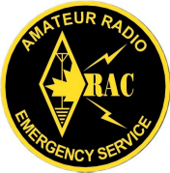
EMRG-409
Training Course
EMERGENCY MEASURES RADIO GROUP
OTTAWA ARES
Two Names - One Group - One Purpose
Introduction To CTCSS
Continuous Tone Coded Squelch
Date Of Last Change: 2009-10-31
Version: 1.0

Slide 2
Course Introduction
Course Number: EMRG-409
Course Name: Introduction To CTCSS
Instructor Led: Optional
Prerequisites:
  None
What You Should Learn From This Course:
  From this course you should learn the difference of tone Encode and Decode, why CTCSS tones are used and best practices for using CTCSS
Recommended Reading:
  Read your radio manuals to understand how each of your radios implements CTCSS
Emergency Measures Radio Group (EMRG) - Ottawa ARES

Slide 3
Motorola Creates CTCSS
Motorola invented CTCSS (Continuous Tone Coded Squelch System) in the early 1960’s and patented it as "PL" short for "Private line".
Other manufacturers came up with "Channel Guard”, "Quiet Channel“, "Call Guard".
CTCSS is also referred to as “tone squelch”, and “sub-audible tone”.
Emergency Measures Radio Group (EMRG) - Ottawa ARES

Slide 4
WHAT IS CTCSS
CTCSS is a continuous tone, so low in frequency (67 Hz to 250 Hz) and amplitude (volume) that it is almost impossible to hear with the un-aided ear.
This “sub-audible tone” is sent over the air from the Transmitter, to the Receiver.
The receiver doesn't let any sound through to the speaker until it hears the specific tone it was programmed with.
Emergency Measures Radio Group (EMRG) - Ottawa ARES

Slide 5
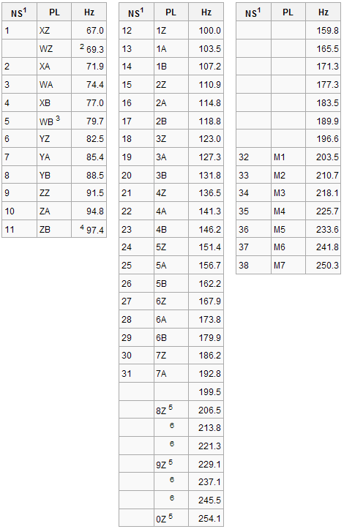
CTCSS TONE LISTS
There is no published standard for CTCSS tones.
Some radios have a minimal set of 38 tones, others have more.
Motorola used a two digit code for their PL tones, such as 4Z for 136.5 Hz.
EMRG uses the following tones; 100.0, 123.0 and 136.5 Hz
Emergency Measures Radio Group (EMRG) - Ottawa ARES

Slide 6

ENCODE - DECODE
Encode - Adds a CTCSS tone to the Transmit signal
Tone Encode
Called Tone or T on most Amateur radios
Decode - Detects the CTCSS tone at the receiver
Called Tone Squelch or TS on most Amateur radios.
Provides Encode & Decode
Tone Decode
Emergency Measures Radio Group (EMRG) - Ottawa ARES

Slide 7
WHY USE CTCSS
Reduce interference on receivers used in high RF environments.
  Radios capable of decoding the tone will not hear other interference on the channel that would otherwise open the squelch on the radio.
Allow the same repeater frequencies to be re-assigned within a shorter distance.
Contrary to popular belief, needing a tone to access a repeater does NOT mean it is closed.
Emergency Measures Radio Group (EMRG) - Ottawa ARES

Slide 8
EMERGENCIES & CTCSS
Some Amateurs believe repeaters should not use CTCSS because there are amateurs who have radios that cannot support CTCSS.
This is not an issue for three reasons;
  Most amateur radios do support CTCSS
  Many people will be partnered with someone and will be using the other persons equipment
  Some locations have permanent radios, plus EMRG has a supply of radios.
Emergency Measures Radio Group (EMRG) - Ottawa ARES

Slide 9
SIMPLEX
Generally CTCSS is not used on simplex frequencies
CTCSS should be used on simplex frequencies when accessing a cross band repeater or during a special event
You may struggle to get your radio to work if you forget you have a CTCSS tone on a simplex frequency, so you can’t hear anything.
Emergency Measures Radio Group (EMRG) - Ottawa ARES

Slide 10
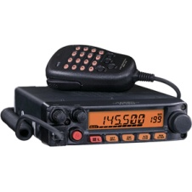
REPEATER TRANSMITS A TONE
EXAMPLE 1:
Mobile or HT
Decodes Tone
Repeater ENCODES Tone
Repeater
Repeaters transmit (encode) a tone so users have the option to program Tone Decode in their radio.
All repeaters should do this as a minimum.
Useful in areas with intermod, which often breaks the squelch making listening annoying.
Emergency Measures Radio Group (EMRG) - Ottawa ARES

Slide 11
EXAMPLE 2:
Two Repeaters
Same Frequency
Repeater 1
Tone 100 Hz
Repeater 2
Tone 123 Hz
Radio can hear 2 repeaters on the same frequency and may transmit back to both
Repeater
Repeater
Repeater coverage areas often overlap especially during certain atmospheric conditions.
Radio may or may not receive/transmit to both repeaters
Using CTCSS in the radio, means only the desired repeater is used.
Problem if both repeaters transmit at the same time.
Emergency Measures Radio Group (EMRG) - Ottawa ARES

Slide 12
EXAMPLE 3a:
Why Program
Encode & Decode
Encodes & Decodes 123Hz Tone
Encodes & Decodes 100Hz Tone
Stittsville Repeater
Cumberland Repeater
EMRG has two community repeaters that operate on the same frequency pair (146.985 – MHz)
Use different CTCSS tones. Stittsville = 123.0 Hz, Cumberland = 100.0 Hz.
The repeaters use the tone on the input and transmit the same tone on their output.
Emergency Measures Radio Group (EMRG) - Ottawa ARES

Slide 13
EXAMPLE 3b:
Why Program
Encode & Decode
Radio 2
Encodes & Decodes 123Hz Tone
Encodes & Decodes 100Hz Tone
Radio 1
Stittsville Repeater
Cumberland Repeater
Two local Amateurs have programmed their radios for the repeaters and are talking to each other. One amateur owns Radio 1 and the other Radio 2.
Other Amateurs using these repeaters are having difficulty communicating with the Amateurs who own Radio 1 and Radio 2.
Emergency Measures Radio Group (EMRG) - Ottawa ARES

Slide 14
EXAMPLE 3c:
Why Program
Encode & Decode
Radio 2
Encodes & Decodes 123Hz Tone
Encodes & Decodes 100Hz Tone
Radio 1
Stittsville Repeater
Cumberland Repeater
Both Amateurs have programmed their radios to transmit the tone so the repeater will work, and both are not using a tone on their radio receive.
Both radios will receive repeaters A & B because there is no tone Decode programmed on either radio.
Emergency Measures Radio Group (EMRG) - Ottawa ARES

Slide 15
EXAMPLE 3d:
Why Program
Encode & Decode
Radio 2
TX 100 Hz Tone
Encodes & Decodes 123Hz Tone
Encodes & Decodes 100Hz Tone
TX 123 Hz Tone
Radio 1
Stittsville Repeater
Cumberland Repeater
Radio 1 is programmed with the 123 Hz Tone Encode for the Stittsville repeater, so only the Stittsville repeater will activate when radio 1 transmits.
Radio 2 is programmed with the 100 Hz Tone Encode for the Cumberland repeater, so only the Cumberland repeater will activate when radio 2 transmits.
Emergency Measures Radio Group (EMRG) - Ottawa ARES

Slide 16
EXAMPLE 3e:
Why Program
Encode & Decode
Radio 2
Encodes & Decodes 123Hz Tone
Encodes & Decodes 100Hz Tone
Radio 1
Stittsville Repeater
Cumberland Repeater
The Amateurs using Radio 1 and Radio 2 can communicate but it uses 2 repeaters and other radio users programmed properly to use either of these repeaters will only hear 1 side of the conversation.
MAKE SURE YOU DO NOT DO THIS!!!!
Emergency Measures Radio Group (EMRG) - Ottawa ARES

Slide 17
CTCSS IS OUR FRIEND
CTCSS is used in all commercial radio systems because it allows greater sharing of spectrum.
Amateurs need to understand and embrace the use of CTCSS.
The SLVRC (Saint Lawrence Valley Repeater Council) now requires CTCSS on many new repeater frequency assignments.
UNDERSTAND YOUR RADIO AND HOW TO USE CTCSS!
Emergency Measures Radio Group (EMRG) - Ottawa ARES

Slide 18
Self Test
What are some other names for CTCSS?
What is the value of using CTCSS?
Is using CTCSS a problem for emergency communications?
If a repeater is transmitting a CTCSS tone, do you program Tone Encode or Tone Decode in your radio?
Should you use CTCSS on Simplex frequencies?
If two repeaters share the same frequency and use CTCSS, do you need to program both CTCSS encode and decode? Why?
If a repeater uses CTCSS, does that mean it is a closed repeater?
Emergency Measures Radio Group (EMRG) - Ottawa ARES

Slide 19
Answers
What are some other names for CTCSS?
  Answers: Sub Audible Tone, Tone Squelch, Private Line (PL), Channel Guard, Quiet Channel, Call Guard
What is the value of using CTCSS?
  Answers: Reduce Interference, More efficient use of spectrum
Is using CTCSS a problem for emergency communications? Why?
  Answers: Most Amateur radios support CTCSS, many people will be paired up with another Amateur so one will support CTCSS, there are spare radios available.
If a repeater is transmitting a CTCSS tone, do you program Tone Encode or Tone Decode in your radio?
  Answer: Tone Decode
Should you use CTCSS on Simplex frequencies?
  Answer: Generally the answer is no, but there are special circumstances where it is best to use CTCSS, such as cross band repeaters
If two repeaters share the same frequency and use CTCSS, do you need to program both CTCSS encode and decode? Why?
  Answer: Yes you need Encode and Decode. Without the Decode, you will hear both repeaters and may be using the wrong repeater without realizing it.
If a repeater uses CTCSS, does that mean it is a closed repeater?
  Answer: NO
Emergency Measures Radio Group (EMRG) - Ottawa ARES

Slide 20

www.emrg.ca
The EMRG web site provides information related to Amateur radio emergency communications, specifically as it relates to the City of Ottawa.
  Project Information
  Newsletters
  Upcoming Events
  Documentation
  Links to related information
Information:
Emergency Measures Radio Group (EMRG) - Ottawa ARES

