Slide 1

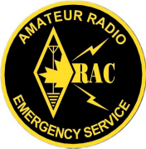
EMRG
General Meeting
EMERGENCY MEASURES RADIO GROUP
OTTAWA ARES
Two Names - One Group - One Purpose
INFORMATION &
STATUS UPDATES
Date Of Last Change: 2008-11-26
Version: 1.0

Slide 2
THINGS TO DO IN 2009
Re-organization of EMRG for future
Step up to supporting Ottawa Red Cross
Complete permanent radio sites (Red Cross & EOC), plus install Barrhaven UHF repeater

Slide 3

Signing New
Agreement
New 3 year agreement being prepared for signature in December
Includes $2000 funding per year to cover;
  Internet access at OFS Dispatch
  Ongoing battery replacement
  Antenna replacement City Hall
  Repeater replacement in Cumberland (VA3EMV/E)
  Final payment West End repeater.

Slide 4
Joint
Exercise
John Ash, manager for Office of Emergency Management (OEM) wants a communications exercise with EMRG in the second half of 2009.
Purpose of the exercise to allow Community Services and EMRG to better understand what is required and what EMRG can provide.
EMRG partnership with the City continues to work well!! We are on the right path.

Slide 5
SKILLS & EQUIPMENT
The most important resource for EMRG is people.
  No Radio, Operating Experience or Technical skills required
EMRG requires the same mix of skills that all organizations require.
  It’s more than just radio!
Emergency Communications is about planned, tested and documented solutions.

Slide 6

OARC SUPPORT
The Ottawa Amateur Radio Club (OARC) has always been a strong supporter of EMRG, but this year they asked how they can help more.
The objective is to leverage the club capabilities to save work for EMRG.
  This includes adding an article to the Groundwave newsletter and possible EMRG section on the Capital City Net.
The OARC also added money to their help, by purchasing a new KPC3+ TNC (~$300)

Slide 7

EMAIL LIST SERVER
As of November 1, 2008 EMRG changed how emails are distributed to EMRG members.
The new email list server is similar to what was previously used a few years ago.
For those who are filtering email the group email will come from
For any other information contact Harold at va3unk AT rac.ca

Slide 8
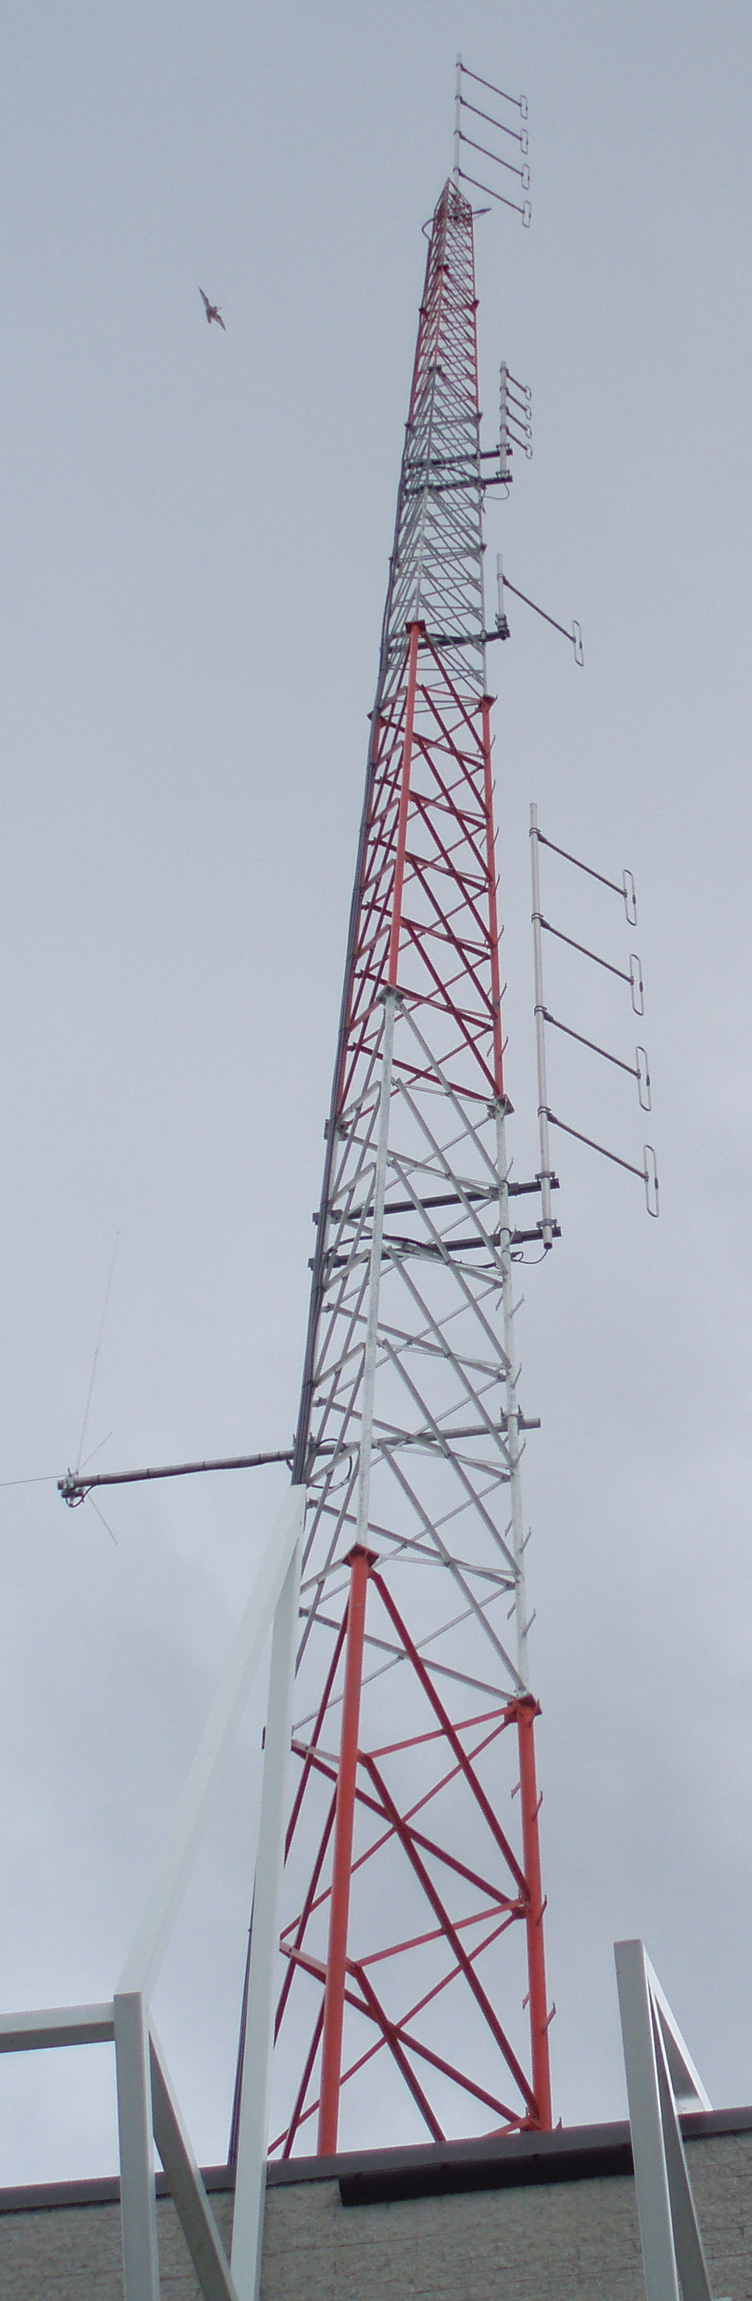
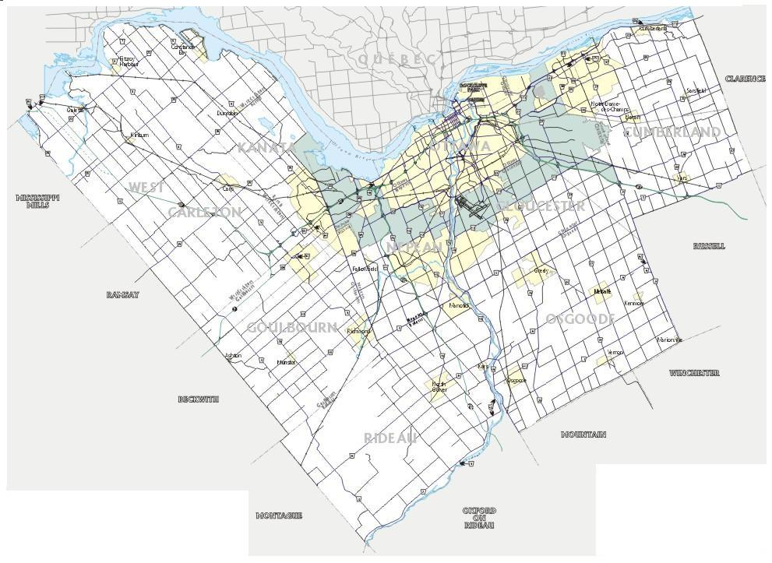
There is no single repeater that can cover the full City of Ottawa.
By using several repeaters, most areas are covered and are accessible from key locations.
VE3OCE VHF
Sinclair 210C-4
Voice & Data
VHF
Omni
Local VHF/UHF club repeater that provides City wide coverage and is diverse in location and power grid.
VA3EMV/E – Stn 53 Cumberland
VHF Community Repeater, providing coverage in the East End.
VE3OCE UHF
Sinclair 310C-4
Voice & Future Linking
Camp Fortune
VE2CRA
VHF Omni
Sinclair 210C-2
VA3OFS
Ottawa Fire (210C)
West -Sinclair
SRL-217 VHF
Omni
East -Sinclair
SRL-217 VHF
Omni
UHF Omni
Sinclair 310C-2
900Mhz
Omni
Multi-channel
VHF Radio
Sinclair 210C-4
VA3EMV/P
EMRG Portable VHF Repeater
Amateur
144/440
Omni
VE3OCE –Dispatch Alta Vista
PRIMARY Communications
& Operations site for EMRG
Wide coverage VHF Voice Rptr
Core coverage UHF Voice Rptr
Wide coverage VHF Data Rptr
EMRG Communications Rm
Equipment Storage
Multi-Channel
220/440 Radios
Diamond X3200A
144/220/440 MHz
EXISTING ANTENNAS
PROPOSED CHANGES
S
VA3EMV/W – Stn 81 Stittsville
VHF Community Repeater, providing coverage in the West End.
VA3OFS – Stn 44 Barrhaven
ALTERNATE Communications
& Operations site for EMRG
Additional Channel Capacity
Improved Southern Coverage
Wide coverage VHF Voice Rptr
Wide coverage VHF Data Rptr**
Mutual Aid VHF Data Rptr**
Boundary for area with Community Repeater installed or under construction
SW
Boundary for area proposed for a Community Repeater
Tower Height: 80 feet
HASL: 110m
Tower Height – 135 feet
HASL – 100 m
REPEATERS

Slide 9
REPEATER USE POLICY
EMRG repeaters are open for use by anyone in the Amateur community under the following understanding;
  The purpose of the repeaters is for emergency communications, so EMRG has priority for exercises and emergencies.
  Conversations should be useful, Amateur radio related if possible and free from personal opinions.
  If the repeater is not working, tell someone. Notify any member of the EMRG management team, or send an email to ve3oce@rac.ca

Slide 10
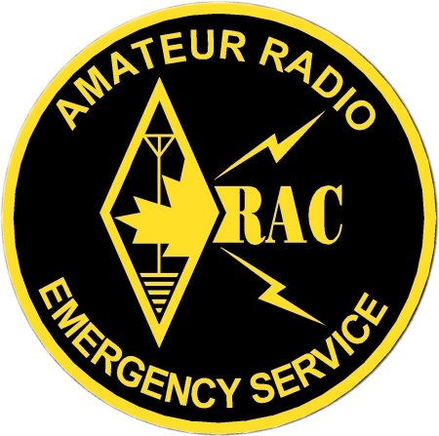


City of Ottawa
ARES
EMO
ARES
City of Cornwall
ARES
Renfrew County
ARES West
ARES
Mutual Aid
Capital/Seaway
District
United Counties of Prescott Russell
ARES
Renfrew County
ARES East
United Counties of Storemont, Dundas
and Glengarry ARES
United Counties of Leeds & Grenville
ARES
South West Lanark - North Leeds ARES
Lanark County
ARES

Slide 11


WORK SESSIONS
Next work session is Sat Dec 13, 8:30 – 12:00, at OFS Dispatch (1423 Randall Ave behind fire station 35)
Work activity includes;
  Install plywood in radio room and move cavities
  Sort out equipment EMRG does not need and either put it in trash pile or “To Sell Pile”
  Catalogue the “To Sell Pile”, and take pictures of each item
  Remove file cabinet from storage area and move upright cabinet
  Radio test on VHF to see which neighbouring ARES repeaters can be reached from OFS Dispatch.

Slide 12
UPCOMING RADIO EVENTS
Collegeville (Dec 3,4 )
  Contact Mike Kelly VE3FFK
Canadian Ski Marathon (Feb 7 & 8)
Tour Nortel (May 3 ?)

Slide 13

www.emrg.ca
The EMRG web site provides information related to Amateur radio emergency communications, specifically as it relates to the City of Ottawa.
  Project Information
  Newsletters
  Upcoming Events
  Documentation
  Links to related information
Information:

