Slide 1


EMRG-{xxx}
Data Communications
EMERGENCY MEASURES RADIO GROUP
OTTAWA ARES
Two Names - One Group - One Purpose
Amateur Radio Data Communications
DEMO NETWORK
Date Of Last Change: 2008-01-11
Version: 1.1

Slide 2
PURPOSE
The purpose of the Technology Demo is to show people some of the things that EMRG is working on, and some ideas that are possible based on available technology .
Hopefully some people will take some of these ideas, or get ideas of their own, and experiment to find solutions that can be applied to EMRG problems.

Slide 3
BASIC DATA COMMUNICATIONS
Outpost & TNC BBS
Message from source to destination in 2 hops
Radio
1
OUTPOST
TNC
2
Radio
Radio
OUTPOST
TNC
KPC3+ TNC
Digipeater
& BBS
TNC is a Digipeater & a BBS
BBS located at radio site to reduce the number of hops
Remote access to TNC for configuration or reset
Simultaneous multi user access
Radio
OUTPOST
TNC

Slide 4
OUTPOST WITH AGWPE
Multiple End User Computers
Gateway Computer
Radio
IP NETWORK
A
G
W
P
E
TNC
OUTPOST
OUTPOST
WiFi &/or Wired IP Network
Loopback Port

Slide 5
AGWPE APPLICATIONS
145.030 MHz
Operator Position 1
Outpost
Radio
Outlook
Express
TNC
IP NETWORK
UHF Option
PaclinkMP
A
G
W
P
E
Radio
Outpost
TNC
Operator Position 2
RMS Packet
VA3OCE-1
APRS Option
Outlook
Express
Radio
TNC
RMS Relay
Loopback Port
Operator Position 3
Outpost
Outlook
Express
Gateway Computer
VA3OCE
Internet Access
AGW Terminal

Slide 6
Winlink 2000
Winlink 2000 is an Email System made up of 3 components;
Client Applications
Telnet
Radio Gateways
Email Servers
HF Pactor
PMBO
Radio Message Server
RMS Pactor
RMS Packet
Airmail
CMS
Common Message Server
Perth Australia
Outpost
HF Pactor
RMS Packet
Radio Message Server
Internet
CMS
Common Message Server
San Diago USA
Email
PaclinkMP
EPMBO
Radio Message Server
RMS Pactor
RMS Packet
RMS Relay
CMS
Common Message Server
Halifax Canada
VHF/UHF
Packet
Telnet

Slide 7
TYPICAL WINLINK SYSTEM
Client Applications
Radio Gateways
Email Servers
CMS
Common Message Server
Perth Australia
Airmail
VHF/UHF Packet
CMS
Common Message Server
San Diago USA
VA3OCE-1
Radio Message Server
RMS Packet
RMS Relay
Telpac
Radio Message Server
RMS Packet
Internet
Email
Paclink
CMS
Common Message Server
Halifax Canada
Email
CMS
Common Message Server
Washinton USA

Slide 8
WINLINK LIKE AN ISP
User A
Email
Wired, DSTAR
or WiFi connection
Internet
WINLINK
MY ISP
Paclink
CMS
Perth Australia
Mail Server
User C
CMS
San Diago USA
Mail Server
Telpac
CMS
Halifax Canada
Mail Server
User D
Packet Radio
User B
Airmail

Slide 9
WINLINK TO “MY ISP”
User A
Email
Wired, DSTAR
or WiFi connection
Internet
WINLINK
MY ISP
Paclink
CMS
Perth Australia
Mail Server
CMS
San Diago USA
Mail Server
Telpac
CMS
Halifax Canada
Mail Server
User D
Packet Radio
Airmail

Slide 10



WINLINK TO ANY EMAIL
User A
Email
TEXT MESSAGING
10 digits@txt.bell.ca
10 digits@pcs.rogers.com
10 digits@msg.telus.com
Wired, DSTAR
or WiFi connection
Internet
WINLINK
Paclink
CMS
Perth Australia
CMS
San Diago USA
Telpac
CMS
Halifax Canada
Packet Radio
Airmail

Slide 11
DSTAR & WiFi
Client Applications
DTAR or WiFi
Radio Gateways
Email Servers
HF Pactor
PMBO
Radio Message Server
RMS Pactor
RMS Packet
Airmail
CMS
Common Message Server
Perth Australia
Outpost
VHF/UHF Packet
Telpac
Radio Message Server
RMS Packet
Internet
CMS
Common Message Server
San Diago USA
Email
Paclink
EPMBO
Radio Message Server
RMS Pactor
RMS Packet
RMS Relay
CMS
Common Message Server
Halifax Canada
Paclink
DTAR or WiFi

Slide 12
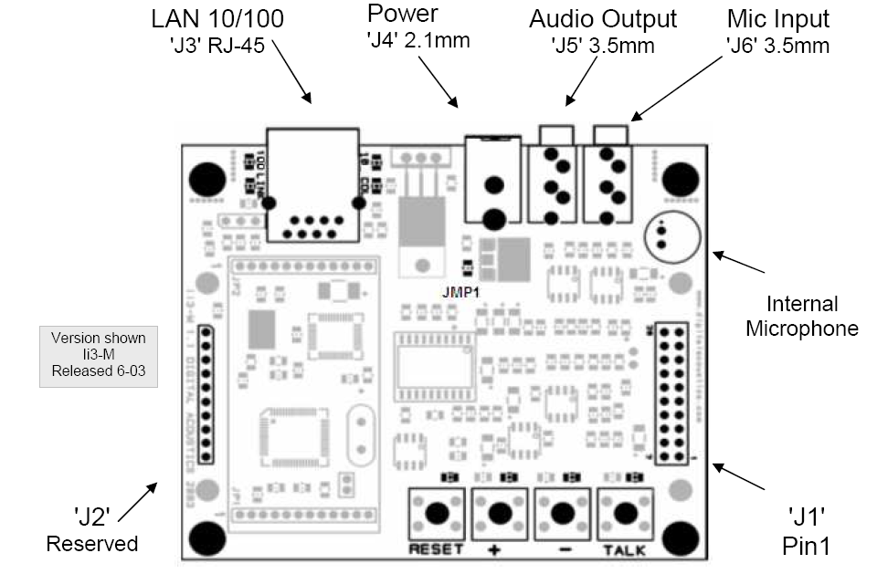
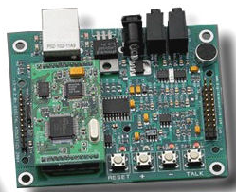
Voice over IP (VoIP)
Console
(Client)
Remote
(Server)
SUI
VoIP
Wired &/or
WiFi LAN
VoIP
RADIO
F
M
F
M
The system is made up of 2 ii3 VoIP Intercom units, configured for Peer to Peer mode, with one as a Client and the other as a server.
Voice over IP
Standalone Audio Interface
LD1

Slide 13


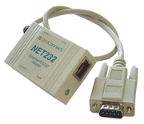
RS232 Serial Extension
Data
Wired &/or
WiFi LAN
RS232
TNC
Serial Communications
RS232 Over Ethernet

Slide 14



Sealed Buildings
Wireless Access Point/
Repeater
Wireless Bridge
Wireless Bridge
Data
TNC
RS232
SUI
VoIP
LAN Switch
LAN Switch
Voice
VoIP
Computers Inside, while Radios & “Appliance” Devices are Outside

Slide 15
POWERING THE LAN
Wireless Access Point/
Repeater
Wireless Bridge
Wireless Bridge
DC-DC Converter
12VDC to 5VDC
12 VDC
Power Supply
Battery Backup
12 VDC
Power Supply
Battery Backup
POE Injector
LAN Switch
LAN Switch

Slide 16
POWERING THE LAN
Wireless Access Point/
Repeater
Wireless Bridge
DC Power Supply
12VDC to 5VDC
12 VDC
Power Supply
Battery Backup
SUI & VoIP
Laptop
POE Injector
12 VDC
Power Supply
Battery Backup
LAN Switch

Slide 17

Power Over Ethernet (POE)
12 VDC Power Injector
RJ45 Plug - T568A
1
white/green
green
white/orange
blue
white/blue
orange
white/brown
brown
DATA & 12VDC
POE
5 3 1 2
8
4 6 8 7
Tab is on back side of plug
8
1
12VDC
1A
(ATO)
+12 VDC
GROUND
Powerpole
DC Power Connector

Slide 18
Power Over Ethernet (POE)
5 VDC Power Supply
Heatsink
D1
6A 100V
3
U1
7805
1
Coaxial DC Power
OD: ID:
+
2
C2
100uf
50V
+
C3
0.1uf
60V
5VDC (600MA)
F1
2A 32V
D2
36V
5W
C1
100uf
60V
DATA & 12VDC
POE
12VDC
RJ45 Plug - T568A
white/green
green
white/orange
blue
white/blue
orange
white/brown
brown
1
7 8 6 4
2 1 3 5
8
Tab is on back side of plug
1
8

Slide 19

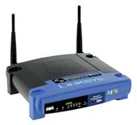
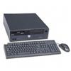
DEMO STATIONS
VE3BQP Home Station
145.030 MHz
Radio
TNC
AGWPE
Radio
RMS Packet
VE3BQP-1
TNC
Internet
DIGI: VE3OCE
NODE: VE3OCE-2
BBS: VE3OCE-1
Winlink
Mail Servers
Radio
TNC
Station 1
VE3ECN@winlink.org
VE3ECN - DEMO1
VA3OCE
Airmail
Outpost
EMAIL Client
Wireless Access Point
Radio
TNCx
IP NETWORK
Station 2
AGWPE
192.168.1.100
VA3OCE@winlink.org
VA3OCE - DEMO2
VA3OCE
PaclinkMP
Outpost
EMAIL Client

Slide 20
DEMO STATIONS
VE3BQP Home Station
145.030 MHz
Radio
TNC
AGWPE
Radio
RMS Packet
VE3BQP-1
TNC
Internet
DIGI: VE3OCE
NODE: VE3OCE-2
BBS: VE3OCE-1
Winlink
Mail Servers
Radio
TNC
Station 1
VE3ECN@winlink.org
VE3ECN - DEMO1
VA3OCE
Airmail
Outpost
EMAIL Client
Wireless Access Point
Radio
TNCx
IP NETWORK
Station 2
AGWPE
192.168.1.100
VA3OCE@winlink.org
VA3OCE - DEMO2
VA3OCE
PaclinkMP
Outpost
EMAIL Client

